Slide 1
Starbucks
Starbucks

Slide 2
Starbucks
For this assignment, I visited the Starbucks website and all in all what I observed in this website is that they only used pictures of the female employees at work and not the male employees. The female employees seemed to be happy and welcoming at the same time because the smile they had put on their faces (Hassan et al., 2017). For me, I believe this is the main reason as to why they used photos of the female employee because they are most likely to put a smile on their faces than the male employees. This is actually a marketing strategy that they are using. On the other hand, the products placed on this website seem to be great and perfect but on the other hand, they do not really look like real foodstuffs.
Notes:
I used the Starbuck website.

Slide 3
Starbucks
I believe that the language being used in this website is the PHP script language and the main reason for this is because I simply checked from the URL of the website.
Notes:
The language being used in this website is the php scripting language.

Slide 4
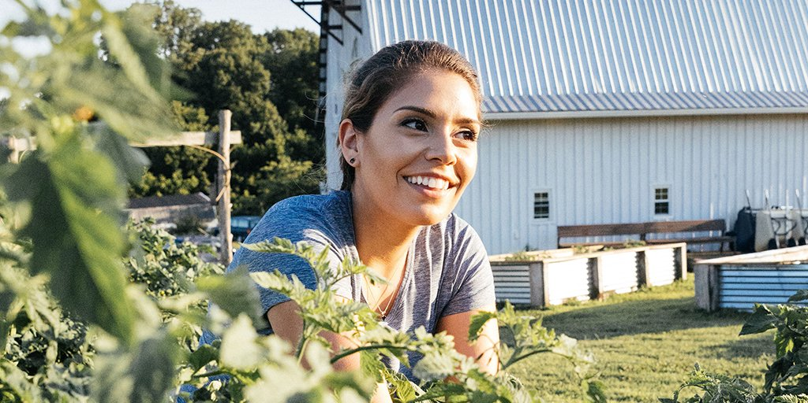
Starbucks
I was just normal in terms of my behavior with the respect to their products and the reason for this is because am used to visiting their fast food stored and actually I know and understand how they prepare their food which is usually good.
Notes:
My behavior was normal.

Slide 5
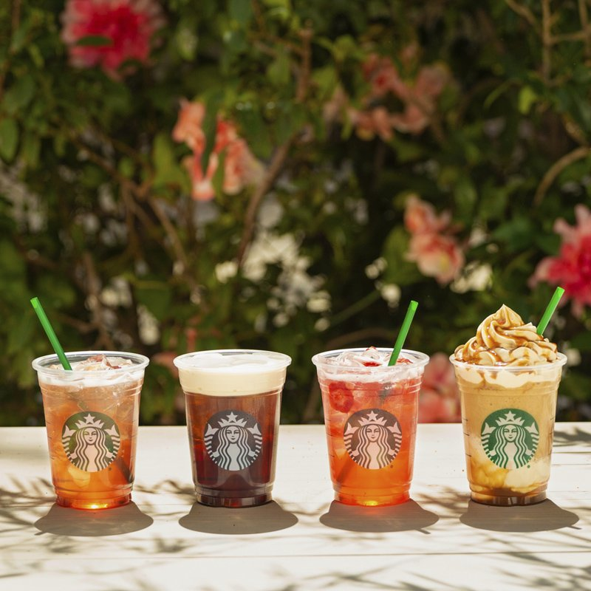
Starbucks
With this kind of advertisement being used on their websites, I think it will definitely attract a lot of customers because of how they organize their advertisements on their websites (Nicolis, 2017). So, for me, I believe the impact will definitely be positive.
Notes:
The impact will be positive.

Slide 6
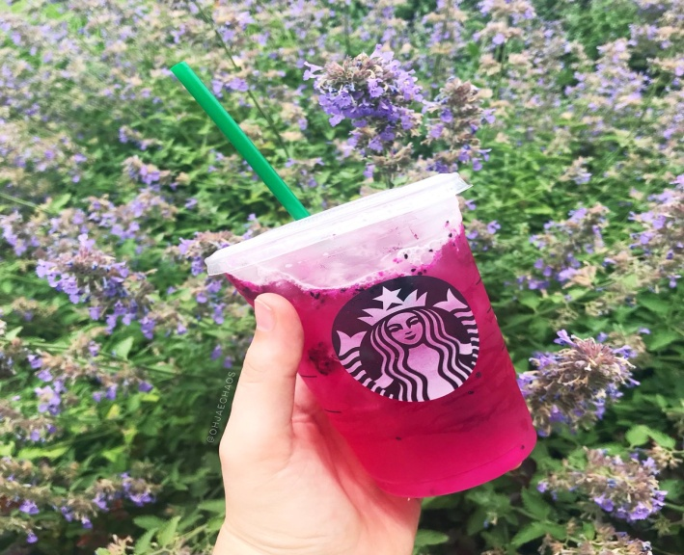
Starbucks
Predictable behavior may definitely influence a customer in a positive way or a negative way. I usually just depend on how the customer feels about something. For this reason, it might have a bigger impact on the customers than the employees because the employees are just there to work and provide services while on the other hand, the customers are the ones who will consume the product.
Notes:
Predictable behavior may definitely influence a customer in a positive way or a negative way.

Slide 7
References
Hassan, M., Kaushik, A. M., & Patel, H. (2017, April). Predictable cache coherence for multi-core real-time systems. In Real-Time and Embedded Technology and Applications Symposium (RTAS), 2017 IEEE (pp. 235-246). IEEE.
Nicolis, C. (2017). Self-oscillations and predictability in climate dynamics-periodic forcing and phase locking.

