Slide 1
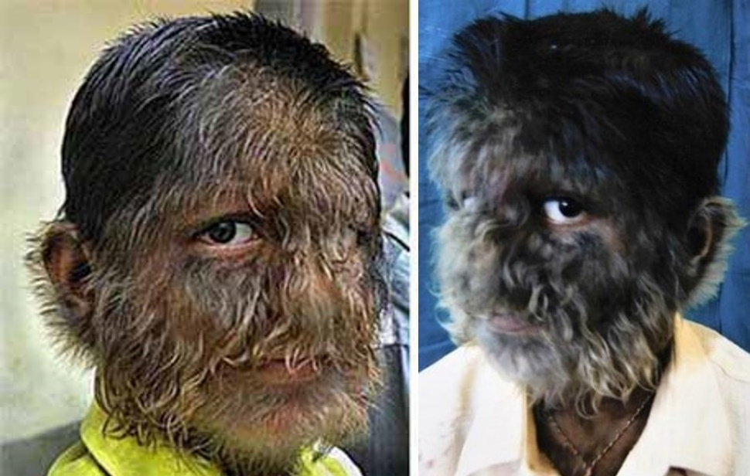
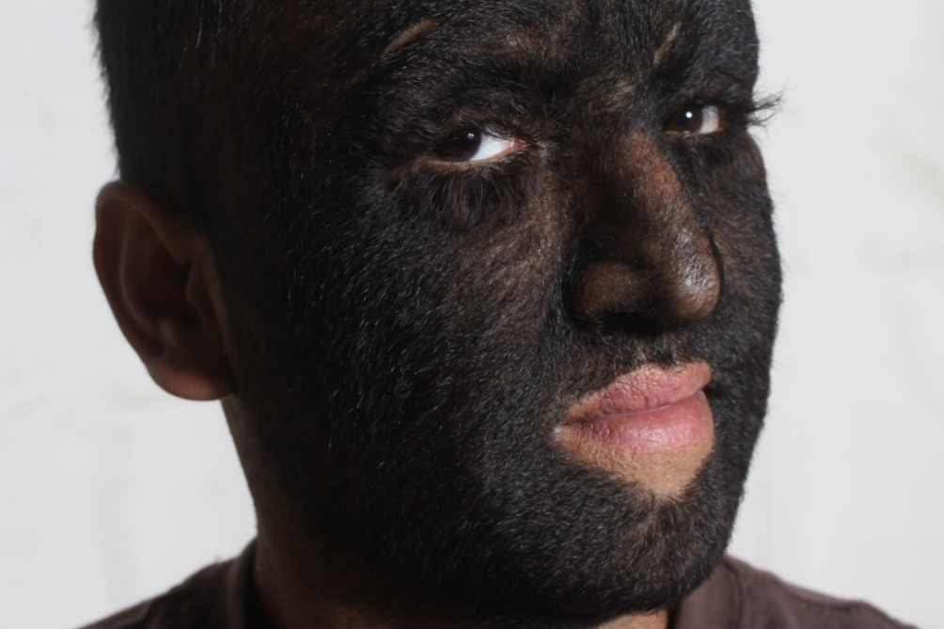
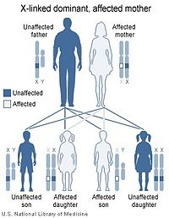
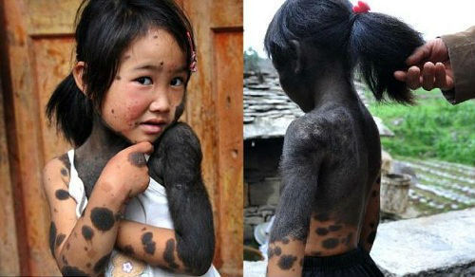
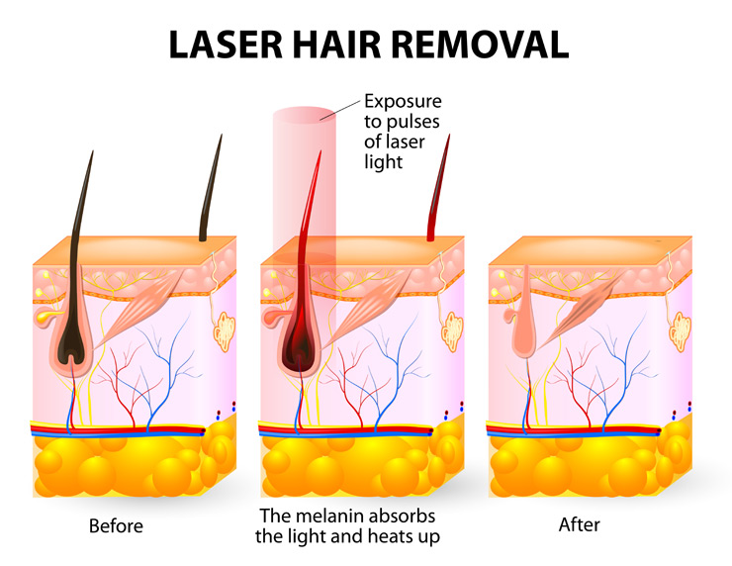
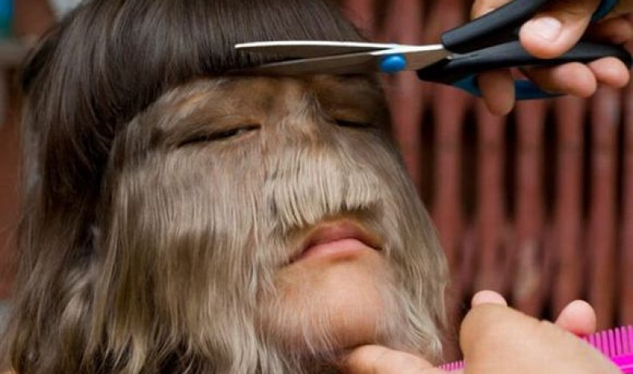
Hypertrichosis
West Coast University
General, overall description of the disease
Pathogenesis/pathophysiology
Complications/sequelae
Hypertrichosis, also called werewolf syndrome, is a condition where hair grows excessively on a person’s body (Roland, 2017).
Hypertrichosis results from a number of mechanisms. During adolescence, the skins in the groin and underarms undergo a transformation where the small venus hair follicles transform into large terminal type. When a similar transformation occurs on other areas of the skin, hypertrichosis occurs. The other mechanism involved in development of hypertrichosis is hair cycle change. Of the three hair cycles; anagen, catagen, and telogen phases, if the anagen phase (hair growth phase) goes beyond normal, the affected area will have excessive hair growth (Kelly, 2016).
Hypertrichosis has no life threatening complications. The only concern is removal of the hair and daily management of the condition. There are complications that arise from treatment of the condition such as hyperpigmentation after laser and electrolysis treatment. However, in the case of acquired hypertrichosis caused by diseases such as cancer or AIDS have potentially fetal complications (Bolognia, Jorizzo, & Schaffer, 2012).
(Photo Courtesy of HuffPost 2012)
Treatment options
Hypertrichosis has no cure or preventive measure. The risks for acquired hypertrichosis can only be reduced by avoiding causative medications. Treatment entails removal of hair by waxing, shaving, hair bleaching, chemical epilation, or plucking. These are shortterm solution that also cause skin irritation. Laser surgery and electrolysis are longterm solutions. Electrolysis uses electrical charges to destroy hair follicles. Laser surgery uses laser light on several hairs to cause hair loss. When complete, these treatments may be more permanent (Pavone, 2015).
Hair removal by laser surgery (Photo Courtesy of Universal Eye Center, 2017)
(Photo Courtesy of Mirror, 2012)
Prevalence of the disease in the Population
Hypertrichosis is a rare condition. The more common type of hypertrichosis is hirsutism which affects about 7% of the U.S. female population. The most rare type is congenital hypertrichosis lanuginosa with only 50 documented cases (Roland, 2017).
Image courtesy of U.S. National Library of Medicine
Hair removal by shaving. (Photo Courtesy of Ahmadenah News, 2009)
Clinical manifestations
Etiology
There are various types of hypertrichosis which manifest differently. Hirsutism appears as dark thick hair on places where woman do not usually grow hair such as chest, back, and face. Congenital hypertrichosis terminalis manifests as long thick hair which grows on the face and body. It begins at birth and continues throughout life. Congenital hypertrichosis lanuginosa starts out as normal lanugo which continues to spread to other parts of the baby’s body instead of disappearing. Acquired hypertrichosis develops later in life. It may appear as terminal hair or vellus hair. It may also appear as excess hair on patches or on all areas where hair grows. Nevoid hypertrichosis usually manifests as a patch of hairs on a defined area (Roland, 2017).
The causes of hypertrichosis are not well known but there some types of the disease that run in families. Congenital hypertricosis occurs when hair growth genes are reactivated. The gene is reactivated when the baby is in the womb. For acquired hypertrichosis, hair growth may be random patches or everywhere on the body. The potential causes are malnutrition, cancer, porphyria cutanea tarda, drugs such as cyclosporine and minoxidil and eating disorders. On specific areas, hypertrichosis develops from increased vascularity, temporary plaster cast use, and lichen simplex (Roland, 2017).
Prognosis
Hypertrichosis prognosis is poor because even after treatment the hair will reappear and requires several treatments. The distribution hair starts at an early age and is rarely progressive. The prognosis is associated with conditions such as epilephsy and renal anomalies which are linked to hair disorders (Pavone, 2015).

Slide 2
Hypertrichosis
West Coast University
References
Bolognia, J., Jorizzo, J. L., & Schaffer, J. V. (2012). Dermatology. Edinburgh: Elsevier/Saunders.
Kelly, E. B. (2016). The 101 most unusual diseases and disorders. Santa Barbara, California : Greenwood, an imprint of ABC-CLIO, LLC.
Pavone, P., Praticò, A. D., Falsaperla, R., Ruggieri, M., Zollino, M., Corsello, G., & Neri, G. (2015). Congenital generalized hypertrichosis: the skin as a clue to complex malformation syndromes. Italian Journal of Pediatrics, 41, 55. http://doi.org/10.1186/s13052-015-0161-3
Roland, J. (2017, April 26). Hypertrichosis (Werewolf Syndrome). Healthline. Retrieved from http://www.healthline.com/health/hypertrichosis#overview1

