Slide 1
Juvenile Delinquency and Justice Policy

Slide 2
WELCOME
Today I will be focusing on juvenile crime and delinquency or simply juvenile crime and justice.
I will be providing you the following information:
The background of Juvenile Delinquency and Justice
A description of Juvenile Delinquency and Justice
The objectives of Juvenile Delinquency and Justice
The importance of Juvenile Delinquency and Justice

Slide 3


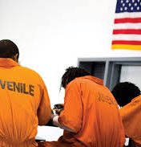

Summary
Juvenile delinquency is cited as a critical issue among many other issues in the justice system of the society or community at large according to (Roberts, 2003).

Slide 4
DESCRIPTION
According to (SIEGEL, 2017), the sentencing should make it easier for the juveniles to be placed in correctional centers or institutions if need be. The policy also supports the rehabilitation of the juveniles and seeks the implementation of delinquency preventive programs, strategies and models in the community.

Slide 5

DESCRIPTION
The prevention programs and rehabilitation of the juveniles focuses on the correction programs for the juveniles which substantially reduce recidivism.
Overall effective juvenile delinquency rehabilitation and prevention programs:
Should have more contact with the juveniles for a given and long duration of time.
Should have an influential component of the setting.
Should offer behavioral treatment programs.
Should be a skill oriented and multimodal treatment.

Slide 6

DESCRIPTION
The juvenile delinquency and justice policy also requires that the juvenile correctional and rehabilitation facilities and institutions be established and improved to aid in the juvenile delinquency and justice system.

Slide 7
Background
Juvenile delinquency rates have risen and fallen in the past years.
Delinquency refers to the minor crimes young adults commit.
In most cases, the juveniles form gangs to commit minor crimes like shoplifting among others.
The juvenile delinquency and justice policy not only relies on the fact that juveniles are prone to committing minor crimes such as shoplifting but also on the fact that sometimes the minor crimes committed by these juveniles or juvenile gangs are at times violent.

Slide 8
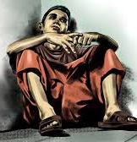
Background
Juvenile gangs have three or more members that share the same sense of identity with a degree and or permanence of organization (Howell, 2009).
This means that the juveniles or juvenile gangs threaten public safety and are prone to recidivism. The juvenile delinquency and justice policy, therefore, attempts to strengthen the justice system for the juveniles to keep the public safe, rehabilitate the juveniles and prevent delinquency.

Slide 9
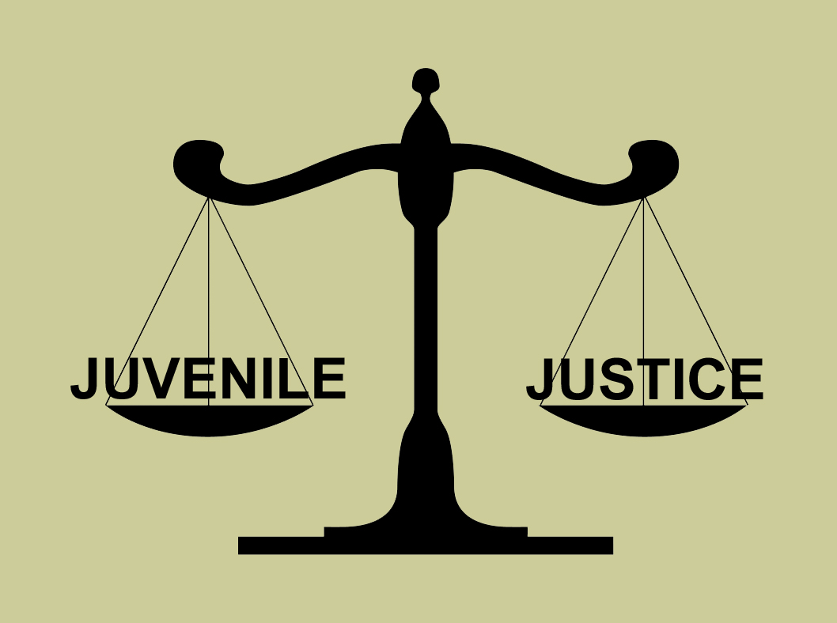
OBJECTIVES
Our first goal aims to better the overall justice system for juveniles by strengthening and intensifying efforts of juvenile incarceration in appropriate circumstances to maximize public safety (OJJPD, 2018).

Slide 10
OBJECTIVES
The second goal is supposed or expected to meet is the establishment and or improvement of the juvenile correction and rehabilitation facilities, institutions and the system in general which play a major role in holding and promoting the accountability of the juveniles for their crimes.
The third goal the policy is meant to achieve is the reduction of rates of juvenile crimes or delinquency.

Slide 11

importance
This policy is important as it will help with the rehabilitation of criminal juveniles reducing the rate of juvenile crime and the chances of recidivism and as a result, keeping the public safe.
This policy will also help maintain a balance or maintain coordination between the juvenile justice system, and the juvenile justice correctional and rehabilitation facilities, programs and institutions.

Slide 12
References
Howell, J. C. (2009). Preventing and reducing juvenile delinquency: A comprehensive framework. Los Angeles: SAGE.
OJJPD. (2018). Office of Juvenile Justice and Delinquency Prevention Proposed Comprehensive Plan for Fiscal Year 1998. Retrieved from Office of Juvenile Justice and Delinquency Prevention: https://www.ojjdp.gov/pubs/plan98/plan-04.html
SIEGEL, LARRY. J. (2017). JUVENILE DELINQUENCY: Theory, practice, and law. Place of publication not identified: WADSWORTH.
Roberts, A. R. (2003). Critical issues in crime and justice. Thousand Oaks (Calif.: Sage publications.

