Slide 1
MKTG 561
Applied Marketing Management
Module 1: Overview
Copyright 2017 Montclair State University

Slide 2
Understanding The 21st Century Marketplace: Marketing Strategy
Module 1 was designed for you to:
Describe strategic marketing management and the concept of value in developing sustainable competitive advantage.
Describe the role of marketing in the strategic planning process within an organization.
Outline the marketing strategy formation process.
Summarize aspiration decisions - how a firm chooses which consumer group(s) to pursue with its marketing efforts.
Describe action decisions - the implementation of the marketing mix as a means to increase customer value.

Slide 3
MKTG 561
Applied Marketing Management
Module 1a: Value & Strategic Marketing Management

Slide 4
Strategic Marketing Management
is a systematic process of building sustainable competitive advantage
by offering superior value proposition
to target consumers
compared to what competitors can or are able to offer

Slide 5
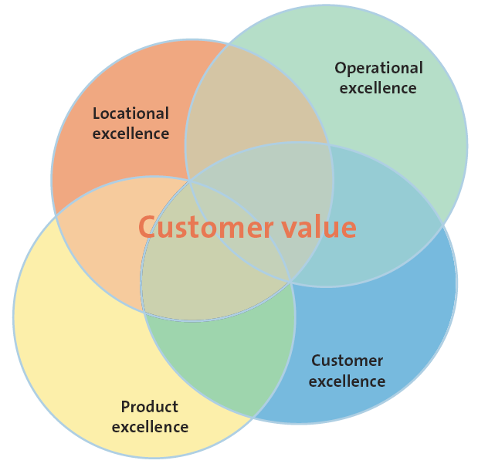
Sustainable Competitive Advantage
Notes:
Sustainable competitive advantages are company assets, attributes, or abilities that are difficult to duplicate or exceed; and provide a superior or favorable long term position overcompetitors. Businesses which have consistently high profitability typically have a sustainable competitive advantage such as a unique process, a patent, or special skills which allow the business to dominate their area and exclude competing businesses.
This slide covers the four strategies to create and deliver value and a sustainable competitive advantage. Think of companies you are very loyal to in many categories (food, electronics, personal care)? Is it their product, location, operational, or customer excellence that draws the student’s loyalty?
CA can change over time, due to changes in customer value perceptions, technology, regulations or other factors.

Slide 6
What Is Customer Value?
Customer perceived value is the difference between the prospective customer’s evaluation of all the benefits and all the costs of an offering compared to its perceived alternatives
Perceived value = Perception of benefits accrued Perception of costs incurred
= Gain
Pain
economic, emotional, experiential, ideological, rational, spiritual, temporal …

Slide 7
Drivers Of Customer Perceived Value
Total customer benefit
Total customer cost
Product benefit
Monetary cost
Services benefit
Time cost
Personal benefit
Energy cost
Image benefit
Psychological cost

Slide 8
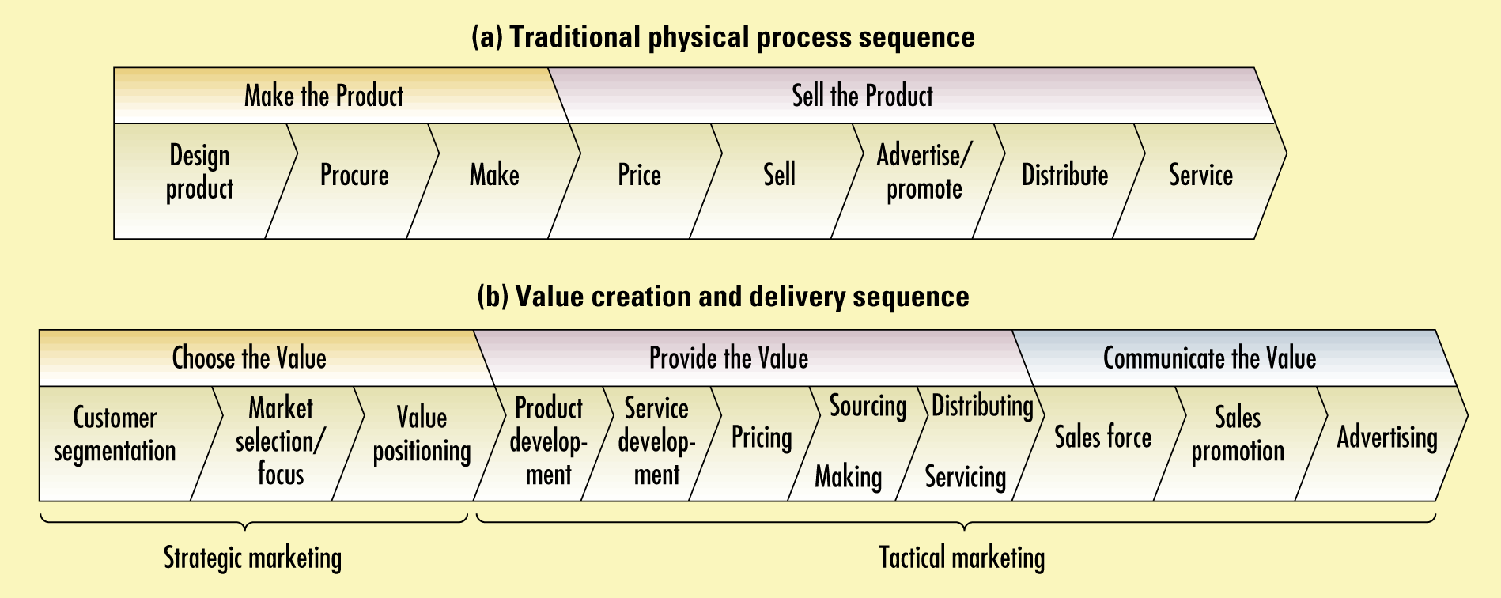
Two Views Of The Value-delivery Proposition Process
Notes:
Traditional Physical Process Sequence:
Make the Product
Design product
Procure
Make
Sell the Product
Price
Sell
Advertise/promote
Distribute
Service
Value Creation and Delivery Sequence
Strategic Marketing
Choose the Value
Customer segmentation
Market selection/focus
Value positioning
Tactical Marketing
Provide the Value
Product development
Service development
Pricing
Sourcing/Making
Distributing/Servicing
Communicate the Value
Sales force
Sales promotion
Advertising

Slide 9
MKTG 561
Applied Marketing Management
Module 1b: Role of Marketing in the Strategic Planning Process Within an Organization

Slide 10
Three Levels Of Business Planning
Functional Planning
(In Marketing Department, called Marketing Planning)
What It Is
Strategic Planning
Operational Planning
Planning done by top-level corporate management
Define the mission
Evaluate the internal and external environment
Set organizational or SBU objectives
Establish the business portfolio (if applicable)
Develop growth strategies
Planning done by top functional-level management such as the firm’s chief marketing officer (CMO)
Perform a situation analysis
Set marketing objectives
Develop marketing strategies
Implement marketing strategies
Monitor and control marketing strategies
Planning done by supervisory managers
Develop action plans to implement the marketing plan
Use marketing metrics to monitor how the plan is working
Who Does It
What They Do

Slide 11
The Business Vision
Business
Vision
Core
Value
BHAGs
Core
Purpose
Notes:
Creating a Vision for the Business
• Core Values – usually three to five, are the timeless, passionately held guiding principles of an organization.
• Core Purpose – which should last for one hundred years is the organization’s reason for being, beyond the current products and services.
• BHAGs – Big, Hairy, Audacious Goals.
Many businesses set goals that describe what they hope to accomplish over the coming days, months or years. These goals help align employees of the business to work together more effectively. Often these goals are very tactical, such as "achieve 10% revenue growth in the next 3 months."
The term Big Hairy Audacious Goal ("BHAG") was proposed by James Collins and Jerry Porras in their 1996 article entitled Building Your Company's Vision. A BHAG encourages companies to define visionary goals that are more strategic and emotionally compelling.
In the article, the authors define a BHAG (pronounced BEE-hag) as a form of vision statement "...an audacious 10-to-30-year goal to progress towards an envisioned future."
A true BHAG is clear and compelling, serves as unifying focal point of effort, and acts as a clear catalyst for team spirit. It has a clear finish line, so the organization can know when it has achieved the goal; people like to shoot for finish lines.
—Collins and Porras, 1996
Collins and Porras also used this concept in their book Built to Last: Successful Habits of Visionary Companies.
In this book they have taken 18 visionary companies and studied them, and also studied 18 comparison companies. Collins is also the author of Good to Great: Why Some Companies Make the Leap... and Others Don't a management book that aims to describe how some companies transition from good to great and why others fail to make the transition.

Slide 12
Situation Analysis (SWOT)
External Analysis
Customer Analysis
Competitor Analysis
Market Analysis
Environmental Context Analysis (culture, economy, natural, legal, political, technology)
Internal Analysis
Company Performance Analysis
Channel Partner (Collaborator) Analysis
Determinants of Strategic Option
Strategy Identification and Selection
Notes:
External Analysis
• Customer Analysis
• Segments
• Motivations
• Unmet Needs
• Environmental Analysis
• Technological
• Governmental
• Economic
• Cultural
• Demographic
• Scenarios
• Information-need areas
• Internal Analysis
• Determinants of Strategic Options
• Past and Current Strategies
• Strategic Problems
• Organizational Capabilities and Constraints
• Financial Resources and Constraints
• Strengths and Weaknesses

Slide 13
Determinants Of Strategic Options
And Choices
Past & current strategies
  Does strategy look as intended?
  In what way did it change and what caused change?
  Consider the danger here!
Strategic problems
  Differentiated from weakness by scale of issue –
    problems that need aggressive attention are often costly
Organizational capabilities & constraints
  Strategy, structure, systems, skills, style, staff, shared values
Financial capabilities and constraints
Strengths & Weaknesses
Notes:
END of SECTION

Slide 14
MKTG 561
Applied Marketing Management
Module 1c: Marketing Strategy Formation Process

Slide 15
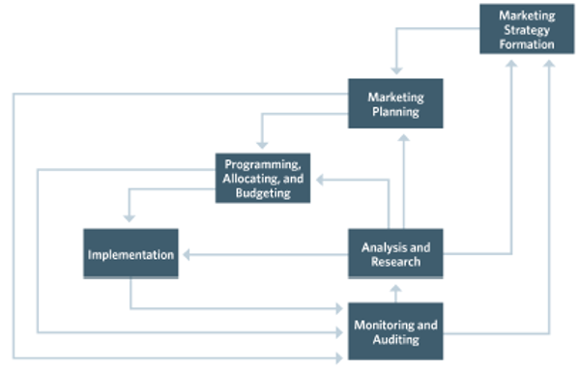
Six Parts Of The Marketing Process

Slide 16
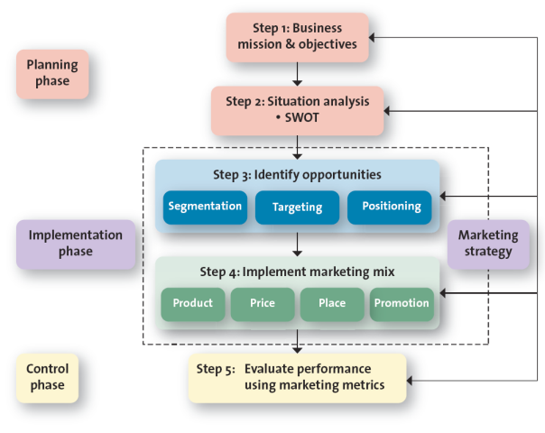
Marketing Plan Elements
Notes:
Explain to students that the marketing plan should be a written plan yet many companies do not write it down. Ask students why companies tend to not write down marketing plans. The most likely answer is that they don’t take the time or haven’t organized the strategy.
Marketing Plan Elements Outline
Planning Phase
Step 1: Business mission & objectives
Step 2: Situation analysis – SWOT
Implementation Phase (Marketing Strategy)
Step 3: Identify opportunities
Segmentation
Targeting
Positioning
Step 4: Implement marketing mix
Product
Price
Place
Promotion
Control Phase
Step 5: Evaluate performance using marketing metrics

Slide 17


Marketing Strategy Formation Process
ANALYSIS
DECISIONS
OUTCOMES
Customer
Acquisition
Retention
Buy Rate
ASPIRATION
What value for whom decision
Segmenting ► Targeting ► Positioning (STP)
1
Competition
Company
Customer
ACTION PLAN
Marketing mix decision: The 4 P’s
Product + Promotion + Place = Value Creating
Price = Value Capturing
2
Collaborators
Sales
Profits
Franchise (Brand, market, position)
Context
Source: Robert J. Dolan, Core Reading: Framework for Marketing Strategy Formation, HBP No. 8153 (Boston: Harvard Business School Publishing, 2014) Copying or posting is an infringement of copyright. Call 1-800-545-7685 or go to custserv@hbsp.harvard.edu
Notes:
END of SECTION

Slide 18
MKTG 561
Applied Marketing Management
Module 1d: Aspiration Decisions – Choosing Customer Groups to Pursue

Slide 19

Aspiration Decisions: Identifying And Evaluating Opportunities Using STP
Segmentation
Targeting
Positioning
Courtesy The Hertz Corporation
Modules 2 and 3 will cover concepts, methods, and analysis to identify market segments, select targets, develop differentiated offerings and positioning for each target segment.
Notes:
After completing the situation audit, the next step is to identify and evaluate opportunities for increasing sales and profits using STP (segmentation, targeting, and positioning). With STP, the firm first divides the marketplace into subgroups or segments, determines which of those segments it should pursue or target, and finally
decides how it should position its products and services to best meet the needs of
those chosen targets.

Slide 20
Hertz: Market Segmentation
Exhibit 2.5 – Hertz Market Segmentation
“” | Segment 1 | Segment 2 | Segment 3 | Segment 4 | Segment 5
Segments | Single people and couples wanting to have a bit of fun | Business customers and families who prefer a luxurious side | Environmentally conscious customers | Families | Commercial customers
Segments (continued) | Fun Collection | Prestige Collection | Green Collection | SUV/minivan & Crossover | Commercial Van/Truck
Cars Offered | Corvette ZHZ | Infiniti QX56 | Toyota Prius | Toyota Rav 4
Cars Offered (continued) | Chevrolet Camaro | Cadillac Escalade | Ford Fusion | Ford Explorer | Ford Cargo Van
Notes:
Hertz realizes that its primary appeal for the SUV/Minivan collection centers on young families, so the bulk of its marketing efforts for this business is directed toward that group.

Slide 21
Retail Market Opportunities For Women’s Apparel: Market Segments And Retail Formats

Slide 22
MKTG 561
Applied Marketing Management
Module 1e: Action Decisions - Implementation of the Marketing Mix

Slide 23
Developing An Integrated Marketing Mix
Marketing mix is the set of controllable tactical marketing tools—product, price, place (distribution), and promotion—that the firm blends to produce the response it wants (and achieve its marketing objectives) in the target market
Develop marketing mix strategies to achieve marketing objectives
The 4 Ps
The 4 Cs
vs
Product
Price
Place
Promotion
Customer solution (benefit)
Customer cost
Convenience
Communication

Slide 24

Step Four: Implement Marketing Mix (4 P’s) And Allocate Resources
Product
Value Creation
Price
Value Capture
Place
Value Delivery
Promotion Value Communication
Courtesy Bel Brands USA
Positioning statement must drive the formulation of the four marketing mix components (4 P’s) for each selected target.
Notes:
In all firms, resources are scarce and must be allocated so that they create the most value for the firm. Ask Students to point out the elements of the marketing mix in this ad? They will certainly see the value creation in the product and the promotion which targets busy women.

Slide 25
Chico’s Strategy
Target Market
  Woman 35 to 55 who want comfortable, casual, but stylish apparel
Bases for Building Sustainable Competitive Advantage
  Unique merchandise sized 0,1,2,3
Marketing Mix Proposition
  Moderately-priced, specialty apparel stores in malls and strip centers selling private label, coordinated outfits

Slide 26
Implement And Control The Marketing Plan
Control: Measuring actual performance, comparing performance to the objectives, making adjustments
A market share analysis is used to compare its sales with those of the industry.
Marketing cost analysis is used to determine the relative profitability of its territories, product lines or other marketing units
A sales-volume analysis is a detailed study of the net sales section of a company’s profit and loss statement
Notes:
Examples of metrics: cost of a prospect, customer acquisition cost, click through rate, response rate, (coupon) redemption rate, sales calls per day, customer retention rate, etc.
Some metrics are based on survey data that requires systematic, ongoing marketing research (customer satisfaction, perceived product quality, perceived service quality, company/product reputation).

Slide 27
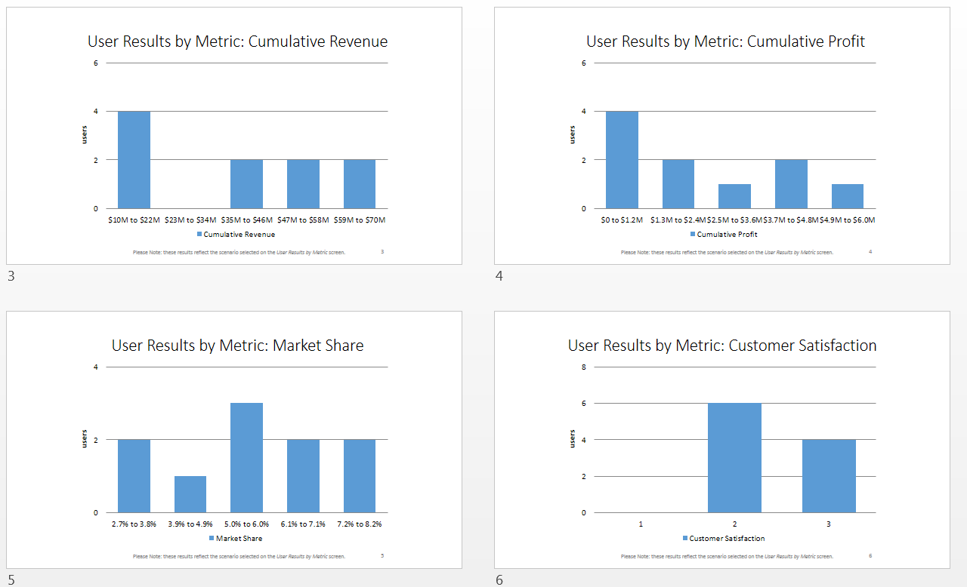
Metrics Dashboard in Managing Markets and Segments Simulation

Slide 28
Marketing Key Performance Indicators
Customer-centric metrics
  Customer satisfaction, Customer acquisition, Customer retention, Customer lifetime value (CLV)
Marketing operations metrics
  Net sales– net amount of sales revenue
  Cost of goods sold (cogs)–net sales less cost of products = net profit
  Gross profit–Net sales less cogs
  Expenses–marketing, admin and misc expenses
  Net profit–difference between gross margin and total expenses
Marketing effectiveness metrics
  Return on marketing investment (ROMI) is the revenue or profit margin generated by investment in a specific marketing program divided by the cost of that program (expenditure) at a given risk level, as determined by management
Notes:
END OF SECTION

