Slide 1
Chapter 3
Internal Analysis: Distinctive Competencies, Competitive Advantage, and Profitability

Slide 2
Learning Objective
Discuss the source of competitive advantage.
Identify and explore the role of efficiency, quality, innovation, and customer responsiveness in building and maintaining a competitive advantage.
Explain the concept of the value chain.
Understand the link between competitive advantage and profitability.
Explain what impacts the durability of a company’s competitive advantage.

Slide 3
Competitive advantage
Exists when a company’s profitability is greater than the average profitability of all companies in its industry.
Sustained competitive advantage - Exists when a company maintains its competitive advantage over a number of years.
  Primary objective of strategy

Slide 4
Distinctive competencies
Firm- Specific strengths that allow a company to differentiate its products and/or achieve lower costs than its rivals.
  Arise from resources and capabilities
Resources: Assets of a company.
  Tangible resources: Physical entities.
    Land, buildings, and inventory, and money.
  Intangible resources: Nonphysical entities created by managers and other employees.
    Brand names, company reputation, and intellectual property.

Slide 5
Distinctive competencies
Capabilities- Company’s skills at coordinating its resources and putting them to productive use:
  reside in an organization’s rules, routines, and procedures.
  Intangible.
  lead to sustained competitive advantage if they are rare and protected from copying.

Slide 6
Distinctive competencies
Requirements
  Firm-specific and valuable resource, and the capabilities to take advantage of that resource.
  Firm-specific capability to manage resources.
    Distinctive competency is strongest when a company possesses both.

Slide 7
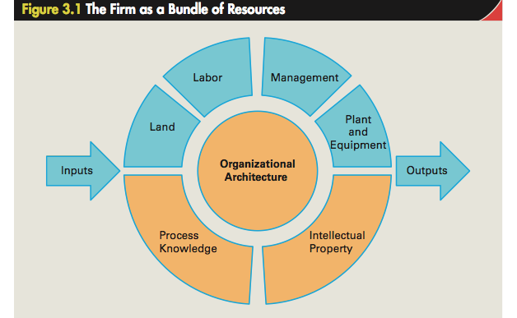

Slide 8
Competitive advantage, value creation, and profitability
Profitability of a company depends on the:
  value customers place on its products.
  price it charges for its products.
  costs of creating those products.
When a company strengthens the value of its products, it can:
  raise prices to reflect the value.
  reduce prices to induce more customers to purchase its products.

Slide 9
Competitive advantage, value creation, and profitability
Point-of-sale price is less than the utility value placed on the product by many customers, due to:
  consumer surplus - customers capture some of that utility.
  customer’s reservation price - each individual’s unique assessment of the value of a product.
  competition from rivals.

Slide 10
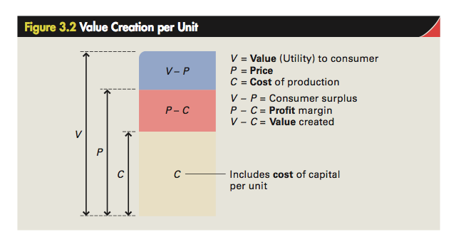

Slide 11
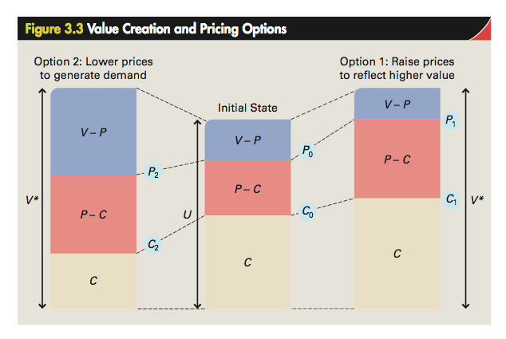

Slide 12
Value creation and pricing options
Managers must understand:
  dynamic relationships among value, pricing, demand, and costs.
  how value creation and pricing decisions affect demand.
  how unit costs change with increases in volume.

Slide 13
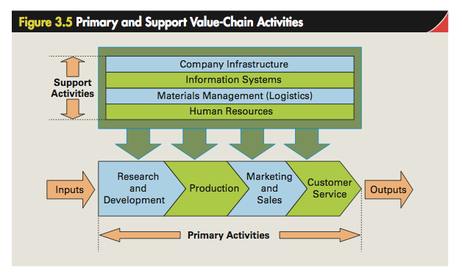

Slide 14
Primary activities
Relate to a product’s design, creation, delivery, marketing, support, and after-sales service.
Research and development
  Design of products and production processes.
  Superior product design increases a product’s functionality and add value.
Production
  Creation process of a good or service.
  Helps lower cost structure and leads to differentiation.

Slide 15
Primary activities
Marketing and sales
  Brand positioning and advertising - increase customers’ perceived value of a product.
  Help create value by discovering customers’ needs.
Customer service
  Provide after-sales service and support.
  Create superior utility by solving customer problems and supporting customers after a purchase.

Slide 16
support activities
Provide inputs that allow the primary activities to take place.
Materials management
  Controls the transmission of physical materials through the value chain.
  Lowers cost and creates more profit .
Human resources
  Ensures value creation by making sure that the company has the right combination of skilled people.

Slide 17
support activities
Information systems
  Electronic systems to improve efficiency and effectiveness of a company’s value creation activities.
Company infrastructure
  Companywide context within which all the other value creation activities occur.
    Organizational structure, control system and company culture

Slide 18
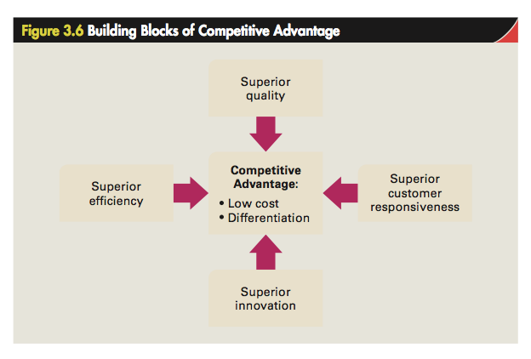

Slide 19
BUILDING BLOCKS OF COMPETITIVE ADVANTAGE
Efficiency
  Measured by the quantity of inputs that it takes to produce a given output.
  Employee productivity - Output produced per employee
    Helps attain competitive advantage through a lower cost structure.
Quality
  Superior quality - Customers’ perception that a product’s attributes provide them with higher utility than those sold by rivals.

Slide 20
BUILDING BLOCKS OF COMPETITIVE ADVANTAGE
  Quality as excellence - Product features and functions, and level of service associated with its delivery.
  Quality as reliability - Occurs when a product consistently performs the function it was designed for, and seldom breaks down.
Innovation
  Product innovation: Development of products that are new to the world or have superior attributes to existing products.

Slide 21
BUILDING BLOCKS OF COMPETITIVE ADVANTAGE
  Process innovation: Development of a new process for producing products and delivering them to customers.
Customer responsiveness
  Superior responsiveness - Achieved by identifying and satisfying customer needs better than one’s rivals.
  Customer response time: Time that it takes for a good to be delivered or a service to be performed.
  Other sources - Superior design, service, and after-sales service and support.

Slide 22
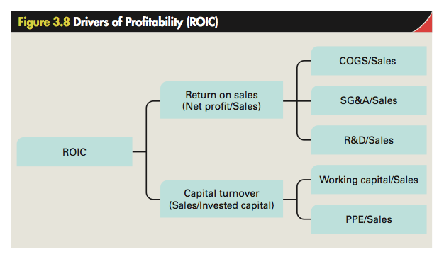

Slide 23
Definitions of basic accounting terms
Term | Definition | Source
Cost of Goods Sold (COGS) | Total costs of producing products | Income statement
Sales, General, and Administrative Expenses ( SG&A) | Costs associated with selling products and administering the company | Income statement
R&D Expenses (R&D) | Research and development expenditure | Income statement
Working Capital | Amount of money the company has to work with in the short term: Current assets – current liabilities | Balance sheet
Property, Plant, and Equipment (PPE) | Value of investments in the property, plant, and equipment that the company uses to manufacture and sell its products Also known as fixed capital | Balance sheet

Slide 24
Definitions of basic accounting terms
Term | Definition | Source
Return on Sales (ROS) | Net profit expressed as a percentage of sales Measures how effectively the company converts revenue into profits | Ratio
Capital Turnover | Revenues divided by invested capital Measures how effectively the company uses its capitals to generate revenue | Ratio
Return on Invested Capital (ROIC) | Net profit divided by invested capital | Ratio
Net Profit | Total revenues minus total costs before tax | Income statement
Invested Capital | Interest-bearing debt plus shareholders’ equity | Balance sheet

Slide 25
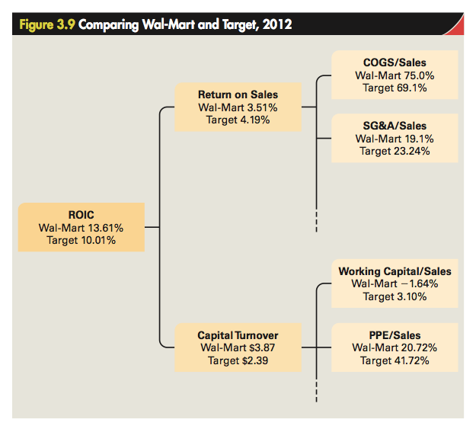

Slide 26
Barriers to imitation
Make it difficult for a competitor to copy a company’s distinctive competencies.
  Greater the barrier, more sustainable a company’s competitive advantage.
Imitating resources
  Firm-specific and value tangible resources are the easiest to imitate.
  Intangible resources
    Brand names - Imitating them is prohibited by law.

Slide 27
Barriers to imitation
    Marketing and technical knowhow - Easy to imitate owing to movement of skilled personnel between companies and visibility of strategies to competitors.
    Technological knowhow - Easy to imitate as patents do not provide complete protection.
Imitating capabilities is difficult because:
  they are not visible to outsiders.
  no one individual has access to all the internal operating routes and procedures of a company.

Slide 28
Capability of competitors and industry dynamism
Capability of competitors is determined by the:
  nature of the competitors’ prior strategic commitments.
    strategic commitment - company’s commitment to a particular way of doing business.
  Absorptive capacity - Ability of an enterprise to identify, value, assimilate, and use new knowledge.
Most dynamic industries are those with a very high rate of product innovation.
  Where product life cycles and competitive advantages are short-lived.

Slide 29
Reasons for failure of companies
Inertia - Companies find it difficult to adapt to changing competitive conditions.
  Power struggles and hierarchical resistance make change difficult.
Prior strategic commitments - Limit a company’s ability to imitate rivals.
  Cause competitive disadvantage.
The Icarus paradox - Companies become very specialized and myopic.
  Lose sight of market realities.

Slide 30
Steps to avoid failure
Focus on the building blocks of competitive advantage
Institute continuous improvement and learning
Track best industrial practice and use benchmarking
Overcome inertia
The role of luck

