Slide 1
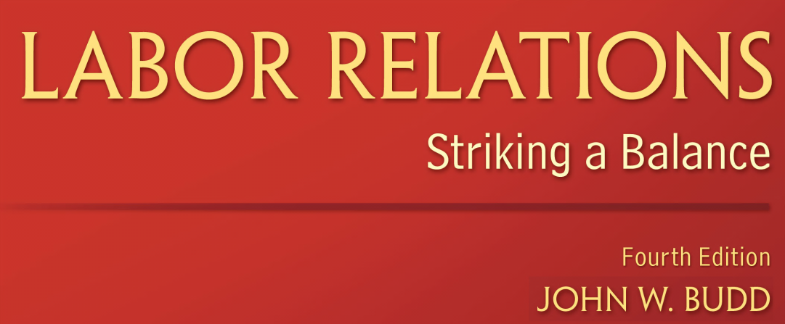
Chapter 3
Historical Development

Slide 2
Learning Objectives
Understand why workers have tried to form unions throughout U.S. history and the influences on their successes and failures
Identify the major events in U.S. labor history, including what happened and why each event is significant

Slide 3
Learning Objectives
Compare the major organizations in labor history and their contrasting strategies
Understand how studying the historical record deepens our comprehension of the current labor relations system and alternatives for reform

Slide 4
Introduction
Current U.S. labor relations system is a product of history
  The Great Uprising of 1877
  The breakup of the AFL–CIO in 2005
Student of labor relations should be aware of major events in U.S. labor history
  Reveal the leading issues and conflicts of an era
The history of labor relations contains rich tapestry of organizations and strategies

Slide 5
Introduction
Historical development of U.S. labor relations involves components of:
  Social
  Business
  Economic
  Legal history

Slide 6
From Local to National Organizations
Most workers today are employees selling their labor for a wage or a salary
  10 percent are self-employed
  Half of employees today work for large organizations
At the end of the 1700s:
  Majority of free people were self-employed
  Businesses were small and local
  Early “large” businesses were in the iron industry and employed around 25 employees

Slide 7
From Local to National Organizations
Over 100 years later:
  U.S. Steel employed 170,000 employees
  Ford’s Highland Park factory outside Detroit had 15,000 employees
  The era of self-employment was over
  Working for a paycheck became widespread
  Fixed working hours, punctuality, and constant work effort replaced autonomous work habits

Slide 8
From Local to National Organizations
Business became “big business”
  Characterized by hierarchical, centralized control and concentrated wealth and power

Slide 9
Figure 3.1 - A Timeline of Labor History up to 1875

Slide 10
From Local to National Organizations
As business organizations became larger and more national in scope, so too did labor unions
  Budding national unions were craft unions
National unions began to develop in the 1850s
  Necessitated by the ability of manufactured goods to be shipped via railroads
  Facilitated by the ability of union leaders to travel via railroads

Slide 11
From Local to National Organizations
U.S. labor organizations was the creation of a national labor federation
  The first such federation was the National Labor Union, founded in 1866
    The National Labor Union lasted only six years
  Established a precedent for the labor movement by uniting diverse unions into a single federation
National Labor Union emphasized:
  Political activity to bring about legal reform
  Favored currency and banking reform, women’s suffrage and a national labor political party

Slide 12
The Great Uprising of 1877
1870s ushered in an era of intense violent labor conflict that would continue into the 20th century
A massive depression caused severe unemployment, wage cuts, and union membership plummeted
  These events became known as the Great Uprising of 1877
Significance of the uprising
  Uprising demonstrates the shared concerns of workers

Slide 13
The Great Uprising of 1877
  Frequently used to define the beginning of the modern era in U.S. labor relations
The Great Uprising of 1877 laid the foundation for future labor
  Can be seen as a “social earthquake”

Slide 14
Uplift Unionism
Noble and holy order of the knights of labor
  One union that survived the depression of 1873–1878
  The Knights of Labor started as a union in the garment industry
    Emphasized secrecy to prevent employers from breaking it
  Initially had various rituals, passwords, and secret signs
  Top leader was called the Grand Master Workman

Slide 15
Uplift Unionism
The knights of labor: Objectives and strategies
  The Knights of Labor is considered the major U.S. example of uplift unionism
  Philosophy in which a union “aspires chiefly to elevate the moral, intellectual and social life of the worker”
  Shorter working hours were needed so that workers would have greater time for education and moral betterment

Slide 16
Uplift Unionism
Knights of Labor consisted of numerous local assemblies
  Aimed to unite all “producers”
  Central conflict was not with employers; it was with those who controlled money and who were perceived as not working
Knights of Labor was broadly inclusive
  Emphasized the solidarity of all producer including African-Americans and women
  Emphasized cooperation and education

Slide 17
Uplift Unionism
Ultimate goal was replacing capitalism with a system of producer cooperatives
  The top leadership of the Knights of Labor opposed the use of strikes and boycotts
The knights of labor: Conflicts and demise
  The Haymarket Tragedy contributed to its overall demise

Slide 18
Uplift Unionism
  A significant movement during the mid-1880s was the drive for an eight-hour workday
  Suffered from conflicts with workers, trade assemblies, and independent trade unions that wanted more vigorous campaigns for improvements in bread-and-butter issues

Slide 19
Pure and Simple Craft Unionism
25 national unions created a new labor federation in December 1886
  The American Federation of Labor (AFL)
  The first president of the AFL was Samuel Gompers
The AFL and its unions: Objectives and strategies
  AFL was a union federation, not a labor union
  The AFL sometimes coordinated bargaining and strikes when multiple unions were involved
  It provided financial assistance to striking unions

Slide 20
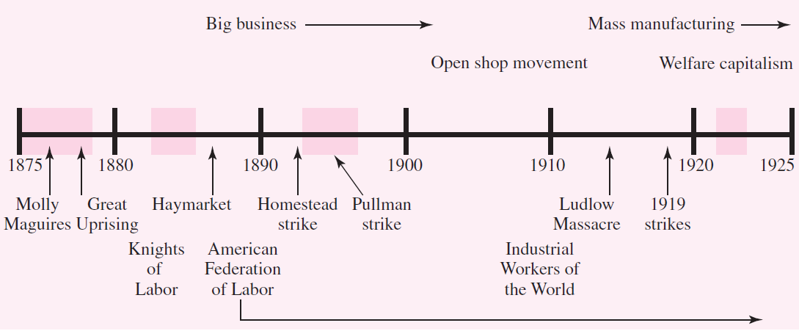
Figure 3.2 - A Time Line of Labor History between 1875 and 1925

Slide 21
Pure and Simple Craft Unionism
The AFL and its affiliated unions are the classic example of business unionism philosophy
  AFL and its unions emphasizes immediate improvements in basic employment condition
    Wages
    Hours
    Working conditions
  Business unionism accepts capitalism and the need for employers to make a profit

Slide 22
Pure and Simple Craft Unionism
      Seeks to win labor’s fair share of the profits through collective bargaining backed up by the threat of striking
AFL unions wholeheartedly endorsed a system of craft unionism
  Unions were divided along craft line by occupation or trade

Slide 23
Pure and Simple Craft Unionism
AFL unions was further guided by the principle of exclusive jurisdiction
  There would be only one union per craft
  Important function of the AFL was to resolve jurisdictional disputes but as with other issues
Important activity of the AFL unions
  Establishing and maintaining job standards through work rules
  Control over decision making was seen as necessary to promote human dignity

Slide 24
Pure and Simple Craft Unionism
The AFL and its unions: Conflicts with employers
  One of the most violent examples of this struggle for workplace control was Homestead strike
  The second great labor history event of the 1890s was the Pullman strike

Slide 25
Workers of the World Unite!
In the Homestead strike skilled and unskilled workers stood together
  Tension between the dominant craft union approach and a perceived need by other workers and union leaders
  Organizing workers of all occupations within an industry into a single union
1905 to 1925, the visible radical and militant approach
  The Industrial Workers of the World (IWW)
  Nickname the “Wobblies”

Slide 26
Workers of the World Unite!
The IWW: Objectives and strategies
  Major U.S. example of revolutionary unionism
  Emphasizes the complete harmony of interests of all wage workers as against the representatives
  Seeks to unite the former, skilled and unskilled
Revolutionary unionism tries to create
  Working-class solidarity rather than solidarity by occupation or industry
  Ultimately seeks to overthrow capitalism
  Goal was to form “One Big Union”

Slide 27
Workers of the World Unite!
IWW did not overlook short-term improvements in working conditions
  Short-term improvements were viewed as important victories for bettering workers
  For advancing the larger struggle against the capitalists
  IWW developed songs, poems, stories, skits, and visual images

Slide 28
Workers of the World Unite!
The IWW: Conflicts and demise
  IWW’s biggest victory was the Lawrence, Massachusetts, textile workers’ strike in 1912
  After a wage reduction, the workers spontaneously walked out
  Within three days 20,000 employees were on strike
  IWW’s emphasis on social justice provided sparks for the industrial unions that would mushroom in the 1930s

Slide 29
Staying Union-Free in the Early 1900s
Craft unions wanted to control the standards of their crafts by
  Restricting entry to skilled workers to maintain high wage levels
  Having workers rather than employers determine all aspects of work to maintain worker dignity

Slide 30
Staying Union-Free in the Early 1900s
1903, employers launched a large-scale effort to achieve open shop
  Open shop is a thoroughly nonunion operation of employees selected by the employer
  The open shop movement was a drive by employers and their employers’ associations in the early 1900s to create and maintain union-free workplaces

Slide 31
Staying Union-Free in the Early 1900s
Open shop movement portrayed an ideology of individual freedom
  Unions were depicted as violating individual liberties by denying workers the ability to choose where to work
  Renamed the American Plan in the 1920s
  Open shop with the “liberty and independence” of the employer that protects the employer’s “natural and constitutional rights”
  Consisted of well-orchestrated collective activity by business

Slide 32
Staying Union-Free in the Early 1900s
Late 1800s, some companies implemented a strategy of welfare work
  Which tried to create harmony between workers and their employers by creating a family like company spirit
  Enhancing the welfare of workers
  Welfare work evolved into the creation of the personnel management function
The 1920s were characterized by welfare capitalism

Slide 33
Staying Union-Free in the Early 1900s
Welfare capitalism: Sought to win worker loyalty
  Increase efficiency by improving supervisory practices implementing orderly hiring and firing procedures
  Providing wage incentives
  Offering protective insurance benefits
  Creating a positive culture
  Improving the physical work environment and safety
  Providing employee voice

Slide 34
Staying Union-Free in the Early 1900s
The most controversial aspect of welfare capitalism was
  The attempt to provide industrial democracy through employee representation plans or company unions
  Employee representation plans are often called company unions
Are company unions sham unions?
  Did not have the authority to force management to discuss specific issues

Slide 35
Staying Union-Free in the Early 1900s
They did provide an open channel of communication with:
  Management and a forum to present grievances
  To prevent unionization
  Companies made concessions to the employee representatives at least sometimes

Slide 36
A New Deal for Workers
On October 24, 1929, the stock market unexpectedly crashed
  Consumer purchasing slowed
  Unemployment increased
  Weak farm prices put farmers out of business
  Panics wiped out savings accounts
  Banks closed

Slide 37
A New Deal for Workers
The New Deal program of the Roosevelt
  Create an active government role in guaranteeing the welfare
  Security of the population, including federally mandated minimum wages and overtime premium

Slide 38
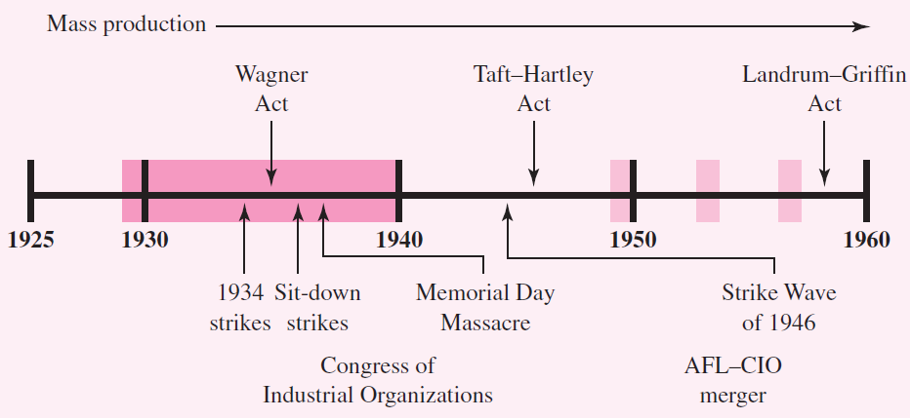
Figure 3.5 - A Time Line of Labor History between 1925 and 1960

Slide 39
A New Deal for Workers
Striking for new labor legislation
  New Deal legislation starting with the National Industrial Recovery Act (NIRA) in 1933
  Encouraged and emboldened workers to form unions
NIRA was weak
  Tremendous strikes in 1934 as workers clashed with employers who refused to recognize their independent unions

Slide 40
A New Deal for Workers
The rise of industrial unionism
  In 1935 Congress passed the Wagner Act, which encouraged unionization, enacted legal protections for workers
  Outlawed company unions
  Industrial unionism seeks to organize all the workers in a workplace or industry
  Industrial unions emerged as a significant force in the mid-1930s

Slide 41
A New Deal for Workers
Sitting down for union recognition
  19th century, companies extensively used labor spies to infiltrate unions and thereby weaken or break them
  Watershed General Motors sit-down strike began in December 1936
  Workers in Flint, Michigan, took over two Chevrolet plants by sitting down
    Refusing to work or leave the plant

Slide 42
A New Deal for Workers
A new federation to rival the AFL
  After the CIO organizing drives resulted in viable unions, it formally became the Congress of Industrial Organizations (CIO) in 1938
  There were now roughly 35 industrial unions affiliated with the CIO, and their growth was spectacular

Slide 43
A New Deal for Workers
By the end of the decade the CIO unions were becoming centralized
  Partly out of necessity when dealing with massive corporations
  Grassroots initiatives increasingly took a backseat to leadership control

Slide 44
Wartime and Postwar Labor Relations
A National War Labor Board (NWLB)
  Created by President Roosevelt with a tripartite structure
The NWLB’s function
  Resolve labor disputes to keep war production moving
The NWLB also created fringe benefits
  Holiday pay, shift differentials
  Health insurance benefits to work around wage controls
  Wartime production demands drew women into factory work in unprecedented numbers

Slide 45
Wartime and Postwar Labor Relations
Cementing the postwar model of labor relations
  The end of World War II brought on the Great Strike Wave of 1945–46
  There were large strikes in autos, steel, coal, rail, oil refining, longshoring, meatpacking, and electrical products
Public attention to the labor movement in the 1950s
  Focused on allegations of union corruption

Slide 46
Wartime and Postwar Labor Relations
  Fears of union corruption and the presence of mafia-infiltrated local unions led to the passage of a major federal law
  In contrast to this rise in public sector unionism, postwar U.S. union density in the private sector peaked at around 35 percent in the mid-1950s
A turbulent end to the 20th century
  For private sector unions, the remaining decades of the 20th century would be years of turbulence and decline
  One source of labor movement turbulence was the postwar civil rights movement

Slide 47
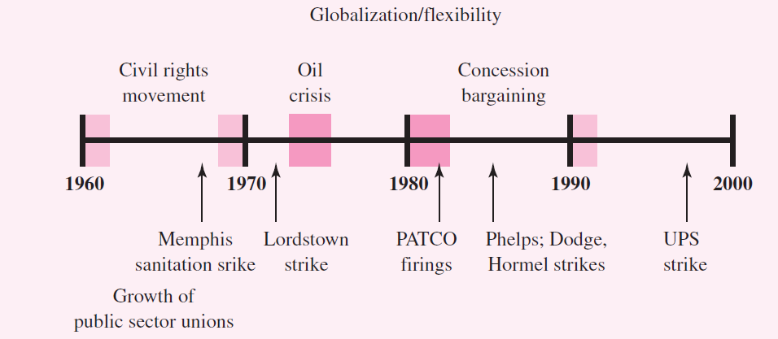
Figure 3.6 - A Time Line of Labor History between 1960 and 2000

Slide 48
Wartime and Postwar Labor Relations
The Civil Rights Act of 1964 outlawed discriminatory practices by both employers and unions
  Memphis sanitation strike demanded improved wages and working conditions, civil rights and respect
Another source of postwar turbulence for the U.S. labor movement was the economy
  In 1981 President Reagan fired the air traffic controllers during the illegal PATCO strike

Slide 49
Labor Relations in the 21st Century
Challenging times of the late 20th century have continued for labor unions
  Globalization continues to undermine labor’s bargaining power
  Private sector union density has dropped to less than 10 percent
Companies and unions react differently to such tremendous pressures
  Labor relations practices have become more divergent

Slide 50
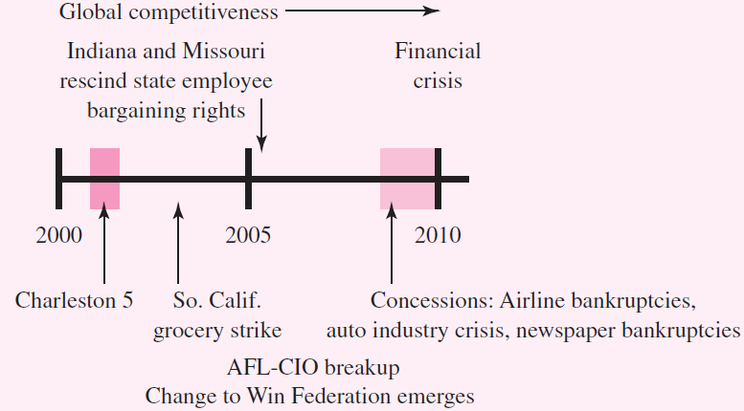
Figure 3.7 - A Time Line of Labor History in the 21st Century

Slide 51
Labor Relations in the 21st Century
The economic and political environment continues to pressure the labor movement to change
  Union mergers have washed away many historical distinctions between craft and industrial unions
  General unionism has largely replaced craft unionism and industrial unionism

Slide 52
Labor Relations in the 21st Century
Despite these challenges for the labor movement millions of productive unionized workers go to work each day protected by unionized contracts negotiated without strikes
  There are pockets of vibrancy

Slide 53
Labor Relations in the 21st Century
The largest unions and watershed strikes in various eras involve traditional blue-collar occupations
  Doctors, university teaching assistants, and nude models have tried to form unions
The details may differ, but the fundamental reasons are universal
  To seek greater equity and increased voice in the workplace through collective action with coworkers

