Slide 1
Unit 7: Contracts: Completed
LS311 Business Law
Notes:
NOTE:
To change the image on this slide, select the picture and delete it. Then click the Pictures icon in the placeholder to insert your own image.

Slide 2
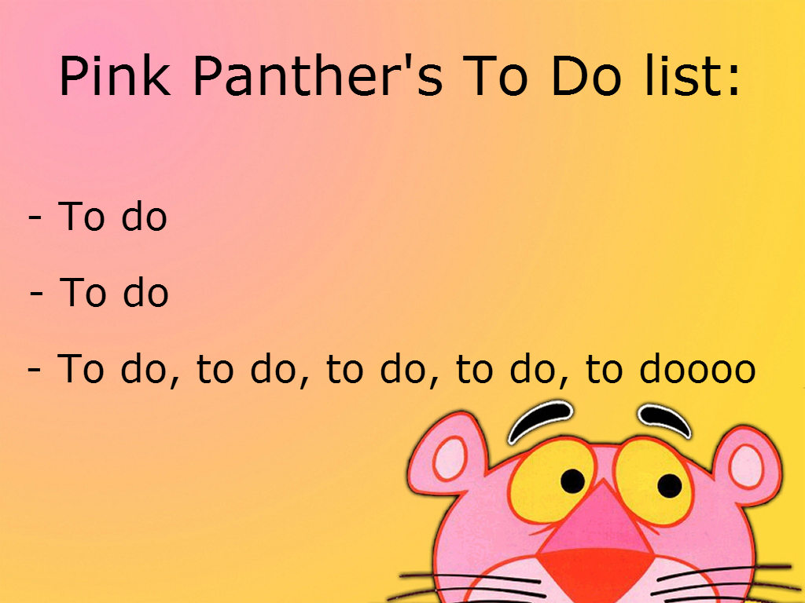
Unit 7 “To-Do” List
To-Do:
  Discussion Board
  Seminar
  Assignment
  Reading

Slide 3
Unit 7 Assignment: Scenario
Candie Cardigan has decided to auction a dress used in a movie filmed in S. Africa.
Cassie Cardigan was chosen to act as the auctioneer and bidding began at $5,000.
Pearl has been looking forward to the auction and bid the initial $5,000.
Jade also wanted the giraffe print dress and upped the ante to $5,500.
The two battled the bidding to where it appeared that Pearl got the dress for $8,500.00, as Cassie smiled and nodded at Pearl.
Candie and Jade had been friends for years, and Candie quietly told Cassie to sell the dress to Jade.
When Pearl presented $8,500 to Cassie, Cassie refused to take her money claiming that the dress was to go to Jade, explaining that Jade had raised her paddle after Pearl’s final bid and showed five fingers meaning that she was bidding $500.00 more over the $8,500.00 bid made by Pearl.
In reality, no such action by Jade had taken place.

Slide 4
Unit 7 Assignment: Scenario
Pearl wants to sue for breach of contract. She has come to your office asking for your help.
She wants you to request that Candie turn the dress over to her (specific performance) for the $8,500 that she bid.
Your supervising attorney Les Agne indicates you should investigate a cause of action for breach of contract, as well as a cause of action based on specific performance.
Be aware of whom the true Plaintiff may be in this potential case and what causes of action may be brought against.
Also, Les has scribbled the following notes to help you with organizing your thoughts regarding Specific Performance.

Slide 5
Unit 7 Assignment: Scenario
Dear Paralegal:
After you establish a contract exists as a result of the auctioning of the giraffe print dress, you may want to consider the following with regard to specific performance:
  You must have a contract in place
  The remedy at law must not be adequate (hence damages alone will not provide relief to the party who is seeking specific performance).
  The remedy must be enforceable
  If one party can bring the action for specific performance, so can the other if the positions were reversed.
Be sure to discuss defenses with regard to the contract.
  In other words, what will Candie or the Auction House say in response to there being a contract?

Slide 6
Unit 7 Assignment: Memo
Please write me a memorandum in the following format:
Date:
To: Les Agne, Attorney at law
From: [Your Name]
Re: Potential Causes of Action for Breach of Contract and Specific Performance
Organize your memorandum with an introduction, body, and conclusion.

Slide 7
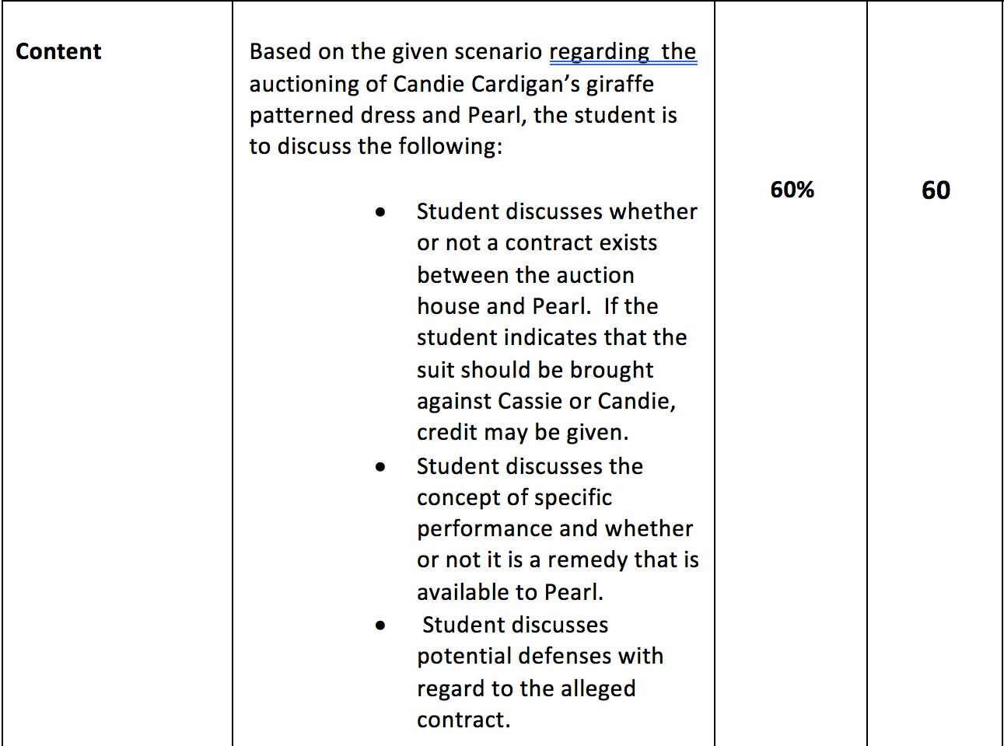
Unit 7 Assignment: Rubric

Slide 8
Contracts: Completed
A breach of contract entitles the non-breaching party to sue for monetary damages. In the context of contract law, damages are designed to compensate the non-breaching party for the loss of the bargain. Often, courts say that innocent parties are to be placed in the position they would have occupied had the contract been fully performed.
There are basically four broad categories of damages:
Compensatory (to cover direct losses and costs).
Consequential (to cover indirect and foreseeable losses).
Punitive (to punish and deter wrongdoing).
Nominal (to recognize wrongdoing when no monetary loss is shown).
Electronic technology offers business several advantages, including speed, efficiency, and lower costs. In the 1990s many observers argued that the development of cyberspace was revolutionary. Therefore, new legal theories, and new laws, would be needed to govern e-contracts, or contracts entered into electronically. To date however, most courts have simply adapted traditional contracts law principles and, when applicable, provisions of the Uniform Commercial Code to cases involving e-contract disputes.

Slide 9
What Does it Mean to Mitigate Damages?
When there has been a breach of contract, the injured party has a duty to mitigate or reduce the damages that he/she has suffered.
What should Paige do in the following situation?
Paige, a technical writer was wrongfully terminated from her positon at Rockets are Us (RAU), an Engineering firm. She sues RAU for breach of contract. How must she mitigate her damages?

Slide 10
What Paige Must Do
A wrongfully terminated employee has a duty to take a similar job if one is available.
If the employee fails to do this, the damages awarded will be equivalent to the employee’s salary less the income he or she would have received in a similar job obtained by reasonable means.
The employer has the burden of proving that such jobs existed and that the
employee could have been hired.
Normally, the employee is under no duty to take a job that is not of the same type and rank.

Slide 11
Liquidated Damages vs Penalties
What is the difference between liquidated damages and penalties? A liquidated damages provision in a contract specifies that a certain dollar amount is to be paid in the event of a future default or breach of contract. (Liquidated means determined, settled, or fixed.)
. A penalty specifies a certain amount to be paid in the event of a default or
breach of contract and is designed to penalize the breaching party

Slide 12
Court’s Test for Determining Liquidated Damages or Penalty…
To determine whether a particular provision is for liquidated damages or for a penalty, the court must answer two questions:
1) At the time the contract was formed, was it apparent that damages would be difficult to estimate in the event of a breach?
2) Was the amount set as damages a reasonable estimate of those potential damages and not excessive?
If the answer is yes to both questions, the provision will be enforced. Ex: Construction contracts use liquidated damages clauses because it would be difficult to estimate the damages from a delay in completing the work.

Slide 13
When would a party seek an equitable remedy?
Sometimes damages are inadequate. When this occurs, parties may attempt to seek an equitable remedy.
Various equitable remedies are available, including:
  Rescission
  Restitution
  Reformation
  Specific performance.

Slide 14
What are Rescission and Restitution?
Rescission – An action to undue a contract or cancel it.
When might a party ask for rescission?
When there has been fraud, mistake, duress, or a failure of consideration, a party may ask for rescission.
The rescinding party must give prompt notice to the breaching party.
Restitution – The return of property or funds previously conveyed
Both parties must make restitution to one another when rescinding a contract. *Note restitution is not just for cases involving rescission.

Slide 15
Important Notations Re: Restitution
Restitution may be sought in actions for breach of contract, tort actions, and other actions at law or in equity.
Usually, restitution can be obtained when funds or property has been transferred by mistake or because of fraud.
An award in a case may include restitution of funds or property obtained:
- through embezzlement, conversion, theft, copyright infringement, or
- misconduct by a party in a confidential or
- other special relationship

Slide 16

Specific Performance
Charles Atlas Earns Much Cash Delivering Elephants! (mnemonic for Specific Performance)
C- There must have been a contract
A- The remedy at law is not adequate
E – Enforceability – An equity court is the only court that can enforce the contract
M- Mutuality of remedy
C- All conditions of the contract have been met
D- Defenses
E- If the contract is not enforced, a hardship will be created.

Slide 17
Stainbrook v Low
Issue: Is complete performance of a contract required for the party to be entitled to the remedy of specific performance?
Decision: No. A party who has substantially performed or offered to perform his or her obligations under a contract is entitled to pursue specific performance as a remedy. The state intermediate appellate court held that specific performance was an appropriate remedy in this case and affirmed the lower court’s order.
Court of Appeals of Indiana, 842 N.E.2d 386 (2006)

Slide 18
What is Reformation?
Reformation: Reformation is an equitable remedy used when the parties have imperfectly expressed their agreement in writing.
Reformation allows a court to rewrite the contract to reflect the parties’ true intentions. Courts order reformation most often when fraud or mutual mistake is present.
If Keshan contracts to buy a forklift from Shelley but the written contract refers to a crane, a mutual mistake has occurred. Accordingly, a court could reform the contract so that the writing conforms to the parties’ original intention as to which piece of equipment is being sold

Slide 19
What is a Quasi Contract?
Quasi contract is a legal theory under which an obligation is imposed in the absence of an agreement
Granted when partial performance under an otherwise unenforceable contract.
Party seeking recovery must show:
1. The party conferred a benefit on the other party
2. The party conferred a benefit with a reasonable
expectation of being paid.
3. The party did not act as a volunteer in conferring the benefit.
4. The party receiving the benefit would be unjustly enriched by
retaining the benefit without paying for it.

Slide 20
Contract Provisions Can Limit Remedies
A contract can say ‘no damages can be recovered for certain types of breaches or that damages will be limited to a certain dollar amount.
A contract may also say that the only remedy for breach is for repair, replacement or refund.
A provision stating no damages may be recovered is called an exculpatory clause.

Slide 21
E-contracts
E-contracts center on basic principles of contracts.
Displaying the offer:
The seller’s Web site should include a hypertext link to a page containing
the full contract so that potential buyers are made aware of the terms to
which they are assenting. The contract generally must be displayed
online in a readable format, such as a twelve-point typeface. All provisions
should be reasonably clear.

Slide 22
Online Acceptances
…“by written or spoken words or by other action or by failure to act”
Restatement Second
Click on agreements – Courts have held a contract can be created by conduct…a simple click of a box indicating “I agree” or “I accept” can create a binding contract.
Note – E-signatures are acceptable but both parties must agree to them
In 2000, the E-sign act was created. Hence, “no contract, record or signature can be denied legal effect simply because it is in e-form.”

Slide 23
When doesn’t the E-sign Act apply?
E-sign Act does NOT apply to these types of contracts:
court papers
divorce decrees
evictions
foreclosures
health insurance terminations
prenuptial agreements
wills

Slide 24
Questions?

