Slide 1
An Introduction to Integrated Marketing Communications
IMC
Alokesh Banerjee

Slide 2
Definition of Integrated Marketing Communications
A concept of marketing communications planning that
recognizes the added value of a comprehensive plan that
evaluates the strategic roles of a variety of communication
disciplines and combines these disciplines to provide clarity,
consistency and maximum communications impact.

Slide 3
Integrated Marketing Communications
A marketing communications planning concept that recognizes the value of a comprehensive plan.
A plan that evaluates the strategic roles of several communications disciplines:
Media advertising
Direct marketing
Interactive/internet marketing
Sales promotion
Publicity/Public relations
Combines the disciplines to provide:
Clarity
Consistency
Maximum communications impact

Slide 4
The Marketing & Promotional Mixes
Marketing Mix:
Product or Service
Pricing
Channels of Distribution
Promotion
Promotional Mix:
Advertising
Direct Marketing
Interactive/internet marketing
Sales Promotion
Publicity/Public Relations
Personal Selling

Slide 5
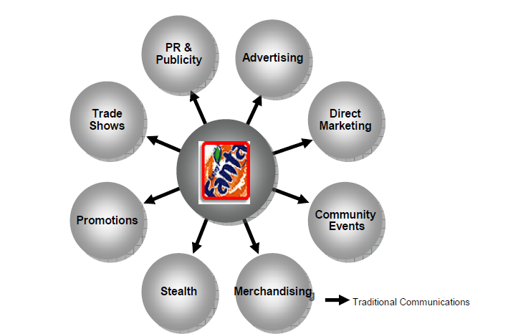
The Traditional Approach

Slide 6
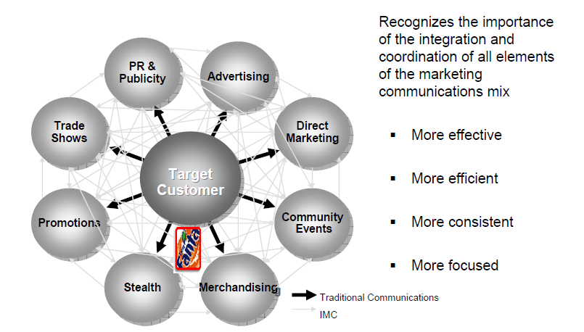
THE IMC APPROACH

Slide 7
The Communication Planning Process - Guidelines
Consumer-centric brand positioning.
Engage consumers by “fitting in” not “Standing out”.
Leverage the emotional code of the context of consumers live.
Change the everyday life experience Not Just The Purchase Experience.
Link the brand across the consumer journey.

Slide 8
Communication-Based Marketing Model
Other Stakeholders
Employees
Investors
Financial Community
Government
Regulators
Corporate Level Message Sources
Administration Manufacturing/ Marketing Finance Human Legal
Operations Resources
Cross-Functional Brand Equity (IM) Team
Marketing Level Message Sources
Product Price Marketing Distribution
Mix Mix Communication Mix
Distributors
Suppliers
Competition
Interactivity
Customers
Consumers
Local Community
Media
Interest Groups
Cross-Functional IMC Team
Marketing Communication Level Message Sources
Personal Adver- Sales Direct Public Pack- Events
Sales tising Promotion Marketing Relations aging

Slide 9
Communication Levels
Corporate Level
Messages sent by a company’s overall business practices
and philosophies such as mission, labor practices,
philanthropies, culture and other processes
Marketing Level
Messages sent by or inferred from by various aspects of marketing mix such as product performance, design, appearance, pricing and distribution
Marketing Communication Level
Strategic and executional consistency among all forms of marketing communication

Slide 10
Reasons For Growing Importance of IMC
Shift from media advertising to other forms of
marketing communication
Movement away from advertising focused-
approaches that emphasize mass media
Shift in power from manufacturers to retailers
Rapid growth of database marketing
Demands for greater ad agency accountability
Changes in agency compensation
Rapid growth of the Internet
Increasing importance of branding

Slide 11
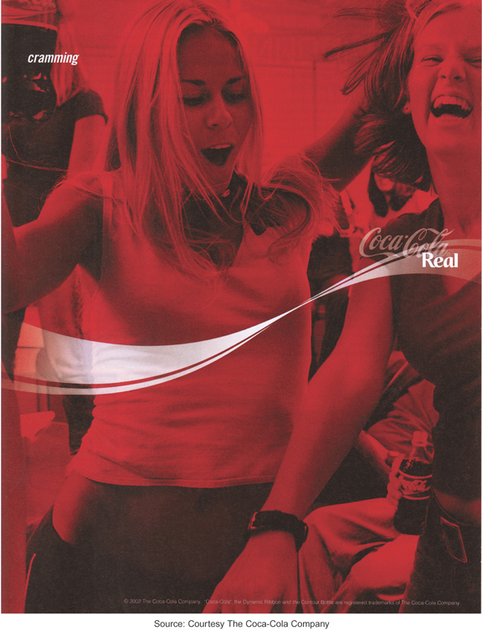
Coca-Cola is the world’s most valuable brand

Slide 12
IMC Communication Tools
IMC Communication Tools
Direct
Marketing
Interactive/
Internet Marketing
Advertising
Sales
Promotion
Publicity/Public
Relations
Personal
Selling

Slide 13
Syllabus
COMMUNICATIONS PLAN - All about IMC
Integrated Marketing Communications Strategy (Part-I) - Integrated Marketing Communications (IMC) - The Changing Communications Environment; The Need for Integrated Marketing Communications. A view of the Communication process - Steps in Developing Effective Communication- Identifying the Target Audience; Determining the Communications Objectives; Designing a message; Choosing the media; selecting the message source; Collecting feedback.
Integrated Marketing Communications Strategy (Part-II) - Setting the total promotion budget and mix - Setting the total promotion budget; Setting the overall communication mix; Integrating the promotion mix. Socially Responsible Marketing Communication - Reviewing the concepts; reviewing the key terms; Discussing the concepts; Applying the concepts; Focus on technology; Focus on ethics.
IMC Case studies
IMC Case studies
Workshop
Entreprenuership - Setting up a Design Company & a case study of using branding as a marketing tool
Students to work in groups on an IMC strategy for a given product / service to be provided by the faculty member / presentation to be evaluated in class and the \Written Submission to be evaluated by faculty later on (50 - 50 )

Slide 14
Advertising
Any paid form of nonpersonal communication about an organization, product, service, idea or cause by an identified sponsor.
Advantages of advertising
Advertiser controls the message
Cost effective way to communicate with large audiences
Effective way to create brand images and symbolic appeals
Often can be effective way to strike responsive chord with consumers
Disadvantages of advertising
High costs of producing and running ads
Credibility problems and consumer skepticism
Clutter
Difficulty in determining effectiveness

Slide 15
Classifications of Advertising
Advertising to Consumer Markets
National advertising
Retail/local advertising
Advertising to increase demand
Primary demand for the product category
Selective demand for a specific brand
Business & professional advertising
Business-to-business advertising
Professional advertising
Trade advertising

Slide 16
An example of a business-to-business ad
Source: Courtesy Honeywell.

Slide 17
Direct Marketing
A system of marketing by which organizations communicate directly with target customers to generate a response and/or a transaction.
Disadvantages of direct marketing
Lack of customer receptivity and very low response rates
Clutter (too many messages)
Image problems – particularly with telemarketing
Advantages of direct marketing
Changes in society have made consumers more receptive to direct-marketing
Allows marketers to be very selective and target specific segments of customers
Messages can be customized for specific customers.
Effectiveness easier to measure

Slide 18
Direct Marketing
Direct marketing methods
Direct mail
Catalogs
Telemarketing
Direct response ads
Direct selling
Internet

Slide 19
Interactive/Internet Marketing
A form of marketing communication through interactive media which allow for a two-way flow of information whereby users can participate in and modify the content of the information they receive in real time.
Advantages of interactive/ internet marketing
Can be used for a variety of IMC functions
Messages can be tailored to specific interests and needs of customers
Interactive nature of the Internet leads to higher level of involvement
Can provide large amounts of information to customers.
Disadvantages of interactive/
internet marketing
Internet is not yet a mass medium as many consumers lack access
Attention to Internet ads is very low
Great deal of clutter on the Internet
Audience measurement is a problem on the Internet

Slide 20
Interactive/Internet Marketing
Use of the Internet as an IMC Tool
As an advertising medium to inform, educate
and persuade customers
As a direct sales tool
To obtain customer database information
To communicate and interact with buyers
To provide customer service and support
To build and maintain customer relationships
As a tool for implementing sales promotion
As a tool for implementing publicity/public
relations programs

Slide 21
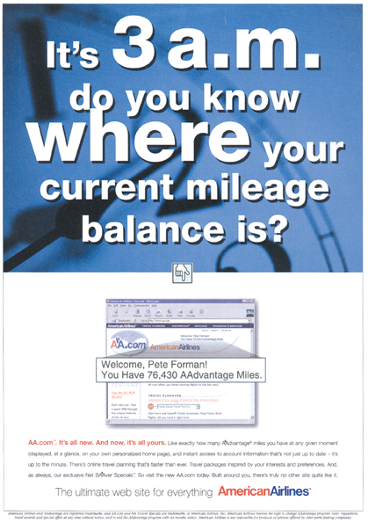
The Internet is an important IMC tool for American Airlines
Source: Courtesy American Airlines.

Slide 22
Sales Promotion
Marketing activities that provide extra value or incentives to the sales force, distributors, or ultimate consumers and can stimulate immediate sales.
Consumer-oriented
Targeted to the ultimate users of a product or service
Coupons
Sampling
Premiums
Rebates
Contests
Sweepstakes
POP materials
Trade-oriented
Targeted toward marketing intermediaries such as retailers, wholesalers, or distributors
Promotion allowances
Merchandise allowances
Price deals
Sales contests
Trade shows

Slide 23
Sales Promotion Uses
Introduce new products
Get existing customers to buy more
Attract new customers
Combat competition
Maintain sales in off season
Increase retail inventories
Tie in advertising & personal selling
Enhance personal selling efforts

Slide 24
Publicity
Nonpersonal communication regarding an organization, product, service, or idea not directly paid for or run under identified sponsorship.
Advantages of publicity
Credibility
Low cost (although not totally free)
Often results in word-of-mouth
Disadvantages of publicity
Not always under control of organization
Can be negative

Slide 25
Publicity Vehicles
News Releases:
Single-page news stories sent to media who might print or broadcast the content.
Feature Articles:
Larger manuscripts composed and edited for a particular medium.
Captioned Photos:
Photographs with content identified and explained below the picture.
Press Conferences:
Meetings and presentations to invited reporters and editors.
Special Events:
Sponsorship of events, teams, or programs of public value.

Slide 26
Advertising Versus Publicity
FACTOR ADVERTISING PUBLICITY
Control Great Little
Credibility Lower Higher
Reach Achievable Undetermined
Frequency Schedulable Undetermined
Cost Specific Unspecified/low
Flexibility High Low
Timing Specifiable Tentative

Slide 27
Public Relations
The management function which evaluates public attitudes, identifies the policies and procedures of an individual or organization with the public interest, and executes a program of action to earn public understanding and acceptance.
Tools used by Public Relations
Publicity
Special publications
Community activity participation
Fund-raising
Special event sponsorship
Public affairs activities

Slide 28
Personal Selling
Direct person-to-person communication whereby a seller attempts to assist and/or persuade perspective buyers to to purchase a product or service.
Advantages of personal selling
Direct contact between buyer and seller allows for more flexibility
Can tailor sales message to specific needs of customers
Allows for more direct and immediate feedback
Sales efforts can be targeted to specific markets and customers who are best prospects.
Disadvantages of personal selling
High costs per contact
Expensive way to reach large audiences
Difficult to have consistent and uniform message delivered to all customers

Slide 29
Promotional Management
Coordinating the promotional mix elements to develop a controlled, integrated program of effective marketing communications.
Considerations for developing the promotional program include:
Type of product
Buyer’s decision process
Stage of product life cycle
Channels of distribution

Slide 30
Integrated Marketing Communications Planning Model
Review of Marketing Plan
Promotional Program Situation Analysis
Analysis of the Communications Process
Budget Determination
Develop Integrated Marketing Communications Programs
Advertising
Sales
Promotion
PR/
Publicity
Personal
Selling
Direct
Marketing
Internet/
Interactive
Advertising
Objectives
Sales
Promotion
Objectives
PR/
Publicity
Objectives
Personal
Selling
Objectives
Direct
Marketing
Objectives
Internet/
Interactive
Objectives
Message
Strategy
Sales
Promotion
Strategy
PR/
Publicity
Strategy
Personal
Selling
Strategy
Direct
Marketing
Strategy
Internet/
Interactive
Strategy
Integration & Implementation of Marketing Communications Strategies
Monitor, Evaluate & Control Promotional Program
Notes:
Notes:
_______________________________________________________________
_______________________________________________________________
_______________________________________________________________
_______________________________________________________________
_______________________________________________________________
_______________________________________________________________
_______________________________________________________________

Slide 31
The Marketing Plan
A document that describes the overall marketing strategy and programs developed for a company, product or brand. The plan includes:
A detailed situation analysis
Specific marketing objectives
A marketing strategy and program that includes selection of a target market and plans for marketing mix elements
4. A program for implementing the strategy
5. A process for monitoring and evaluating performance

Slide 32
Situation Analysis
Internal Factors
Assessment of the firm’s promotional organization and capabilities
Review of the firm’s previous promotional programs
Assessment of firm or brand image and implications for promotion
Assessment of relative strengths and weaknesses of product/service
External Factors
Customer analysis
Competitive analysis
Environmental analysis

Slide 33
IMC Program Situation Analysis External Factors
Environmental analysis
Technological Political/Legal
Demographic Socio/Cultural
Economic
Competitive Analysis
Direct and indirect competitors
Position relative to competitors
Size of competitors’ advertising/
promotional budgets
IMC strategies being used by competitors

Slide 34
IMC Program Situation Analysis External Factors
Customer Analysis
Who buys our product or service?
Who initiates and makes the decision
to purchase and who influences the process?
How is the purchase decision made?
What attributes or criteria are important to customers?
What are customers’ perceptions of and attitudes
toward our company, product/service or brands?
What factors influence the decision making process?
Contact points where customers can be reached?

Slide 35
Analysis of Communications Process
Analyze response process of customers
in the target audience.
Analyze best combination of source,
message and channel factors for
communicating with target audience.
Establish communication goals and objectives.

Slide 36
Potential Communications Objectives
Sales
Customer loyalty
Company image
Brand image
Store patronage
Service contract
An inquiry
A visit by a prospect
Product trial
Recommendation
Adoption of the product

Slide 37
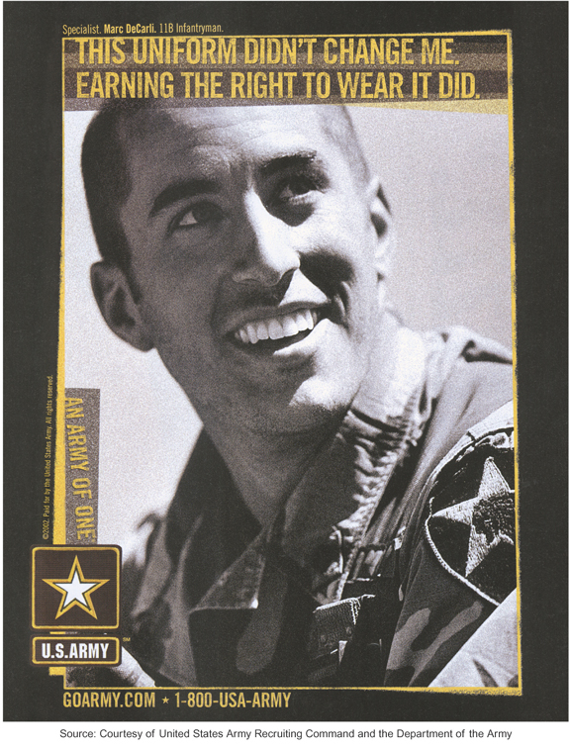
The objectives of this ad include image building and encouraging inquiries

Slide 38
Potential Communications Objectives
Individual sales
Customer loyalty
Company image
Brand image
Store patronage
Service contract
An inquiry
A visit by the prospect
Product trial
Prescription for use
Recommendation
Adoption of the product

Slide 39
Contact Points Where Customers Can Be Effectively Reached
Mass media
Broadcast - radio/TV
Newspapers
Magazines
Direct Marketing
Internet/interactive
Brochures, sales literature
Publicity/PR
Events/sponsorships
Local
Regional
National/international
Sales Promotions
In-store/POP
Product placements in movies and television shows
Promotional products

Slide 40
Develop Integrated Marketing Communications Program
Advertising
Determine objectives and budget
Message development
Called “Creative Strategy”
Determine basic appeal
Determine main message
Media strategy
Communication channels
Type of media . . .
Newspapers/Magazines
Radio/Television
Outdoor/Specialty
Select specific media
Specific papers, magazines, TV programs, radio stations, billboards, or other media

Slide 41
Integrate and Implement Marketing Communications Strategies
Integrate promotional mix strategies.
Create and produce ads.
Purchase media time and space
Design and implement direct marketing programs
Design and implement sales promotion
program
Design and implement public relations/
publicity programs
Design and implement interactive/
internet marketing programs

Slide 42
Monitor, Evaluate and Control Integrated Marketing Communications Program
Evaluate promotional program results and determine effectiveness
Take actions to control and adjust promotional programs

