Slide 1
THE RITES AND RITUALS OF THE SHINTO RELIGION
Name;
Course;
Tutor;
Date;

Slide 2
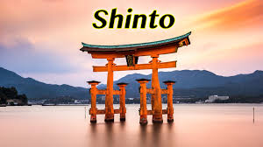
The rites and rituals of the Shinto Religion
Shinto is one of the oldest religions in Japan
In this faith, there is a significant stress on a strict adherence to ritual practices which are expected to be observed with great diligence
From the beginning, the adherents of this religion do not have weekly stipulated services. Instead, individuals may elect to go to the shrines either on the first day of the month or the 15th day
Primarily, when a child is born, it is expected that the newborn would be taken to the tutelary kami within the first thirty and one hundred days of birth.
Shinto shrine
Shinto symbol

Slide 3
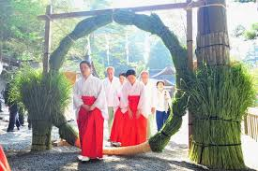
Shinto rites and rituals
The 25th day of January each year is another important calendar in the Shinto religion. On this day, the youthful members of the community are enjoined into the association of elders. Today, the practice is among individuals who have attained the age of 20 years chichi-go-san (Breen & Teeuwen, 2013)
Apart from the rites of this religion, several rituals are performed. Firstly, there are purification rituals. In this ceremony, individuals gather at a corner of the precincts of the shrine for purification purposes
Apart from the purification rituals, the religion also performs the presentation of foodstuffs to the shrine in celebration of the blessings of kami
Shichi-go san festival
Purification ritual

Slide 4
References
Breen, J., & Teeuwen, M. (2013). Shinto in history: Ways of the kami. Routledge.

