Slide 1
Chapter 3
Human Resources Management Policies and Procedures

Slide 2
Learning Objectives
Explain the difference between HR policies and HR procedures.
Identify the steps managers use to develop HR policies and procedures.
State the importance of conducting a legal review before implementing HR policies and procedures.

Slide 3
Learning Objectives
Assess the impact of advanced technology on HR-related policy and procedure development.
Explain why HR managers must develop, implement, and maintain effective recordkeeping systems.

Slide 4
HR Policies & Procedures Activities
Policy and Procedure Development
HR policy(ies): A course of action selected from alternatives and designed to guide future decision-making.

Slide 5
HR Policies & Procedures Activities
Policy and Procedure Development
HR procedures: The methods or steps used to effectively develop and apply HR policies

Slide 6
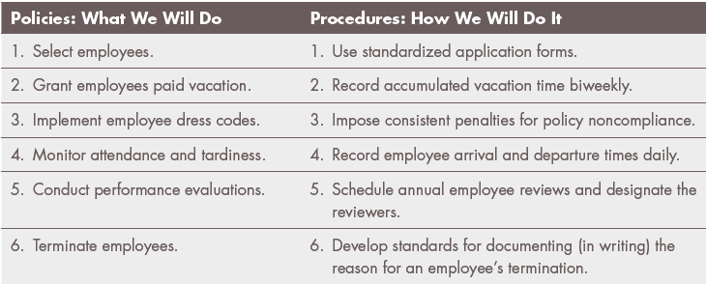
HR Policies & Procedures Activities
Policy and Procedure Development

Slide 7
HR Policies & Procedures Activities
Areas of Policy and Procedure Development
Staffing the Organization
Developing staff
Motivating staff
Maintaining staff

Slide 8
HR Policies & Procedures Activities
Staffing the Organization
Recruitment and Selection of Employees
Identify the specific skills, knowledge, and abilities needed in the organization

Slide 9
HR Policies & Procedures Activities
Staffing the Organization
Recruitment and Selection of Employees
Ensure an adequate pool of qualified applicants to maximize the operation’s chances to hire an outstanding candidate
Provide sufficient job information to discourage unqualified job applicants to avoid wasting time and resources in the interviewing process

Slide 10
HR Policies & Procedures Activities
Staffing the Organization
Recruitment and Selection of Employees
Be sure not to illegally exclude potential candidates for non-job related reasons

Slide 11
HR Policies & Procedures Activities
Staffing the Organization
Recruitment and Selection of Employees
Refer candidates to the individual who will make the hiring decision, or make the actual hiring selection
Provide the candidate with a good deal of job-related and organization-related information to encourage the desired candidate to accept the position

Slide 12
HR Policies & Procedures Activities
Developing Staff
New Staff Orientation
Training for Current Staff
It is the role of the HR manager to ensure legally defensible policies and procedures are developed

Slide 13
HR Policies & Procedures Activities
Motivating Staff
Two factors are commonly agreed to affect worker motivation:
A worker’s ability to do a job
A worker’s willingness to do a job

Slide 14
HR Policies & Procedures Activities
Motivating Staff
Theories of employee motivation
Needs hierarchy (Abraham Maslow)
Theory X and Theory Y (Douglas McGregor)
Motivation/Hygiene Theory (Frederick Herzberg)

Slide 15
HR Policies & Procedures Activities
Motivating Staff (cont.)
Theories of employee motivation
Three Need (Achievement, Affiliation and Power) Theory (David McClelland)
Expectancy Theory (Victor Vroom)

Slide 16
HR Policies & Procedures Activities
Maintaining Staff
Major areas of concern include worker health and safety, and development employee assistance programs (EAP).
EAP: The term used to describe a variety of employer initiated efforts to assist employees in the areas of family concerns, legal issues, financial matters and health maintenance.

Slide 17
Steps in HR Policy and Procedure Development
Identify the HR issue to be addressed
Consider on-site factors affecting implementation
Consider off-site factors affecting implementation

Slide 18
Steps in HR Policy and Procedure Development
Draft policy and procedures and submit for (legal) review
Develop related documentation and record keeping requirements
Communicate finalized policy and procedures to affected parties

Slide 19
Review for Legal Compliance
A policy that is already flawed or illegal from the outset simply should not be implemented.
In most cases, a legal review of a policy proposed by experienced managers will not indicate that the proposed policy is illegal; but such a review must still be undertaken prior to the policy’s implementation.

Slide 20
Review for Legal Compliance
For example, in the case of dress codes, a legal review will help a HR manager ensure dress code requirements do not violate:
Sex discrimination laws
Race discrimination laws
Religious discrimination laws

Slide 21
Applying Advanced Technology to HR Policies and Procedures
Information Dissemination
Changes in policies and procedures should be accompanied by a written (hard copy) document detailing the new policy or procedures. The hard can be signed by employees, and then a copy of the signed document can be placed in the employee’s personal file.

Slide 22
Applying Advanced Technology to HR Policies and Procedures
Information Dissemination
Personal File: A record of information about a single employee’s employment. Typically, this file includes information about the employee’s personal status, application, performance evaluations, and disciplinary warnings.

Slide 23
Applying Advanced Technology to HR Policies and Procedures
Information Dissemination
Employee Handbook (manual): A permanent reference guide for employers and employees that contains information about a company, its goals and its current employment policies and procedures.

Slide 24
Applying Advanced Technology to HR Policies and Procedures
Information Dissemination
Example methods of information dissemination:
E-mail with E-mail attachment
Website posting
CD
Toll free number: telephone voice recording
Electronic News Posting/ Blog

Slide 25
Applying Advanced Technology to HR Policies and Procedures
Information Storage
Areas in which data storage is of significant concern:
Employment Applications
Resumes
Performance evaluations
Disciplinary records

Slide 26
Applying Advanced Technology to HR Policies and Procedures
Information Storage
Areas in which data storage is of significant concern: (cont.)
Medical files
Insurance-related records and correspondence
Training records and documentation
Certificates, transcripts, diplomas
Military records

Slide 27
Applying Advanced Technology to HR Policies and Procedures
Information Storage
Areas in which data storage is of significant concern: (cont.)
Governmental entity inquiry records
Lawsuit-related information
Other employee or employment-related correspondence

Slide 28
Applying Advanced Technology to HR Policies and Procedures
Information storage: The processes, equipment, and documents that make up a company’s total records retention effort.

Slide 29
Applying Advanced Technology to HR Policies and Procedures
Information Storage
Key components of record-keeping systems:
Security Features
Records Specific Designated Servers

Slide 30
Documentation and Record Keeping
Selected recordkeeping requirements enforced by the United States government:
Employee Name, address, Social Security number, gender, date of birth
Position, job category
Applications, resumes, recruitment notices, job orders, employment tests
Date of hire
I-9 form

Slide 31
Documentation and Record Keeping
Selected recordkeeping requirements enforced by the United States government: (cont.)
Work permits/age certificates for minors
Dates and reasons for promotion, demotion, transfer, layoff, rehire, and termination
Performance evaluations
Training opportunities, agreements

Slide 32
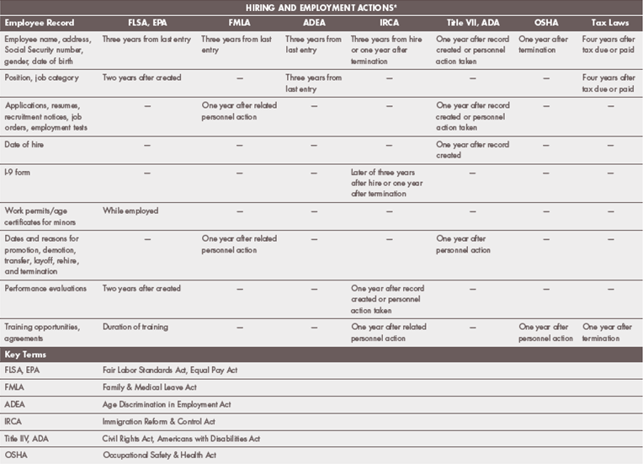
Documentation and Record Keeping

Slide 33
Documentation and Record Keeping
Constructive Discharge: An employee-initiated termination of employment brought about by conditions that make the employee's work situation so intolerable a reasonable person would feel compelled to quit.
Also known as constructive wrongful discharge.

Slide 34
Documentation and Record Keeping
RFI: An official EEOC “Request for Information”
Responding to an RIF is an EEOC requirement that the accused party submit all requested copies of personnel policies, the accuser’s personnel files, the personnel files of other individuals, and any other information deemed relevant by the EEOC.

