Slide 1
Health Science:
Human and Social Dimension
Dr. M. L. Holt
Application #6
Morgan State University

Slide 2
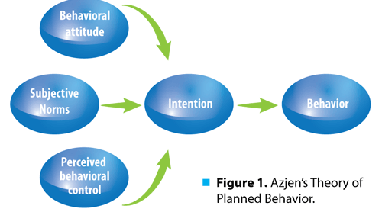
TPB
Add perceived behavioral control over behavior
Takes into account situations where one may not have complete volitional control over a behavior

Slide 3
Instructions
You have been assigned an internship at a drug rehab center in downtown Baltimore. One of your assignments is to create an intervention for addicts who are between the ages of 18 to 24.
Examine how you would address attitudes, subjective norms, and perceived behavioral control in your intervention. Give specific detail about what kinds of activities and reinforcement tools that you would utilize.

