Slide 2
Company Overview​
A small retail clothing company which has been in the market since last 3 years and has established a strong customer base in these 3 years by providing customers with better shopping experience. ​
​
The header quarter is located in New York and two other branches located in Dallas (TX) and Philadelphia (pa).​
​
The company aims to grow in the retail market, open more stores in strategic locations and create its online store presence so that it can increase its customers across the united states.​
​

Slide 3
Business Model​
Products: ​ High-end fashion clothing for young adults.​ ​
Target market: ​
High quality national branded cloths for young adults aged 18-25 ​
Mid – high income​
Customers who love to buy current fashion clothing at low pricing.​
​
Marketing strategy: ​
Using social media for marketing in cost-effective manners – like Facebook, Instagram, and Twitter.​
Constant updated about product and current fashion trends on our website.​
Creating brands and company awareness by creating newsletters, posters, and flyers.​
​
​
​
​

Slide 4
Writing blogs about new trends.​
Introducing discount coupons​
Doing newspaper advertisement​
Creating product catalog​
Email marketing​
​
Revenue generation:​
Seamless and easy processes for customers to buy the products online and in store and also free and easy return process of products.​
Introducing discount coupons for customer which will help to increase sales.​
Value and satisfy customer needs and provide them with great customer services and product knowledge. ​
Recognizing our company strength, weakness, opportunities, and threats.​
​
​

Slide 5
Price strategy:​
Provide high quality and innovative product to the customers in the price range that differentiate our products from rivals.​
Provide temporarily low prices on the products to reduce the competition in the market. It will discourage competitors because they won't be able to compete and loose profitability and new competitors won't be able to enter easily.​
Introducing great quality that encourage customers to buy the products at our given price range.​
​
​
​
​
​
​

Slide 6
Mission and Vision​
Our company's mission is to offer high quality fashionable clothing for young adults and built a strong emotional relationship with the customers by offering premium prices on innovative and new trends clothing as compared to rivals.​
​
Our company's vision is to establish long term relationship with the vendors and customers and make our business sustainable with outstanding services .​
​
​
​

Slide 7
Goal and Value​
Our company's goal is to achieve profitable margin of 60 percent by the end of the year.​
​
Our company's values:​
Warm welcoming environment for customers and vendors​
Team work​
Be passionate​
Focus on innovation and new ideas​
Thirst for improvement​
Be humble​
High quality​
​
​
​

Slide 8
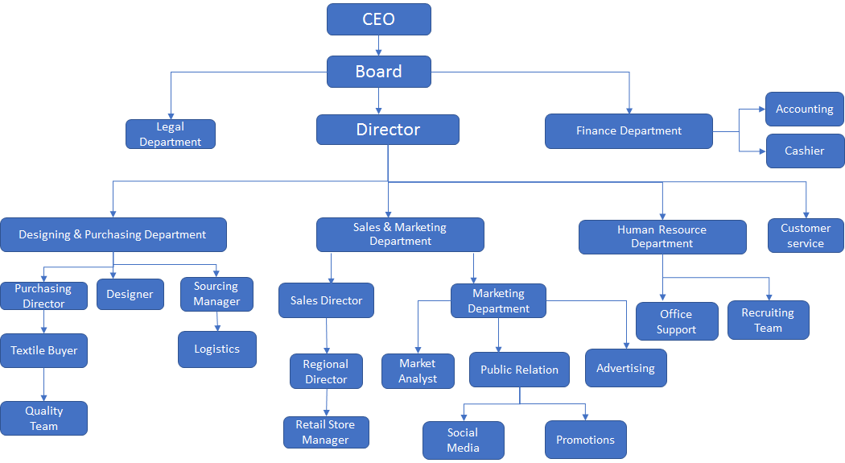
Organizational Chart

Slide 9
Resources and Capabilities
Strong Customer Base
Wide Range of Products for every section of Youth
Popular Brand Name in Youth
Great reach to youth through Social Media

Slide 10
Skills and competencies​
Well Known Key persons from Fashion Industry in Management
Creative and Innovative Marketing Team
Highly Experienced Fashion Designers
Young Fashion Students as Sales Executives

Slide 11
Applying Competencies to Organizational Functions​
Research and Development​
Research and Development is a critical component for the consistent development of better products in a company. Not only does it identify potentially profitable market trends, but it also puts the responsive organization in a space where it can position itself to benefit from the evolving tastes and needs of the consumers. ​
Strategy Directives:​
Research on comparable products in clothing ranges that Our Company hopes to infiltrate; determine ways of reducing the cost of production while maintaining the quality, if not improving. ​
Identifying the specific needs that the mid-segment consumer market has that current brands are not satisfying (completely or partially) then determining ways of exploiting those loophole to drive sales in the sale for fashionable clothing. ​

Slide 12
Since our company is a retail company, the target market is not the manufacturers. We have different suppliers. Rather it is the young adult aged 18-25 that would like a clothing is more fashionable. That way, individuals can have trendy clothes that they desire without necessarily having to pay a lot of money to the brands ​
​
The strategic role of R & D in utilizing the strategic location like New York City where we can find more number of people aged between 18-25. Another advantage with the location it is easy to linkup to other distribution channels to maximize the potential for quick sales.​
​

Slide 13
Marketing ​
​
Marketing involves both active advertisement and subliminal product placement. Aggressive marketing of our company’s product will see YouTube advertisements, targeted social media clips and posters disseminated to the web content that typical consumers would look up on the internet. That way, the organization can greatly increase its chances of reaching an audience that can easily translate the information on the advert into sales. ​
​
In addition to that Marketing Department should seek out events where we can find more number of people 18-25 aged. For example, college events (or) university fests. It is recommended to make our brand visible on University websites, social media platform etc. positive reviews on this platform helps to improve sales. ​
​
​
​

Slide 14
Defining a Strategy and How it relate to the Organization’s Mission
Our objective is to be a unique retailer in innovative garment industry. That justifies our mission, offering in-expensive trendy clothing with a high quality for consumers aged between 18-25. It is mission that buttresses the vision to establish long term relationship with the vendor and customers and make a sustainable business with outstanding services.
Strategic Directives
Using technology-based media to promote the innovations and resulting products Our Company is a strategy that helps the consumers identify the product with progress and fresh ideas. Therefore, this strategy aims to show both the ‘coolness’ and practicability of using products at an individual level.

Slide 15
The first prong in this strategy is to market its affordability. Most of the consumers of our product is students. They don’t have much money to spend on clothing. They look for fashionable products with a great quality with in the budget. Offering discounts, keeping the prices low comparing to our rivals, maintaining a good quality and designing best outfits based on trend helps organization to maintain sustainable competitive advantage
Secondly, there is the question of sustainability. Our Company must market itself without being in direct competition with the current competitors by using a unique costing formula. Our targeted consumers are young adults. Sustainability of our product will depend on trends in their interest. Company needs to update with the current trends in young adults and make the products based on their interest. R&D team should conduct some surveys to know what kind of products they like to prefer. This will make Our Company to maintain sustainability.

Slide 16
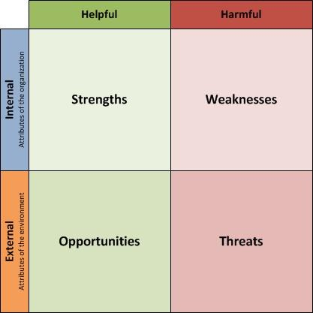
SWOT Analysis

Slide 17
Strengths | Weaknesses | Opportunities | Threats
Good quality clothing | Poor sales | New products | Declining economy
Loyalty program | Small range for targeted market so we miss out on sales outside of targeted range | Paid promotions on popular social media accounts | Large amounts of competitors in the industry
Premium price range to offset competitors | By selling only clothes the company misses out on sales from accessories | New incentive programs | Supplier cost fluctuation
Obtain products at wholesale prices to stock inventory | Too much inventory can require a copious amount of space | Partnerships with non-competing businesses in the industry | Strictly online retailers can effect brick & motor locations

Slide 18
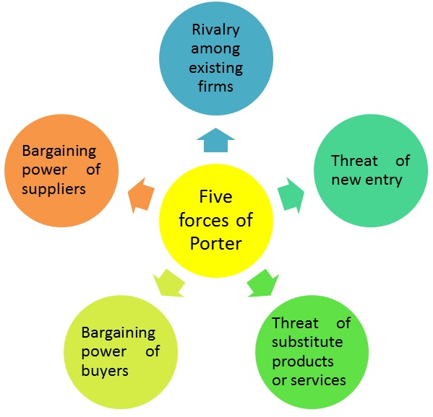
Porter's Five Forces

Slide 19
Porter's Five Forces
Rivalry Amongst Existing companies : High
There ae a lot of clothing retail companies in the industry
Mergers between larger companies can effects smaller new businesses in the industry
Threat of New Entry : Medium
Requires large amounts of capital to enter industry via brick and mortar
Low barrier to enter the industry via the internet
Threat of Substitutes : Medium
Our clothing products would be unique which will differentiate our products form that of our competitors
High Quality items that appeal to our target market

Slide 20
Bargaining Power of Buyers : Low​ - Medium
Consumers like to have fairly priced items​
Bargaining Power of Sellers : low
Will employ manufacturers outside of the U.S

Slide 21
Efficiency and Innovation Initiatives
An innovative approach to in-store interior design, culture curation (regarding associates working at the interacting with the customers at our stores) and customer-centered purchase / point-of-sale process to generate positive emotional responses in customers
A creative and innovative web design and integrated underlying IT solutions architecture that
Seamlessly integrates our latest product portfolio with the website, enabling the customer access to the latest designs and concepts that the company provides
Creates a significantly positive and differentiating user experience for the customer, with ease-of-use and intuitive user interfaces

Slide 22
Optimized product design by providing significant support to the design process / team in their efforts to discover innovative designs and concepts, as well as guide inventory and product purchasing decision making
A significant factor in our strategy is the ability to manage operational costs (of business processes, sales and after-sales processes) at the optimum level.
This will require an innovative perspective in business processes and information system design
Careful and value-targeted process monitoring to be established to ensure critical processes are performing at desired levels of efficiency
Innovative information systems to be implemented that allow efficient and real-time information exchanges between different departments of the company.

Slide 23
Value Creation for Customers
Our primary focus areas are as follows:
Increasing customer surplus, perceived value of items at point-of-sale
In-store design / process optimization to ensure that the customers perceive the store to cater to mid to high-level customers and stock quality products
A comprehensive advertising and marketing strategy, with a focus on platforms that are more effective for the desired customer segment (such as fashion blogs, social media and other digital platforms) to increase brand awareness and improve value associated with our brand. Efforts in this area should translate to achieving the ability to mark up prices and apply premium (or sub-premium) pricing models for the latest designs and products

Slide 24
Decrease business process overheads and purchase costs to optimize cash flows and keep costs under control
Investment in the creative process to enable the customer access to the latest and most innovative designs, ideas and products that are specifically curated for the targeted customer segment. Efforts in this area must be supported by the marketing strategy to ensure awareness of efforts taken in this area
Business process innovation to increase the quality of our products, as well as reduce the overhead costs of each unit on an average.
While this is not the primary focus of our business strategy, it is none the less of significant importance, to ensure that we as a business can reduce average costs to mitigate the risk of being undercut by rival companies (especially in the same market segment).
Reduce / control procurement costs to reduce purchase and shipping of products (inventory / stock) by utilizing and improving contracts and logistics

Slide 25
Value Creation – An Overview
Value
Price
Cost
} | This includes the perceived value of the product both in terms of quality / design, as well as in social terms (brand awareness through marketing efforts). Our focus is to increase value in these areas (to premium / sub-premium levels) to provide us mark-up capabilities
} | This needs to be flexible, with a minimum margin in place, and will increase for product categories that are heavily differentiated in quality, or temporarily decrease when coupons / sales are in effect
} | As mentioned before, while this is not our primary area of focus, measures will be taken to ensure costs per unit are under control, and desired and optimal thresholds will be defined
Targeted average distribution to be: 40% (Value) - 20% (Price) - 40% (Cost)

Slide 26
Thank You!

