Slide 1

Chapter 5
Sales and Collection Business Process

Slide 2
Agenda
Welcome and Introduction
Sales and Collection Business Process
Midterm Exam
Week 5 Homework
Questions

Slide 3
Learning Objectives
Describe the business activities that comprise the sales and collection process
Develop an activity model of the sales and collection process
Understand and apply different activity modeling options
Develop business rules to implement controls for the sales and collection process
Develop UML Class Diagrams for the sales and collection process
Implement a relational database from the UML Class Diagram of the sales and collection process
Use multiplicities to implement foreign keys in relational tables

Slide 4
Credit Sales System Flowchart
1 1-4

Slide 5
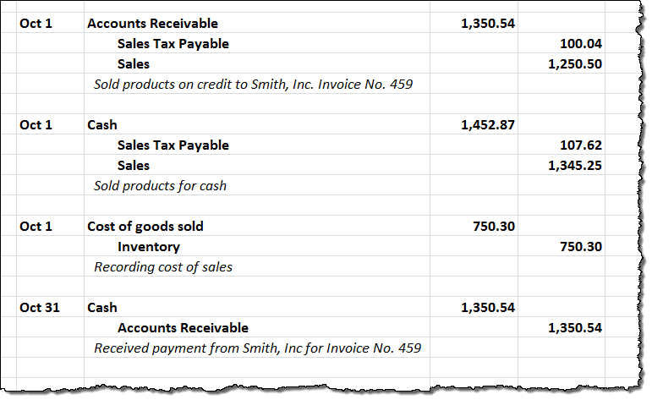
Review of Sales and Collections Accounting
LO# 1

Slide 6

Sunset Graphics

Slide 7

Sunset Graphics Continuing Example
LO# 2
Sunset graphics design and sell
  signs and banners,
  lettering and vinyl graphics for vehicles and boats,
  corporate promotional items, and
  silk-screened t-shirts and embroidered gear, among other products.

Slide 8
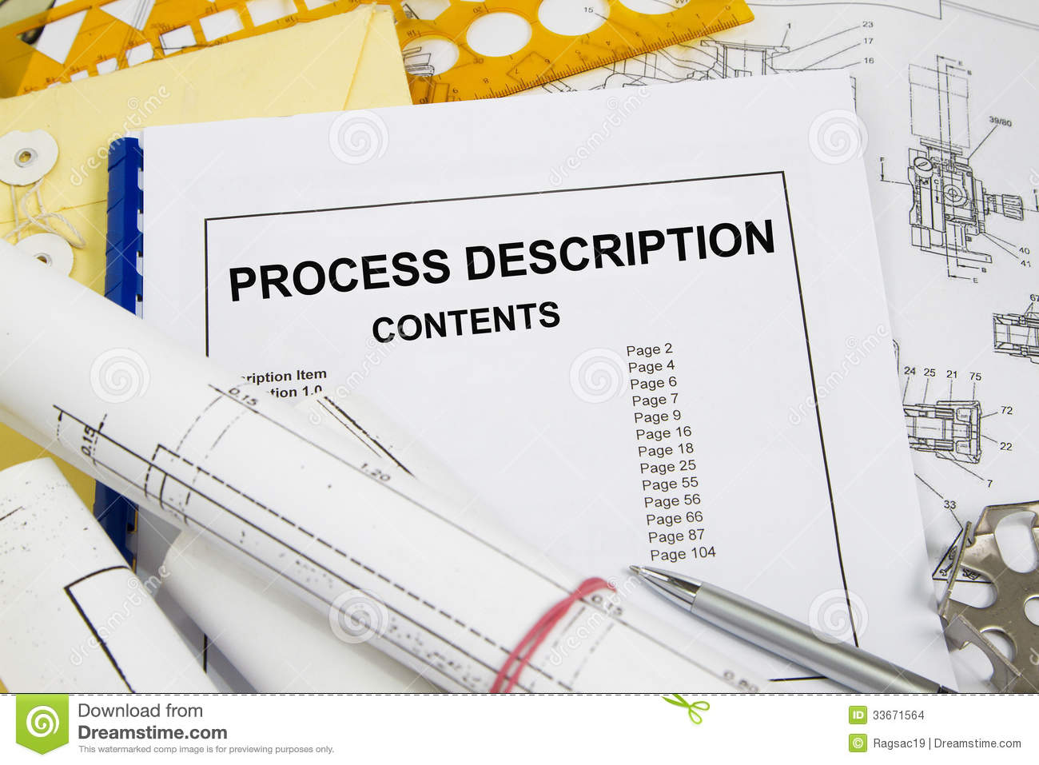
Sunset Graphics Sales Process Description
LO# 2
Sunset prepares a quote that carefully describes the products and services to be provided to the customer
Customer places the order for all or part of the quoted products and services
Sunset orders any products not in inventory from their suppliers (outside the sales process)
Sunset applies graphics
Sunset delivers the products to the customer
Sunset bills the customer and collects payment

Slide 9
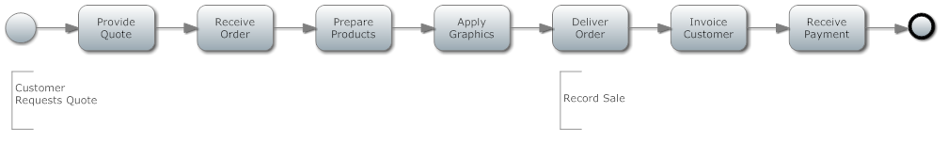
Basic BPMN activity model
LO# 2

Slide 10
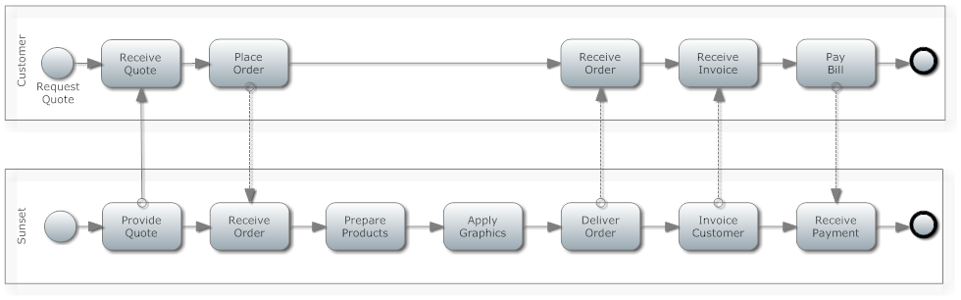
BPMN Model Refinement
LO# 3
Collaboration Sales Activity Model

Slide 11
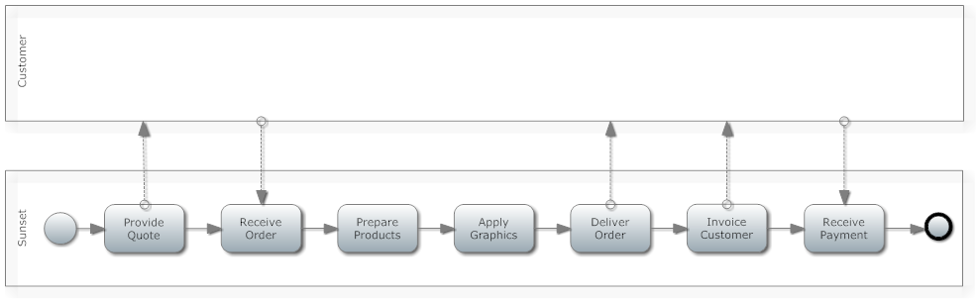
Further BPMN Model Refinement
LO# 3
Collaboration Sales Activity Model emphasizing the CHOREOGRAPHY – message flows between pools, since Sunset is not interested in the Customers activities. To clarify the diagram, the message flows should be labeled, e.g., “quote information” for the first message flow.

Slide 12
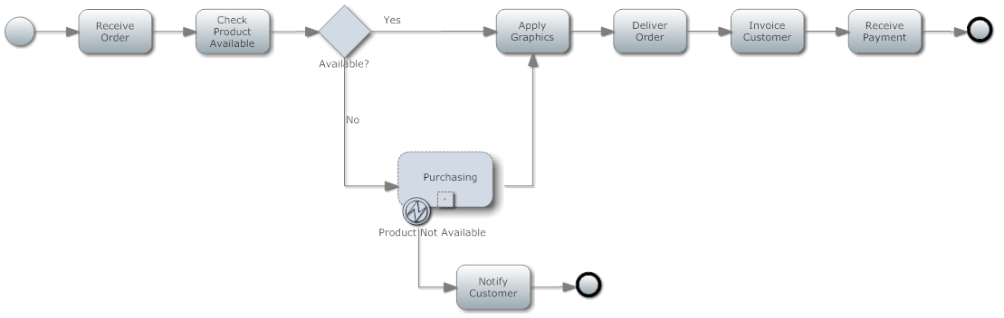
More BPMN Model Refinement
LO# 3
Considering EXCEPTIONS to the process. Shows the process flow when the supplier does not have the products necessary to fulfill the customer’s order. Sub-process represents the PURCHASING activities without the detail; the INTERMEDIATE ERROR EVENT shows exception flow.

Slide 13
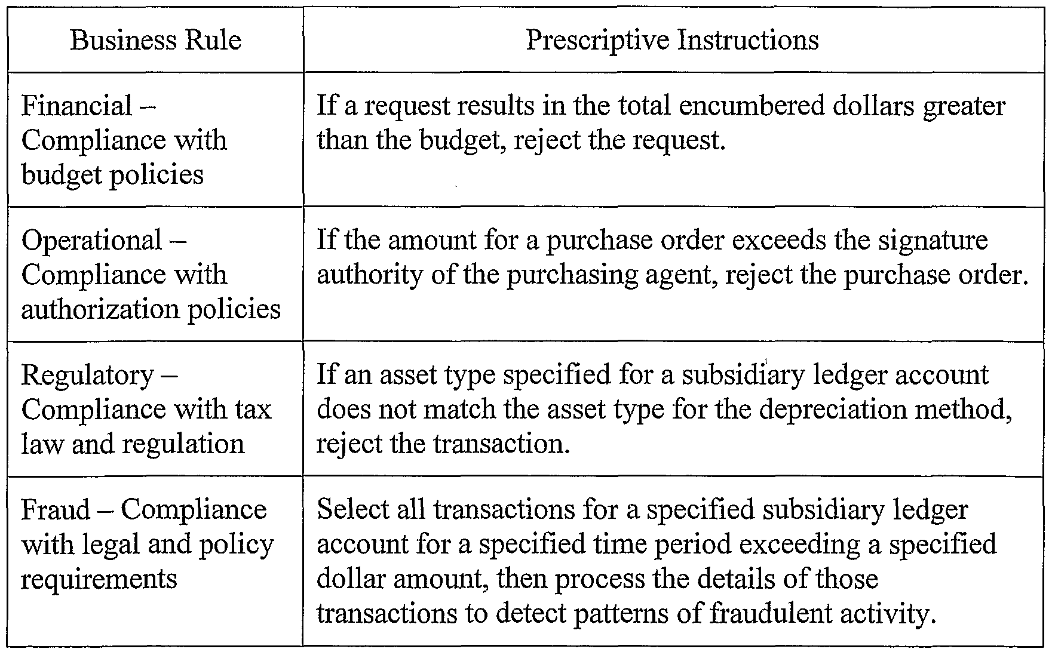
Business Rules
LO# 4
Business rules help ensure that information systems operate in a consistent and effective manner to achieve organizational objectives.
Business rules are constraints on the process.
Business rules implement control activities, such as
  Approvals, authorizations, verifications, and reconciliations
  Reviews of operating performance
  Security of assets and segregation of duties

Slide 14
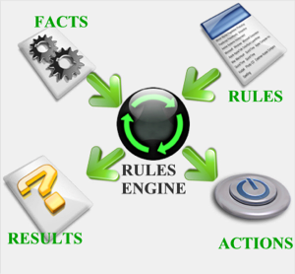
Establishing Business Rules for Sunset’s Sales
LO# 4
Define objectives for each important business event
Use the BPMN activity diagram to identify important business events
Define constraints on each event
  What people/employees can do.
  What information is available and not available
  What the information system should do

Slide 15
Sample Business Rules
Process Steps | Intention | Partner Authority/Action | Access Controls | Application Controls
Provide Quote | Provide quotes promptly and accurately | Partner must provide quote within 1 business day of request; Manager must approve quotes > $5,000 | Partners preparing quotes cannot modify established product and service prices | System must provide quote number control, default values, range and limit checks, and create audit trail
Receive Order | Record order promptly and accurately; ensure customer credit is authorized | Partner must record order within one hour of receipt; Manager must approve orders > $5,000; Credit manager must approve credit order > $1,000 | Partners accepting orders cannot modify established product and service prices; Partners accepting orders cannot approve request for customer credit > $1,000. | System must provide order number control, default values, range and limit checks, and create audit trail; system links quote to order

Slide 16
Sunset Graphics Structure Models
LO# 5
The primary purpose of an UML model of the sales and collection process is to create a blueprint for the development of a relational database to support the collection, aggregation, and communication of process information.
To develop UML class diagrams, the REA framework (resources, events, and agents) is a proven approach to describing business processes in a way that meets both accounting and broad management information requirements.

Slide 17
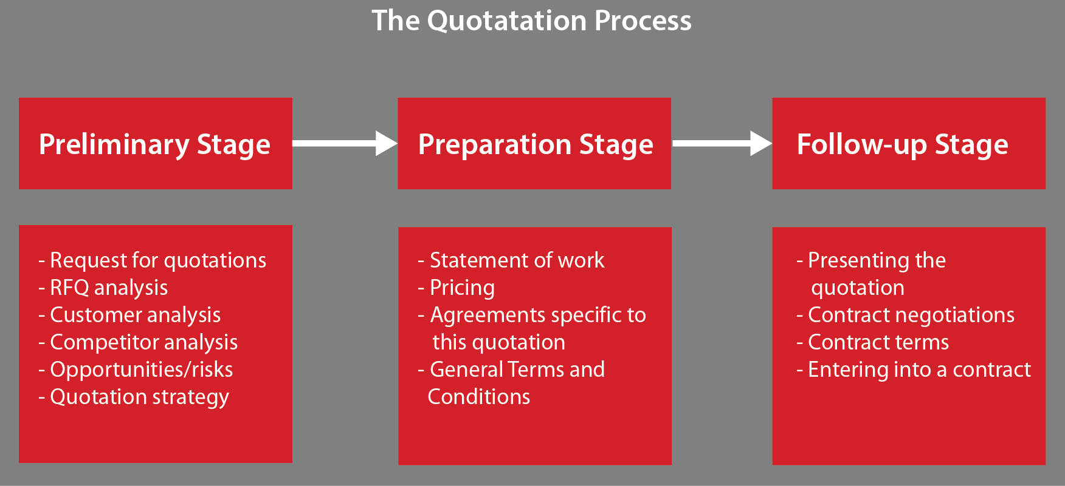
The quotation process

Slide 18
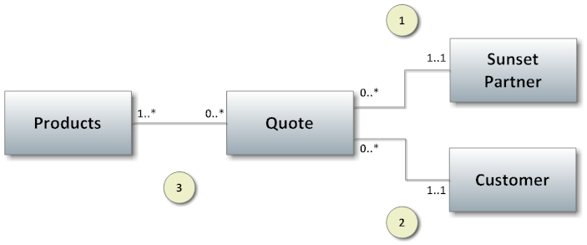
Sunset’s Quotes - Defining Business Relationships
LO# 5
Each Sunset Partner may participate in a minimum of zero Quotes and a maximum of many Quotes, but each Quote involves only one Sunset Partner
Each Customer may participate in zero to many Quotes and each Quote is prepared for only one Customer
Each Quote specifies prices and quantities for at least one product

Slide 19
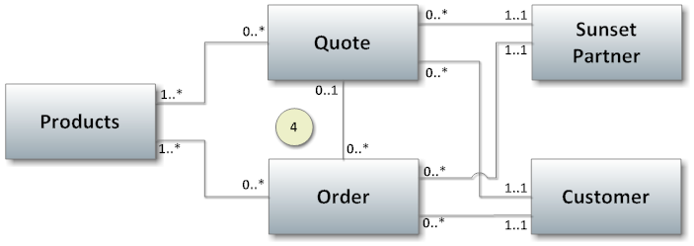
Adding the Order Event
LO# 5
4. Each quote can result in a minimum of 0 orders and a maximum of many orders. Each order may related to 0 or 1 quote (some orders don’t have quotes).

Slide 20
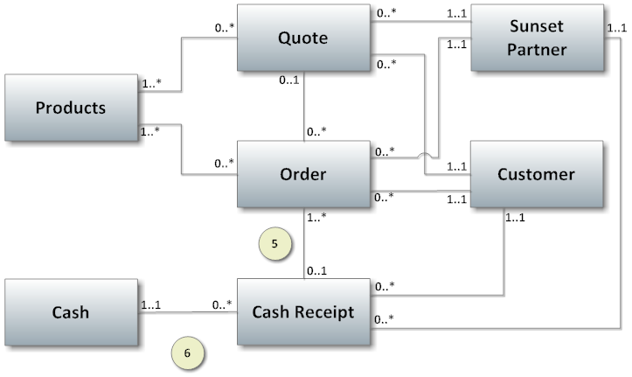
Adding Cash Receipts
LO# 5
Each order can be either paid or unpaid.
Each cash receipt is deposited into one bank account
Notes:
Ask students when Sunset might model sales separately. In this case, each order results in one sale and each sale is ordered first, so the orders and sales can be modeled as one event.

Slide 21
Type Images for Categorical Information
LO# 5
Type images apply guidelines, constraints, and descriptive information to their resources, events, and agents to help manage the business process
Type images also support summarization of the economic activity to support management’s information requirements
For Sunset Graphics, type images allow
  Product categorization
  Order status summary
  Assignment of partners to manage product categories

Slide 22
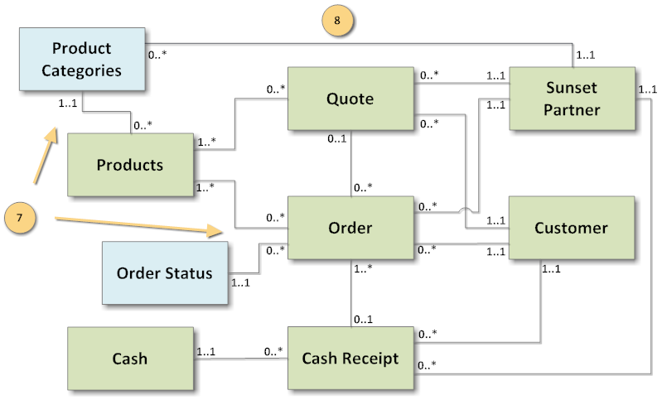
Adding Type Images to the Model
LO# 5
Orders (and Sales) can be summarized by product category.
Sunset partners can be assigned to manage on or more product categories.

Slide 23
UML Class Models Support DB Planning
LO# 6
The database will contain one table for each class plus one table to support each many-to-many relationships
Multiplicities indicate location of foreign keys
Multiplicities indicate linking tables

Slide 24
LO# 6
Associations that will be implemented with Linking Tables
This model would result in a database with 9 tables for classes and 2 linking tables.

Slide 25
Posting Foreign Keys Example
LO# 7
Customer Number is posted in the Quote table as a foreign key.
Customer Number is posted in the Order table as a foreign key.
Quote Number is posted in the Order table as a foreign key.
Notes:
Rule of thumb – post the foreign key toward the MANY side of the one-to-many relationships (look at maximum multiplicities only).

Slide 26
Rule of Thumb
LO# 7
POST TOWARD THE * and AWAY FROM THE 1
The primary key of Customer should be a foreign key in the Sale Table!

Slide 27
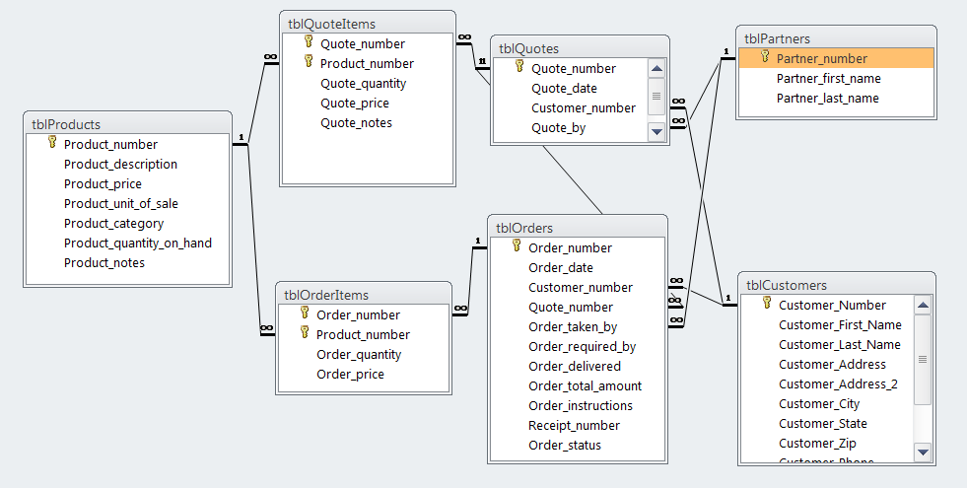
Resulting DB Tables and Relationships
LO# 6

Slide 28
LO# 6
Associations that will be implemented with Linking Tables
This model would result in a database with 9 tables for classes and 2 linking tables.

Slide 29
Generic Sales and Cash Receipts Model
LO# 5
Each customer participates in a minimum of zero and a maximum of many sales.
Each sale involves a minimum of one and a maximum of many inventory items.
Each cash receipt (e.g., one check from a customer) is deposited into one and only one account, and each account is associated with a minimum of zero cash receipts and a maximum of many cash receipts. These multiplicities reflect typical business practices.
These multiplicities depend on the nature of the business. Some businesses require payment at the time of the sale. Some allow payment terms. Some provide revolving accounts for their customers. Some collect payments in advance of the sale (e.g., magazine subscriptions). So, there are no typical multiplicities for this association.

Slide 30



homework

Slide 31


Week 5 Assignment 1
Please complete the homework in McGraw-Hill connect for Week 5.
Due Date: Sunday June 11th at midnight your local time.

Slide 32
Week 5 Assignment 2
Complete discussion questions from your textbook, page 145, 1, 2, 3, 7, and 8.
Due Date: Sunday June 11th at midnight your local time. Upload to the assignment dropbox.
The sales and collection process generates revenue accounts receivable, and cash flow information for a firm’s financial statements. What other information do you think managers would like to collect?
How to approach: Think of the other information that is generated and used when there is a sale. How would an organization use that information and what information would help manage the business?

Slide 33
Week 5 Assignment 2
2. What kinds of businesses collect cash before recording the corresponding sales? How would that different sequence affect internal control requirements.
Think of businesses that collect cash before delivery of goods and services.
For internal controls, does cash collection represent the recognition of revenue? What is the implication of that on internal controls in the sales to cash transaction cycle?
3. Draw a basic sales activity model using BPMN for a fast-food restaurant. Draw a second basic sales activity model using BPMN for a traditional restaurant. Discuss similarities and differences. How would you add taking reservations to the second model?
How to approach: List the steps for each activity model – fast-food restaurant and traditional restaurant. The convert that to a BPMN for each one. Make sure that you use the correct notation symbols.

Slide 34
Week 5 Assignment 2
7. From your experience, think about the sales process for an online or brick-and-mortar store. Describe some business rules that help provide internal controls over the process.
List business rules that online or brick-and-mortar stores use to provide controls over the process and explain how they do that.

Slide 35
Week 5 Assignment 2
8. What classes and associations would be included in a model that describes the information needed for a query that calculates the accounts receivable balance for each customer? Describe differences in the information for the open-invoice method, where customers pay according to specific invoices, versus the balance-forward method, where customers pay balances on monthly statements?
Create a UML class diagram for the classes and associations that are involved in the accounts receivable process. Then, explain how the queries would work:
Calculates the accounts receivable balance for each customer.
What are the differences between the open-invoice method and the balance forward method?

Slide 36

QUESTIONS

