Slide 1
Film Techniques
Intro to Film – ART 2010

Slide 2
What’s your favorite scene?
What movie and why?

Slide 3
Mise En Scene
Refers to the staging of a scene (theater), in relation to setting, arrangement of the actors, the lighting, etc. In film, it describes the arrangement of elements within the frame of a single shot

Slide 4
Death of a Salesman set

Slide 5
Entering the Emerald City

Slide 6
Composition
The arrangement of all the elements within the screen image to achieve a balance of light, mass, shadow, color, and movement.
Crop Duster scene (North by Northwest)
https://www.youtube.com/watch?v=g458w2X9uHc

Slide 8
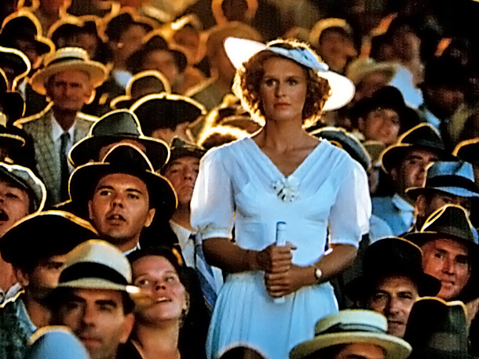
Back Lighting
Lighting which comes from directly behind the subject, placing it in silhouette

Slide 9
Camera Angles
Position of camera in relation to the subject determines the camera angle
Low Angle: camera looking up at subject
Tarentino trunk scenes
https://www.youtube.com/watch?v=V_whQnqwEYk
High Angle: camera looking down at subject

Slide 10
Camera Angles
Crop Duster Scene (Hitchcock)
http://www.ritholtz.com/blog/2011/05/north-by-northwest-crop-duster/
The draft shows where Hitchcock wants the audience and character to look.

Slide 11
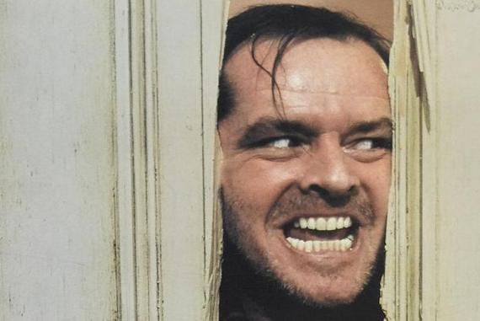
Close-Up
A shot in which a face or object fills the frame

Slide 12
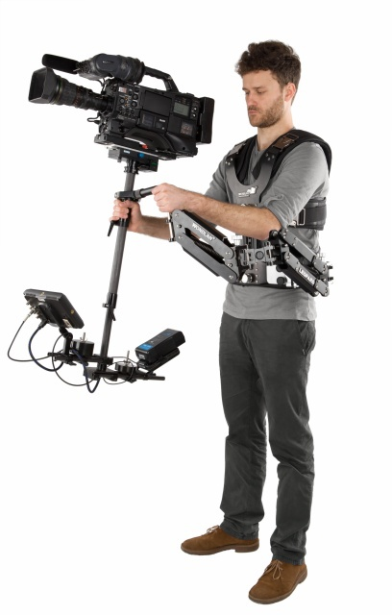
Dolly Shot
steadycam
A shot taken while the camera is in motion
https://www.youtube.com/watch?v=eMhDQFLwrAA
(Rocky II)
Steadicam
http://www.youtube.com/watch?v=3Sr-vxVaY_M (Goodfellas)

Slide 13
Crane Shot
A moving shot taken on a specially constructed crane, usually from a high perspective
Touch of Evil

Slide 14
Other camera movements
Pan: horizontal camera movement
https://www.youtube.com/watch?v=4lQ_MjU4QHw
Zoom
https://www.youtube.com/watch?v=sgpnJpgX-Hw

Slide 15
Filmmaking: Composition and Framing Tutorial
https://www.youtube.com/watch?v=K6N2SpA2XPI

Slide 16
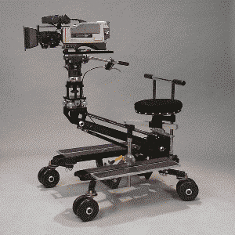
Singin’ in the Rain
http://www.youtube.com/watch?v=D1ZYhVpdXbQ
(Dolly)

Slide 17
Motion
Accelerated (Fast) Motion: taking place at higher speed than it did in reality
Superman (1978) train scene
https://www.youtube.com/watch?v=lSlTtr5NVUg
Decelerated Motion: taking place at slower speed than it did in reality
Chariots of Fire https://www.youtube.com/watch?v=CSav51fVlKU

Slide 18
Continuity
Continuity Editing: A style of editing that maintains a continuous and seemingly uninterrupted flow of action
https://www.youtube.com/watch?v=6M8szlSa-8o

Slide 19
Flashback
A shot or sequence that takes the action of the story into the past
Harry Potter & The Deathly Hollows Part 2
https://www.youtube.com/watch?v=LHolRZeQNG4

Slide 20
Cross-Cutting
Jumping back and forth between two or more locations, inviting us to find a relationship between two or more events
The Godfather Baptism Scene
https://www.youtube.com/watch?v=1CDlBLvc3YE

Slide 21
Montage
Montage: a rapid succession of shots assembled, usually by means of super-impositions and/or dissolves, to convey a visual effect, such as the passing of time
Creed Montage
https://www.youtube.com/watch?v=G-j8W2ffr2k

Slide 22
Cinema Verite
A way of filming real-life scenes without elaborate equipment, playing down the technical means of production (script, special lighting, etc.) and emphasizing the “reality” of the screen world
Hoop Dreams
http://www.youtube.com/watch?v=lWUYDZzwybc

Slide 23
Sound
Non-diegetic: sound whose source is neither visible on the screen nor has been implied to be present in the action
Score
The Natural https://www.youtube.com/watch?v=i94ldGNNSQ0

Slide 24
Sound - Diagetic
sound whose source is visible on the screen or whose source is implied to be present by the action of the film:
voices of characters
sounds made by objects in the story
music represented as coming from
instruments in the story space
(filmsound.org)

Slide 25
Soundtrack Songs
The Great Gatsby
https://www.youtube.com/watch?v=o8wtDY6TZgc

Slide 26
Sound (cont)
Voice-over
Shawshank Redemption
http://www.youtube.com/watch?v=cMuam1MObtI

Slide 27
Throw the ball, Joey
http://www.youtube.com/watch?v=Adh_8pva10k

