Slide 1
Chapter 12
Implementing strategy through organization

Slide 2
Learning objectives
Explain the concept of organization architecture.
Articulate how strategy is implemented through the right combination of organizational structure, controls, incentives, process, culture, and people.
Discuss how effective organizational design enables a company to implement its business level strategy.
Discuss how effective organization design enables a company to implement its corporate level strategy.

Slide 3
ORGANIZATION ARCHITECTURE
The totality of a firm’s organizational arrangements including its formal organizational structure, control systems, incentive systems, organizational culture, organization processes, and human capital.
Organizational structure: The combination of the location of decision-making responsibilities, the formal division of the organization into subunits, and the establishment of integrating mechanisms to coordinate the activities of the subunits.

Slide 4
Organizational ARCHITECTURE
Controls: The metrics used to measure the performance of subunits and make judgments about how well managers are running them.
Incentives: The devices used to encourage desired employee behavior.
Organization processes: The manner in which decisions are made and work is performed within the organization.

Slide 5
Organizational ARCHITECTURE
Organization culture: The norms and value systems that are shared among the employees of an organization.
People: The employees of an organization, as well as the strategy used to recruit, compensate, motivate and retain those individuals and the type of people that they are in terms of their skills, values, and orientation.

Slide 6
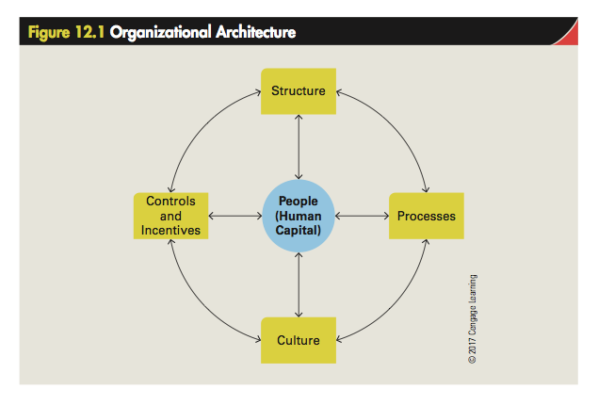

Slide 7
Organizational Structure
Organizational structure can be thought of in terms of three dimensions:
  Vertical differentiation: The location of decision making responsibilities within a structure, referring to centralization or decentralization, and number of layers in a hierarchy, referring to whether to organizational structure is tall or flat.
  Horizontal differentiation: The formal division of the organization into subunits.
  Integrating mechanisms: Processes and procedures used for coordination subunits.

Slide 8
Centralization and Decentralization
A firm’s vertical differentiation determines where in its hierarchy the ­decision-making power is concentrated.
  Centralization: Structure in which the decision making authority is concentrated at a high level in the management hierarchy
  Decentralization: Structure in which the decision making authority is distributed to lower level managers or other employees
    Autonomous sub-unit: A sub-unit that has all the resources and decision-making power required to run the operation on a day-to-day basis

Slide 9
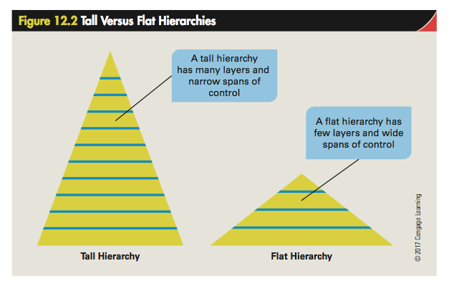

Slide 10
Tall Organizations
Limitations
  Communication problems
    Long time taken in decision-making and adherence
    Distortion of commands and orders
  Increases expenses
Solution
Delayering: The process of reducing the number of levels in a management hierarchy

Slide 11
Integrating Mechanisms
Ways to increase communication and coordination among functions and divisions:
  Direct contact
  Liaison roles
  Teams: Formation of a group that represents each division or department:
    Facing a common problem
    With a goal of finding a solution to the problem

Slide 12
Structural Forms
Functional structure: The organizational structure is built upon the division of labor within the firm with different functions focusing on different tasks
    Thus, there might be a production function, and R&D function, a marketing function, a sales function, and so on.
    A top manager, such as the CEO, or a small top management team, oversees these functions. Most single businesses of any scale are organized along functional lines.

Slide 13
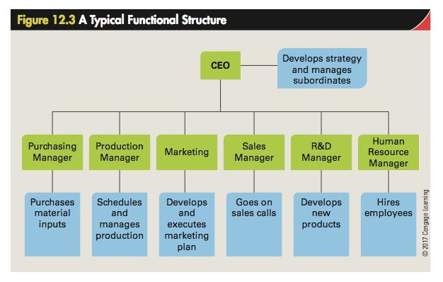

Slide 14
multidivisional structure
Multidivisional structure: An organizational structure in which a firm is divided into divisions, each of which is responsible for a distinct business area.
  Allows a company to grow and diversify while reducing coordination and control problems
  Uses self-contained divisions and has a separate corporate headquarters staff

Slide 15
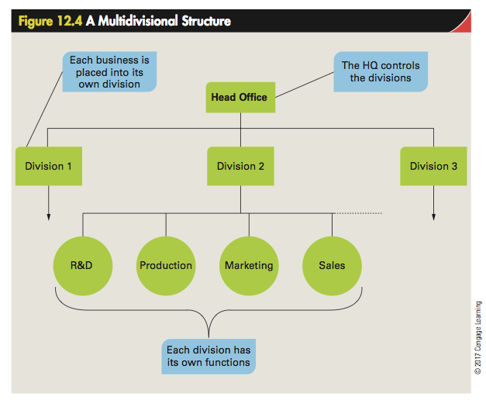

Slide 16
Matrix Structure
Matrix structure: An organizational structure in which managers try to achieve tight coordination between functions, particularly R&D, production, and marketing
  High technology firms based in rapidly changing environments will sometimes adopt a matrix structure.

Slide 17
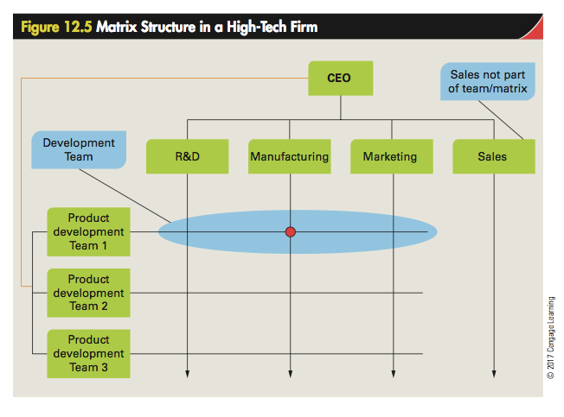

Slide 18
Strategic Control Systems
Mechanism that allows managers to monitor and evaluate:
  whether their business model is working as intended.
  how their business model could be improved.
Basic structure of competitive advantage:
  Control and efficiency
  Control and quality
  Control and innovation
  Control and responsiveness to customers

Slide 19
Formal Integrating Mechanisms
There is often a need to coordinate the activities of different functions and divisions within an organization to achieve strategic objectives.
The formal integrating mechanisms used to coordinate subunits vary in complexity from simple direct contact and liaison roles, to teams, to a matrix structure.
In general, the greater the need for coordination between sub-units (functions or divisions), the more complex the formal integrating mechanisms need to be.

Slide 20
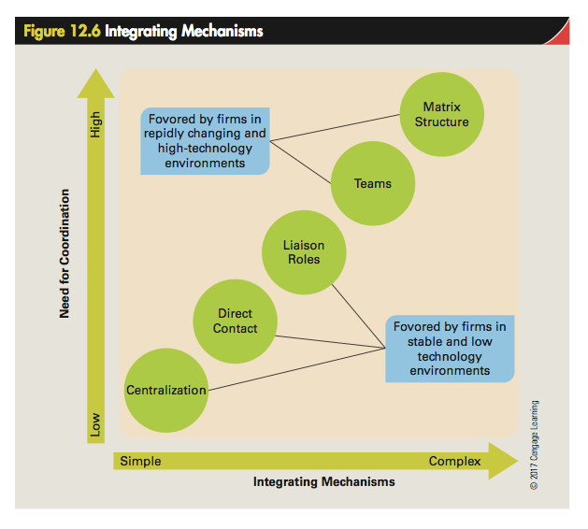

Slide 21
Informal Integrating Mechanisms
Knowledge networks that are supported by an organization culture that values teamwork and cross-unit cooperation
  Knowledge network: A network for transmitting information within an organization that is based not on formal organization structure, but on informal contacts between managers within an enterprise and on distributed information systems.

Slide 22
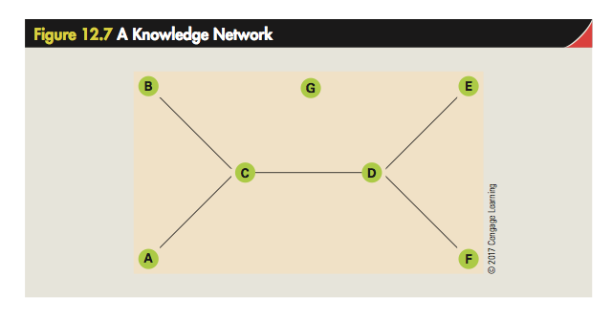

Slide 23
ORGANIZATION CONTROLS AND INCENTIVES
Control: The process through which managers regulate the activities of individuals and units so that they are consistent with the goals and standards of the organization
  Goal: A desired future state that an organization attempts to realize
  Standard: A performance requirement that the organization is meant to attain on an ongoing basis

Slide 24
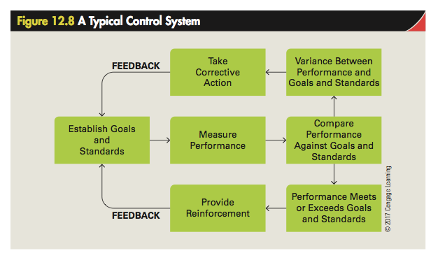

Slide 25
Methods of Control
Personal control: Control by personal contact with and direct supervision of subordinates
Bureaucratic control: Control through a formal system of written rules and procedures
Output control: Goals that are set for units or individuals to achieve and monitoring performance against those goals
Market control: The regulation of the behavior of individuals and units within an enterprise by setting up an internal market for some valuable resource(s), such as capital

Slide 26
Incentive Control
Incentives: The devices used to encourage and reward appropriate employee behavior
When incentives are tied to team performance, as is often the case, they have the added benefit of encouraging cooperation between team members and fostering a degree of peer control.
  Peer control: The pressure that employees exert on others within their team or work group to perform up to or in excess of the expectations of the organization

Slide 27
Organizational Culture
Specific collection of values and norms shared by people and groups in an organization
  Values: The ideas or shared assumptions about what a group believes to be good, right and desirable
  Norms: Social rules and guidelines that prescribe the appropriate behavior in particular situations
Culture can exert a profound influence on the way people behave within an organization, on the decisions that are made, on the things that the organization pays attention to, and ultimately, on the strategy and performance of the firm.

Slide 28
IMPLEMENTING STRATEGY THROUGH ORGANIZATION ARCHITECTURE
Strategy and Organization in the Single Business Enterprise
  The business level strategy of the firm
  The nature of the environment in which the firm competes

Slide 29
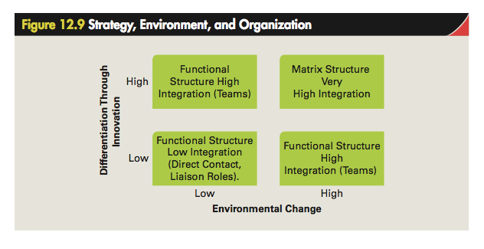

Slide 30
Strategy, Environment and the Need for Integration
The need for integration between functions is greater for firms that are competing through product development and innovation.
In such organizations there is an ongoing need to coordinate the R&D, production and marketing functions of the firm to ensure that:
  new products are developed in a timely manner.
  that they can be efficiently produced and delivered.
  that they match consumer demands.

Slide 31
Integration and Control Systems:
Low Integration
  Bureaucratic controls in the form of budgets are used to allocate financial resources to each function, and to control spending by the functions. Output controls will then be used to assess how well a function is performing.
High Integration
  Bureaucratic controls will again be used for financial budgets and, as before, output controls will be applied to the different functions. Output controls will also be applied to cross-functional product development teams.

