Slide 1
Chapter 11
Corporate Performance, Governance, and Business Ethics

Slide 2
Learning Objectives
Understand the relationship between stakeholder management and corporate performance.
Explain why maximizing returns to stockholders is often viewed as the preeminent goal in many corporations.
Describe the various governance mechanisms that are used to align the interests of stockholders and managers.

Slide 3
Learning Objectives
Explain why these governance mechanisms do not always work as intended.
Identify the main ethical issues that arise in business and the causes of unethical behavior.
Identify what managers can do to improve the ethical climate of their organization, and to make sure that business decisions do not violate good ethical principles.

Slide 4
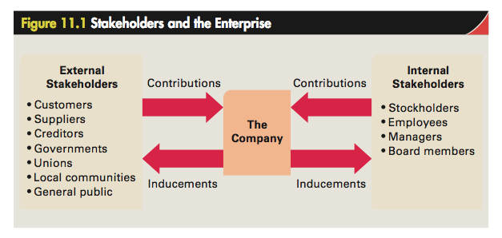
Stakeholders

Slide 5
Stakeholders and Corporate
Performance
Stakeholders: Individuals or groups with an interest, claim, or stake in the company
  Internal stakeholders: Stockholders and employees, including executive officers, other managers, and board members
  External stakeholders: All other individuals and groups that have some claim on the company

Slide 6
Steps in Stakeholder Impact Analysis
Identify stakeholders along with their interests and concerns
Identify the probable claims of stakeholders on the organization
Identify important stakeholders from the organization’s perspective
Identify the resulting strategic challenges

Slide 7
Profitability, Profit Growth, and Stakeholder Claims
Stockholders receive a return on investment from dividend payments and capital appreciation in the market value of a share
Ways to grow profits:
  Participating in a market that is growing
  Taking market share from competitors
  Consolidating the industry through horizontal integration
  Development of new markets through international expansion, vertical integration, or diversification

Slide 8
Agency Theory
Deals with business relationship problems when decision-making authority is delegated from one person to another
Relationship between stockholders and senior managers:
  Stockholder - Principal
  Senior managers - Agent

Slide 9
Agency problem
Information asymmetry: Agent has more information about the resources being managed than the principal
Laws for monitoring agents:
  Codetermination law (Mitbestimmungsgesetz in German law)
  Securities and Exchange Commission (SEC)
  Generally agreed-upon accounting principles (GAAP)

Slide 10
Agency problem
On-the-job consumption: Describes the behavior of senior management’s use of company funds to acquire perks
Empire building - Buying new businesses to increase the size of the company through diversification

Slide 11
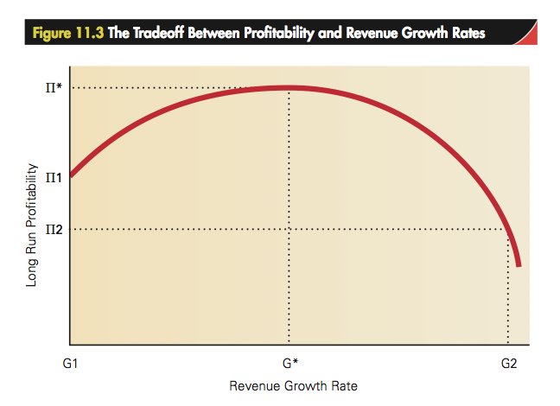

Slide 12
Challenges for principals
Shaping the agents’ behavior to act in accordance with the goals set
Reducing the information asymmetry
Developing mechanisms for removing agents who do not act in accordance with the goals

Slide 13
Governance Mechanisms
Used by principals to:
  Align incentives with the agents
  Monitor and control agents
Types:
  Board of directors
  Stock-based compensation
  Financial statements
  Takeover constraint

Slide 14
Board of Directors
Inside directors: Senior employees of the company
Outside directors: Not full-time employees of the company
  Provide objectivity to the monitoring and evaluation of processes

Slide 15
Stock-Based Compensation
Stock options: Right to purchase company stock at a predetermined price at some point in the future
  Strike price - Stock’s trading price when the option was originally granted
  Motivate managers to adopt strategies that increase the share price of the company
  Has become increasingly controversial
Aligns management and stockholder interests

Slide 16
Financial Statements and Auditors
Quarterly and annual reports of publicly traded companies are filed with the SEC:
  to give accurate information about the way the agents run the company.
SEC requires that the accounts be audited by an independent and accredited accounting firm:
  to make sure managers do not misrepresent the financial information.

Slide 17
Takeover Constraint
Risk of being acquired by another company
Corporate raiders - Purchase large blocks of shares in companies that appear to be pursuing strategies inconsistent with maximizing stockholder wealth
  Greenmail: Pushing companies to either change their strategy to benefit stockholders, or charging a premium for the stocks when the company wants to buy them back

Slide 18
Governance Mechanisms Inside a Company
Strategic control systems - Formal target-setting, measurement, and feedback systems
  Establish standards and targets against which performance can be measured
  Create systems for measuring and monitoring performance on a regular basis
  Compare actual performance against the established targets
  Evaluate results and take corrective action if necessary

Slide 19
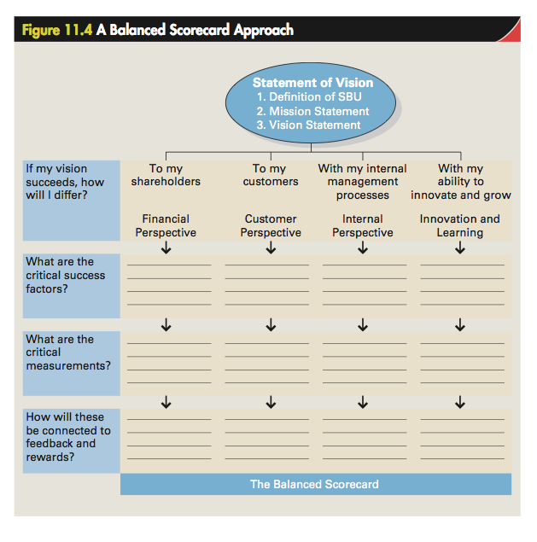

Slide 20
Governance Mechanisms Inside a Company
Employee incentives - Motivate employees to work toward goals central to maximizing long-term profitability
  ESOPs
  Stock-option grants
  Bonus pay

Slide 21
Ethics and Strategy
Ethics
  Accepted principles of right or wrong that govern the conduct of a person, the members of a profession, or the actions of an organization
Business ethics
  Accepted principles of right or wrong governing the conduct of businesspeople
Ethical dilemmas
  Situations where there is no agreement over exactly what the accepted principles of right and wrong are

Slide 22
Ethical Issues in Strategy
Due to potential conflict between:
  Goals of the enterprise
  Goals of individual managers
  Fundamental rights of important stakeholders
Noblesse oblige - Responsibility of people of high birth to give something back to the society that made their success possible

Slide 23
Rights of stakeholders
Stakeholders | Rights
Stockholders | Timely and accurate information about their investments
Customers | Be fully informed about the products and services they purchase
Employees | Safe working conditions Fair compensation for the work they perform Just treatment by managers
Suppliers | Expect contracts to be respected
Competitors | Expect that the firm will abide by the rules of competition and not violate the basic principles of antitrust laws
Communities and the general public | Expect that a firm will not violate the basic expectations that society places on enterprises

Slide 24
unethical behavior arising from agency problems
Self-dealing
  Managers using company funds for personal use
Information manipulation
  Managers use their control over corporate data to distort or hide information
    To enhance their own financial situation or the competitive position of the firm
Anticompetitive behavior
  Aimed at harming actual or potential competitors to enhance the long-run prospects of the firm
Opportunistic exploitation
  Managers rewriting the terms of a contract to make it favorable to the firm

Slide 25
unethical behavior arising from agency problems
Substandard working conditions
  Managers underinvest in working conditions or pay employees below-market rates
    To reduce their production costs
Environmental degradation
  Occurs when a company’s actions directly or indirectly result in pollution or other forms of environmental harm
Corruption
  Can arise when managers pay bribes to gain access to lucrative business contracts

Slide 26
Roots of Unethical Behavior
Personal ethics: Generally accepted principles of right and wrong governing the conduct of individuals
Failing to ask oneself if a decision is ethical
Some organizational cultures de-emphasize business ethics
Pressure to meet unrealistic performance goals
Unethical leadership

Slide 27
Behaving Ethically
Favor hiring and promotion with a well-grounded sense of personal ethics
Build an organizational culture that places a high value on ethical behavior
  Code of ethics: Formal statement of the ethical priorities to which a business adheres
Ensure that leaders practice and preach ethical behavior

Slide 28
Behaving Ethically
Ensure people consider the ethical dimension of business decisions
Use ethics officers
Put strong governance processes in place
Act with moral courage

