Slide 1

Business Ethics and Social Responsibility
Chapter 2
©2022 Cengage Learning. All Rights Reserved. May not be scanned, copied or duplicated, or posted to a publicly accessible website, in whole or in part.
Notes:
Add slide notes here

Slide 2
Learning Objectives (1 of 2)
By the end of this chapter, you should be able to:
LO 1 Define ethics and give examples of ethical dilemmas.
LO 2 Explain and give examples of ethical standards and theories.
LO 3 List the categories of ethical dilemmas and give examples for each category.
LO 4 Explain the models used for resolving ethical dilemmas.
LO 5 Describe the obstacles we face when trying to make ethical decisions.
LO 6 Develop a list of arguments to convince a business of the importance of ethics.
Notes:
Add slide notes here

Slide 3
Learning Objectives (2 of 2)
LO 7 Explain how the absence of business ethics in a business can be destructive.
LO 8 Give examples of how the commitment to business ethics can help a company achieve long-term success.
LO 9 Explain the components of an ethical culture.
LO 10 Explain how a business can create an ethical culture.
LO 11 Discuss why corruption exists in international business and its resulting harms.
LO 12 Explain why simply adopting another country’s customs can be risky for a business.
Notes:
Add slide notes here

Slide 4
What Is Ethics?

Slide 5
What Is Ethics? (1 of 2)
Examples:
  Underinflated football issue in the NFL
  Turing increases drug price by 5,000%
  Uber’s billing policies
Definition: Normative Standards, Generally Accepted Rules of Conduct That Govern Society

Slide 6
What Is Ethics? (2 of 2)
What Is “Fair”?
What if Something “Just Doesn’t Seem Right” or “That’s Just Not Fair”?
  Discuss seeing two movies for the price of one
  Writing a fake review because your boss wants you to
  Telling the clerk you received too much change

Slide 7
Normative Standards (1 of 3)
Normative Standards
  How we behave, on average
  How we treat each other
  Expectations on contracts beyond legal interpretation

Slide 8
Normative Standards (2 of 3)
Applying Standards of Ethical Reasoning to Business Dilemmas
  Ethical standard is established
  Individual ethical standards differ
  Debate over sources of ethical standards
  Evaluate ethical standards and conflicts as new data appear

Slide 9
Normative Standards (3 of 3)
There Is No Statute on Cutting in Line, but We Do Honor That Normative Standard
We Refer to Adultery as “Cheating” Because the Normative Standard Is That Such Relationships Breach the Social Norm
We Refer to “Cheating” on Exams as Well

Slide 10
What Is Business Ethics?

Slide 11
Three Layers of Business Ethics
Basic Values (Honesty)
Notions of Fairness (How We Treat Others)
Issues Related to Community and the Environment

Slide 12
Ethics Standards: Positive Law
Codified Law Is Followed
However, There Can Still Be Issues with Fairness, Disclosure, Etc., Even Though There Is Compliance with the Law, as with the Verdicts in the 2008 Financial Markets Cases

Slide 13
Ethical Standards: Natural Law
Positive Law Is Not the Standard Because Some Principles Are Inviolate
Slavery Was Wrong Even though Laws Allowed It in the United States

Slide 14
Ethical Standards: Moral Relativism
Ethics Standard Is Based on the Situation You Are Dealing with
Depending on Pressures, You Make a Decision without Regard to Positive Law or Normative Law Standards

Slide 15
Ethical Standards: Religion
Tenets of Faith Are Ethical Standards
Even if the Law Allows You to Disclaim Liability for Selling Goods “As Is,” the Standards of Religion Might Require You to Do More

Slide 16
What Are the Categories of Ethical Dilemmas?

Slide 17
Ethical Dilemmas (1 of 2)
Categories of Ethical Dilemmas
  Taking things that don’t belong to you
  Saying things you know are not true
  Giving or allowing false impressions
  Buying influence or engaging in conflict of interest
  Hiding or divulging information
  Taking unfair advantage

Slide 18
Ethical Dilemmas (2 of 2)
Categories of Ethical Dilemmas
  Committing acts of personal decadence
  Perpetrating interpersonal abuse
  Permitting organizational abuse
  Violating rules
  Condoning unethical actions
  Balancing ethical dilemmas

Slide 19
Analyzing Ethical Dilemmas (Consider 2.3)
Make sure you have a grasp of all the available facts.
List any information you would like to have but don’t and what assumptions you would have to make, if any, in resolving the dilemma.
Take each person involved in the dilemma and list the concerns they face or might have on what to do about a product and its safety issue.
Develop a list of resolutions for the problem. Apply the various models for reaching this resolution.
Evaluate the resolutions for costs, legalities, and impact. Try to determine how each of the parties will react to and be affected by each of the resolutions you have proposed.
Make a recommendation for the actions that should be taken.

Slide 20
Resolution of Business Ethical Dilemmas

Slide 21
Resolution of Dilemmas (1 of 5)
Blanchard and Peale
  Is it legal?
  Is it balanced?
  How does it make me feel?
The Front-Page-of-the-Newspaper Test
  How would the story be reported?
  Use an objective and informed reporter’s view

Slide 22
Resolution of Dilemmas (2 of 5)
VA | “V.A. Officials Acknowledge Link between Delays and Patient Deaths”
Volkswagen | “Deception at Heart of VW Emissions Scandal” “Volkswagen Tries to Curb Damage, but Shares Fall”
Wells Fargo | “Warned about Excesses, Then Prodded to Sell: Bending the Rules Just to Get ‘a Paycheck’” “‘Lions Hunting Zebras’: Wells Fargo Employees Targeted People Who Would ‘Put Up the Least Resistance’”
Uber | “Uber Team Defends Actions as Judge Cites ‘Many Bad Things’ in Case” “Uber’s CEO Plays with Fire” “Kalanick Feud Threatens Uber-SoftBank Deal”
Tesla | “Tesla Is Subject of DOJ Probe” “Tesla Investors Can’t Look the Other Way”

Slide 23
Resolution of Dilemmas (3 of 5)
Laura Nash and Perspective
  How would I view the problem if I sat on the other side of the fence?
  Am I able to discuss my decision with my family, friends, and those closest to me?
  What am I trying to accomplish?
  Will I feel as comfortable over the long term as I do today?

Slide 24
Resolution of Dilemmas (4 of 5)
Wall Street Journal Model
  Compliance: Are you violating any laws?
  Contribution: What does this action contribute to my customers, shareholders, bondholders, employees, community, and suppliers?
  Consequences: How will this action affect me, my company, my family, our employees, and our shareholders?

Slide 25
Resolution of Dilemmas (5 of 5)
Other Models
  Immanuel Kant’s Categorical Imperative
  The Golden Rule

Slide 26
Why We Fail to Reach Good Decisions in Ethical Dilemmas

Slide 27
Why We Fail to Reach Good Ethical Decisions (1 of 2)
Rationalizations
  “Everybody else does it.”
  “If we don’t do it, someone else will.”
  “That’s the way it has always been done.”
  “We’ll wait until the lawyers tell us it’s wrong.”

Slide 28
Why We Fail to Reach Good Ethical Decisions (2 of 2)
Rationalizations
  “It doesn’t really hurt anyone.”
  “The system is unfair.”
  “I was just following orders.”
  “You think this is bad, you should have seen. . .”
  “It’s a gray area.”

Slide 29
Social Responsibility: Another Layer of Business Ethics

Slide 30
Social Responsibility (1 of 3)
Whom Should Shareholders Serve?
Policy Question: Best Way to Serve Interest Is if the Corporation Is Responsive to:
Moral Question: Whose Interest Should the Corporation Serve?
Inherence
Enlightened self-interest
Invisible hand
Social responsibility
Shareholders only
Shareholders only
Larger society
Larger society
Shareholders only
Larger society
Shareholders only
Larger society

Slide 31
Social Responsibility (2 of 3)
Inherence
  Serve shareholders
  Friedman view
Enlightened Self-Interest
  Manager is responsible first to shareholders but serves them best by being responsible to larger society
  Business value is enhanced if it is responsive to society needs

Slide 32
Social Responsibility (3 of 3)
Invisible Hand
  Best for society to guide itself
Social Responsibility School
  Manager should serve larger society
  Become involved in all types of political and social issues
  Encourage managers to be involved

Slide 33
Why Business Ethics?

Slide 34
Why Business Ethics?
Personal Accountability and Comfort: Business Ethics for Personal Reasons
Standard of Personal Behavior Applied to a Group of People Working Together to Make a Profit

Slide 35
Importance of Ethics in Business Success and the Costs of Unethical Conduct

Slide 36
Importance of Ethics (1 of 6)
Ethics Resource Center Study
  Firms with written codes of ethics did substantially better as an investment than the general Dow Jones Composite over a 30-year period
  Executives feel ethical behavior strengthens a firm’s competitive edge
  Johnson & Johnson recall of Tylenol earned it high respect and higher earnings in spite of cost as well as a type of immunity to scrutiny for decades

Slide 37
Importance of Ethics (2 of 6)
Costs of Unethical Behavior
  BP and the refinery explosion and pipeline rupture and Deepwater Horizon
  Nestlé and the infant formula
  Tylenol and its recall of $100 million in inventory
  GM, the Malibu design, and the litigation
  GM and the engine switch case

Slide 38
Importance of Ethics (3 of 6)
“The Tony Bennett Factor”
  The keys to long-term survival

Slide 39
Importance of Ethics (4 of 6)
Ethics as a Strategy
Impact on Reputation of Ethical Missteps
Reputation’s Impact on Market Price and Capitalization: Johns-Manville and Asbestos
Reputational Capital and Its Importance

Slide 40
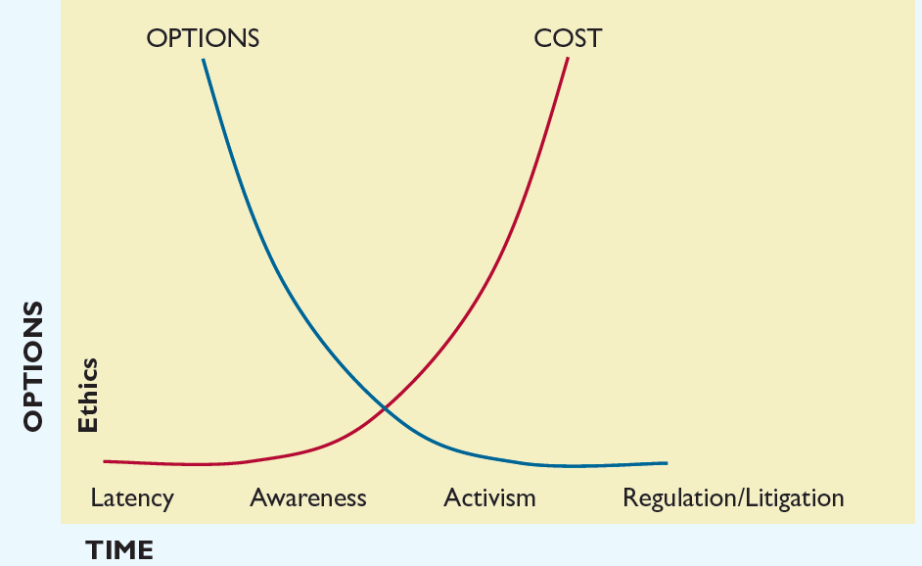
Importance of Ethics (5 of 6)
Leadership and Ethics: Making Choices before Liability and Regulation

Slide 41
Importance of Ethics (6 of 6)
The Subprime Mortgage Market
  Lucrative area
  Questions about fairness and disclosure
  With collapse of the mortgages, new regulations, economic setbacks, and financial downturns in companies that pushed the envelope on subprime loans
  Companies that pulled back from subprimes are now doing well

Slide 42
Creation of an Ethical Culture in Business

Slide 43
Creating an Ethical Culture (1 of 7)
Federal Sentencing Commission
  Code of ethics
  Training for employees
  Means for anonymous reporting
  Following up on employee reports
  Action by the board in monitoring and following up
  Self-reporting by company
  Enforcement within company
  High-ranking officer in charge

Slide 44
Creating an Ethical Culture (2 of 7)
Sarbanes–Oxley Has Changed Corporate Governance, Reporting, and Operations
Tone at the Top

Slide 45
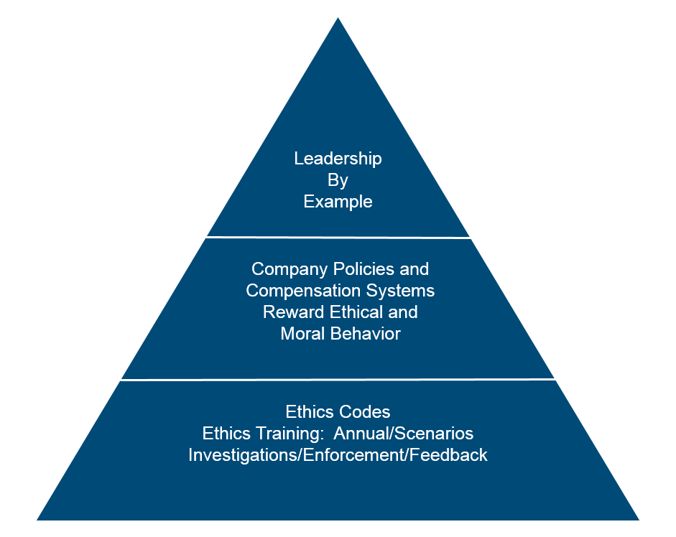
Creating an Ethical Culture (3 of 7)
The Ethical Culture

Slide 46
Creating an Ethical Culture (4 of 7)
Developing an Ethics Stance
  Setting parameters for personal and business behavior
  Setting tone of tolerance or intolerance for behavior

Slide 47
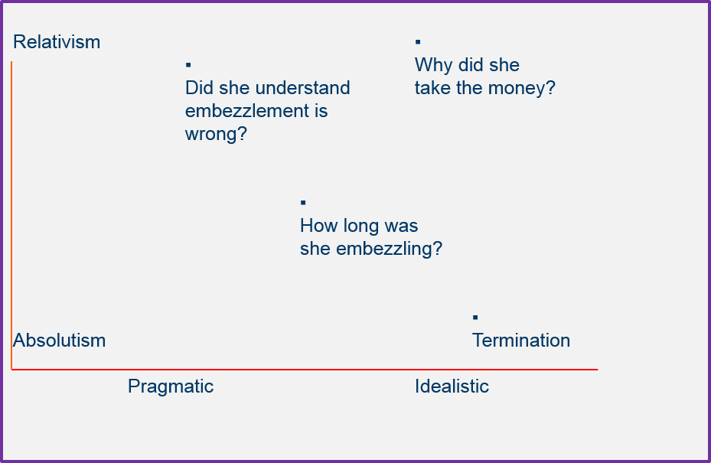
Creating an Ethical Culture (5 of 7)
Your Ethics Stance: The Embezzling Employee

Slide 48
Creating an Ethical Culture (6 of 7)
Watch for Dangers of Unethical Environment
  Intense competition and issues of survival (pressure)
  Managers making poor judgments
  Avoiding the “either/or conundrum”
  Disparity in time devoted to ethics discussion versus performance discussion

Slide 49
Creating an Ethical Culture (7 of 7)
Being Careful about Pressure and Signals
  Competition is so intense that business survival is threatened
  Managers make poor judgments
  Employees have few or no personal values
  Employees respond only to earnings demands
  Managers and executives are touting earnings

Slide 50
Ethical Issues in International Business

Slide 51
International Business (1 of 5)
Businesses Must Decide Whether to Operate under One Uniform Set of Standards
Cultures, Laws, and Standards Vary
  Creates issues of bribes, grease payments, and culture-related gifts
  Problems of economic development where bribery is common

Slide 52
International Business (2 of 5)
A Possible Uniform Standard for Ethical Choices
  Categorical imperative: How would you want to be treated?
    Are you comfortable with a world with your standards?
  Christian principle: The Golden Rule
    And as ye would that men should do to you, do ye also to them likewise. (Luke 6:31)
    Thou shalt love. . .thy neighbor as thyself. (Luke 10:27)
  Confucius: What you do not want done to yourself, do not do to others.
  Aristotle: We should behave to our friends as we wish our friends to behave to us.

Slide 53
International Business (3 of 5)
A Possible Uniform Standard for Ethical Choices
  Judaism: What you hate, do not do to anyone.
  Buddhism: Hurt not others with that which pains thyself.
  Islam: No one of you is a believer until he loves for his brother what he loves for himself.
  Hinduism: Do nothing to thy neighbor which thou wouldst not have him do to thee.
  Sikhism: Treat others as you would be treated yourself.
  Plato: May I do to others as I would that they should do unto me.

Slide 54
International Business (4 of 5)
Corruption Perceptions Index 2019
Least | Corrupt | Most | Corrupt
Denmark | United Kingdom | Somalia | Chad
New Zealand | Australia | Syria | Angola
Finland | Austria | South Sudan | Turkmenistan
Singapore | Hong Kong | Yemen | Haiti
Sweden | Iceland | North Korea | Democratic Republic of Congo
Switzerland | Belgium | Guinea Bissau | Cambodia
Norway | Estonia | Equatorial Guinea | Zimbabwe
Netherlands | Ireland | Libya | Uzbekistan
Canada | Japan | Burundi | Mozambique
Luxembourg | France | Venezuela | Eritea
Germany | United States of America | Iraq | Tajikistan
 |  | Congo

Slide 55
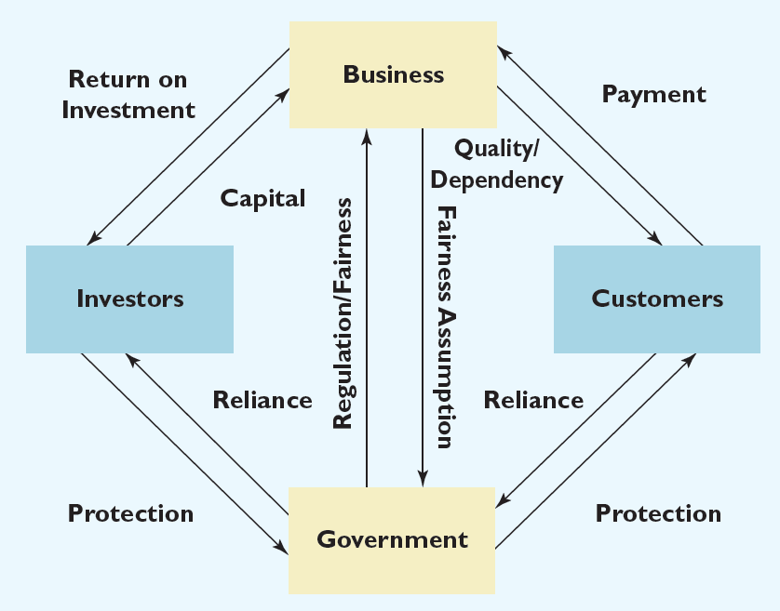
International Business (5 of 5)
Interdependence of Trust, Business, and Government

Slide 56

Summary (1 of 2)
Now that the lesson has ended, you should have learned how to:
Define ethics and give examples of ethical dilemmas.
Explain and give examples of ethical standards and theories.
List the categories of ethical dilemmas and give examples for each category.
Explain the models used for resolving ethical dilemmas.
Describe the obstacles we face when trying to make ethical decisions.
Develop a list of arguments to convince a business of the importance of ethics.

Slide 57
Summary (2 of 2)
Explain how the absence of business ethics in a business can be destructive.
Give examples of how the commitment to business ethics can help a company achieve long-term success.
Explain the components of an ethical culture.
Explain how a business can create an ethical culture.
Discuss why corruption exists in international business and its resulting harms.
Explain why simply adopting another country’s customs can be risky for a business.

