Slide 1
BUS340: Week 5
Weekly Lecture

Slide 2


Introduction to Week 5
We must make this last week of class a priority. You’ve made it this far – you are almost finished!
Take advantage of your peers’ knowledge and experience in the discussion forums.
Ask questions if you have them. I am here to help you succeed.
Our last week will examine practices for creating and delivering oral presentations. Since ours is a virtual classroom, what we cannot convey verbally will be much more critical to demonstrate via the written word.
As such, this topic will expand to evaluate the component of effective online presentations.

Slide 3

Week 5
Objectives for Week 5
This week we will
Craft a compelling message for electronic media.
Assess practices for creating and delivering oral presentations.
Evaluate the components of effective online presentations.
Create a business proposal that identifies the benefits of change.

Slide 4
Keep in Mind:
In our contemporary organizations, business communication is far more detailed and
complex than most people in the workplace realize.
Without acute attention to detail, many people in the workplace miss details that prove critical to successful business communication.

Slide 5

Tips for Creating & Delivering Effective Oral Presentations
Same 3-Step Process as Written Presentations
When creating and delivering oral presentations, analyzing the situation means we have committed to determining our specific audience, their needs, and our message Bovée and Thill (2021). As we gather information, it becomes critical that our research skills are fine-tuned.
Our main idea needs to be clearly defined by limiting our scope.
Another fundamental aspect of oral presentations is using examples as evidence. This can be in the form of data, statistics, and other professional published material. The goal is to defend our assertion using credible sources.
Bovée, C. L., & Thill, J. V. (2021). Business communication today. (15th ed.). Pearson.

Slide 6


Week 5
Failure to build a strong relationship with our audience by neglecting attention to proving our integrity will result in the demise of credibility.
Once that has been depleted, it is challenging to regain.

Slide 7

Week 5
According to Bovée and Thill (2021), as a standard rule, we should allot approximately 50% of our time to planning, another 25% to writing, and the last 25% to completing.
This is consistent in business, as planning projects requires approximately 80% of our time, and the latter 20% is dedicated to execution.
Reference: Bovée, C. L., & Thill, J. V. (2021). Business communication today. (15th ed.). Pearson.

Slide 8
Tips for Discussion Questions Sources
Situations like those presented in DQ #1 aren’t uncommon in business, so what we have covered in class will serve you very well. I highly recommend reflecting on the core topics we’ve covered throughout the class to help formulate your response.
For our second DQ this week, when responding to each of the questions listed in the discussion question requirements, be sure to cite the information you’ve retrieved from Chapter 16. This is also an ideal situation to share some of the research you’ve conducted to strengthen your response further.

Slide 9
Tips for Final Project
Remember that assignments submitted after class has officially concluded are ineligible for grading.
Consider creating an outline based on the assignment’s detailed requirements.
Each point made in the assignment’s requirements are areas that should be elaborated upon.
Use level headings to ensure organization.
Refer to Chapter 5 and take advantage of the notes you’ve acquired throughout the class.
The title and reference pages are not included in this page count requirement.
Submit your work to the Writing Center before submitting it for a grade!
Once you’ve submitted your assignment, double-check to make sure it is there, that it can be opened, and that there aren’t any glitches in the system.

Slide 10

Miscellaneous Tips
Please note that we must adhere to the late policy as instructors. If you have an emergency, the burden of responsibility is to contact your instructor before any given due date. In most cases, you will be offered an extension.
Keep in contact with your academic advisor. They are also committed to your success, and we work closely with academic advisors on behalf of our students.
Keep your APA Manual (7th ed.) your best buddy throughout your degree program. While learning and memorizing everything is impossible, it’s beneficial as a resource guide.

Slide 11

Greatest Tips for Week 5
that will serve you well throughout your educational journey
If you aren’t already watching the Announcements, I highly recommend checking those daily. Anytime your professor posts an Announcement, it contains information pertinent to any given week, the class topic, or to benefit you throughout your educational journey.
If you notice a gradual decline in your grades but aren’t checking your feedback, you are likely missing beneficial information. Information that can and will help correct the problem(s) causing a continuous decline in your grade. Be sure to review the feedback provided by your instructor.
Make your education a priority. Your employer will expect higher knowledge and critical thinking abilities when you graduate. Show them how much you’ve gained through your degree program!

Slide 12
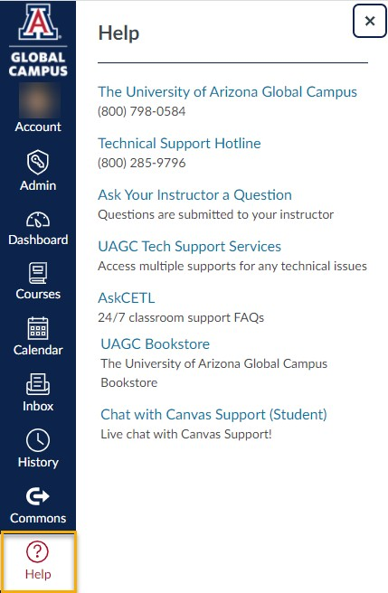
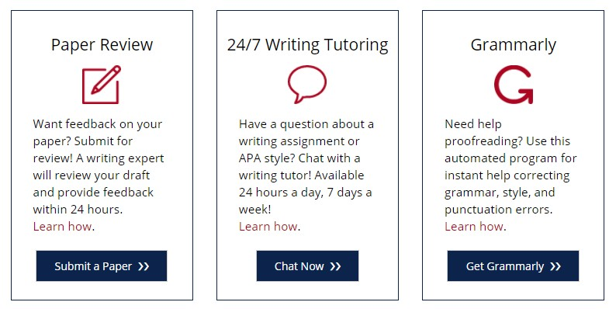
Amazing Support System
Take Advantage of Available Resources
Need More Help?
Listed under the “Writing Center & Library” link in the left navigation are the following free supports:
You can also click on the “Help” icon within our course to access tech supports phone number, email, and chat options.

Slide 13

The Writing Center
https://writingcenter.uagc.edu/
Any questions about the content you’ve developed?
Formatting concerns?
APA questions?
I recommend getting into the habit of submitting all work to the Writing Center before submitting it for a grade. They will help you catch errors that will help you avoid introducing erroneous errors in your written assignments.

Slide 14
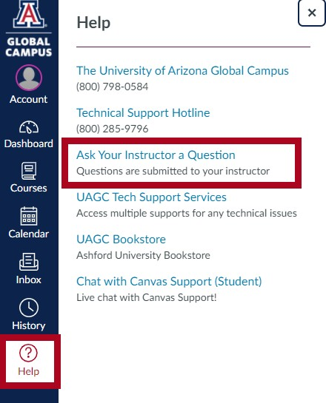
Any Questions?
Click on the “Help” icon in the left navigation of your course and select the Ask Your Instructor a Question option. For private questions, be sure to reserve those for email correspondence.

Slide 15

References
Bovée, C. L., & Thill, J. V. (2021). Business communication today. (15th ed.). Pearson.

