Slide 1
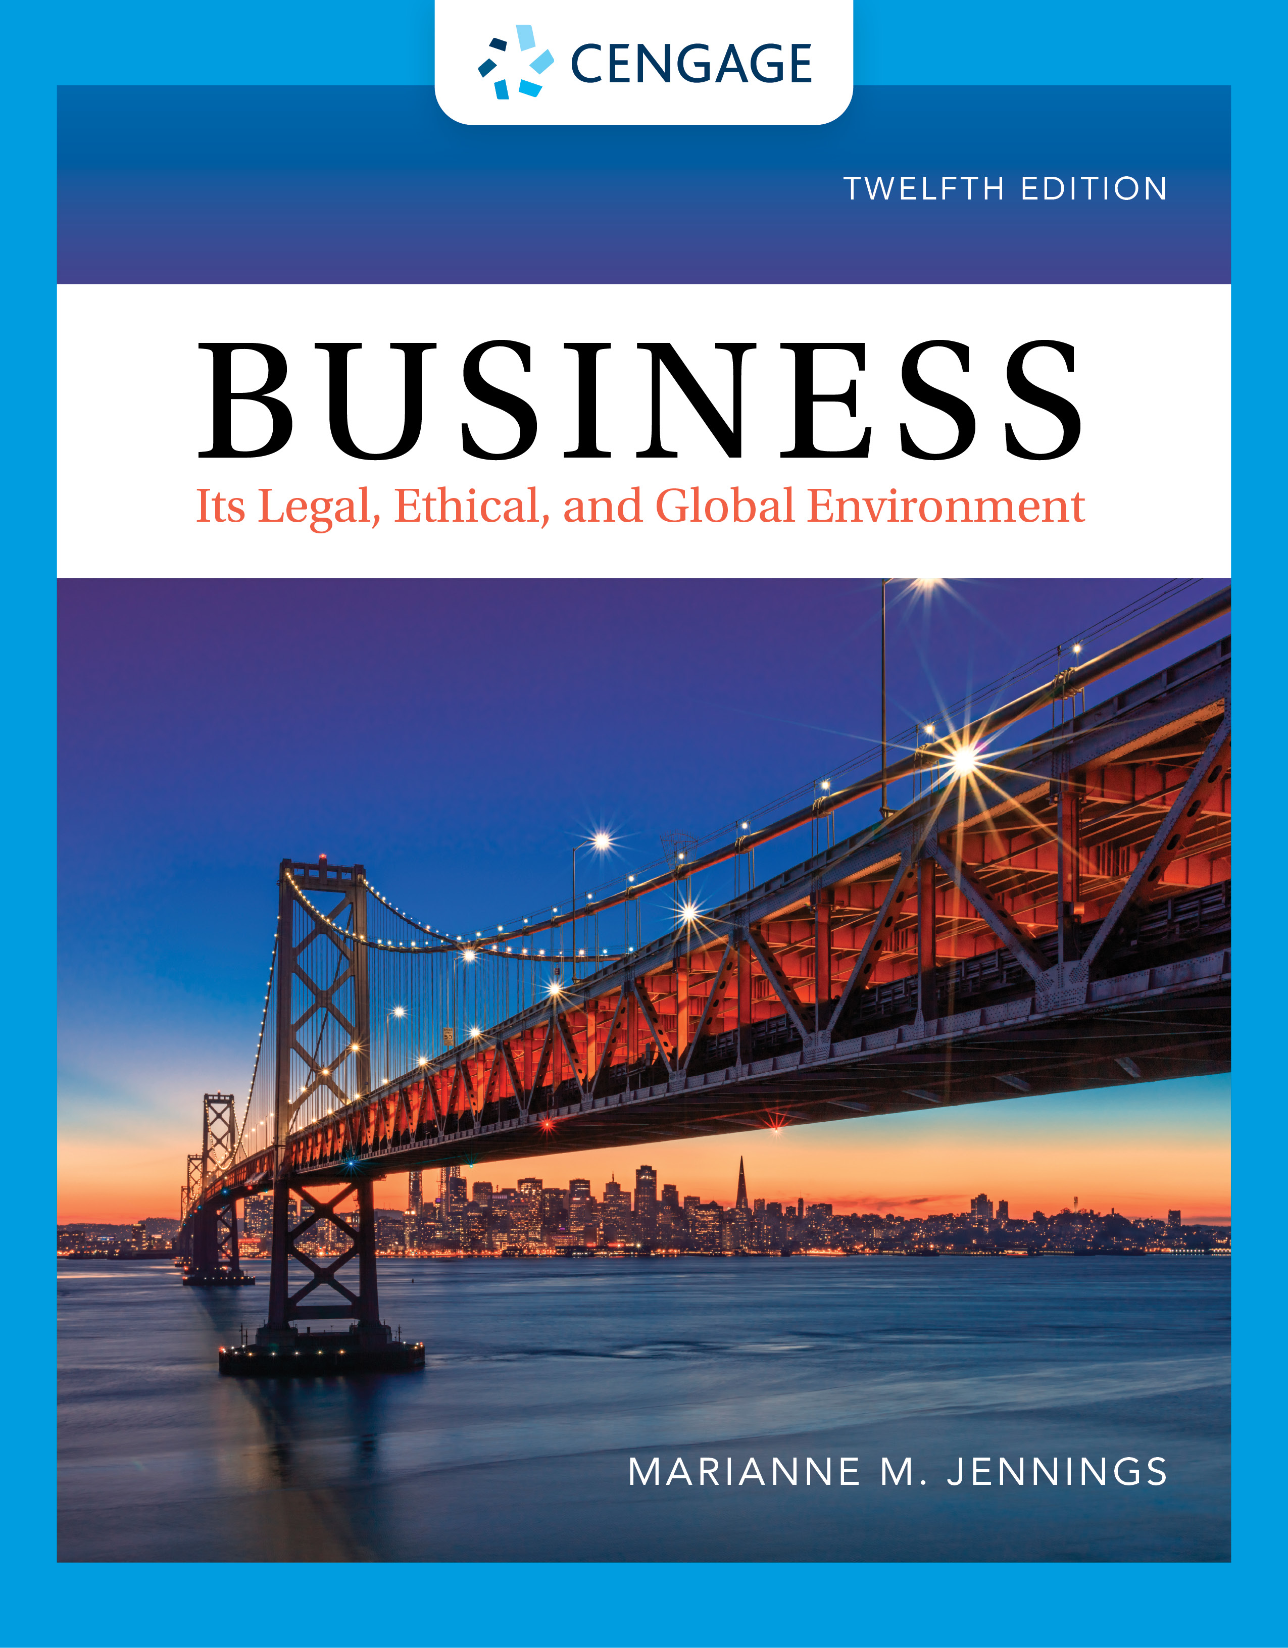
Environmental Regulation and Sustainability
Chapter 10
©2022 Cengage Learning. All Rights Reserved. May not be scanned, copied or duplicated, or posted to a publicly accessible website, in whole or in part.
Notes:
Add slide notes here

Slide 2
Learning Objectives (1 of 2)
By the end of this chapter, you should be able to:
LO 1 Explain the doctrine of nuisance and how it affects property uses and rights.
LO 2 Describe the history of air pollution laws.
LO 3 List the laws that mandate action to reduce air pollution and describe how those laws are enforced.
LO 4 Describe the history of water pollution regulation and its enforcement mechanisms.
LO 5 Describe statutory regulations for toxic substances and their disposals.
Notes:
Add slide notes here

Slide 3
Learning Objectives (2 of 2)
LO 6 Explain liability under CERCLA and its requirements for cleaning up waste sites.
LO 7 Explain when an EIS must be filed and by whom.
LO 8 List the environmental regulations covered by federal and state statutes.
LO 9 Explain the process of fracking and its regulatory framework.
LO 10 Discuss the rights of landowners and others to challenge endangered species protections that affect land use.
LO 11 Identify penalties for the violation of federal environmental
laws.
LO 12 List examples of environmental controls in other countries.
Notes:
Add slide notes here

Slide 4
Common Law Remedies and the Environment

Slide 5
Common Law Remedies
Nuisances
Interference with use and enjoyment
Damages and injunction possible
Balancing test employed
Case 10.1 Spur Industries, Inc. v Del E. Webb Dev. Co. (1972)
What is “moving to the nuisance”?
Who wins? Who pays?

Slide 6
Statutory Environmental Laws: Air Pollution Regulation

Slide 7
Air Pollution Regulation (1 of 8)
Air Pollution Regulation
Air Pollution Control Act (1955)
Clean Air Act (1963)
Air Quality Act (1977/1990)

Slide 8
Air Pollution Regulation (2 of 8)
Clean Air Act Amendments of 1970
EPA authorized to establish standards
States required to adopt implementation plans (SIPs)
EPA approval required for plans
Economic and technological issues
Clean Air Act Amendments of 1977
Nonattainment areas
Prevention of significant deterioration (PSD) areas

Slide 9
Air Pollution Regulation (3 of 8)
Economic Controls for Nonattainment Areas
New plants must have the greatest possible emission control
All other operations must be in compliance
New plant emissions must be offset with reduction elsewhere
Follow the bubble concept; for a new plant to begin operations, its pollution must be offset by reduction in the area

Slide 10
Air Pollution Regulation (4 of 8)
Control in PSD areas
Prevention of significant deterioration
EPA has the right to review proposed plant construction
Plant has to show that there will not be significant deterioration

Slide 11
Air Pollution Regulation (5 of 8)
1990 Amendments to the Clean Air Act
Focus on smog, alternative fuels, toxic emissions, and acid rain
Federal implementation plan (FIP): EPA plan to reduce pollution in cities failing to submit adequate SIP
Plans must use maximum achievable control technology (MACT) (Michigan v EPA)

Slide 12
Air Pollution Regulation (6 of 8)
New Forms of Control: Administrative Regulation Expansion
Emissions offset policy
Bubble concept
Plant modification (Environmental Defense v Duke Energy)
Clean Power Plan and the interstate regulation of pollution

Slide 13
Air Pollution Regulation (7 of 8)
Clean Power Plan and the Ultra Vires Challenge
Upwind and downwind liability resulted in the closing of coal plants
Resulting impact on the coal industry was reined in following a change in administrations
Affordable Clean Energy Plan
Parts of the plan are under judicial challenge by individual states
Climate Change/Global Warming
Paris Accord 2015
Abandoned following U.S. withdrawal

Slide 14
Air Pollution Regulation (8 of 8)
Additional Changes in 1990 Amendments to Clean Air Act
Affected small businesses such as dry cleaners, paint shops, and bakeries
Created emissions permit market

Slide 15
Statutory Environmental Law: Water Pollution Regulation

Slide 16
Water Pollution Regulation (1 of 4)
Water Pollution Regulation
Rivers and Harbors Act of 1899
Prohibited discharges into navigable waters
Used for enforcement since other laws had no teeth
Most industries got around the act quickly by obtaining the permits required under the act
Water Quality Act of 1965
Created the Federal Water Pollution Control Administration (FWPCA)
States required to establish water quality standards
No enforcement procedures—states did little

Slide 17
Water Pollution Regulation (2 of 4)
Water Pollution Regulation
Federal Water Pollution Control Act of 1972
Federal government responsible for standards and control
Emissions controlled by industrial groups
Ranges for groups referred to as effluent guidelines
National Pollution Discharge Elimination System (NPDES)
Renamed Clean Water Act in 1977

Slide 18
Water Pollution Regulation (3 of 4)
Effluent Guidelines
Conventional, nonconventional, toxic
National Pollution Discharge Elimination System (NPDES)
Best conventional treatment (BCT)
Best available treatment (BAT)
Applies to direct and “functional equivalent” of direct dischargers [County of Maui, Hawaii v Hawaii Wildlife Fund, 140 S.Ct. 1462 (2020)]
Cost-benefit analysis is required (Entergy Corporation v Riverkeeper, Inc.)

Slide 19
Water Pollution Regulation (4 of 4)
Other Water Regulation
Safe Drinking Water Act
Passed in 1986
States responsible for enforcement but must have minimum federal standards for drinking water systems
Oil Pollution Act of 1990
Passed in response to huge spills like Exxon Valdez
Companies must either clean up the spill or pay the federal government its costs for the cleanup
Applies to all navigable waters up to 200 miles offshore

Slide 20
Statutory Environmental Law: Solid Waste Disposal Regulation

Slide 21
Solid Waste Disposal Regulation
Solid Waste Disposal Regulation
Toxic Substances Control Act of 1976
Response to chemical dumping
EPA controls the manufacture and disposal of toxic substances
Resource Conservation and Recovery Act of 1976
Regulates methods of disposal through a permit system
Discourages dumping

Slide 22
Superfund (1 of 4)
Superfund: Comprehensive Environmental Response, Compensation, and Liability Act (CERCLA)
Suit can be brought to recover funds expended from the company responsible for the dumping
1986 amendment: Superfund Amendment and Reauthorization Act
EPA can sue to recover cleanup funds from those who are responsible

Slide 23
Superfund (2 of 4)
Liability for Cleanup Cost May Extend to Lenders
Under the Asset Conservation, Lender Liability, and Deposit Insurance Protection Act of 1966, Lenders Are Protected from Liability So Long as They Do Not Participate in the Management of the Property

Slide 24
Superfund (3 of 4)
Lender Immunity Not Lost if the Lender:
Monitors or enforces terms of the security agreement
Monitors or inspects the premises or facility
Mandates that the debtor take action on hazardous materials
Provides financial advice or counseling
Restructures or renegotiates the loan terms
Exercises any remedies available at law
Forecloses on the property
Sells the property
Leases the property

Slide 25
Superfund (4 of 4)
Four Classes of Responsible Parties
Owners and operators at the time of contamination
Current owners and operators—whether they were responsible for the contamination or not
Transporters of the hazardous material
Those who arranged for the transport of the hazardous materials

Slide 26
Case 10.2
Case 10.2 Burlington Northern Railway/Shell Oil Co. v U.S. (2009)
What is the meaning of “arranger” for purposes of CERCLA liability?
What is the basis for allocation of liability for CERCLA cleanups?

Slide 27
Consider 10.4
PARTY | LIABILITY | CATEGORY
Dairy Farm | Pre-1957 | Owner, but the dairy farm operation probably cannot be assigned liability unless what is in the groundwater came from cows or that operation
Holex Company | 1957–1980 | Owner—liability for the toxic waste from the munitions operations
Whittaker | 1980–present | Owner—liability for owning and operating the munitions plant
Chartis | 1999–present | Insurance policy for cleanup and environmental liability; has paid out $30 million
United States Government | 1957– present | Contractor for the work at the site

Slide 28
Due Diligence and EPA Standards (1 of 2)
“All appropriate inquiries” pursuant to CERCLA section 101(35)(B) must be conducted within one year prior to the date of acquisition of the subject property and must include:
(1) An inquiry by an environmental professional as defined in § 312.10, as provided in § 312.21;
(2) The collection of information pursuant to § 312.22 by persons identified under § 312.1(b); and
(3) Searches for recorded environmental cleanup liens, as required in § 312.25

Slide 29
Due Diligence and EPA Standards (2 of 2)
The following components of all the appropriate inquiries must be conducted or updated within 180 days of and prior to the date of acquisition of the subject property:
Interviews with past and present owners, operators, and occupants (see § 312.23);
Searches for recorded environmental cleanup liens (see § 312.25);
Reviews of federal, tribal, state, and local government records (see § 312.26);
Visual inspections of the facility and of adjoining properties (see § 312.23); and
Declaration by the environmental professional (see § 312.21(d))

Slide 30
Guidelines for Self-Audits (1 of 2)
Violations were uncovered as part of a self-audit or due diligence done on property
Violations were uncovered voluntarily
Violations were reported to the EPA within 10 days
Violations were discovered independently and disclosed independently, not because someone else was reporting or threatening to report

Slide 31
Guidelines for Self-Audits (2 of 2)
There is correction of the violation within 60 days
There is a written agreement that the conduct will not recur
There can be no repeat violations or patterns of violations
There is no serious harm to anyone as a result of the violation
The company cooperates completely with the EPA

Slide 32
Brownfield Issues
Many CERCLA Sites That Are Abandoned and/or Unused (Brownfields)
Fear of Liability Precludes Development and Use
Cost of Cleanup Is Prohibitive for Projects
Federal, State, and Local Programs to Encourage Redevelopment

Slide 33
Statutory Law: Environmental Quality Regulation

Slide 34
Environmental Quality
Environmental Quality Regulation
National Environmental Policy Act of 1969
Requires federal agencies to file environmental impact statements for all major actions (EISs)
Content of EIS
Environmental impact
Adverse effects
Alternatives
New effects—short term versus long term
Irreversible effects
Issues with curbing time and length for EIS statements

Slide 35
Case 10.3
Case 10.3 Sierra Club v United States Department of Transportation (1985)
What is the basis for the appeal?
What has the FAA allowed?
Is another EIS ordered?

Slide 36
Statutory Law: Other Federal Environmental Regulations

Slide 37
Other Environmental Laws (1 of 2)
Other Regulations
Surface Mining and Reclamation Act of 1977 requires mining companies to restore land
The fracking issue and regulatory no man’s land
Noise Control Act of 1972; EPA and the FAA regulate aircraft noise pollution
Pesticide Control Act
Must register with the EPA to ship
Must label all pesticides
OSHA
Responsible for workplace environment and safety issues

Slide 38
Other Environmental Laws (2 of 2)
Other Regulations
Asbestos Hazard Emergency Response Act (AHERA)
Schools must inspect for asbestos and take action
Asbestos is a toxic pollutant and community right-to-know substance
Duty to disclose the presence of asbestos
Endangered Species Act
Powerful tool for environmentalists
Habitats cannot be disturbed

Slide 39
Case 10.4
Case 10.4 Babbitt v Sweet Home Chapter of Communities for a Great Oregon (1995)
Did Congress intend to give the secretary authority to shut down an industry?

Slide 40
State Environmental Laws
State EPA
Regulation of fuel used
Incentives for carpooling

Slide 41
Enforcement of Environmental Laws

Slide 42
Enforcement (1 of 4)
Parties
Environmental Protection Agency (EPA)
Council on Environmental Quality (CEQ)
Part of the executive branch
Sets national policies and makes recommendations

Slide 43
Enforcement (2 of 4)
Parties
Other agencies
Atomic Energy Commission
Federal Power Commission
HUD
Department of Interior
Forest Service
Bureau of Land Management
Department of Commerce

Slide 44
Enforcement (3 of 4)
Criminal Sanctions
Clean Air Act
Fines vary by type of violation, up to 15-year imprisonment
Clean Water Act
$54,833 per day and/or up to 1-year imprisonment
$5,000 to $50,000/3 years for violations with knowledge; $100,000/6 years for subsequent violations
Resource Conservation and Recovery Act
5 years and/or up to $50,000 per day violation
15 years and/or up to $250,000 or $1,000,000 if an organization for intentional

Slide 45
Enforcement (4 of 4)
Criminal Sanctions
Oil Pollution Act
$25,000 per day or $1,000 per barrel
$3,000 per barrel if willful or negligent
$250,000 and/or 5 years for failure to report
Civil Liability
Environmental groups can bring suits
Sierra Club
Environmental Defense Fund
League of Conservation Voters

Slide 46
Case 10.5
Case 10.5 U.S. v Citgo Petroleum Corp. (2015)
Did Congress intend to prosecute the failure to take action to protect birds and other species from injury?
Is there strict liability when animals are injured or killed by conditions on private property?

Slide 47
International Environmental Issues
Notes:
Add slide notes here

Slide 48
International Issues (1 of 2)
EU Has the European Environment Agency
ISO 14000
LEED Certification

Slide 49
International Issues (2 of 2)
Eco-audit Stickers
Show products’ environmental impact
International Organization for Standardization (ISO) developed ISO 14000, a series of environmental standards
Companies seek ISO 14000 certification

Slide 50
Summary (1 of 2)
Now that the lesson has ended, you would have learned how to:
Explain the doctrine of nuisance and how it affects property uses and rights.
Describe the history of air pollution laws.
List the laws that mandate action to reduce air pollution and describe how those laws are enforced.
Describe the history of water pollution regulation and its enforcement mechanisms.
Describe statutory regulations for toxic substances and their disposals.

Slide 51
Summary (2 of 2)
Explain liability under CERCLA and its requirements for cleaning up waste sites.
Explain when an EIS must be filed and by whom.
List the environmental regulations covered by federal and state statutes.
Explain the process of fracking and its regulatory framework.
Discuss the rights of landowners and others to challenge endangered species protections that affect land use.
Identify penalties for the violation of federal environmental laws.
List examples of environmental controls in other countries.

