Slide 1
Chapter 8
Observation
© 2019 Cengage. All rights reserved.

Slide 2
Learning Outcomes
After studying this chapter, you should
Discuss the role of observational technologies as marketing research tools
Know the difference between direct and contrived observation
Identify ethical issues particular to research using observation
Explain the observation of physical objects and message content
Describe major types of mechanical observation
Summarize techniques for measuring physiological reactions

Slide 3
Introduction
Scientists rely heavily on observation
Observations play a key role in discovering ideas and developing theories
Inductive learning begins with collections of observations

Slide 4
Technology and Observation in Marketing Research
Observation is the systematic process of recording the behavioral patterns of people, objects, and occurrences as they take place
  Advances in technology have given a bigger role for observational research tools in marketing research
  Observation can be a useful part of either qualitative or quantitative research
  Scientific observation addresses a research question aimed at discovering market knowledge
LO01
Notes:
Learning Objective 01

Slide 5
Technological Advances and Observation
Internet, cellular, social networking and near-field technologies have fueled big data analytics
  Because most of this data gathering involves no two-way communication (no survey or interview), these types of data qualify as behavioral observational
  They leave behind a systematic recording of what people actually did
These technologies enable data collection to be automated
LO01
Notes:
Learning Objective 01

Slide 6
What Can Be Observed?
Physical movements
Verbal behavior
Expressive behavior and physiological reactions
Spatial tensions and locations
Temporal patterns
Physical objects
Verbal and pictorial records
Neurological activity
Internet activities
Geographical information
Physical distribution
LO01
Notes:
Learning Objective 01

Slide 7
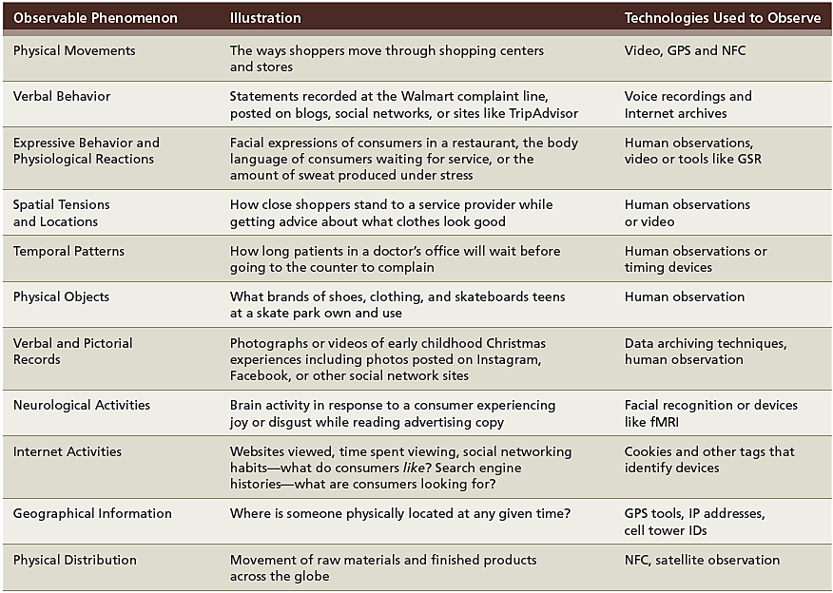
EXHIBIT 8.1 Different Types of Observable Behaviors Tracked by Marketing Research
LO01
Notes:
Learning Objective 01

Slide 8
Disadvantages of Observation
Behavior can be observed, but motives cannot
Analytical models do better with predicting behavior than explaining it
Observation period is often too short
LO01
Notes:
Learning Objective 01

Slide 9
The Nature of Observation Studies (1 of 2)
Mechanical observation, as performed by supermarket scanners or traffic counters, can very accurately record behavior that is routine, repetitive, or programmatic
Unobtrusive observation is no communication with the person being observed is necessary so that he or she is unaware that he or she is an object of research
LO01
Notes:
Learning Objective 01

Slide 10
The Nature of Observation Studies (2 of 2)
Visible observation is observation in which the observer’s presence or mechanical measurement device is obviously known to the subject
Hidden observation is observation in which the subject is unaware that observation is taking place
Observations are free from nuisances such as social desirability bias or memory problems
LO01
Notes:
Learning Objective 01

Slide 11
Observation of Human Behavior
Behavioral scientists have recognized that nonverbal behavior can be a communication process by which individuals exchange meanings
Head nods, smiles, raised eyebrows, winks, and other facial expressions or body movements serve as communication symbols
Observation of nonverbal communication may hold considerable promise for the marketing researcher
LO01
Notes:
Learning Objective 01

Slide 12
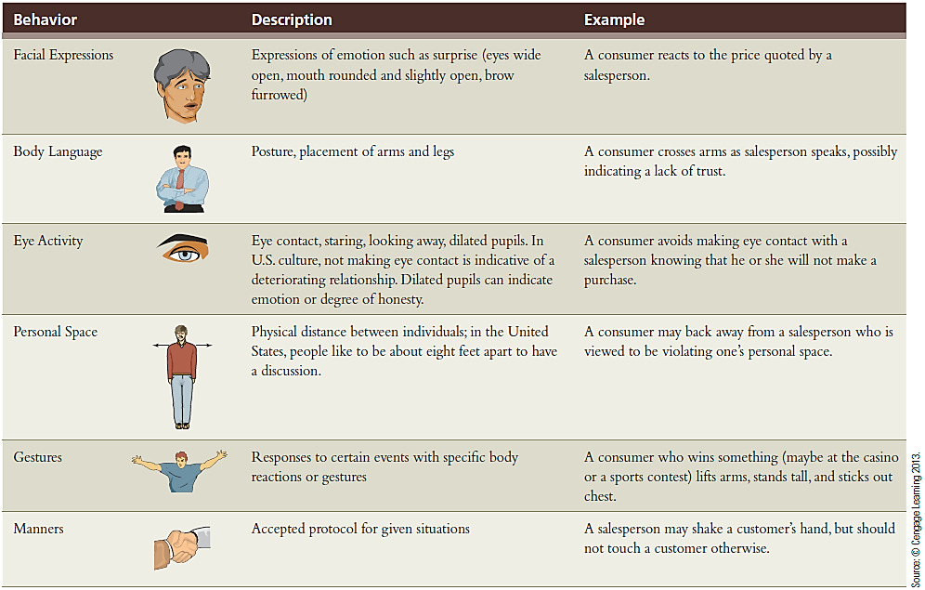
EXHIBIT 8.2 Observing and Interpreting Nonverbal Communication
LO01
Notes:
Learning Objective 01

Slide 13
Direct Observation
Direct observation is a straightforward attempt to observe and record what naturally occurs
  The observer plays a passive role, making no attempt to control or manipulate a situation
  The data consist of records of events made as they occur
  May greatly reduce problems with perceptual distortion that lead to response error
LO02
Notes:
Learning Objective 02

Slide 14
Why Use Direct Observation?
Straightforward
Economical
Obtain data quickly and easily
Often the most accurate way to gather data
Has limited flexibility because not all phenomena are observable
LO02
Notes:
Learning Objective 02

Slide 15
Errors Associated with Direct Observation
When human observers record behaviors, the observer may record events subjectively
Observer bias is a distortion of measurement resulting from the cognitive behavior or actions of a witnessing observer
  The observer should record as much detail as possible
Pace of events, observer’s memory, observer’s writing speed, and other factors limit the detail of what can be recorded
LO02
Notes:
Learning Objective 02

Slide 16
Contrived Observation
Contrived observation is observation in which the investigator creates an artificial environment in order to test a hypothesis
  Can increase the frequency of certain behavior patterns
  If situations are not contrived, the research time spent waiting and observing would expand considerably
LO02
Notes:
Learning Objective 02

Slide 17
Complementary Evidence
Observational approaches can be combined (complement) with other research approaches
Survey responses combined with information on how long the respondent took to make a choice reveal more than either type of data alone
Response latency is the amount of time it takes to make a choice between two alternatives
  Used as a measure of the strength of preference
LO02
Notes:
Learning Objective 02

Slide 18
Ethical Issues in the Observation of Humans (1 of 2)
Observation is sometimes akin to spying
Raises the question of the respondent’s right to privacy
If the researcher obtains permission to observe someone, the subject may not act naturally
New technologies afford opportunities to observe behaviors of interest to marketing managers
  Deep-packet inspection refers to the ability of an Internet service provider to read data transmitted by users
LO03
Notes:
Learning Objective 03

Slide 19
Ethical Issues in the Observation of Humans (2 of 2)
When do you collect observational data?
  Is the behavior being observed commonly performed in public?
  Is the behavior performed in a setting in which the anonymity of the person being observed is assured?
  Has the person agreed to be observed?
  Has the person been adequately notified that their behavior (including data transfers) is being observed?
If the answer to these questions is “yes”, then the study is probably ethical
If the answer is “no”, input from IRB is needed
LO03
Notes:
Learning Objective 03

Slide 20
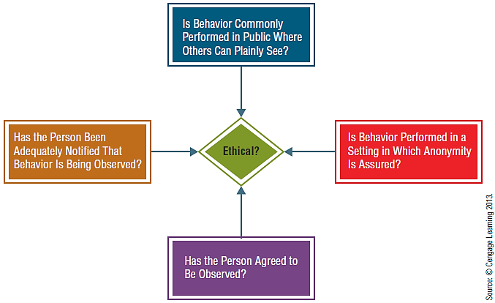
EXHIBIT 8.3 Is the Observation Ethical?
LO03
Notes:
Learning Objective 03

Slide 21
Observation of Physical Objects
Artifacts are the things that people made and consumed within a culture that signal something meaningful about the behavior taking place at the time of consumption
Inventories are counting and recording physical objects through retail or wholesale audits
Content analysis is the systematic observation and quantitative description of the manifest content of communication
LO04
Notes:
Learning Objective 04

Slide 22
Mechanical Observation
Types
  Television, radio, and digital monitoring
  Monitoring web traffic
  Scanner-based research
  Camera surveillance
  Smartphones
LO05
Notes:
Learning Objective 05

Slide 23
Television, Radio, And Digital Monitoring
Television Monitoring is the computerized mechanical observation used to obtain television ratings
Nielsen’s portable people meter device that looks and functions much like a small cell phone but automatically detects broadcast signals, satellite radio and tv transmissions
Pretesting Group’s PeopleReader unobtrusively measures the time a user spends on viewing printed advertising pages or pages displayed on a computer or tablet
LO05
Notes:
Learning Objective 05

Slide 24
Monitoring Web Traffic
Web traffic and buzz
  Click-through rate is the percentage of views of a page for which the user clicks on a target link to enter the website
  Conversation volume is the measure of the amount of Internet postings that involve a specific name or term
CTR and online advertising
  Applying the CTR to the amount spent on the advertisement gives the advertiser a cost per click
LO05
Notes:
Learning Objective 05

Slide 25
EXHIBIT 8.4 Online Advertising Metrics
LO05
Notes:
Learning Objective 05

Slide 26
Scanner-Based Research
Scanner-based consumer panel is a type of consumer panel in which participants’ purchasing habits are recorded with a laser scanner rather than a purchase diary
Scanner data is a mechanical observation form that requires no input from customers
LO05
Notes:
Learning Objective 05

Slide 27
Camera Surveillance
Cameras planted inconspicuously in places can be useful in marketing research
Shopping center security video can help identify problems with merchandising and the types of things that attract consumers to come into and remain in an environment
LO05
Notes:
Learning Objective 05

Slide 28
Smartphones
Most people don’t realize how much information is recorded through their everyday use of the phone.
All text messages, browsing, and phone calls leave behind some kind of record
Smartphones also contain GPS devices capable of recording the phone’s, and thus most likely the user’s, whereabouts anytime the phone is connected
Like other areas, technology may outpace the ethics of using this type of data
LO05
Notes:
Learning Objective 05

Slide 29
Measuring Physiological Reactions (1 of 2)
There are five major categories of mechanical devices used to measure physiological reactions
Eye-tracking is used to observe eye movements
Pupilometer is used to observe and record changes in the diameter of a subject’s pupils
Psychogalvanometer measures galvanic skin response, a measure of involuntary changes in the electrical resistance of the skin
LO06
Notes:
Learning Objective 06

Slide 30
Measuring Physiological Reactions (2 of 2)
Voice-pitch analysis is a physiological measurement technique that records abnormal frequencies in the voice that are supposed to reflect emotional reactions to various stimuli
  This is relatively new
Neurological devices can reveal how much thought takes place and what types of feelings a person is probably experiencing
  Magnetic resonance imaging (MRI) device—a machine that allows one to measure what portions of the brain are active at a given time
LO06
Notes:
Learning Objective 06

