Slide 1
BUS340: Week 3
Weekly Lecture

Slide 2


Introduction to Week 3
As we embark on the heart of our class, please save your research from previous weeks, as you may likely be able to find another way to use it in this week’s work (or future weeks/classes).
Don’t forget to avoid non-credible sources. We only use scholarly, peer-reviewed sources in academic writing.
To piggyback on preparing and writing a business message, as covered this past week, we will be exploring the process of developing compelling messages for electronic media.
In addition, we’ll be taking a new twist this week by assessing visual design principles and how it relates to business communication, too.

Slide 3

Week 3
Objectives for Week 3
This week we will
Craft a compelling message for electronic media.
Assess communications using the principles of visual design.
Develop a video cover letter.

Slide 4
Keep in Mind:
In our contemporary business landscape, the use of electronic, digital, and social
media has become mainstream.
In business, the core difference between what we’ve grown accustomed to in our words may lie in formal terms versus casual, slang, or jargon.

Slide 5

Tips for Effective Email Messages
It’s Our Responsibility
Avoid sending emails containing erroneous information or emails that aren't truly necessary.
Remember that all email correspondence and social media posts can become legal forms of communication.
Ensure your email is free of grammar errors and typos.
Avoid fluff and superfluous information that will lose the reader’s attention (as you risk losing their respect, too).
Remember, social media used for business is free of anything personal.
Podcasts should be delivered with the same formality and professionalism devoted to conveying a message via a written paper or business correspondence.
Bovée, C. L., & Thill, J. V. (2021). Business communication today. (15th ed.). Pearson.

Slide 6

A Good Reminder
Remember to spend as much time as necessary to ensure that the words you choose deliver what otherwise could/would be conveyed through nonverbal
communication. Once a message is received and read, we don’t have a second chance.
The same process applies to business writing for electronic, social, and visual media that applies to academic writing. As such, take heed of the correct and accurate information you
have acquired versus what you believe or assume to be right.

Slide 7

Week 3
Video Cover Letter & Resumes
In our contemporary landscape, using video cover letters and resumes is preferred.
Video Cover Letter & Resumes
Preparing: prepare by creating an outline and practicing.
Professionalism: First impressions cannot be redone.
Presentation: the ability to convey our skills and persuasively succinctly address gaps in existing skills.

Slide 8

Week 3
Video Cover Letter & Resumes
Similar to a video blog, a video cover letter and resume should be presented in a
professional and convincing manner.
Identify specific skill sets you possess that align with the position this video cover letter is prepared for.

Slide 9
Tips for Discussion Questions
Multiple statements must be satisfied to fully answer this week’s first discussion question. I recommend starting with an outline to ensure you’ve covered all the main points you will be graded on. This also helps ensure we don’t wander off-topic and add irrelevant information to our posts.
For the second DQ, the more forthcoming you are with your response, the better your post will likely be. This type of discussion question requires a healthy degree of transparency. It also requires supporting documentation, as we cannot fully defend a good stance without the professional support of a credible, published author.

Slide 10

Miscellaneous Tips
Please note that we must adhere to the late policy as instructors. If you have an emergency, the burden of responsibility is to contact your instructor before any given due date. In most cases, you will be offered an extension.
Stay connected with your academic advisor. They are also committed to your success, and we work closely with academic advisors on behalf of our students.
Keep your APA Manual (7th ed.) your best buddy throughout your degree program. While learning and memorizing everything is impossible, it’s beneficial as a resource guide.

Slide 11

Greatest Tips for Week 3
that will serve you well throughout your educational journey
If you aren’t already watching the Announcements, I highly recommend checking those daily. Anytime your professor posts an Announcement, it contains information pertinent to any given week, the class topic, or to benefit you throughout your educational journey.
If you notice a gradual decline in your grades but aren’t checking your feedback, you are likely missing beneficial information. Information that can and will help correct the problem(s) causing a continuous decline in your grade. Be sure to review the feedback provided by your instructor.
Make your education a priority. Your employer will expect higher knowledge and critical thinking abilities when you graduate. Show them how much you’ve gained through your degree program!

Slide 12
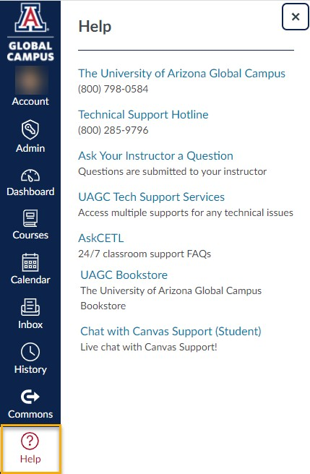
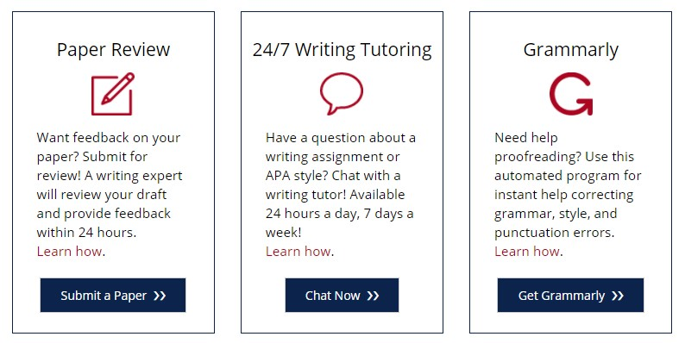
Amazing Support System
Take Advantage of Available Resources
Need More Help?
Listed under the “Writing Center & Library” link in the left navigation are the following free supports:
You can also click the “Help” icon within our course to access tech supports phone numbers, email, and chat options.

Slide 13

The Writing Center
https://writingcenter.uagc.edu/
Any questions about the content you’ve developed?
Formatting concerns?
APA questions?
I recommend getting into the habit of submitting all work to the Writing Center before submitting it for a grade. They will help you catch errors that will help you avoid introducing erroneous errors in your written assignments.

Slide 14
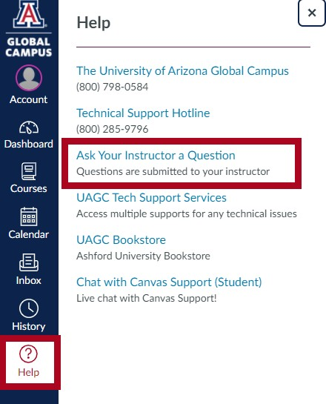
Any Questions?
Click on the “Help” icon in the left navigation of your course and select the Ask Your Instructor a Question option. For private questions, be sure to reserve those for email correspondence.

Slide 15

References
Bovée, C. L., & Thill, J. V. (2021). Business communication today. (15th ed.). Pearson.

