Slide 1
Chapter Eleven
Managing Project Teams

Slide 2
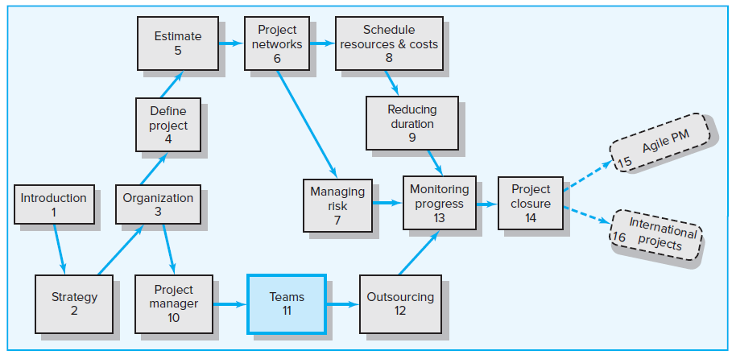
Where We Are Now

Slide 3
Learning Objectives
11-01 Identify key characteristics of a high-performance project team.
11-02 Distinguish the different stages of team development.
11-03 Understand the impact situational factors have on project team
development.
11-04 Identify strategies for developing a high-performance project
team.
11-05 Distinguish functional conflict from dysfunctional conflict and
describe strategies for encouraging functional conflict and
discouraging dysfunctional conflict.
11-06 Understand the challenges of managing virtual project teams.
11-07 Recognize the different pitfalls that can occur in a project team.

Slide 4
Chapter Outline
11.1 The Five-Stage Team Development Model
11.2 Situational Factors Affecting Team Development
11.3 Building High-Performance Project Teams
11.4 Managing Virtual Project Teams
11.5 Project Team Pitfalls

Slide 5
High-Performing Teams
Synergy
Positive synergy 1 + 1 + 1 + 1 + 1 = 10
Negative synergy 1 + 1 + 1 + 1 + 1 = 2
Characteristics of High-Performing Teams
Share a sense of common purpose
Make effective use of individual talents and expertise
Balance role and share tasks
Exert energy toward problem solving
Accept differences of opinion and expression
Encourage risk taking and creativity
Set high personal performance standards
Identify source of both professional and personal growth

Slide 6
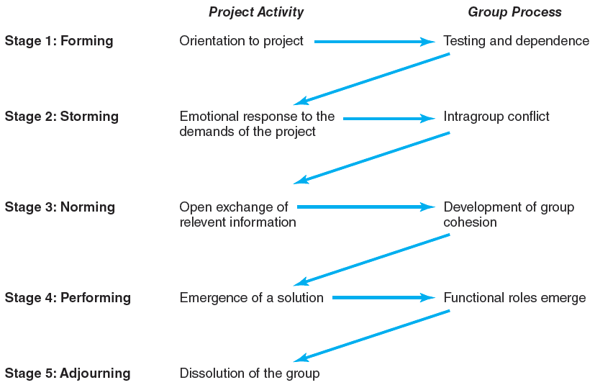
11.1 The Five-Stage Team Development Model
FIGURE 11.1

Slide 7
11.2 Situational Factors Affecting Team Development
Conditions Favoring Development of High-Performing Project Teams
There are 10 or fewer members per team.
Members volunteer to serve on the project team.
Members serve on the project from beginning to end.
Members are assigned to the project full time.
Members are part of an organization culture that fosters cooperation and trust.
Members report solely to the project manager.
All relevant functional areas are represented on the team.
The project involves a compelling objective.
Members are located within conversational distance of each other.

Slide 8
11.3 Building High-Performance Project Teams
FIGURE 11.3

Slide 9
Recruiting Project Members
Factors affecting recruitment
The importance of the project
The management structure being used to complete the project
Considerations that need to be factored into the recruitment process
Problem-solving ability
Availability
Technological expertise
Credibility
Political connections
Ambition, initiative, and energy
Familiarity

Slide 10
Conducting Project Meetings
The first project team meeting—project kick-off meeting
Establishing ground rules
Planning decisions
Tracking decisions
Managing change decisions
Relationship decisions
Managing subsequent project meetings

Slide 11
Establishing Team Norms
Confidentiality is maintained; no information is shared outside the team unless all agree to it.
It is acceptable to be in trouble, but it is not acceptable to surprise others. Tell others immediately when deadlines or milestones will not be reached.
There is zero tolerance for bulling a way through a problem or an issue.
Agree to disagree, but when a decision has been made, regardless of personal feelings, move forward.
Respect outsiders, and do not flaunt one’s position on the project team.
Hard work does not get in the way of having fun.

Slide 12
Establishing a Team Identity
Effective use of meetings
Co-location of team members
Creation of project name
Get the team to build or do something together early on
Team rituals

Slide 13
Requirement for an Effective Project Vision
FIGURE 11.4

Slide 14
Managing Project Reward Systems
The reward system encourages team performance and extra effort.
Most project managers advocate the use of group rewards.
To increase the value of rewards, rewards need to have lasting significance.
Some project managers have to use negative reinforcement to motivate project performance.
There are times when we need to reward individual performance. Examples of this kind of rewards include
Letter of recommendation
Public recognition for outstanding work
Job assignments
Flexibility

Slide 15
Orchestrating the Decision-Making Process
Facilitating group decision making involves four major steps.
Identifying problems
Generating alternatives
Reaching a decision
Following up

Slide 16
Managing Conflict within the Project
Encouraging Functional Conflict
Functional conflict plays a critical role in obtaining a deeper understanding of the issues and coming up with the best decisions possible.
Project managers can legitimize dissent within the team by
Designating someone to play the role of devil’s advocate.
Asking the group to take 15 minutes to come up with all the reasons the team should not pursue a course of action.
Managing Dysfunctional Conflict
Mediate the conflict
Arbitrate the conflict
Control the conflict
Accept the conflict
Eliminate the conflict

Slide 17
Sources of Conflict over the Project Life Cycle
FIGURE 11.5

Slide 18
Rejuvenating the Project Team
Informal Techniques
Institute new rituals
Show the team an inspiration movie
Have the project sponsor give a pep talk
Formal Techniques
Hire an external consultant to facilitate a team-building session to elevate team performance and clarify ownership (whether the team has direct influence over the issue) issues
Link team-building activities with outdoor experience to provide an intense common experience that accelerate the social development of the team

Slide 19
11.4 Managing Virtual Project Teams
Two biggest challenges involved in managing a virtual project team are
Developing trust
Hold a face-to-face meeting at the beginning and orchestrate the exchange of social information
Set clear roles for each team member
Form teams with people who have already worked effectively together on projects, if possible
Developing effective patterns of communication
Don’t let team members vanish
Establish a code of conduct to avoid delays
Establish clear norms and protocols for surfacing assumptions and conflicts
Use electronic video technology to verify work
Share the pain

Slide 20
24-Hour Global Clock
FIGURE 11.6

Slide 21
11.5 Project Team Pitfalls
Groupthink
Illusion of invulnerability
Whitewash of critical thinking
Negative stereotypes of outsiders
Direct pressure
Bureaucratic bypass syndrome
Team spirit becomes team infatuation

Slide 22
Key Terms
Brainstorming
Dysfunctional conflict
Functional conflict
Groupthink
Nominal group technique (NGT)
Positive synergy
Project kick-off meeting
Project vision
Team building
Virtual project team

