Slide 1
Chapter Ten
Being an Effective Project Manager

Slide 2
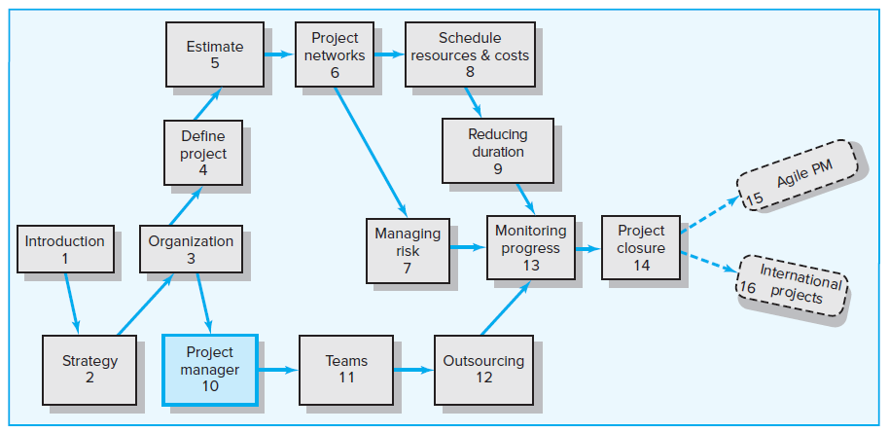
Where We Are Now

Slide 3
Learning Objectives
10-01 Understand the difference between managing and leading a project.
10-02 Understand the need to engage project stakeholders.
10-03 Identify and apply different “influence currencies” to build positive
relations with others.
10-04 Create a stakeholder map and develop strategies for managing
project dependencies.
10-05 Understand the need for a highly interactive management style on
projects.
10-06 More effectively manage project expectations.
10-07 Develop strategies for managing upward relations.
10-08 Understand the importance of building trust and acting in an ethical
manner while working on a project.
10-09 Identify the qualities of an effective project manager.

Slide 4
Chapter Outline
10.1 Managing versus Leading a Project
10.2 Engaging Project Stakeholders
10.3 Influence as Exchange
10.4 Social Network Building
10.5 Ethics and Project Management
10.6 Building Trust: The Key to Exercising Influence
10.7 Qualities of an Effective Project Manager

Slide 5
10.1 Managing versus Leading a Project
Managing—coping with complexity
Formulate plans and objectives
Monitor results
Take corrective action
Expedite activities
Solve technical problems
Serve as peacemaker
Make tradeoffs among time, costs, and project scope
Leading—coping with change
Recognize the need to change to keep the project on track
Initiate change
Provide direction and motivation
Innovate and adapt as necessary
Integrate assigned resources

Slide 6
10.2 Engaging Project Stakeholders
Stakeholders are people and organizations that are actively involved in the project or whose interests may be positively or negatively affected by the project.
Project Management Maxims
You can’t do it all and get it all done.
Projects usually involve a vast web of relationships.
Hands-on work is not the same as leading.
More pressure and more involvement can reduce your effectiveness as a leader.
What’s important to you likely isn’t as important to someone else.
Different groups have different stakes (responsibilities, agendas, and priorities) in the outcome of a project.
Remember: Project management is tough, exciting, and rewarding—endeavor to persevere.

Slide 7
Network of Stakeholders
FIGURE 10.1

Slide 8
10.3 Influence as Exchange
The Law of Reciprocity
One good deed deserves another, and likewise one bad deed deserves another.
Quid pro Quo
Mutual exchange of resources and services build relationships.
You scratch my back, I’ll scratch yours.
Influence “Currencies” (Cohen and Bradford)
Cooperative relationships are built on the exchange of organizational “currencies” (favors).

Slide 9
Commonly Traded Organizational Currencies
TABLE 10.1

Slide 10
10.4 Social Network Building
Mapping Stakeholder Dependencies
Project team’s perspective
Whose cooperation will we need?
Whose agreement or approval will we need?
Whose opposition would keep us from accomplishing the project?
Stakeholder’s perspective
What differences exist between the team and the people on whom the team depends?
How do the stakeholders view the project?
What is the current status of the relationship the team has with the stakeholders?
What sources of influence does the team have relative to the stakeholders on whom the team depends?

Slide 11
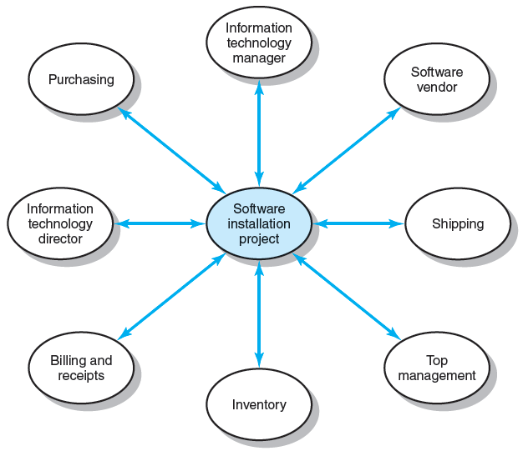
Stakeholder Map for Financial Software Installation Project
FIGURE 10.2

Slide 12
Management by Wandering Around (MBWA)
Management by Wandering Around (MBWA) involves managers spending the majority of their time outside their offices in order to have face-to-face interactions with employees building cooperative relationships.
Relationships should be built before they are needed.
Characteristics of Effective Project Managers
Initiate contact with key stakeholders to keep abreast of developments
Anticipate potential problems
Provide encouragement
Reinforce the objectives and vision of the project
Intervene to resolve conflicts and prevent stalemates from occurring

Slide 13
Managing Upward Relations
Project success is strongly affected by the degree to which a project has the support of top management. Top management must
Provide an appropriate budget
Be responsive to unexpected needs
Send a clear signal to others in the organization of the importance of the project and the need to cooperate
Rescind unreasonable demand
Provide additional resources
Recognize the accomplishments of team members

Slide 14
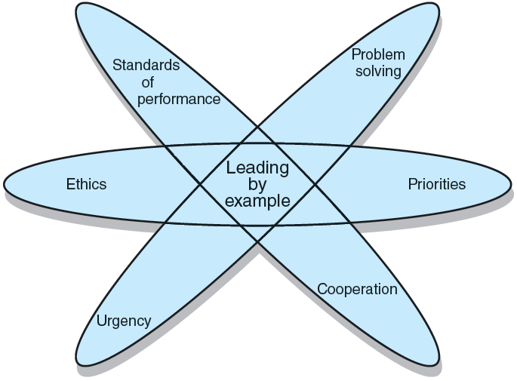
Leading by Example
FIGURE 10.4

Slide 15
10.5 Ethics and Project Management
Ethical Dilemmas—situations where it is difficult to determine whether conduct is right or wrong
Padding of cost and time estimations
Exaggerating pay-offs of project proposals
Falsely assuring customers that everything is on track
Being pressured to alter status reports
Falsifying cost accounts
Compromising safety standards to accelerate progress
Approving shoddy work

Slide 16
10.6 Building Trust: The Key to Exercising Influence
Trust
Is an elusive concept.
Is a function of character (personal motives) and competence (skills necessary to realize motives).
Is sustained through frequent face-to-face contact.
The core of highly effective people is a character ethic (Stephen Covey in Seven Habits of Highly Effective People).
Consistency—more predictable
Openness—more receptive to others
A sense of purpose—what is best for the organization and the project

Slide 17
10.7 Qualities of an Effective Project Manager
Effective communication skills
Systems thinking
Personal integrity
Proactivity
High emotional intelligence (EQ)
General business perspective
Effective time management
Optimism

Slide 18
Contradictions of Project Management
Innovate and maintain stability
See the big picture while getting their hands dirty
Encourage individuals but stress the team
Be hands-off/hands-on
Be flexible but firm
Manage team versus organizational loyalties

Slide 19
Key Terms
Emotional intelligence (EQ)
Inspiration-related currencies
Law of reciprocity
Management by wandering around (MBWA)
Personal-related currencies
Position-related currencies
Relationship-related currencies
Social network building
Stakeholders
Systems thinking
Task-related currencies

