Slide 1
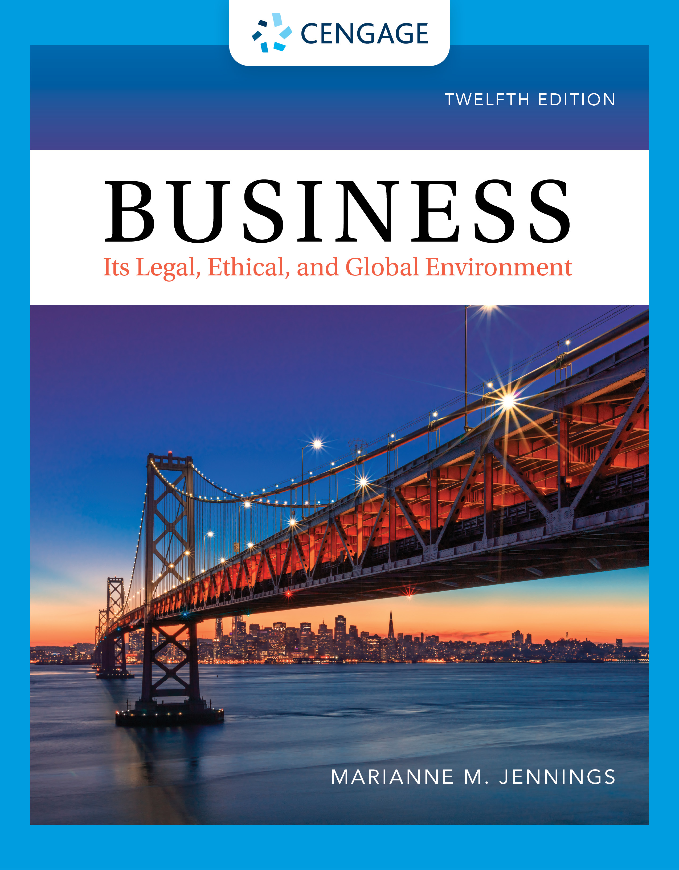
Contracts and Sales: Introduction and Formation
Chapter 11
©2022 Cengage Learning. All Rights Reserved. May not be scanned, copied or duplicated, or posted to a publicly accessible website, in whole or in part.
Notes:
Add slide notes here

Slide 2
Learning Objectives (1 of 2)
By the end of this chapter, you should be able to:
LO 1 Explain the sources of contract law and how subject matter controls their application.
LO 2 List the types of contracts and give examples of each.
LO 3 List the elements required for valid formation of a contract and the requirements for each.
Notes:
Add slide notes here

Slide 3
Learning Objectives (2 of 2)
LO 4 Explain what types of contracts must be in writing and the parol evidence rule for written contracts.
LO 5 Discuss the issues that require caution in international contracts.
Notes:
Add slide notes here

Slide 4
What Is a Contract?

Slide 5
Definition of a Contract
“A contract is a promise (or set of promises) for breach of which the law gives a remedy.”
Defined in Restatement (Second) of Contracts, American Law Institute (ALI)

Slide 6
Sources of Contract Law

Slide 7
Sources of Contract Law (1 of 3)
Common Law
Based on English common law
Summarized in Restatement (Second) of Contracts
Applies to contracts with subject matters of land or services
Examples: Mortgage, lease, or medical services

Slide 8
Sources of Contract Law (2 of 3)
Uniform Commercial Code (UCC)
Drafted by the ALI and National Conference of Commissioners on Uniform State Laws
Common law is not uniform from state to state
First appeared in the 1940s
Adopted in whole or in part in all states
Article 2 governs contracts for the sale of goods; more liberal than common law

Slide 9
Does the UCC Apply?
Case 11.1 Huzinec v Six Flags Great Adventure, L.L.C. (2017)
Is the purchase of a ticket to an amusement park a license?
Is it the sale of a good?
Is the primary purpose to have the ticket or to have access?

Slide 10
UCC versus Common Law
List of Items | UCC | Common Law
Car | X | -
Horse | X | -
Easement | - | X
Lease | - | X
Mortgage | - | X
Real Estate Listing Agreement | - | X
Fabric | X | -
Loan | - | X
Roof Repair | - | X
Air Conditioner | X | -

Slide 11
Sources of Contract Law (3 of 3)
Uniform Commercial Code (UCC)
Article 2 leases
New addendum to the UCC
Covers leases of goods: Long-term leases such as car leases
Adopted in most states

Slide 12
Types of Contracts

Slide 13
Bilateral versus Unilateral
Bilateral: First Party (Offeror) Makes a Promise in Exchange for the Second Party’s (Offeree’s) Promise
Example: You promise to pay back money with interest, and the bank promises to loan you the money
Unilateral: First Party (Offeror) Makes a Promise in Exchange for Offeree’s Performance
Example: “Drive my car across the country and I’ll pay you $500 plus expenses”
“The Unilateral Murder” and the law student acting on a TV offer

Slide 14
Express versus Implied
Express Contracts: Written or Oral Agreements
Implied-in-Fact Contracts: Non-spoken, Non-written Understandings
Example: When you go into a doctor’s office, you have an implied contract to pay the doctor for services even though you may not sit down and organize the details

Slide 15
Quasi Contracts
Implied-in-Law
Fictional contract created by a court
Elements
One party confers a benefit on another
Both are aware of the benefit
Retention of the benefit without compensation would be unfair and unjust

Slide 16
Void versus Voidable Contracts
Void Contracts: Ones to Do Something Illegal or against Public Policy—Neither Side Can Enforce
Example: Contract to buy drugs
Void contracts are illegal and do not exist at law!
Voidable Contracts: Contracts in Which One Party Has the Right to End the Contract
Example: Contracts of minors are voidable

Slide 17
Executed versus Executory
Executed Contract: One in Which the Promises under the Contract Have Been Performed
Executory Contract: One That Has Been Entered into but Not Yet Performed
Contracts Can Be Partially Executory/Executed if One Side Has Performed

Slide 18
Consumer Credit Contracts

Slide 19
Consumer Credit Contracts Formation
Statutorily Imposed Requirements for Proper Formation
Detailed Regulation on Formation, Performance, and Remedies

Slide 20
Equal Credit Opportunity Act (1 of 3)
Consumer Credit Contracts
Equal Credit Opportunity Act
Passed to be certain credit was awarded on applicant’s merits and not on extraneous factors such as age, sex, race, color, religion, or national origin

Slide 21
Equal Credit Opportunity Act (2 of 3)
Equal Credit Opportunity Act
Cannot consider
Marital status
Receipt of public assistance income
Receipt of alimony or child support
Plans for children
Spouses have rights to individual credit applications

Slide 22
Equal Credit Opportunity Act (3 of 3)
Equal Credit Opportunity Act
Penalties
Actual damage plus punitive damages of up to $10,000
Class action: Punitive damages of up to $500,000 or 1% of creditor’s net worth (whichever is less)

Slide 23
ECOA Violation?
Case 11.2 A.B.&S. Auto Service, Incorporated v South Shore Bank of Chicago (1997)
What, according to Bonner’s expert, is the impact of considering criminal records of applicants?
Do you think a criminal record is an indication of character?

Slide 24
Subprime or Predatory Lending
Subprime or Predatory Lending
Loans for those with no credit history, bankruptcies, moderate incomes, or poor credit histories
Contracts are often difficult to understand
High interest rates and fees
“Ninja” lending: No job, no income, no assets

Slide 25
TILA
Truth-in-Lending Act (TILA)
Part of the Consumer Credit Protection Act
Purpose was full disclosure
Elaboration and forms are found in Regulation Z
Application
Consumer credit transactions
Open-end transactions (credit cards and lines of credit)
Closed-end transactions (loans, financing)

Slide 26
Truth-in-Lending
Regulation Z Was Originally Part of the Federal Reserve Regulations
Consumer Financial Protection Bureau (CFPB) Is a New Agency Created under Dodd–Frank
Will be housed in the Federal Reserve
Will be funded by the Federal Reserve

Slide 27
CARD
Credit Card Accountability, Responsibility, and Disclosure Act
Credit terms must last for one year
Restrictions on soliciting those under 21 and restrictions on colleges and universities

Slide 28
Additional Credit Protections
Liability Limitations
$50 maximum liability if you comply with notification requirements
Credit Card Chips and Liability Limitations
Credit Balance Transfer Protections
Additional disclosures and regulations on transferring balances

Slide 29
Formation of Contracts

Slide 30
Formation of Contracts Overview

Slide 31
Formation: Offer
Offer Is the First Part of the Contract
Parties
Offeror = Person who makes offer
Offeree = Person who receives offer
Must have language that indicates intent to contract
Not just inquiry
More than negotiation
Courts use an objective, not a subjective, standard

Slide 32
Case 11.3
Case 11.3 Leonard v PepsiCo (2000)
Was the commercial an offer for a Harrier Jet?
What was the acceptance?
Does the commercial satisfy the statute of frauds?

Slide 33
Consider 11.3 (1 of 2)
TO: Brit Ripley
FROM: Yachts International
RE: Sailing Vessel Infinity
We are prepared to make an offer to purchase the U.S. Coast Guard Documented Vessel Infinity for the price of $600,000 on the following terms and conditions:
Price: $600,000
Terms: Cash $300,000 at close of escrow
Note: $300,000 (unsecured) due in one year

Slide 34
Consider 11.3 (2 of 2)
Interest: 0.5% per month on unpaid balance versus 100,000 shares of stock of a public company
Will guarantee $3.00 per share in one year. Buyer reserves the right to repurchase shares at $3.00 per share in one year if guarantee given.
Escrow: ASAP
Conditions:
All insurance to remain in effect until close and seller to deliver to Port of San Francisco in sailable and seaworthy condition.
/s./ J.P. Morgan
Yachts International

Slide 35
Formation: Essential Terms
Under Common Law, Offer Must Contain Essential Terms of the Contract:
Parties
Subject matter
Price and payment terms
Delivery terms
Performance times
Under UCC Article 2, Offer Need Only Contain:
Parties
Subject matter
Quantity
Courts can consider industry custom and course of dealing in determining whether terms are sufficient

Slide 36
Communication
Communication of the Offer
Offeree cannot accept offer that never arrives
Ads are generally considered invitations for offers—not offers

Slide 37
Offer: Termination (1 of 2)
Revocation: Offer Can Be Revoked Any Time Prior to Acceptance
Exception is option
Offeror is paid to hold offer open
It is a separate contract for time
UCC merchant’s firm offer UCC 2-205
Offer by merchant signed in writing states it will be kept open (irrevocable) for period stated (maximum of 3 months)

Slide 38
Offer: Termination (2 of 2)
Termination of an Offer by Rejection
Offeree indicates “no”
Rejection by changes in terms: Counteroffer

Slide 39
Case Study
Case 11.4 Al Dente, LLC v Consiglio (2016)
What were the forms of communication and the timeline?
Why did one side believe a contract was formed?
What was the other side’s perspective?
What lessons did you learn about contract negotiations and documentation?

Slide 40
Offer: Termination (UCC) (1 of 2)
Termination by Counteroffer: UCC 2-207
Non-merchants: Addition of terms in acceptance does not equal a counteroffer
Acceptance results but additional terms are not part of the contract

Slide 41
Offer: Termination (UCC) (2 of 2)
Termination by Counteroffer: UCC 2-207
Merchants: “Battle of the forms”
Acceptance with additional terms = Contract
Additional terms are part of a contract unless:
Terms are material: Price, warranties (immaterial = shipment or payment terms)
The offer is limited: “This offer is limited to these terms”
There are objections to new terms

Slide 42
UCC Contract Formation

Slide 43
Contract Formation
Case 11.5 C9 Ventures v SVC-West, L.P. (2011)
Explain how tense physical circumstances affect contract signatures and validity.
Discuss whether this is a contract governed by the UCC or if common law is important to the decision.

Slide 44
Checklist for Formation of Contracts (1 of 2)
Do your contract homework.
Negotiate details.
Identify both parties clearly. Be certain corporate names are correct. Make sure the parties have the proper authority to enter into the transaction. (Are copies of board resolutions approving the contract available?)
Define the terms used in the contract, including industry terms.

Slide 45
Checklist for Formation of Contracts (2 of 2)
Pay attention to what communications are sent and received and respond in detail to additional terms, different terms, changes, and proposals.
Do not begin performance until the terms are clear and definite.
If additional correspondence arrives after performance has begun, stop before continuing performance in order to clarify.

Slide 46
Formation: Acceptance (1 of 3)
Acceptance: Offeree’s Response
Offeree’s positive response
Must be communicated to offeror
Using proper means of acceptance
Only offeree has power to accept

Slide 47
Formation: Acceptance (2 of 3)
Acceptance: Offeree’s Response
The mailbox rule
Timing rule in contract acceptances that provides that acceptance is effective upon mailing if properly done
Acceptance by stipulated means
Mailbox rule applies
If offeree does not use means stipulated, then counteroffer and/or rejection

Slide 48
Formation: Acceptance (3 of 3)
Acceptance with No Stipulated Means
Mailbox rule if same means or stipulated means used
Arrival if different (slower) method used
If non-stipulated means used, it is a counteroffer and a rejection

Slide 49
Timing Rules for Acceptance
TYPE OF OFFER
METHOD OF ACCEPTANCE
ACCEPTANCE EFFECTIVE?
No means given
No means given
Means specified (specified or stipulated means)
Means stipulated (specified or stipulated means)
Same or reasonable method of communication
Slower or unreasonable method of communication
Stipulated means used
Stipulated means not used
When properly mailed, dispatched (mailbox rule)
When received, if offer still open
Mailbox rule
Counteroffer and rejection

Slide 50
Formation: Timing
Case 11.6 Kass v Grais (2009)
Discuss the FedEx issue in the case.
What could the parties have done differently to avoid this confusion?

Slide 51
Formation: E-Contracts
E-commerce and Contract Formation
Formation by “clickon,” “clickthrough,” or “clickwrap” agreements
Offeree agrees to terms contained in an online agreement
Offeree must actually see the terms before they become part of the agreement
Offeree accepts by clicking the “I Agree” button

Slide 52
Formation: Consideration (1 of 2)
Distinguishes Gifts from Contracts
The Bargained-for Exchange
What each party is willing to give up for the other party’s promise
Courts are not concerned with the adequacy of consideration, only the legal sufficiency of consideration

Slide 53
Formation: Consideration (2 of 2)
Unique Consideration Issues
Charitable subscriptions are enforceable even though detriment is one-sided
Reliance (promissory estoppel) provides element of detriment for contracts not yet begun

Slide 54
Statute of Frauds (1 of 7)
When Record Is Required
Statute of frauds (1677) controls what must be recorded
Types of contracts
Real property
Contracts that cannot be performed in one year
Contracts to pay the debt of another
UCC contracts for sale of goods for $5,000 or more

Slide 55
Statute of Frauds (2 of 7)
Exception: Performance
What Form of Record Is Required?
Need not be one formal document; can be pieced together
Merchant’s confirmation memorandum § 2-201

Slide 56
Statute of Frauds (3 of 7)
Case 11.7 Rosenfeld v Basquiat (1996)
Did the contract comply with the statute of frauds?
What is the effect of not complying with the statute of frauds?
Was the writing void?

Slide 57
Statute of Frauds (4 of 7)
The Recording Requirement in the Electronic Contract
Allows for the identification of electronically transferred documents using encryption technology
Digital signatures help authenticate users

Slide 58
Statute of Frauds (5 of 7)
Uniform Electronic Transactions Act (UETA)
Contracts formed on the Internet
Law in 47 states and D.C.
Electronic Signatures in Global and National Commerce Act of 2000 (E-sign)
Federal law
Requires parity for electronic signatures

Slide 59
Statute of Frauds (6 of 7)
Case 11.8 Stonewall of Woodstock Corp. v Stardust 11TS, LLC and Oliver Block, LLC (2018)
Significant communication back and forth
E-mails can be used for purposes of meeting statute of frauds requirements
E-mails must, however, indicate intent to contract

Slide 60
Statute of Frauds (7 of 7)
Case 11.9 Interfood, Inc. v Select Veal Feeds, Inc. (2014)
E-mails were sufficient to establish the objection required under the UCC when terms of the contract were changed
Time stamps on the e-mails were sufficient to establish timing requirements

Slide 61
Common Law versus UCC Rules on Formation
AREA
UCC
COMMON LAW
Application
Offers
Options
Acceptance
Consideration
Writing Requirement
Defenses
Sales of goods
Need subject matter (quantity); code gives details
Merchant’s firm offer; no consideration needed
Can have additional terms; mailbox rule works for reasonable means of acceptance
Required for contracts but not for modification or firm offers
Sale of goods $500 or more
Must be free of all defenses for valid contract
Services, real estate, employment contracts
Need subject matter, price, terms, full details agreed upon
Need consideration
Mirror image rule followed; must use same/faster method to get mailbox rule (old rule: same method)
Always required
Real estate, contracts, not to be performed in one year; paying the debt of another
Must be free of all defenses for valid contract

Slide 62
Parol Evidence
The Effect of the Written Contract
Contract reduced to its final and unambiguous form cannot be contradicted with extrinsic evidence
Exceptions include evidence on fraud, misrepresentations, and ambiguities
UCC exceptions: Merchant’s confirmation memorandum

Slide 63
Issues in Formation of International Contracts

Slide 64
International Contracts
UN’s Convention on Contracts for the International Sale of Goods (CISG)
Adopted in 1980
United States has adopted
Party Autonomy Still Controlling in International Contracts
Must provide for additional risks
Force majeure and political, war, and pandemic risk (COVID-19)

Slide 65
Avoiding Legal Pitfalls in International Transactions (1 of 3)
Use short, simple contracts. The tendency to place all possibilities in a contract is a U.S. tradition. In Germany, for example, the parties have a one-page agreement that references and incorporates terms and conditions of one of the parties.
Watch unconscionability protections. While the United States focuses its unfairness protections on consumers, other countries afford these same protections to commercial transactions.

Slide 66
Avoiding Legal Pitfalls in International Transactions (2 of 3)
Some disclaimers are void in other countries. For example, the clause, “We are only liable for loss of data which is due to a deliberate act on our part. We are not responsible for lost profits in any event,” would be valid in the United States but void in Germany. In Germany, sellers of software must assume liability for at least gross negligence.
One party’s attempt to limit liability would be void in Germany. Any liability limitation must be specifically addressed and negotiated for such a clause to be valid.
Unusually long periods for performance are typical in the United States but void in Germany.

Slide 67
Avoiding Legal Pitfalls in International Transactions (3 of 3)
Price increase limitations are typical in non-U.S. contracts.
In other countries, parties can refuse to pay on a current contract if performance on an earlier contract was less than satisfying and damages are owed.

Slide 68
International Contracts Case
Case 11.10 Intershoe, Inc. v Bankers Trust (1991)
Is the memo a final writing?
What dangers would the court introduce if orders such as this were contradicted by oral testimony?

Slide 69
Summary
Now that the lesson has ended, you should have learned how to:
Explain the sources of contract law and how subject matter controls their application.
List the types of contracts and give examples of each.
List the elements required for valid formation of a contract and the requirements for each.
Explain what types of contracts must be in writing and the parol evidence rule for written contracts.
Discuss the issues that require caution in international contracts.

