Slide 1
Chapter 5
Qualitative Research Tools
© 2019 Cengage. All rights reserved.

Slide 2
Learning Outcomes
After studying this chapter, you should
Contrast qualitative research with quantitative research
Know the role of qualitative research in exploratory research designs
Describe the basic orientations of qualitative research
Understand the strengths and weaknesses of common qualitative tools and how digital processes sometimes assist efforts
Prepare a focus group interview outline
Recognize ways social networking and the blogosphere provide opportunities for qualitative research
Appreciate the role of exploratory qualitative research in scientific decision-making

Slide 3
Introduction: What is Qualitative Research?
Qualitative research is interested more in qualities than quantities, often extending beyond the obvious

Slide 4
Describing Qualitative Research
Qualitative marketing research
  Addresses marketing objectives through techniques allowing the researcher to provide elaborate interpretations of market phenomena without depending on numerical measurement
  Focuses on discovering new insights and true inner meanings
Researcher-dependent
  Researcher must extract meaning from open-ended responses, e.g., text from a recorded interview or a collage representing the meaning of some experience

Slide 5
Uses of Qualitative Research
Qualitative research is useful when:
  It is difficult to develop specific and actionable decision statements or research objectives
  The research objective is to develop a detailed and in-depth understanding of some phenomena
  The research objective is to learn how consumers use a product in its natural setting or to learn how to express some concept in colloquial terms
  The behavior the researcher is studying is particularly context-dependent
  A fresh approach to studying the problem is needed

Slide 6
Qualitative “Versus” Quantitative Research
Qualitative research can accomplish research objectives that quantitative research cannot and vice versa
  The key to successfully using either is to match the right approach to the right research context
Quantitative marketing research
  Addresses research objectives through empirical assessments that involve numerical measurement and statistical analysis
Many good research projects combine both qualitative and quantitative research

Slide 7
EXHIBIT 5.1 Comparing Qualitative and Quantitative Research
Qualitative Research | Research Aspect | Quantitative Research
Discover Ideas, Used in Exploratory Research with General Research Objects | Common Purpose | Test Hypotheses or Specific Research Questions
Observe and Interpret | Approach | Measure and Test
Unstructured, Free-Form | Data Collection Approach | Structured Response Categories Provided
Researcher Is Intimately Involved. Results Are Subjective. | Researcher Independence | Researcher Uninvolved Observer. Results Are Objective.
Small Samples—Often in Natural Settings | Samples | Large Samples to Produce Generalizable Results (Results That Apply to Other Situations)
Exploratory Research Designs | Most Often Used | Descriptive and Causal Research Designs
Source: William Zikmund and Barry Babin, Essentials of Marketing Research, 5th ed, Cengage Learning, 2012.
LO01
Notes:
Learning Objective 01

Slide 8
Contrasting Qualitative with Quantitative Methods
Qualitative research results are researcher-dependent, or subjective
  Qualitative researchers are more interested in observing, listening, and interpreting
Qualitative research usually involves smaller samples than the typical quantitative study
  Acceptable in discovery-oriented research
  Smaller sample sizes do not necessarily equate to cost savings
LO01
Notes:
Learning Objective 01

Slide 9
Qualitative Research and Exploratory Research Designs (1 of 2)
When researchers have limited experience or knowledge about an issue, exploratory research is useful
Research is either exploratory or confirmatory
  Confirmatory research tests hypotheses
  Exploratory research plays a key role in developing ideas that lead to research hypotheses
Most exploratory research designs produce qualitative data
LO02
Notes:
Learning Objective 02

Slide 10
Qualitative Research and Exploratory Research Designs (2 of 2)
Qualitative data
  Data that are not characterized by numbers but rather, are textual, visual, or oral
  Focus on stories, visual portrayals, meaningful characterizations, interpretations, and other expressive descriptions
Quantitative data
  Represent phenomena by assigning numbers in an ordered and meaningful way
LO02
Notes:
Learning Objective 02

Slide 11
Idea Generation
Qualitative research can generate ideas for new products, advertising copy, promotional ideas, and product improvements in numerous ways
Checklist for a creative mindset
  Quantity leads to quality
  Wilder is better
  Do not judge
  Question assumptions
LO02
Notes:
Learning Objective 02

Slide 12
Concept Testing
Concept testing is a frequently performed type of exploratory research representing many similar research procedures all having the same purpose
  To screen new, revised, or repositioned ideas
Concept testing processes work best when they not only identify ideas with the most potential, but also lead to important refinements
LO02
Notes:
Learning Objective 02

Slide 13
EXHIBIT 5.2 Testing New Product Concepts
 | Concept
Component | Havana’s | Bekkah
Brand Image | Family oriented, Cuban themed, with generous portions of modestly priced food. | Upscale hangout for on–the-go individuals looking for a change of pace
Atmosphere | Bright colors, Cuban music all day and every day with every restaurant built around a bar featuring genuine ’57 Chevys | Muted colors and stone walls giving the appearance of an oasis in an arid climate.
Product Assortment | Traditional Cuban slow-cooked meats with generous sides like black beans and fried plantains. Cuban sangria and a wide assortment of beer are featured. | Lebanese meats sliced very thin with traditional Middle Eastern seasonings, a variety of pita breads, feta cheese, and yogurt relishes. Lebanese wines are featured and supplement an otherwise domestic collection.
Price Points | Average ticket per customer is projected to be around $14. | Average ticket per customer is projected to be around $26.
Location | Suburban location around the top 10 largest metropolitan areas in the United States and Canada | Major SMSAs (standard metropolitan statistical areas) across the southern United States from San Diego, CA, to Jacksonville, FL
LO02
Notes:
Learning Objective 02

Slide 14
Qualitative Research Orientations
Major categories of qualitative research
  Phenomenology—originating in philosophy and psychology
  Ethnography—originating in anthropology
  Grounded theory—originating in sociology
  Case studies—originating in psychology and in business research
LO03
Notes:
Learning Objective 03

Slide 15
Phenomenology
Phenomenology is a philosophical approach to studying human experiences based on the idea that human experience itself is inherently subjective and determined by the context in which people live
  Focuses on how relationships between a person and the physical environment, objects, people, or situations shape a person’s behavior
  Seeks to describe, reflect upon, and interpret experiences
  Relies on conversational interview tools
    Respondents are asked to tell a story about some experience
LO03
Notes:
Learning Objective 03

Slide 16
What Is Hermeneutics?
Hermeneutics is an approach to understanding phenomenology that relies on analysis of texts through which a person tells a story about him- or herself
  Extracts meaning by connecting text passages to one another or to themes expressed outside the story
  Hermeneutic unit a text passage from a respondent’s story that is linked with a key theme from within the respondent’s story or provided by the researcher
LO03
Notes:
Learning Objective 03

Slide 17
Ethnography
Ethnography represents ways of studying cultures through methods that involve becoming highly active within that culture
Participant-observation an ethnographic research approach where the researcher becomes immersed within the culture that he or she is studying and draws data from his or her observations
Netnography is the application of ethnographic procedures to online phenomena
Observation plays a key role in ethnography
LO03
Notes:
Learning Objective 03

Slide 18
Grounded Theory
Grounded theory represents an inductive investigation in which the researcher poses questions about information provided by respondents or taken from historical records
Particularly applicable in highly dynamic situations involving rapid and significant change
Key questions asked by grounded theory researcher:
  What is happening here?
  How is it different?
LO03
Notes:
Learning Objective 03

Slide 19
Case Studies
Case studies are the documented history of a particular person, group, organization, or event
  Themes are identified by the frequency with which the same term (or a synonym) arises in the narrative description
How are case studies used?
  Commonly applied to business
  Primary advantage is the ability to study an entire organization in depth with meticulous attention to detail
LO03
Notes:
Learning Objective 03

Slide 20
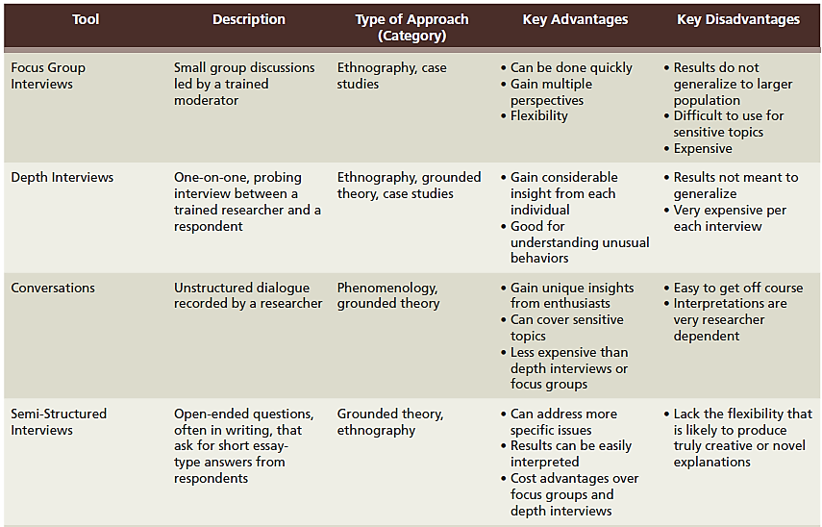
EXHIBIT 5.3 Common Qualitative Research Tools (1 of 2)
LO04
Notes:
Learning Objective 04

Slide 21
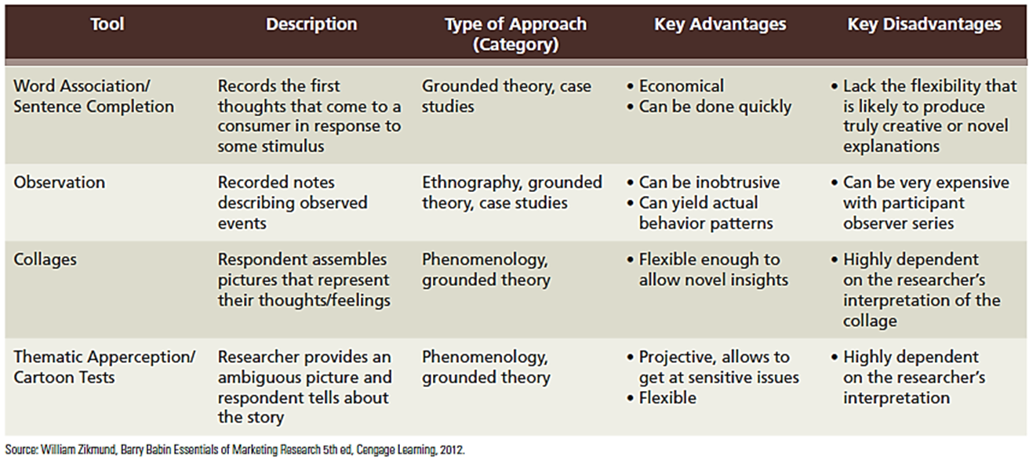
EXHIBIT 5.3 Common Qualitative Research Tools (2 of 2)
LO04
Notes:
Learning Objective 04

Slide 22
Focus Group Interview
Focus group interview is an unstructured, free-flowing interview with a small group (6-10 people) led by a moderator who encourages dialogue among respondents
Advantages
  Relatively fast
  Easy to execute
  Allow respondents to piggyback off each other’s ideas
  Provide multiple perspectives
  Flexibility to allow more detailed descriptions
  High degree of scrutiny
LO04
Notes:
Learning Objective 04

Slide 23
Focus Group Respondents
Respondents are screened based on some relevant characteristic
Respondents are inappropriate if they are either unwilling to express their views or they are overbearing
Group composition
  Six to ten people
  Relatively homogeneous
  Similar lifestyles and experiences
LO04
Notes:
Learning Objective 04

Slide 24
Environmental Conditions
A focus group session may typically take place at the research agency in a room specifically designed for this purpose
  Agency facilities include studio-like rooms where the focus groups are conducted, viewed and recorded
Participants receive refreshments prior to the interview to help create a more relaxed atmosphere conducive to a free exchange of ideas
LO04
Notes:
Learning Objective 04

Slide 25
The Focus Group Moderator
Moderator is a person who leads a focus group interview and ensures that everyone gets a chance to speak and contribute to the discussion
Qualities of a good moderator:
  Develops rapport with the group
  Good listener
  Tries not to interject his/her own personal opinions
  Directs verbal traffic capably without turning off productive participants
LO04
Notes:
Learning Objective 04

Slide 26
Focus Groups as Diagnostic Tools
Can supply diagnostic help to other research studies
Excellent tools for spotting problems with ideas as an idea screening technique
Mature products can also be “focused-grouped” for improvements
LO04
Notes:
Learning Objective 04

Slide 27
Depth Interviews (1 of 2)
Depth interviews are a one-on-one interview between a professional researcher and a research respondent conducted about some relevant business or social topic
Probing is an interview technique that tries to draw deeper and more elaborate explanations from a respondent
LO04
Notes:
Learning Objective 04

Slide 28
Depth Interviews (2 of 2)
Probing is useful for the following reasons:
  Clarification
  Free-form thinking
  Pause
  Contrast
  Meaning
  Change
Laddering is a particular approach to probing that asks respondents to compare differences between brands at different levels
LO04
Notes:
Learning Objective 04

Slide 29
Depth Interview Procedure
Typically an hour or more
Produces the same amount of text as a focus group
Interviewer must be aware of what is happening
  Records both surface reactions and subconscious motivations of the respondent
Analysis and interpretation is highly subjective
Particularly advantageous when the focus is on some unique or unusual behavior
LO04
Notes:
Learning Objective 04

Slide 30
Conversations
Conversations are an informal qualitative data-gathering approach in which the researcher engages a respondent in a discussion of the relevant subject matter
The goal is to have the respondent produce a dialogue about his/her lived experiences
A conversational approach is advantageous because conducting a single interview is usually inexpensive
LO04
Notes:
Learning Objective 04

Slide 31
Social Listening
Social Listening refers to marketing research using prompted or unprompted social media conversations to gather data
LO04
Notes:
Learning Objective 04

Slide 32
Semi-Structured Interviews
Semi-structured interviews are written forms that ask respondents for short essay responses to specific open-ended questions
Semi-structured interviews typically are part of a survey
The Advantages of semi-structured interviews include
    Can address more specific issues
    Responses are easier to interpret
    Can be relatively cost effective without the presence of an interviewer
LO04
Notes:
Learning Objective 04

Slide 33
Free-Association and Sentence-Completion Methods
Free-association techniques record a respondent’s first cognitive reactions (top-of-mind) to some stimulus
  Allow researchers to map a respondent’s thoughts or memory
The sentence-completion method is based on free-association principles
LO04
Notes:
Learning Objective 04

Slide 34
Observation and Collages
Observation
  Field notes are the researcher’s descriptions of what actually happens in the field
  They become the text from which meaning is extracted
  Advantageous for gaining insight into things that respondents cannot or will not verbalize
Collages
  Respondents prepare a collage to represent their experience with some good, service, or brand
  Analyzed for meaning
LO04
Notes:
Learning Objective 04

Slide 35
Thematic Apperception Test (TAT)
Thematic Apperception Test presents subjects with an ambiguous picture(s) in which consumers and products are the center of attention
The investigator asks the subject to tell what is happening in the picture(s) now and what might happen next
Picture frustration is a version of the TAT using a cartoon drawing in which the respondent suggests a dialogue in which the characters might engage
LO04
Notes:
Learning Objective 04

Slide 36
EXHIBIT 5.4 Picture Frustration Version of TAT Aimed to Get at Consumer Reactions to Salesperson Demeanor
LO04
Notes:
Learning Objective 04

Slide 37
Projective Research Techniques
Projective Research Technique is an indirect means of questioning that enables respondents to project beliefs and feelings onto a third party, an inanimate object, or a task situation
Encourages respondents to describe a situation in their own words with little prompting by the interviewer
Particularly useful in studying sensitive issues
LO04
Notes:
Learning Objective 04

Slide 38
Preparing a Focus Group Outline
Discussion guide includes written introductory comments informing the group about the focus group purpose and rules and then outlines topics or questions to be addressed in the group session
Helps control the interview and guide the discussion into product areas
The amount of content depends on the nature and experience of the researcher and the complexity of the topic
LO05
Notes:
Learning Objective 05

Slide 39
Steps for an Effective Focus Group Discussion Guide
Welcome and introductions
Broad icebreaker that does not reveal too many specifics about the interview
Make questions increasingly more specific as the interview proceeds
If there is a very specific objective to be accomplished, that question should probably be saved for last
A Debriefing statement and answering any questions
LO05
Notes:
Learning Objective 05

Slide 40
Disadvantages of Focus Groups
Focus groups disadvantages include
  Require objective, sensitive, and effective moderators
  May have unique sampling problems
  Not a representative, random sample
  Cost a considerable amount of money
    Particularly when they are not conducted by someone employed by the company requesting the focus group
LO05
Notes:
Learning Objective 05

Slide 41
Social Media and the Blogosphere
Technological advances have greatly improved researchers’ ability to perform all aspects of marketing research
Changing qualitative marketing research more than any other area
Facilitating interviewing
  Videoconferencing technologies
  Interactive media and online focus groups
  Social networking
  Software development
LO06
Notes:
Learning Objective 06

Slide 42
Online Focus Group Techniques
Advantages
  Fast
  Inexpensive
  Bring together many participants from wide-spread geographical areas
  Respondent anonymity
  Transcript automatically recorded
Disadvantages
  Less control over who participates
  Participants cannot touch or taste something
  Facial expression and body language cannot be seen
  Reduced ability of moderator to probe and ask questions
LO06
Notes:
Learning Objective 06

Slide 43
Social Networking
One of the most impactful trends in recent times
  For many, social networking sites have become the primary tool for communicating with friends both far and near and known and unknown
A large portion of social networking information discusses marketing and consumer-related information
  Companies monitor these sites for information related to their brands
LO06
Notes:
Learning Objective 06

Slide 44
Ethics
Marketing researchers should be aware of potential ethical issues that arise in conducting qualitative research involving social media or online posts.
  In netnography, a researcher may pose as a member of a brand-community under false pretense just to get access to the data
  A researcher may interject some less-than-honest conversation as a way of getting reactions
The ethical principles of marketing research should not change because of the online context
LO06
Notes:
Learning Objective 06

Slide 45
Software Development
Interpretive software
  Help identify themes and connections within text
  Examples: ATLAS.ti and NVivo
Text exploring tools
  Modern predictive analytic software enables text data to be mined from various sources, e.g., social networking sites, recorded conversations from call centers, and e-mail contacts
  Provides counts of how frequently a word appears in a text or dialog
LO06
Notes:
Learning Objective 06

Slide 46
Word Clouds
Word Clouds are a graphical depiction of the frequency with which words occur
Words occurring more frequently are shown in correspondingly large type face
Word clouds are an easy way to portray the frequency with which terms occur in a given interview, story, or other text data unit.
Clients easily understand the graphic.
LO06
Notes:
Learning Objective 06

Slide 47
EXHIBIT 5.5 A Word Cloud of Expert Wine Descriptions
LO06
Notes:
Learning Objective 06

Slide 48
EXHIBIT 5.6 Illustrating Some Ways Technological Developments Facilitate Qualitative Research
LO06
Notes:
Learning Objective 06

Slide 49
Exploratory Research in Science and in Practice
Misuses of exploratory and qualitative research
  Subjectivity
    Predominantly limits testing—particularly hypothesis testing
  Replicability
    When the same conclusion is reached based on another researcher’s interpretation
  Motivational research era
    Too few researchers engaged in too much interpretation of too few respondents
LO07
Notes:
Learning Objective 07

Slide 50
Scientific Decision Processes (1 of 2)
Objectivity and replicability are two characteristics of scientific inquiry
A focus group, or a depth interview, or TAT alone cannot best represent a complete scientific inquiry
Before making a scientific decision, a research project should include a confirmatory study using objective tools and an adequate sample
LO07
Notes:
Learning Objective 07

Slide 51
Scientific Decision Processes (2 of 2)
The primary barriers to scientific decisions
  Time
  Money
  Emotion
LO07
Notes:
Learning Objective 07

