Slide 1
Chapter 1
The Role of Marketing Research
© 2019 Cengage. All rights reserved.

Slide 2
Learning Outcomes
After studying this chapter, you should
Know what marketing research is and what it does for business
Understand the difference between basic and applied marketing research
Understand how the role of marketing research changes with the orientation of the firm
Be able to integrate marketing research results into the strategic planning process
Know when marketing research should and should not be conducted
Appreciate the way technology and internationalization are changing marketing research

Slide 3
What Is Marketing Research?
Key questions in business and marketing research
  What do we sell?
  How do consumers view our company?
  What does our company/product mean?
  What do consumers desire?
  How does our brand touch consumers?
LO01
Notes:
Learning Objective 01

Slide 4
Marketing Research Defined (1 of 2)
Marketing Research is the application of the scientific method in searching for the truth about marketing phenomena
The process includes:
  Idea and theory development
  Problem definition
  Information gathering
  Analyzing data
  Model building
  Communicating the findings and their implications
LO01
Notes:
Learning Objective 01

Slide 5
Marketing Research Defined (2 of 2)
This definition suggests that marketing research information is:
  Not accidental or haphazardly gathered
  Accurate and objective
  Relevant to all aspects of the marketing mix
  Limited by one’s definition of marketing
We explore marketing research as it applies to all organizations and institutions engaging in some form of marketing activity
LO01
Notes:
Learning Objective 01

Slide 6
Digital Marketing
Digital Marketing is a term used to capture all of the various communicative technologies through which marketing enterprises (suppliers, manufacturers, retailers, etc.) work together with customers toward enhancing value from interaction, including exchange and relationships
LO01
Notes:
Learning Objective 01

Slide 7
EXHIBIT 1.1 Marketing Research and Digital Technologies
LO01
Notes:
Learning Objective 01

Slide 8
Applied Marketing Research
Applied Marketing Research is conducted to address a specific marketing decision for a specific firm or organization
Example:
  Should Green Mountain Coffee add cola to its array of pod-based beverages?
LO02
Notes:
Learning Objective 02

Slide 9
Basic Marketing Research
Basic Marketing Research is conducted without a specific decision in mind and usually does not address the needs of a specific organization
  Attempts to expand the limits of marketing knowledge in general
  Not aimed at solving a pragmatic problem
Can test the validity of a general marketing theory (one that applies to all of marketing) or can be used to learn more about some market phenomenon, e.g., social networking
LO02
Notes:
Learning Objective 02

Slide 10
The Scientific Method
The Scientific Method is the way by which researchers go about using knowledge and evidence to reach objective conclusions about the real world
All marketing research, whether basic or applied, involves the scientific method
Marketing researchers apply the scientific method to understand marketing phenomena
LO02
Notes:
Learning Objective 02

Slide 11
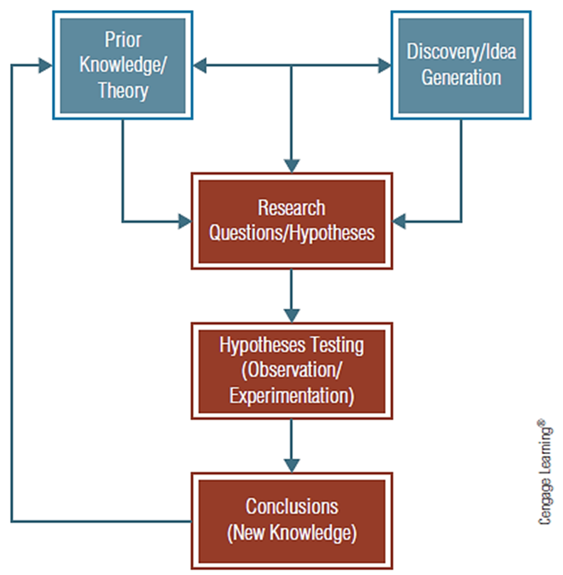
EXHIBIT 1.2 The Scientific Method
LO02
Notes:
Learning Objective 02

Slide 12
Marketing Research and Strategic Management Orientation
Types of strategic management orientations provide a common theme for decision-making
  Product-oriented
  Production-oriented
  Marketing-oriented
  Stakeholder-oriented
LO03
Notes:
Learning Objective 03

Slide 13
EXHIBIT 1.3 Types of Business Orientation
Product Orientation | Production Orientation | Marketing Orientation | Stakeholder Orientation
Internal focus | Internal focus | External focus | External focus
Emphasize product superiority | Emphasize efficiency and low costs | Emphasize customer tastes and desires | Emphasize a balance in satisfying all parties touched by organization
Product research is critical | Process research is important | Customer research is essential | Consumer research is important
Narrow or even niche markets served | Mass markets often required for success | Identifiable market segments matched with unique product | Select segments served balanced with great concern for public persona
LO03
Notes:
Learning Objective 03

Slide 14
The Marketing Concept
Focuses on how a firm provides value to customers more than on the physical product or production process
A marketing-oriented firm must:
  Be customer-oriented—makes decisions with a conscious awareness of their effect on the consumer
  Emphasize long-run profitability—ensures continuity of firm
  Adopt a cross-functional perspective—integrate marketing across other business functions
LO03
Notes:
Learning Objective 03

Slide 15
Keeping Customers and Building Relationships
Relationship marketing is the idea that a major goal of marketing is to build long-term relationships with the customers contributing to their success
Views a sale not as the end of a process but as the start of the organization’s relationship with a customer—marketers want customers for life
  Satisfied customers will return to a company that has treated them well
LO03
Notes:
Learning Objective 03

Slide 16
Marketing Research: A Means For Implementing the Marketing Concept
Tracking trends
Analysis of existing data
  Use sales data to offer customers product suggestions
LO03
Notes:
Learning Objective 03

Slide 17
Marketing Research and Strategic Marketing Management
Developing and implementing a marketing strategy involves four stages:
  Identifying and evaluating market opportunities
  Analyzing market segments and selecting target markets
  Planning and implementing a marketing mix that will provide value to customers and meet organizational objectives
  Analyzing firm performance
LO04
Notes:
Learning Objective 04

Slide 18
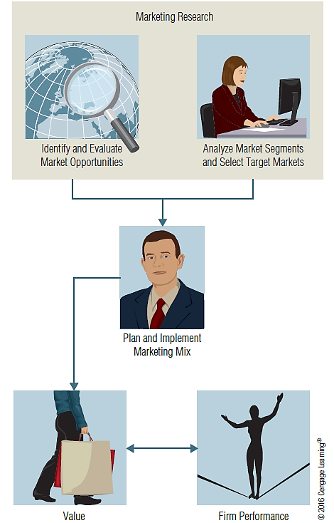
EXHIBIT 1.4 Marketing Research Cuts Decision Risk with Input That Leads to Value
LO04
Notes:
Learning Objective 04

Slide 19
Stage1: Identifying and Evaluating Opportunities
Monitoring the competitive environment for signals indicating a business opportunity
  Helps managers recognize problems and identify opportunities for enriching marketing efforts
  Motivates a firm to take action to address consumer desires in a way that is beneficial to both the customers and to the firm
  Estimates of market sales potential allow managers to evaluate the profitability of various opportunities
LO04
Notes:
Learning Objective 04

Slide 20
Stage 2: Analyzing and Selecting Target Markets
Geo-demographics is information describing the demographic profile of consumers in a particular geographic region
Once the company knows the geo-demographics of a market segment, it can effectively communicate with those customers by choosing media that reach that particular profile
  Example: Architectural Digest magazine
LO04
Notes:
Learning Objective 04

Slide 21
Stage 3: Planning and Implementing a Marketing Mix
Marketing research can be used to support specific decisions about aspects of the marketing mix
It is essential that an overall research plan involves all elements of marketing strategy
LO04
Notes:
Learning Objective 04

Slide 22
Types of Marketing Mix Research: Product Research
Designed to evaluate and develop new products and to learn how to adapt existing product lines
  Concept testing
  Product testing
  Brand-name evaluation
  Package testing
LO04
Notes:
Learning Objective 04

Slide 23
Types of Marketing Mix Research: Pricing Research
Pricing research represents typical marketing research
Pricing Strategy involves finding the amount of monetary sacrifice that best represents the value customers perceive in a product after considering various market constraints
Pricing research by its nature also involves consumer quality perceptions
LO04
Notes:
Learning Objective 04

Slide 24
Types of Marketing Mix Research: Distribution Research
Studies aimed at selecting retail sites or warehouse locations that will physically distribute products.
Needed to gain knowledge about retailers’ and wholesalers’ operations and to learn their reactions
Used to examine the effect of just-in-time ordering systems or exclusive distribution on product quality
LO04
Notes:
Learning Objective 04

Slide 25
Types of Marketing Mix Research: Promotion Research
Promotion is the communication function of the firm responsible for informing and persuading buyers
Promotion Research investigates the effectiveness of advertising, premiums, coupons, sampling, discounts, public relations, and other sales promotions
Firms spend more time, money, and effort on advertising research
LO04
Notes:
Learning Objective 04

Slide 26
The Integrated Marketing Mix
Integrated marketing communication is all promotional efforts (advertising, public relations, personal selling, event marketing, and so forth) are coordinated to communicate a consistent image
Research suggests firms with a consumer orientation are particularly oriented toward integrating all aspects of their marketing into a single message
Integration means sending a consistent message
LO04
Notes:
Learning Objective 04

Slide 27
Stage 4: Analyzing Marketing Performance (1 of 2)
Total value management is trying to manage and monitor the entire process by which consumers receive benefits from a company
Performance-monitoring research refers to research that regularly, sometimes routinely, provides feedback for evaluation and control of marketing activity
  Most common forms: market-share analysis and sales analysis
LO04
Notes:
Learning Objective 04

Slide 28
Stage 4: Analyzing Marketing Performance (2 of 2)
Marketing metrics refer to quantitative ways of monitoring and measuring marketing performance
  Allows the firm to assess the return on investment (ROI) associated with marketing activities
LO04
Notes:
Learning Objective 04

Slide 29
When is Marketing Research Needed?
(1 of 2)
The determination of the need for marketing research centers on:
  Time constraints
    Systematic research takes time
  The availability of data
    If the data cannot be obtained or obtained in a timely fashion, the research project should not be conducted
  The nature of the decision
    The more strategically or tactically important the decision, the more likely it is that research will be conducted
  Benefits versus costs—the value of the research information in relation to costs
LO05
Notes:
Learning Objective 05

Slide 30
When is Marketing Research Needed?
(2 of 2)
Questions to consider when deciding whether to make a decision without research or to postpone the decision in order to conduct research
  Is the potential payoff worth the investment?
  Will the information gained by marketing research improve the quality of the marketing decision enough to warrant the expenditure?
  Is the proposed research expenditure the best use of the available funds?
LO05
Notes:
Learning Objective 05

Slide 31
EXHIBIT 1.5 Should We Conduct Marketing Research?
Factor | Conduct Market Research | Do Not Conduct Market Research
Time | Sufficient time is available before decision will be made. | Time pressure requires a decision before adequate research can be completed.
Data Availability | Firm does not have access to data but data can be obtained. | Firm already has relevant data or data cannot be obtained.
Nature of Decision | Decision is of considerable strategic or tactical importance. | Decision is NOT of considerable strategic or tactical importance.
Benefits versus Costs | Potential value of research exceeds costs of conducting research. | Costs of research exceed potential value of project.
 | GO! | STOP!
LO05
Notes:
Learning Objective 05

Slide 32
Marketing Research in the Twenty-First Century (1 of 2)
Communication technologies
  Virtually everyone is “connected” today
  The speed with which people exchange information continues to increase
  Today, even the most basic laptop computers can solve complicated statistical problems
  Small, inexpensive appliances like a smartphone access software and data existing on a cloud (large servers that supply information and software to large numbers of Internet users), reducing the need for specialized software
LO06
Notes:
Learning Objective 06

Slide 33
Marketing Research in the Twenty-First Century (2 of 2)
Global marketing research
  Business research is increasingly global
  Companies that conduct business globally must understand the nature of those particular markets and judge whether they require customized marketing strategies
  Increased need to culturally cross-validate, verify that the empirical findings from one culture also exist and behave similarly in another culture.
LO06
Notes:
Learning Objective 06

