Slide 1
Organizational Behavior, 14e
Chapter 5
Motivating Behavior

Slide 2
Learning Outcomes
After studying this chapter, you should be able to:
Characterize the nature of motivation, including its importance and basic historical perspectives.
Describe the need-based perspectives on motivation.
Describe the major process-based perspectives on motivation.
Describe learning-based perspectives on motivation.

Slide 3
The Importance of Motivation
Motivation – set of forces that leads people to behave in particular ways
Job performance (P) depends upon motivation (M), ability (A), and environment (E):
P = M × A × E
To reach high levels of performance, an employee must:
Want to do the job well (motivation)
Be able to do the job effectively (ability)
Have the materials, resources, equipment, and information required to do the job (environment)
A deficiency in any one of these areas hurts performance.

Slide 4
The Motivational Framework
How motivational processes occur:
Need: anything an individual requires or wants
A need deficiency triggers attempts to satisfy the need.
Goal-directed behaviors result from individuals trying to satisfy their need deficiencies.
Rewards and punishments are consequences of the goal-directed behavior.
Assessment of the extent to which the outcome addressed the original need deficiency

Slide 5
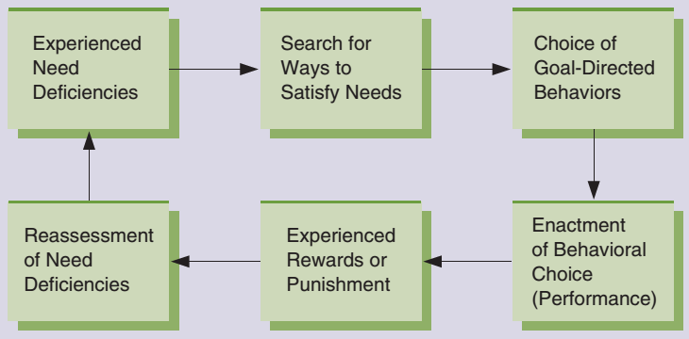
Figure 5.1 Motivational Framework
This framework provides a useful way to see how motivational processes occur. When people experience a need deficiency, they seek ways to satisfy it, which results in a choice of goal-directed behaviors. After performing the behavior, the individual experiences rewards or punishments that affect the original need deficiency.

Slide 6
Early Perspectives on Motivation
Traditional approach
Scientific management – approach to motivation that assumes that employees are motivated by money
Human relations approach – suggests that fostering a false sense of employees’ inclusion in decision making will result in positive employee attitudes and motivation to work hard
Human resource approach – assumes that people want to contribute and are able to make genuine contributions

Slide 7
Individual Differences and Motivation
Task-specific self-efficacy – a person’s beliefs in their capabilities to do what is required to accomplish a specific task
Three dimensions of self-efficacy:
Magnitude | beliefs about how difficult a task can be to accomplish
Strength | beliefs about how confident the person is that the specific task can be accomplished
Generality | beliefs about the degree to which similar tasks can be accomplished

Slide 8
Knowledge Check 5.1
You want to enhance an employee’s belief in being able to accomplish tasks similar to those at which they have already been successful. Which of the dimensions of task-specific efficacy will you focus on?
Magnitude
Strength
Generality
Expectation

Slide 9
The Hierarchy of Needs
Need-based theory – assumes that need deficiencies cause behavior
Hierarchy of needs – assumes that human needs are arranged in a hierarchy of importance
Basic (or deficiency) needs
Physiological
Security
Belongingness
Growth needs
Esteem
Self-actualization

Slide 10
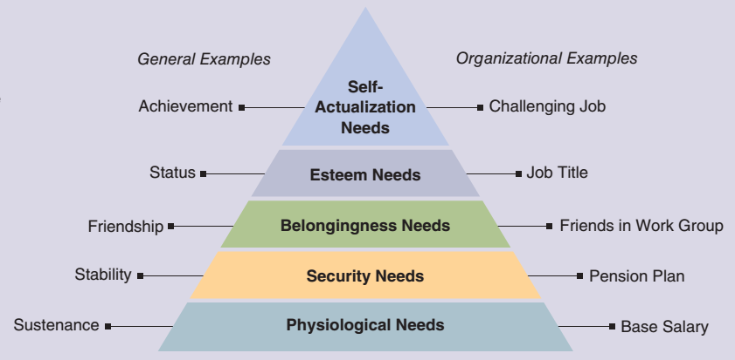
Figure 5.2 The Hierarchy of Needs
Maslow’s hierarchy of needs consists of five basic categories of needs. This figure illustrates both general and organizational examples of each type of need. Of course, each individual has a wide variety of specific needs within each category.

Slide 11
Discussion Activity
Maslow’s hierarchy of needs provides a good general framework for categorizing human needs. Refer to Figure 5.2 as needed as you consider these questions:
What are the meanings of the labels deficiency needs and growth needs, and why do the needs of the hierarchy fall under one of these labels?
Does a manager need to pay more attention to employees’ deficiency needs or growth needs? Why?
What deficiencies do you see in Maslow’s model?

Slide 12
Discussion Activity Debrief
What are the meanings of the labels deficiency needs and growth needs, and why do the needs of the hierarchy fall under one of these labels?
The three sets of needs at the bottom of the hierarchy are called deficiency needs because they must be satisfied for the individual to survive and be fundamentally comfortable. Growth needs focus on personal growth and development.
Does a manager need to pay more attention to employees’ deficiency needs or growth needs? Why?
The answer here is often situational. Workers who cannot meet deficiency needs cannot survive, so meeting those needs is primary for any employer. Growth needs can then be attended to, which will help the employees be more productive.
What deficiencies do you see in Maslow’s model?
Research shows that the needs hierarchy does not generalize well to other countries. Levels of needs are not always present, and the actual hierarchy of needs does not always conform to Maslow’s model. Sometimes, managers are overly clumsy or superficial in their attempts to use a theory such as this one.

Slide 13
The ERG and Two-Factor Theories
ERG theory – describes existence, relatedness, and growth needs
More than one need may motivate a person at the same time.
Satisfaction-progression and frustration-regression components
Two-factor theory – identifies motivation factors, which affect satisfaction, and hygiene factors, which determine dissatisfaction
Motivation factors – Are intrinsic to the work itself and include factors such as achievement and recognition
Hygiene factors – Are extrinsic to the work itself and include factors such as pay and job security

Slide 14
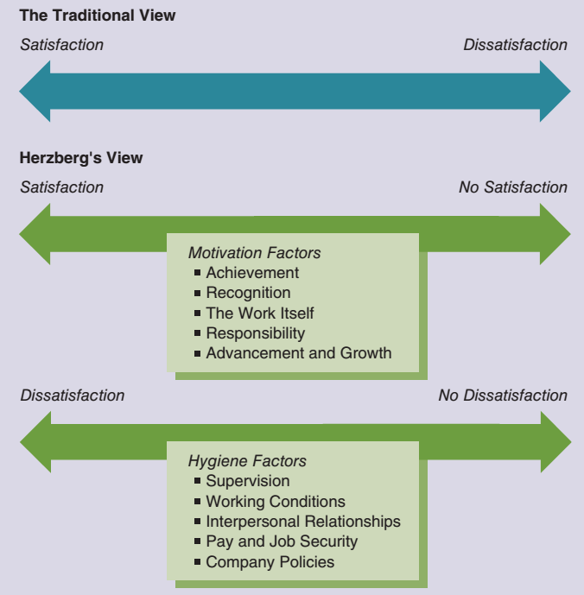
Figure 5.3 The Two-Factor Theory of Motivation
The traditional view of satisfaction suggested that satisfaction and dissatisfaction were opposite ends of a single dimension. Herzberg’s two-factor theory found evidence of a more complex view. In this theory, motivation factors affect one dimension, ranging from satisfaction to no satisfaction. Other workplace characteristics, called “hygiene factors,” are assumed to affect another dimension, ranging from dissatisfaction to no dissatisfaction.

Slide 15
The Acquired Needs Framework
Acquired needs framework – centers on the needs for achievement, affiliation, and power
Need for achievement – the desire to accomplish a task or goal more effectively than was done in the past
Need for affiliation – the need for human companionship
Need for power – the desire to control the resources in one’s environment

Slide 16
The Equity Theory of Motivation
Process-based perspective – focuses on how people behave in their efforts to satisfy their needs
Equity theory – focuses on people’s desire to be treated with what they perceive as equity and to avoid perceived inequity
Equity – the belief that we are being treated fairly in relation to others; inequity is the belief that we are being treated unfairly in relation to others
Equity comparison process in terms of an input-to-outcome ratio:
$$\begin{matrix}\frac{Outcomes \left(self\right)}{Inputs \left(self\right)} & compared with & \frac{Outcomes \left(other\right)}{Inputs \left(other\right)}\end{matrix}$$

Slide 17
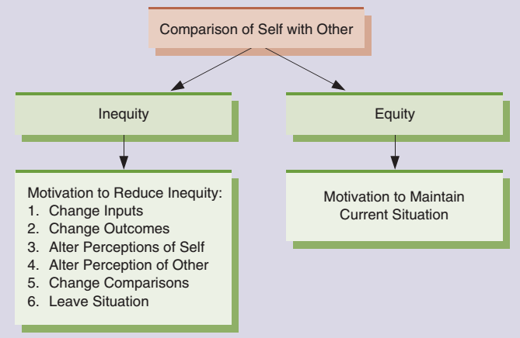
Figure 5.4 Responses to Perceptions of Equity and Inequity
People form equity perceptions by comparing their situation with that of someone else. If they perceive equity, they are motivated to maintain the current situation. If they perceive inequity, they are motivated to use one or more of the strategies shown here to reduce the inequity.

Slide 18
The Expectancy Theory of Motivation
Expectancy theory – suggests that people are motivated by how much they want something and the likelihood they perceive of getting it
Basic expectancy model components:
Effort-to-performance expectancy | The perceived probability that effort will lead to performance
Performance-to-outcome expectancy | The perceived probability that performance will lead to certain outcomes
Outcome | Anything that results from performing a behavior
Valence | The degree of attractiveness or unattractiveness (value) that a particular outcome has for a person

Slide 19
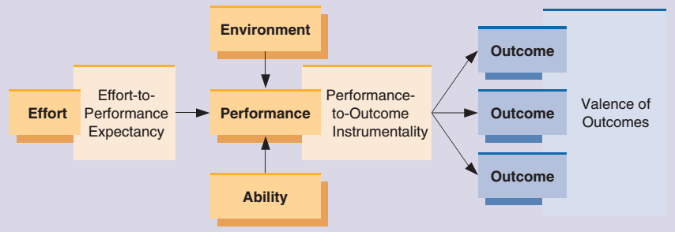
Figure 5.5 The Expectancy Theory of Motivation
The expectancy theory is the most complex model of employee motivation in organizations. As shown here, the key components of expectancy theory are effort-to-performance expectancy, performance-to-outcome instrumentality, and outcomes, each of which has an associated valence. These components interact with effort, environment, and ability to determine an individual’s performance.

Slide 20
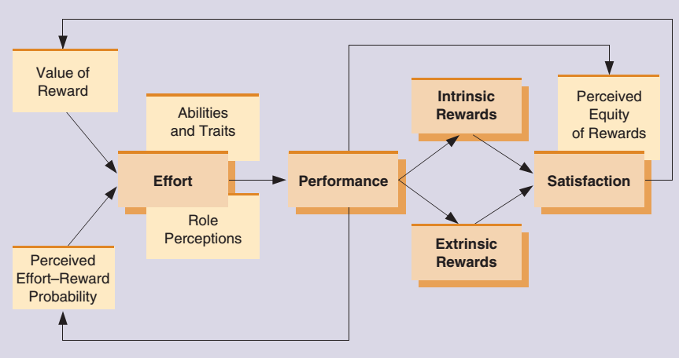
Figure 5.6 The Porter-Lawler Model
The Porter and Lawler expectancy model provides interesting insights into the relationships between satisfaction and performance. As illustrated here, this model predicts that satisfaction is determined by the perceived equity of intrinsic and extrinsic rewards for performance. That is, rather than satisfaction causing performance, which many people might predict, this model argues that it is actually performance that eventually leads to satisfaction.

Slide 21
Evaluations of Expectancy Theory
Expectancy theory has been tested by many different researchers in a variety of settings and using a variety of methods.
Its complexity makes it difficult to test.
People will engage in motivated behavior if they:
Value the expected rewards
Believe their efforts will lead to performance
Believe their performance will result in the desired rewards

Slide 22
How Learning Occurs
Learning – a relatively permanent change in behavior or behavioral potential resulting from direct or indirect experience
How learning occurs:
Traditional view
Classical conditioning – a simple form of learning that links a conditioned response with an unconditioned stimulus
Contemporary view
Learning as a cognitive process, which assumes people are conscious, active participants in how they learn

Slide 23
Reinforcement Theory and Social Learning
Reinforcement theory – based on the idea that behavior is a function of its consequences
Also called operant conditioning (Skinner)
People consciously explore different behaviors and systematically choose those that result in the most desirable outcomes.
Social learning – when people observe the behaviors of others, recognize the consequences, and alter their own behavior as a result
Behavior being observed and imitated must be relatively simple.
Observed and imitated behavior must be concrete, not intellectual.
Learner must have the physical ability to imitate the observed behavior.

Slide 24
Behavior Modification
Behavior modification – the application of reinforcement theory to influence the behaviors of people in organizational settings
Positive reinforcement uses rewards or other desirable consequences that a person receives after exhibiting behavior.
Negative reinforcement (avoidance) involves opportunity to avoid or escape from an unpleasant circumstance after exhibiting behavior.
Punishment is the application of unpleasant or aversive consequences to decrease the likelihood of a behavior.
Extinction decreases the frequency of behavior by eliminating a reward or desirable consequence that follows a behavior.

Slide 25
Behavior Modification
Behavior modification – the application of reinforcement theory to influence the behaviors of people in organizational settings
Positive reinforcement uses rewards or other desirable consequences that a person receives after exhibiting behavior.
Negative reinforcement (avoidance) involves opportunity to avoid or escape from an unpleasant circumstance after exhibiting behavior.
Punishment is the application of unpleasant or aversive consequences to decrease the likelihood of a behavior.
Extinction decreases the frequency of behavior by eliminating a reward or desirable consequence that follows a behavior.

Slide 26
Figure 5.7 Types of Reinforcers
Individual behavior can be affected when stimulus is either presented or removed after a particular behavior. This is also dependent on whether the stimulus is positive or negative.

Slide 27
The Timing of Reinforcement
Timing of Reinforcement | Nature of Reinforcement
Fixed-ratio | Behavior is reinforced according to the number of behaviors exhibited, with the number of behaviors needed to gain reinforcement held constant.
Fixed-interval | Behavior is reinforced according to some predetermined, constant schedule based on time.
Variable-ratio | Behavior is reinforced according to the number of behaviors exhibited, but the number of behaviors needed to gain reinforcement varies from one time to the next.
Variable-interval | Behavior is reinforced after periods of time, but the time span varies from one time to the next.

Slide 28
Motivating the Right Behavior
Define the problem—what is it that could be improved?
Identify and define the specific behavior(s) you wish to change.
Record and track the occurrence of the target behavior.
Analyze the current negative consequences of the undesired behavior and arrange for more positive consequences to follow the desired behavior.
Evaluate whether the behavior has improved and by how much.

Slide 29
Table 5.1 Applying Motivation Theories to Various Managerial Challenges to Enhance Motivation
Managerial Challenges | Self-Efficacy | Needs Theory | Herzberg’s Two-Factor Theory | Expectancy Theory | Equity Theory | Reinforcement
Firm has a low-cost business strategy but needs to motivate employees | x | x | x | x | x | x
An employee feels he cannot meet his performance goals | x |  |  | x
An employee feels underpaid relative to her coworkers |  |  | x |  | x
An employee engages in inappropriate behavior (bullying, ridiculing coworkers) |  |  |  |  |  | x
A talented employee is not feeling challenged at work |  | x | x | x
Because the work is repetitive, some employees find it boring and hard to stay motivated |  | x | x

Slide 30
Knowledge Check 5.2
According to research, what is the most effective schedule of reinforcement for sustaining a behavior?
Variable reinforcement
Fixed-ratio reinforcement
Fixed-interval reinforcement
Extinction

Slide 31
Self-Assessment
When you think of your tasks, performance, and outcomes over recent months, what do you see as your most valuable motivator?
Because Maslow’s hierarchy of needs makes intuitive sense, many people use it to better understand their behaviors. In what ways does it make sense to you? In what ways do you feel your behaviors don’t follow Maslow’s hierarchy?
If you had to give your boss advice on the best way to motivate you, what would you tell that person?

Slide 32
Self-Assessment
When you think of your tasks, performance, and outcomes over recent months, what do you see as your most valuable motivator?
Because Maslow’s hierarchy of needs makes intuitive sense, many people use it to better understand their behaviors. In what ways does it make sense to you? In what ways do you feel your behaviors don’t follow Maslow’s hierarchy?
If you had to give your boss advice on the best way to motivate you, what would you tell that person?

Slide 33
Summary
Click the link to review the outcomes for this presentation.
Link to Learning Outcomes

