Slide 1

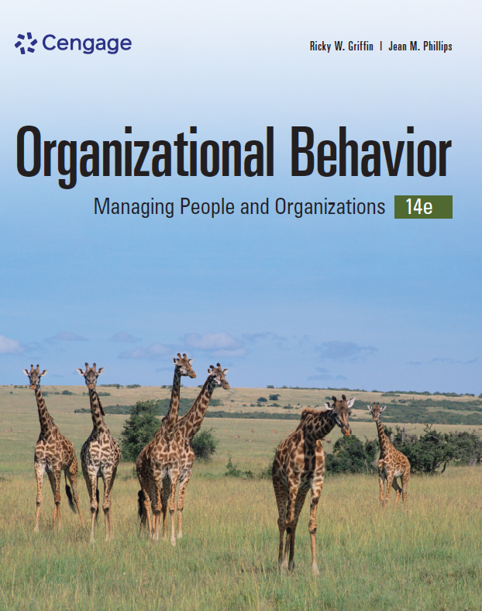
Organizational Behavior, 14e
Chapter 4
Individual Values, Perceptions, and Reactions

Slide 2

Learning Outcomes
After studying this chapter, you should be able to:
Describe three important work-related attitudes, including how they are formed.
Define cognitive dissonance.
Describe the role and importance of values and emotions in organizational behavior.
Describe basic perceptual processes and how perception affects fairness, justice, and trust in organizations.
Discuss the nature of stress, including the basic causes and consequences and how it can be effectively managed.

Slide 3

4-1 Attitudes in Organizations
After studying this chapter, you should be able to:
Describe three important work-related attitudes, including how they are formed.
Define cognitive dissonance.
Describe the role and importance of values and emotions in organizational behavior.
Describe basic perceptual processes and how perception affects fairness, justice, and trust in organizations.
Discuss the nature of stress, including the basic causes and consequences and how it can be effectively managed.

Slide 4
How Attitudes Are Formed
Attitudes – a person’s complexes of beliefs and feelings about specific ideas, situations, or other people
  Formed by personal values, experiences, and personality
Structural components of attitudes
  Cognition – the knowledge a person presumes to have about something
  Affect – a person’s feelings toward something
  Intention – component of an attitude that guides a person’s behavior

Slide 5
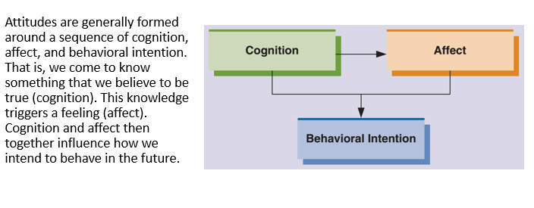
Figure 4.1 Attitude Formation

Slide 6
Cognitive Dissonance
Cognitive dissonance – an incompatibility or conflict between behavior and an attitude or between two different attitudes
Approaches to cope with cognitive dissonance:
  Change the conflicting behavior
  Change the conflicting attitude
  Reason that one of the conflicting attitudes or behaviors is not important in this context
  Seek additional information to better reason that the benefits of one conflicting attitude or behavior outweigh the costs of the other
Recognize that attitudes can change

Slide 7
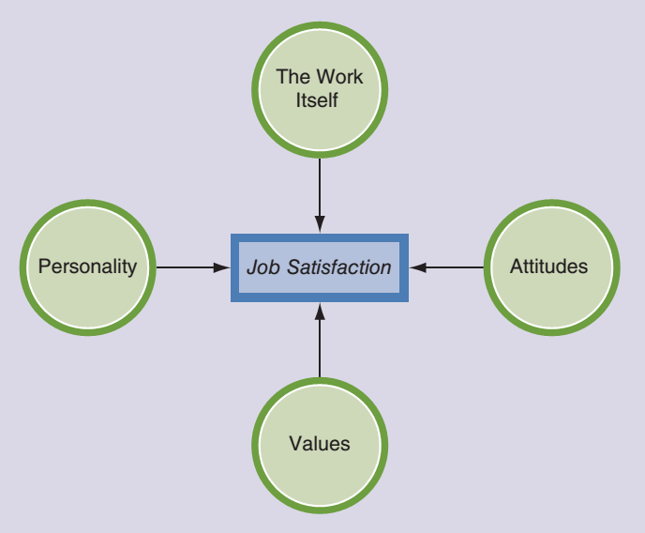
Figure 4.2
Influences on Job Satisfaction
Job satisfaction is one of the most important job-related attitudes in organizations. It reflects both our attitudes and our feelings about our job. Job satisfaction is strongly influenced by our personality, values, other attitudes, and the work itself.

Slide 8
Organizational Commitment
Organizational commitment – reflects the degree to which an employee identifies with the organization and its goals and wants to stay with the organization
  Affective commitment – positive emotional attachment to the organization and strong identification with its values and its goals; employees want to stay with the organization
  Normative commitment – a feeling of moral or ethical obligation to the organization; employees stay because they believe it would be wrong to leave
  Continuance commitment – staying with the organization because of perceived high economic and/or social costs; employees stay because they feel they have to

Slide 9
Employee Engagement
Employee engagement – heightened emotional and intellectual connection that an employee has for their job, organization, manager, or coworkers that, in turn, influences them to apply additional discretionary effort to their work
Evidence suggests that high employee engagement is related to superior business performance
Engagement is enhanced when employees:
Have clear goals
Have the resources needed to do a good job
Get meaningful performance feedback
Are able to use their talents
Are recognized for doing a good job
Have positive relationships with coworkers
Have opportunities to learn and grow
Have supportive leadership

Slide 10
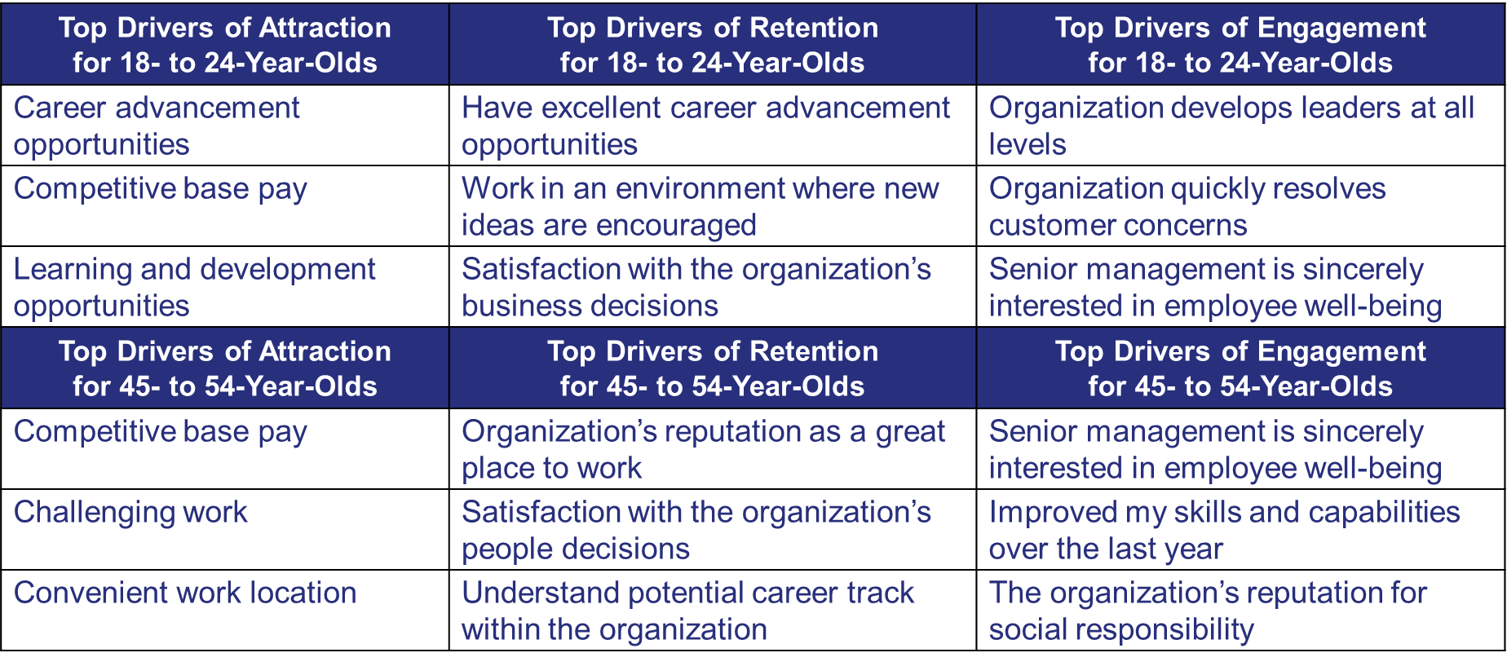
Table 4.1 Top Three Worldwide Drivers of Employee Attraction, Retention, and Engagement for Different Age Groups

Slide 11
Knowledge Check 4.1
Which of these comes first in attitude formation?
Behavioral intention
Cognition
Affect
Cognitive dissonance

Slide 12
4-2
Values and Emotions in Organizations

Slide 13
Types of Values
Value – way of behaving or end-state desirable to a person or group
  Terminal values – reflect long-term life goals such as prosperity, happiness, a secure family, and a sense of accomplishment
  Instrumental values – preferred means of achieving terminal values or preferred ways of behaving
  Intrinsic work values – relate to the work itself
  Extrinsic work values – relate to the outcomes of doing work

Slide 14
Conflicts among Values
Intrapersonal value conflict – occurs when an individual experiences conflict between an instrumental value and a terminal value
  People are generally happier and less stressed when instrumental and terminal values are aligned
Interpersonal value conflict – occurs when two different people hold conflicting values
  Often the cause of personality clashes and other disagreements
Individual–organization value conflict – when an employee’s values conflict with those of the organization
  Lower levels lead to greater job satisfaction, performance and commitment

Slide 15
How Values Differ around the World
Global differences in values may lead to different managerial behaviors.
Two major dimensions:
  Traditional versus secular-rational values: reflects the contrast between societies in which religion is very important and those in which it is not
  Survival versus self-expression values: reflects the contrast between societies that emphasize economic and physical security and those that emphasize subjective well-being, self-expression, and quality of life

Slide 16
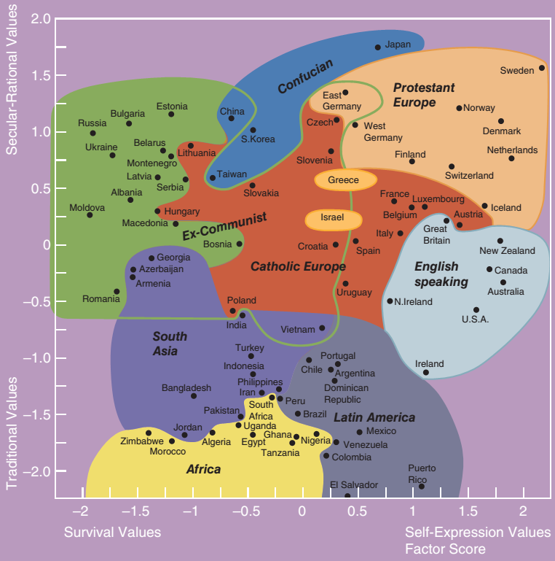
Figure 4.3
How Values Differ around the World
Values differ around the world. One useful way to understand differences in values is in terms of secular/rational values and survival/self-expression values. This figure illustrates how different regions of the world reflect these two sets of values.

Slide 17
Discussion Activity 1
As a class, review the matrix found in Figure 4.3.
Are country placements as you would expect?
Which placements surprised you most?
How would you, as a manager, interact with an employee from Latvia or Estonia differently from the way you interact with an employee from Puerto Rico?

Slide 18
Discussion Activity 1 Debrief
As a class, review the matrix found in Figure 4.3.
Are country placements as you would expect?
Which placements surprised you most?
How would you, as a manager, interact with an employee from Latvia or Estonia, for example, differently from the way you interact with an employee from Puerto Rico?
  Answers for these questions will vary widely, depending on the respondent’s own region of origin. Compare these different points of view where possible. Carefully examine your responses for any stereotypes that might be present

Slide 19
The Role of Emotions in Behavior
Emotion – intense, short-term physiological, behavioral, and psychological reaction to a specific object, person, or event that prepares us to respond to it
Mood – short-term emotional state that is not directed toward anything in particular
Affectivity – the tendency to experience a particular mood or to react to things with certain emotions
  Positive affect – reflects a combination of high energy and positive evaluation characterized by emotions like elation
  Negative affect – consists of feelings of being upset, fearful, and distressed

Slide 20
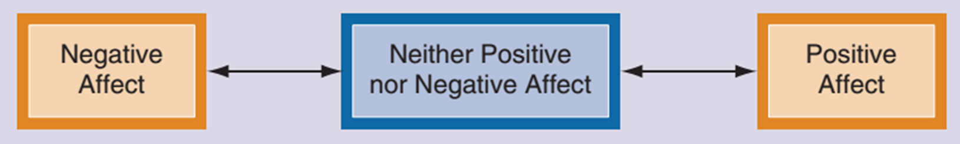
Figure 4.4 Positive and Negative Affect
Affect can vary anywhere along a continuum ranging from positive affect to negative affect. As illustrated here, it is also possible to fall in between these extremes and reflect neither positive nor negative affect.

Slide 21
4-3
Perception in Organizations

Slide 22
Basic Perceptual Processes
Perception – the set of processes by which an individual becomes aware of and interprets information about the environment
  Selective perception – the process of screening out information that we are uncomfortable with or that contradicts our beliefs
  Stereotyping – the process of categorizing or labeling people on the basis of a single attribute
    Certain forms can be useful and efficient.
    Other forms are inaccurate and can be harmful.

Slide 23
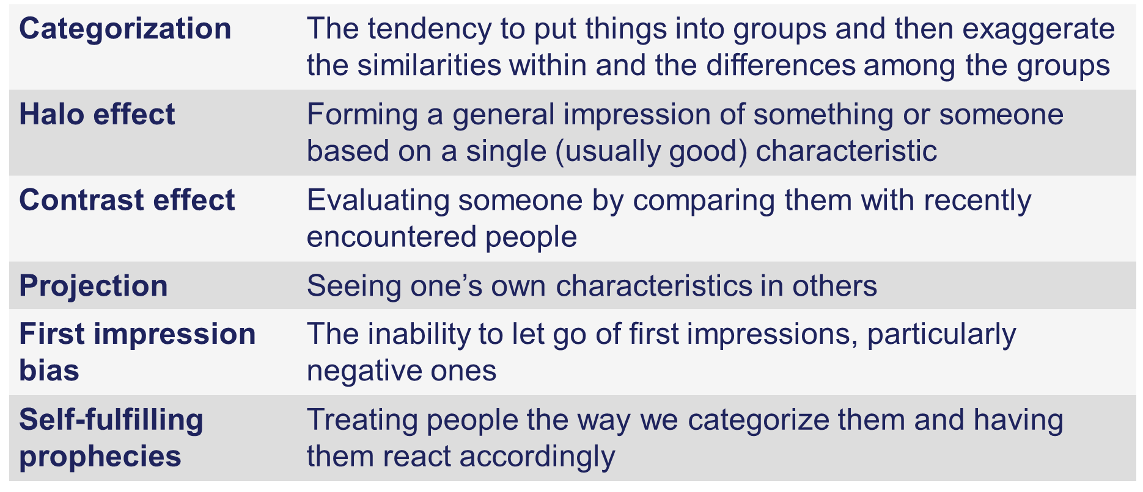
Errors in Perception

Slide 24
Perception and Attribution
Attribution – the way we explain the causes of our own as well as other people’s behaviors and achievements, and understand why people do what they do
  Are they due to the individual because of internal factors such as effort and ability?
  Or are they due to the environment because of external factors such as luck, resources, and other people?
Self-handicapping – when people create obstacles for themselves that make success less likely

Slide 25
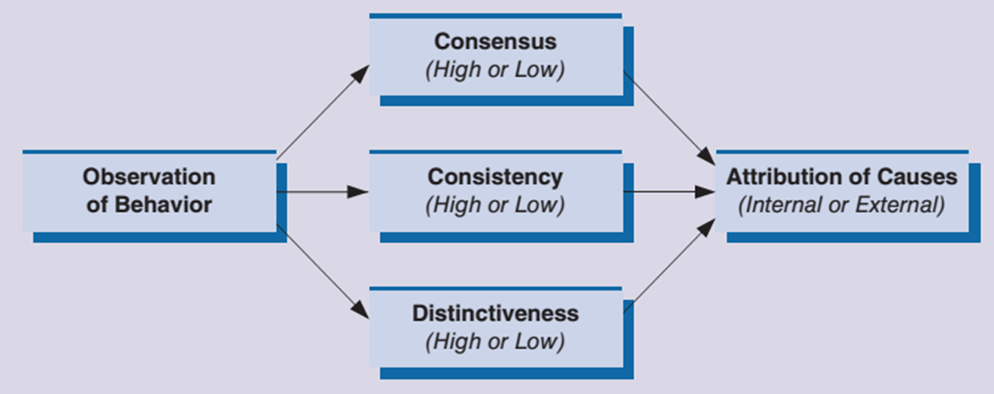
Figure 4.5 The Attribution Process
The attribution process involves observing behavior and then attributing causes to it. Observed behaviors are interpreted in terms of their consensus, their consistency, and their distinctiveness. Based on these interpretations, behavior is attributed to either internal or external causes.

Slide 26
Perception of Fairness, Justice, and Trust
Organizational fairness – employees’ perceptions of organizational events, policies, and practices as being fair or not fair
Distributive fairness – perceived fairness of the outcome received, including resources distributions, promotions, hiring and layoff decisions, and raises
Procedural fairness – addresses the fairness of the procedures used to generate the outcome
Interactional fairness – perceived fairness of interpersonal treatment and explanations received during the decision-making process
Trust – expectation that another person will not act to take advantage of us regardless of our ability to monitor or control them

Slide 27
Discussion Activity 2
In the previous discussion, you were asked to make observations about the value matrix presented in Figure 4.3.
In the discussion, did you find yourself relying on stereotypes?
What errors of perception can contribute to problematic reliance on stereotypes?
When people make attributions, do they generally stem more from internal or external factors?

Slide 28
Discussion Activity 2 Debrief
In the discussion, did you find yourself relying on stereotypes?
  Answers for these questions will vary widely based on the previous Discussion Activity.
What errors of perception can contribute to problematic reliance on stereotypes?
  Often, categorization and first impression bias contribute greatly to whether we rely heavily on stereotypes.
When people make attributions, do they generally stem more from internal or external factors?
  When you answer this question, also consider how it might relate to having an internal or external locus of control.

Slide 29
4-4
Stress in Organizations

Slide 30
The Nature of Stress
Stress – a person’s adaptive response to a stimulus that places excessive psychological or physical demands on that person
The stress process (Selye)
  General adaptation syndrome (GAS) – identifies three stages of response to a stressor: alarm, resistance, and exhaustion
  Sources of stress
    Eustress – pleasurable stress that accompanies positive events
    Distress – unpleasant stress accompanies negative events

Slide 31
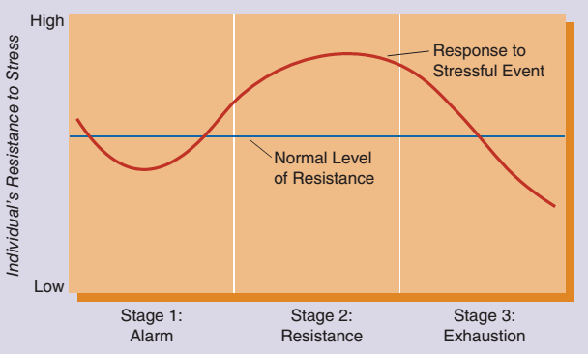
Figure 4.6 The General Adaptation Syndrome
The general adaptation syndrome (GAS) perspective describes three stages of the stress process. The initial stage is called alarm. As illustrated here, a person’s resistance often dips slightly below the normal level during this stage. Next comes actual resistance to the stressor, usually leading to an increase above the person’s normal level of resistance. Finally, in stage 3, exhaustion may set in, and the person’s resistance declines sharply below normal levels.

Slide 32
Common Causes of Stress
Organizational stressor – a factor in the workplace that can cause stress
  Task demands – stressors associated with the specific job a person performs
  Physical demands – conditions associated with the job’s physical setting and requirements
  Role demands – stressors associated with the expected behaviors of a particular position in a group or organization
  Interpersonal demands – stressors deriving from group pressures, leadership, interpersonal conflicts
Life stressor – life change or trauma

Slide 33
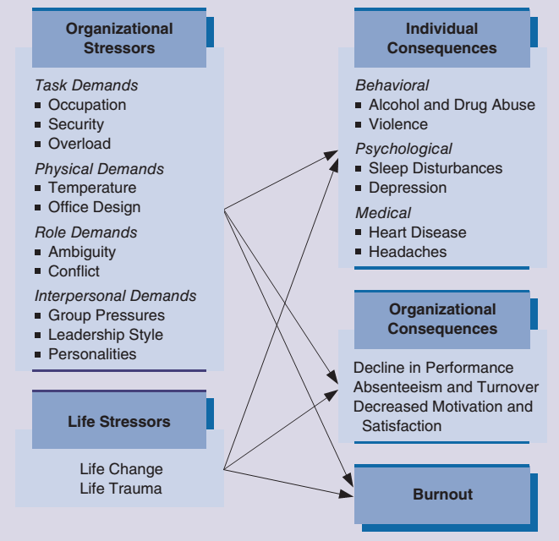
Figure 4.7
Causes and Consequences of Stress
The causes and consequences of stress are related in complex ways. As shown here, most common causes of stress can be classified as either organizational stressors or life stressors. Similarly, common consequences include individual and organizational consequences, as well as burnout.

Slide 34
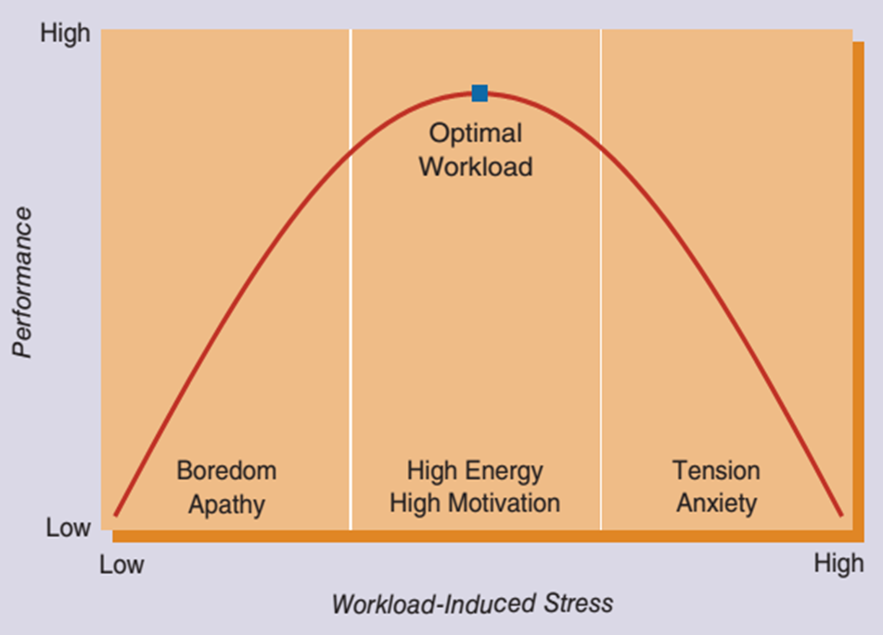
Figure 4.8 Workload, Stress, and Performance
Too much stress is clearly undesirable, but too little stress can also lead to unexpected problems. For example, too little stress may result in boredom and apathy and be accompanied by low performance. Although too much stress can cause tension, anxiety, and low performance, for most people there is an optimal level of stress that results in high energy, motivation, and performance.

Slide 35
Consequences of Stress
Individual consequences
  Behavioral consequences
  Psychological consequences
  Medical consequences
Organizational consequences
  Include decline in performance, withdrawal, and negative changes in attitude
  Burnout – a general feeling of exhaustion that develops when an individual simultaneously experiences too much pressure and has too few sources of satisfaction

Slide 36
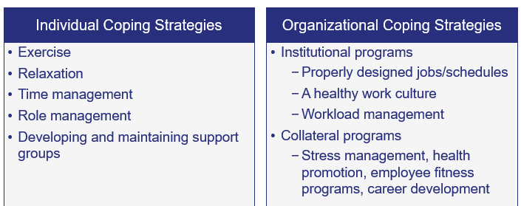
Managing and Controlling Stress

Slide 37
Work–Life Balance
Work–life relationship – interrelationship between a person’s work life and personal life
Balancing work–life linkages
  Importance of long-term versus short-term perspectives
  Balance needs of both wage earners in double-income families
  Accept that there’s a work–life integration

Slide 38
Polling Activity
From your experience, which of the following do you believe is the most prevalent source of organizational stress and the one businesses should be most concerned about addressing?
Task demands
Physical demands
Role demands
Interpersonal demands

Slide 39
Self-Assessment
Our values are an important foundation on which we base most of our decisions. Take some time to specifically name your terminal values, your instrumental values, and your intrinsic and extrinsic work values.
Although stress is part of everyone’s life, some people appear to manage it more effectively. How do you feel about your current stress level? What things do you do to manage the distress and encourage the eustress?
How do you feel about your own current work–life balance? If you feel it is out of balance, what adjustments can you make?

Slide 40
Summary
Click the link to review the outcomes for this presentation.
Link to Learning Outcomes

