Slide 1

Organizational Behavior, 14e
Chapter 3
Individual Differences
Griffin/Phillips, Organizational Behavior, 14th Edition. © 2024 Cengage Learning, Inc. All Rights Reserved. May not be scanned, copied or duplicated, or posted to a publicly accessible website, in whole or in part.

Slide 2
Learning Outcomes
After studying this chapter, you should be able to:
Explain the nature of individual differences, the concept of fit, and the role of realistic job previews.
Define personality and describe general personality frameworks and attributes that affect behavior in organizations.
Identify and discuss other important personality traits that affect behavior in organizations.
Discuss different kinds of intelligence that affect behavior in organizations.
Describe different learning styles that influence how people process information and that affect behavior in organizations.

Slide 3
3-1
People in Organizations

Slide 4
Individual Differences and the Concept of Fit
Individual differences – personal attributes that vary from one person to another
Concept of fit
Person-job fit – the fit between a person’s abilities and the demands of the job, and the fit between a person’s desires and motivations and the attributes and rewards of a job
Person-group fit – the extent to which an individual fits with the workgroup’s and supervisor’s work styles, skills, and goals
Person-organization fit – the fit between an individual’s values, beliefs, and personality and the values, norms, and culture of the organization
Person-vocation fit – the fit between a person’s interests, abilities, values, and personality and a profession

Slide 5
Realistic Job Previews
Realistic job previews (RJPs) – present both positive and potentially negative information to job candidates
Goal is not to deter candidates, but to:
Provide accurate information about job and organization
Build trust
Reduce turnover (especially from employees who quit because the job wasn’t what they expected)

Slide 6
Discussion Activity
Almost everyone has experienced a job interview. Think of a job you’ve had where the interviewer or person doing the hiring did a poor job of providing a realistic job preview. If you feel comfortable doing so, share that experience with the class. In what ways can interviewers be “honest” without discouraging job applicants?

Slide 7
Discussion Activity Debrief
Almost everyone has experienced a job interview. Think of a job you’ve had where the interviewer or person doing the hiring did a poor job of providing a realistic job preview. If you feel comfortable doing so, share that experience with the class. In what ways can interviewers be “honest” without discouraging job applicants?
The whole point of an RJP is to build trust between the organization and the potential employee. A common reason employees give when leaving an organization is that the job is not what they expected; therefore, RJPs can be helpful in reducing turnover rates and employee satisfaction.

Slide 8
3-2
Personality and Individual Behavior

Slide 9
Personality
Personality – the relatively stable set of psychological attributes that distinguish one person from another
The nature versus nurture debate concerns the extent to which personality attributes are inherited from our parents or shaped by our environment.
In understanding how personality attributes affect individuals’ behavior, managers can help influence the development of successful behavior patterns and attitudes in employees.

Slide 10
The “Big Five” Framework
“Big Five” personality traits – a set of fundamental traits especially relevant to organizations
Agreeableness | The ability to get along with others
Conscientiousness | Refers to an individual being dependable and organized
Neuroticism | Characterized by a person’s tendency to experience unpleasant emotions: anger, anxiety, depression, and feelings of vulnerability
Extraversion | The quality of being comfortable with relationships
Openness | The capacity to entertain new ideas and to change as a result of new information
Introversion – The tendency to be less comfortable in relationships and social situations

Slide 11
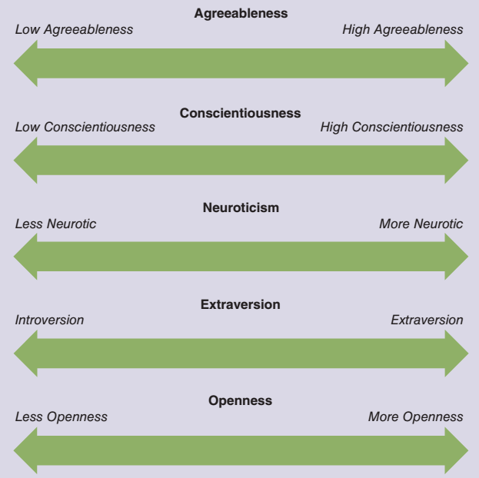
Figure 3.1
“Big Five”
Personality Traits
The “big five” personality framework is currently popular among researchers and managers. These five dimensions represent fundamental personality traits presumed to be important in determining the behaviors of individuals in organizations. In general, experts agree that personality traits closer to the left end of each dimension are more positive in organizational settings, whereas traits closer to the right are less positive.

Slide 12
The Myers-Briggs Framework
The Myers-Briggs framework – personality framework based on Carl Jung’s work on psychological types and measured by the Myers–Briggs Type Indicator (MBTI)
    Used to categorize personality across four general dimensions:
Extroversion (E)/Introversion (I) | Thinking (T)/Feeling (F)
Sensing (S)/Intuition (N) | Judging (J)/Perceiving (P)
    Sixteen personality classifications result from the higher and lower positions of the general dimensions.
    Myers-Briggs Type Indicator (MBTI) is a popular questionnaire used to assess personality types, communication styles, and interaction preferences.

Slide 13
Written Assignment Activity
Each class member can take a brief Myers–Briggs type self-assessment online at https://www.humanmetrics.com/personality/test.
After taking the test, explore some of the website’s comments about your type and then write a brief assessment of your experience of taking the test with these questions in mind:
How accurate do you believe the test results were?
What result surprised you least? Most?
In what ways does this information help you in your daily life or in making decisions?

Slide 14
3-3
Other Important Personality Traits

Slide 15
Locus of Control
Locus of control – the extent to which one believes one’s circumstances are a function of either one’s own actions or of external factors beyond one’s control
  Internal locus of control reflects the perception that we are in control of our lives and what happens to us.
  External locus of control reflects the belief that forces beyond our control dictate what happens to us.

Slide 16
Table 3.2 Effects of Locus of Control on Organizational Outcomes
Organizational Outcome | Internal versus External Locus of Control
Job satisfaction | Internals are generally more satisfied with their job, pay, supervisor, and coworkers.
Commitment | Internals are more committed and have lower absenteeism.
Job motivation | Internals have greater task motivation, job involvement, and self-confidence than do externals.
Job performance | Internals tend to have higher job performance than externals.
Career success | Internals tend to earn a higher salary than do externals.
Conflict and stress | Internals report lower role conflict, work-family conflict, burnout, and stress than do externals.
Social integration | Internals tend to be more socially integrated at work and report more favorable relationships with their supervisors.

Slide 17
Authoritarianism and Machiavellianism
Authoritarianism – the belief that power and status differences are appropriate within hierarchical social systems such as organizations
  A person who is highly authoritarian may accept directives or orders from someone with more authority purely because the other person is the “boss.”
Machiavellianism – a trait causing a person to behave in ways to gain power and control the behavior of others

Slide 18
Tolerance for Risk and Ambiguity
Tolerance for risk – the degree to which a person is comfortable with risk and is willing to take chances and make risky decisions
  The potential consequences of a manager’s risk propensity depend heavily on the organization’s environment and its business strategy.
Tolerance for ambiguity – reflects the tendency to view ambiguous situations as either threatening or desirable
  Being tolerant of ambiguity is related to creativity, positive attitudes toward risk, and orientation to diversity.

Slide 19
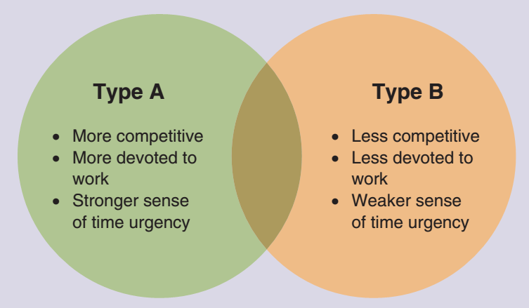
Figure 3.2 Type A and B Traits
Few people have extreme Type A or Type B personality profiles. Instead, people tend toward one type or the other. This is reflected by the overlap between the profiles shown here.

Slide 20
The Bullying Personality
Workplace bullying – repeated mistreatment of another employee through verbal abuse; conduct that is threatening, humiliating, or intimidating; or sabotage that interferes with the other person’s work
  Bullying is complex and comes in a variety of forms.
  Certain personality types may also be frequent targets of bullying.

Slide 21
Role of the Situation
The relationship between personality and behavior changes depending on the strength of the situation we are in.
  For example, strong organizational cultures might decrease the influence of personality on employee behaviors by creating clear guidelines for employee behavior.

Slide 22
Group Activity
Form groups of three to five participants and consider the following scenario: You and a coworker have been in your jobs for about two years. A supervisor position has opened up in your division, and you both apply for the job.
Within your group, discuss how each of these individuals would approach the situation and how they would react if they didn’t get the position:
You have an internal locus of control.
You have an external locus of control.
You are highly tolerant of risk.
You have a low tolerance of risk.
You are a type A personality.
You are a type B personality.
You are tolerant of ambiguity.
You are intolerant of ambiguity.

Slide 23
3-4
Intelligence

Slide 24
Intelligence
In addition to personality and personality traits, an important set of individual differences is various types of intelligence.
  General mental ability – the capacity to rapidly and fluidly acquire, process, and apply information
    It involves reasoning, remembering, understanding, and problem solving.
  Information processing capacity – involves the manner in which individuals process and organize information

Slide 25
Gardner’s Theory of Multiple Intelligences
Linguistic | Words and language
Logical-mathematical | Logic and numbers
Musical | Music, rhythm, and sound
Bodily-kinesthetic | Body movement and control
Spatial-visual | Images and space
Interpersonal | Other people’s feelings
Intrapersonal | Self-awareness
Multiple intelligences – suggests there is more than one way to be smart and is important for determining different learning preferences

Slide 26
Table 3.4 Matching Intelligence Types with Career Choices
(1 of 2)
Type of Intelligence | Related Careers | Preferred Learning Style
Bodily-Kinesthetic: physical agility and balance; body control; hand-eye coordination | Athletes, firefighters, chefs, actors, gardeners | Touch and feel, physical experience
Interpersonal: ability to relate to others and perceive their feelings; interprets behaviors of others; relates to emotional intelligence | Psychologists, doctors, educators, salespeople, politicians | Human contact, teamwork
Intrapersonal: self-awareness; understands oneself and one’s relationship to others and to the world; relates to emotional intelligence | Related to success in almost all careers | Self-reflection, self-discovery

Slide 27
Table 3.4 Matching Intelligence Types with Career Choices
(2 of 2)
Type of Intelligence | Related Careers | Preferred Learning Style
Linguistic: verbal and written language; explaining and interpreting ideas and information | Authors, speakers, lawyers, TV and radio hosts, translators | Verbal and written words and language
Logical-Mathematical: logic and pattern detection; analytical; problem solving; excels at math | Engineers, directors, scientists, researchers, accountants, statisticians | Logic and numbers
Musical: recognition of rhythm and tonal patterns; musical ability; high awareness and use of sound | Musicians, DJs, music teachers, acoustic engineers, music producers, composers | Music, sounds, and rhythm
Spatial-Visual: creation and interpretation of visual images; visual and spatial perception | Artists, engineers, photographers, inventors, beauty consultants | Pictures, shapes; visually

Slide 28
Emotional Intelligence
Emotional intelligence (EI) – an interpersonal capability that includes the ability to perceive and express emotions, to understand and use them, and to manage emotions in oneself and other people
  Self-awareness: being aware of what you’re feeling
  Self-motivation: persisting in the face of obstacles, setbacks, and failures
  Self-management: managing your own emotions and impulses
  Empathy: sensing how others are feeling
  Social skills: effectively handling emotions of others

Slide 29
Polling Activity
Which of the dimensions of emotional intelligence do you feel is most valuable for managers to possess?
  Self-awareness
  Self-motivation
  Self-management
  Empathy
  Social skills

Slide 30
3-5
Learning Styles

Slide 31
Learning Styles
Learning style – individual differences and preferences in how we process information while problem-solving, learning, or engaging in similar activities
Sensory modality – a system that interacts with the environment through one of the basic senses:
Visual: learning by seeing
Auditory: learning by hearing
Tactile: learning by touching
Kinesthetic: learning by doing

Slide 32
Kolb Learning Style Inventory
Convergers | Learn by active experimentation and abstract conceptualization; superior in technical tasks, inferior in interpersonal settings
Divergers | Learn by concrete experience and reflective observation; superior in generating alternate hypotheses and ideas; tend to be imaginative and people- or feeling-oriented
Assimilators | Learn by abstract conceptualization and reflective observation; more concerned about abstract concepts and logical soundness than about people and practical values; suited to research and planning
Accommodators | Learn by active experimentation and concrete experience; focus on risk taking, opportunity seeking, and action; deal with people easily; suited to action-oriented jobs such as marketing and sales

Slide 33
Learning Style Orientations
Discovery learning | An inclination for exploration during learning
Experiential learning | A desire for hands-on approaches to instruction
Observational learning | A preference for external stimuli such as demonstrations and diagrams
Structured learning | A preference for processing strategies such as taking notes, writing down task steps, subjective assessments
Group learning | Preference to work with others while learning; active and interactional

Slide 34
Knowledge Check 3.1
What type of learning style orientation do you have if you prefer to take notes, write down task steps, and conduct subjective assessments as strategies for processing information?
Discovery learning
Experiential learning
Observational learning
Structured learning
Notes:
Answer: d. Structured learning
A structured learning orientation involves a preference for processing strategies such as taking notes, writing down task steps, and so forth. Structured learning is related to preferences for subjective assessments.

Slide 35
Self-Assessment
Think back to job interviews you’ve had in the past. What did you do well? What could use improvement? What do you wish the interviewer had done differently?
If you’ve ever taken the Myers-Briggs inventory, how did you feel about the results? If you haven’t taken it, what might you expect the results to be for you?
Think about your learning style. When you encounter a teaching style that doesn’t match your learning style, in what ways do you compensate?

Slide 36
Summary
Click the link to review the outcomes for this presentation.
Link to Learning Outcomes

