Slide 1
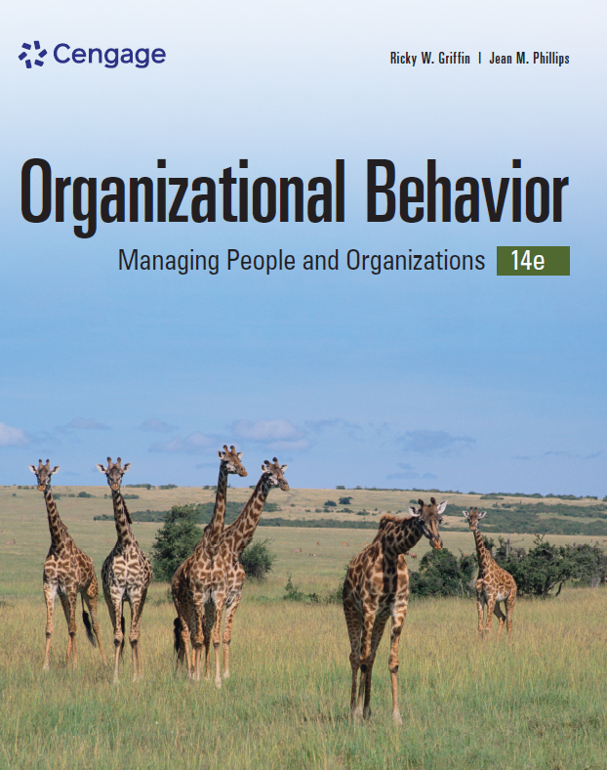
Organizational Behavior, 14e
Chapter 1
An Overview
of Organizational Behavior
Griffin/Phillips, Organizational Behavior, 14th Edition. © 2024 Cengage Learning, Inc. All Rights Reserved. May not be scanned, copied or duplicated, or posted to a publicly accessible website, in whole or in part.

Slide 2
Icebreaker
Form groups of 4–6 participants. During a 5-minute period, each group makes a list of everything they ALL have in common.
When time is up, each group announces the number of items on their list. Each group can also share its most interesting item.

Slide 3
Learning Outcomes
After studying this chapter, you should be able to:
Describe organizational behavior, including the impact it has on both personal and organizational success.
Identify the basic management functions and essential skills that make up the management process and relate them to organizational behavior.
Discuss the strategic context of organizational behavior, including the relationships between strategy and organizational behavior.
Identify and describe contextual perspectives on organizational behavior.
Discuss the role of organizational behavior in managing for effectiveness, including the role of research in organizational behavior.
Summarize the framework around which this book is organized.

Slide 4
1-1
What Is Organizational Behavior?

Slide 5
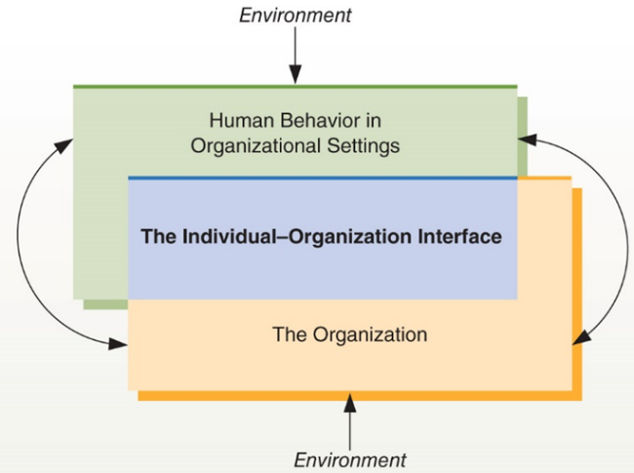
Figure 1.1 The Nature of Organizational Behavior
The field of organizational behavior attempts to understand human behavior in organizational settings, the organization itself, and the individual-organization interface. As illustrated here, these areas are highly interrelated. Thus, although it is possible to focus on only one of these areas at a time, a complete understanding of organizational behavior requires knowledge of all three areas.

Slide 6
Why Study OB?
Studying OB can help you:
Become a better employee
Become a better manager
Understand how people behave and why they do what they do
Help you focus on developing a global mindset
Organizations that successfully implement OB principles have:
Motivated, engaged employees whose goals align with business strategy
Strong leadership and direction
Better bottom lines

Slide 7
Knowledge Check 1.1
What three elements make up the nature of organizational behavior, or what organizational behavior attempts to understand?
Individuals, managers, and work environments
Human behavior, organization behavior, and the environment surrounding the organization
The organization, human behavior in organizational settings, and the individual-organization interface
Comprehensive behavior, organization influences, and the organization-environment interactions
Notes:
Answer: c. The organization, human behavior in organizational settings, and the individual-organization interface
Organizational behavior (OB) is the study of human behavior in organizational settings, of the interface between human behavior and the organization, and of the organization itself.

Slide 8
1-2
The Managerial Context of
Organizational Behavior

Slide 9
Basic Management Functions and Organizational Behavior
Management functions
Planning
Organizing
Leading
Controlling
Resources used by managers
Human
Financial
Physical
Information

Slide 10
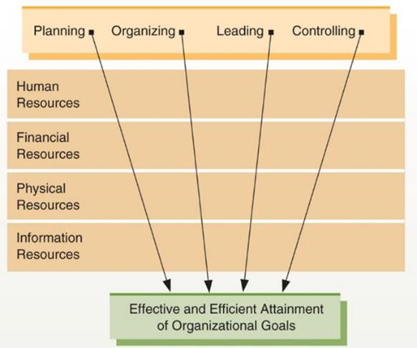
Figure 1.2 Basic Managerial Functions
Managers engage in the four basic functions of planning, organizing, leading, and controlling. These functions are applied to human, financial, physical, and information resources with the ultimate purpose of efficiently and effectively attaining organizational goals.

Slide 11
Functions of Management
Planning | Determining an organization’s desired future position and the best means of getting there
Organizing | Designing jobs, grouping jobs into units, and establishing patterns of authority between jobs and units
Leading | Getting the organization’s members to work together toward the organization’s goals
Controlling | Monitoring and correcting the actions of the organization and its members to keep them directed toward their goals

Slide 12
Critical Management Skills
Technical skills | The skills necessary to accomplish specific tasks within the organization
Interpersonal skills | The ability to effectively communicate with, understand, and motivate individuals and groups
Conceptual skills | The ability to think in the abstract and to consider the “big picture”
Diagnostic skills | The ability to understand cause-and-effect relationships and to recognize the optimal solutions to problems

Slide 13
Human Resource Management
Human resource management (HRM)
The set of organizational activities directed at attracting, developing, and maintaining an effective workforce
Questions OB helps HR managers answer:
Which applicants should be hired?
Which rewards will be more motivating than others?

Slide 14
Group Activity
Form groups of three to five participants. Each group should choose a type of manager (CEO, HR vice president, supplies manager, team supervisor, etc.) and then describe what that manager’s activities would look like for each of the management functions: planning, organizing, leading, and controlling.
After about 15 minutes, have each group make a brief report about their manager and that manager’s activities.

Slide 15
1-3
The Strategic Context of
Organizational Behavior
Notes:
.

Slide 16
Sources of Competitive Advantage
Competitive advantage
An organization’s edge over rivals in attracting customers and defending itself against competition
Sources of competitive advantage:
Innovation
Distribution
Speed
Convenience
First to market
Cost
Service
Quality
Branding

Slide 17
Types of Business Strategies
Cost leadership | Striving to be the lowest-cost producer for a particular level of product quality. Emphasizes operational excellence: maximizing the efficiency of the manufacturing or product development process to minimize costs.
Differentiation | Developing a product or service that has unique characteristics valued by customers. Emphasizes product innovation: developing new products or services.
Specialization | Focusing on a narrow market segment or niche and pursuing either differentiation or cost leadership within that segment. Emphasizes customer loyalty: delivering unique and customizable products or services to meet customers’ needs and increase customer loyalty.
Growth | Company expands organically or through mergers/acquisitions; response to investor preference for rising earnings; success depends on finding the right number/types of employees to sustain growth.

Slide 18
Knowledge Check 1.2
Which type of business strategy is most likely to emphasize product innovation?
Cost leadership
Differentiation
Specialization
Growth
Notes:
Answer: b. Differentiation
Differentiation is more likely to be concerned with product innovation—that is, with developing a product or service that has unique characteristics valued by customers.

Slide 19
1-4
Contextual Perspectives on
Organizational Behavior

Slide 20
Origins of Organizational Behavior
(1 of 2)
Scientific management
First formal study of OB (1890s), abandoned after WWI
Maximized productivity; led to monotonous, dehumanizing conditions
Guiding principles
Replace rule-of-thumb work with methods based on scientifically studying the tasks using time-and-motion studies.
Scientifically select, train, and develop all workers.
Managers provide detailed instructions and supervision to workers.
Divide work nearly equally between workers and managers.

Slide 21
Origins of Organizational Behavior
(2 of 2)
Human relations movement
Inspired by the Hawthorne effect
Viewed organizations as cooperative systems
Treated workers’ orientations, values, and feelings as important parts of organizational dynamics and performance
Created a new era of more humane, employee-centered management and highlighted the importance of people to organizational success
Was hampered by unsound research methods

Slide 22
Organizations as Open Systems
System
An interrelated set of elements that function as a whole—inputs are combined/transformed by managers into outputs from the system
Value of the systems perspective
Underscores the importance of an organization’s environment
Conceptualizes the flow and interaction of various elements of the organization

Slide 23
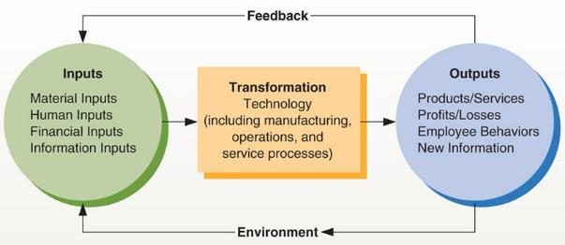
Figure 1.3 The Systems Approach to Organizations
The systems approach provides a useful framework for understanding how elements of an organization interact among themselves and with their environment. Various inputs are transformed into different outputs, with important feedback from the environment. If managers do not understand these interrelations, they may tend to ignore their environment or overlook important interrelationships within their organizations.

Slide 24
Situational Perspectives on Organizational Behavior
The situational perspective
Recognizes that most organizational situations and outcomes are influenced by other variables
The universal model
Presumes a direct cause-and-effect linkage between variables
Complexities of human behavior and organizational settings make universal conclusions virtually impossible

Slide 25
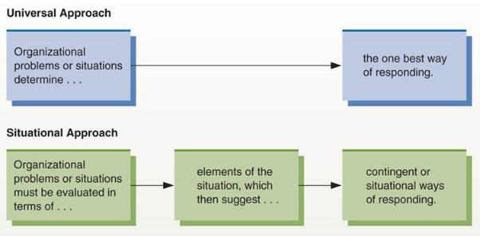
Figure 1.4 Universal versus Situational Approach
Managers once believed that they could identify the “one best way” of solving problems or reacting to situations. Here we illustrate a more realistic view, the situational approach. The situational approach suggests that approaches to problems and situations are contingent on elements of the situation.

Slide 26
Interactionalism: People and Situations
Interactionalist perspective
Focuses on how individuals and situations interact continuously to determine individuals’ behavior
Attempts to explain how people select, interpret, and change various situations

Slide 27
Polling Activity
You are a manager of a design department for a company that does printing for a variety of clients. Your team of designers is talented and works well together, with one exception. One employee, who submits excellent work and is never late, is either quiet or almost rude to coworkers. In turn, the coworkers pointedly avoid this employee. Which of these approaches do you believe would be most likely to help you deal with this employee and the coworkers?
Systems perspective
Situational perspective
Interactionalist perspective

Slide 28
1-5
Managing for Effectiveness

Slide 29
Managing for Effectiveness
Managers’ goals
Enhance behaviors and attitudes
Promote citizenship
Minimize dysfunctional behaviors
Drive strategic execution

Slide 30
Enhancing Individual and Team
Performance Behaviors
Productivity
  Narrow measure of efficiency: number of products or services created per unit of input
Performance
  Broader concept made up of all work-related behaviors
Commitment
  The degree to which an employee feels a true member of the organization, overlooks minor sources of dissatisfaction, and intends to stay with the organization

Slide 31
Enhancing Employee Engagement and Commitment
Employee engagement
  The extent to which employees understand and embrace their role in the organization
Job satisfaction/dissatisfaction
  Influenced by personal factors (individual needs and aspirations) and group and organizational factors (relationships with coworkers and working conditions)
Organizational commitment
  Sense of organizational membership, overlooking minor dissatisfactions, with intent to remain with organization

Slide 32
Promoting Organizational Citizenship Behaviors
Organizational citizenship
Behaviors that make a positive overall contribution to the organization
Encompasses factors outside the strict requirements of the job:
Willingness to train new hires
Works late/overtime
Good attendance
Represents the organization well
Personal values consistent with the organization

Slide 33
Minimizing Dysfunctional Behaviors
Dysfunctional behaviors
Behaviors that detract from, rather than contribute to, organizational performance:
Absenteeism
Turnover
Theft, sabotage
Harassment, bullying, violence
Politicized behavior (spreading rumors, etc.)
Incivility, rudeness
Workplace violence

Slide 34
Driving Strategic Execution
Strategic execution
The degree to which managers and their employees understand and carry out the actions needed to achieve strategic goals
Assessed at the individual/group level, the organizational level, and in terms of financial performance
Often requires balancing seemingly contradictory outcomes
For example, paying high salaries can enhance satisfaction and reduce turnover but detract from bottom-line performance.

Slide 35
How Do We Know What We Know?
Quality of information
  Common sense and intuition and are often wrong—one thing doesn’t necessarily lead to the other
Goals and confidence
Satisfaction and productivity
Rewards and motivation
  OB relies on the scientific method
  Knowledge generation that relies on systematic studies that identify and replicate a result using a variety of methods, samples, and settings

Slide 36
The Scientific Method
Theory – a collection of verbal and symbolic assertions that specify how and why variables are related, and the conditions under which they should and should not relate
Hypothesis – a written prediction specifying expected relationships between certain variables
Independent variable – the variable the researchers set
Dependent variable – the variable the researchers measure
  Example: In an experiment to determine the effect of employee wages on employee satisfaction, wages are the independent variable, and satisfaction is the dependent variable.

Slide 37
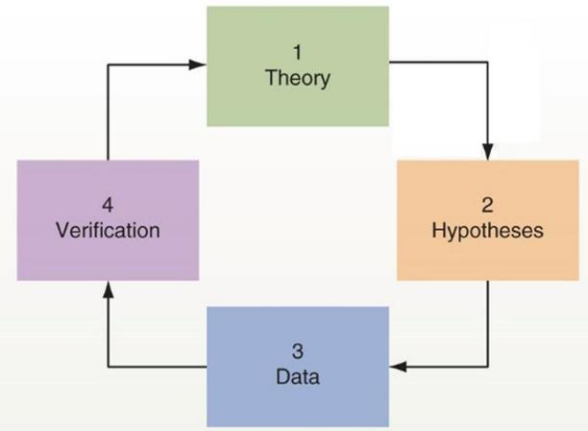
Figure 1.5 The Scientific Method
The scientific method is a useful approach to learning more about organizational behavior. Using theory to develop hypotheses and then collecting and studying relevant data can help generate new knowledge.

Slide 38
Correlation
Correlation – strength of the relationship between the two variables
Ranges between −1 and +1
A correlation of +1 is a perfect positive relationship: as one variable increases, the other always increases
A correlation of −1 is a perfect negative relationship: as one variable increases, the other always decreases
A correlation of 0 means that there is no relationship between the two variables
Meta-analysis – used to combine the results of many different research studies done for a variety or organizations and jobs
There may not be global replication of behaviors.

Slide 39
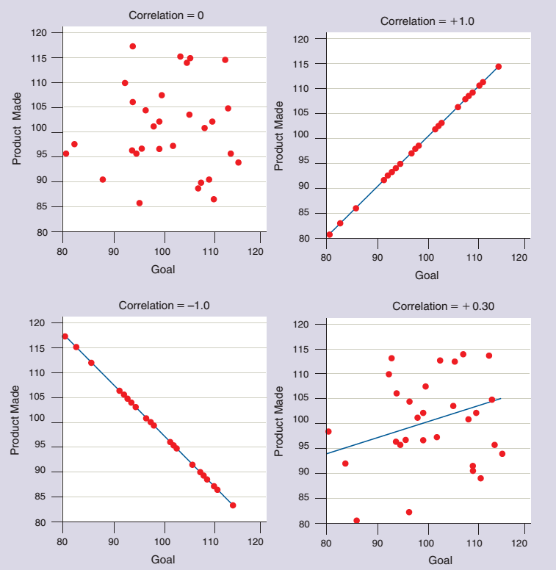
Figure 1.6
Interpreting Correlations
Correlations between variables can range from −1 to +1. By studying correlations, we can learn more about how two variables are related. Correlations of −1 or +1 are unusual, as is a correlation of 0. Fortunately, we can still learn a great deal from correlations that are statistically significant.

Slide 40
Discussion Activity
Perhaps you’ve heard the warning that “correlation is not causation.” As a class, discuss what this admonition means for those using the scientific method.

Slide 41
Discussion Activity Debrief
Perhaps you’ve heard the warning that “correlation is not causation.” As a class, discuss what this admonition means for those using the scientific method.
The scientific method is a useful approach to studying many things, including organizational behavior. However, sometimes researchers find a correlation between variables and make assessments based on numbers, rather on the numbers within the context of their research. For example, one study found that the number of high school graduates increased at the same rate between 1965 and 2020 as pizza consumption in the United States. Does that mean only people with diplomas consume pizza, or does eating pizza lead to greater graduation rates? Obviously, many other factors are involved and must be considered when reaching conclusions.

Slide 42
1-6
The Framework of the Book

Slide 43
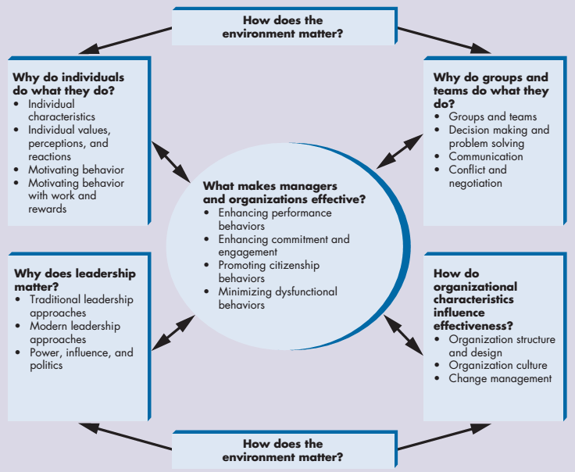
Figure 1.7 Organizational Behavior Framework
An array of environmental, individual, group and team, leadership, and organizational characteristics impact organizational behavior. If managers understand these concepts and characteristics, they can better promote organizational effectiveness.

Slide 44
Self-Assessment
When you look at the list of critical management skills (technical, interpersonal, conceptual, and diagnostic), in what area(s) do you feel strongest? What can you do to increase your competence in the other areas?
In what ways are you hoping this class on organizational behavior contributes to your future career?
As an employee, what skills and functions of a manager do you most appreciate when they perform well? What do you need to perform well as a manager?

Slide 45
Summary
Click the link to review the outcomes for this presentation.
Link to Learning Outcomes

