Slide 1
Chapter Seven
Managing Risk

Slide 2
Where We Are Now

Slide 3
Learning Objectives
07-01 Describe the risk management process.
07-02 Understand how to identify project risks.
07-03 Assess the significance of different project risks.
07-04 Describe the five responses to managing risks.
07-05 Understand the role contingency plans play in the risk management
process.
07-06 Understand opportunity management and describe the five approaches to responding to opportunities in a project.
07-07 Understand how contingency funds and time buffers are used to
manage risks on a project.
07-08 Recognize the need for risk management being an ongoing activity.
07-09 Describe the change control process.

Slide 4
Chapter Outline
7.1 Risk Management Process
7.2 Step 1: Risk Identification
7.3 Step 2: Risk Assessment
7.4 Step 3: Risk Response Development
7.5 Contingency Planning
7.6 Opportunity Management
7.7 Contingency Funding and Time Buffers
7.8 Step 4: Risk Response Control
7.9 Change Control Management

Slide 5
7.1 Risk Management Process
Risk Defined
An uncertain event or condition that if it occurs, has a positive or negative effect on project objectives.
No amount of planning can overcome or control risk.
Risk Management Defined
An attempt to recognize and manage potential and unforeseen trouble spots that may occur when the project is implemented.
What can go wrong (risk event)
How to minimize the risk event’s impact (consequences)
What can be done before an event occurs (anticipation)
What to do when an event occurs (contingency plans)

Slide 6
Risk Event Graph
FIGURE 7.1

Slide 7
Benefits of Risk Management
A proactive rather than reactive approach
Reduces surprises and negative consequences
Prepares the project manager to take appropriate action
Provides better control over the future
Improves chances of reaching project objectives on time, within budget, and of meeting required performance.

Slide 8
The Risk Management Process
FIGURE 7.2

Slide 9
7.2 Step 1: Risk Identification
Generate a list of all the possible risks that could affect the project through brainstorming and other problem identifying techniques.
Focus on the events that could produce consequences, not on project objectives.
Use risk breakdown structure (RBS) in conjunction with work breakdown structure (WBS) to identify and analyze risks.
Identify the macro risks first then specific areas can be checked.
Use risk profile (a list of questions) to address traditional areas of uncertainty on a project.

Slide 10
The Risk Breakdown Structure (RBS)
FIGURE 7.3

Slide 11
Partial Risk Profile for Product Development Project
FIGURE 7.4

Slide 12
7.3 Step 2: Risk Assessment
Scenario analysis assesses the significance of each risk event in terms of probability and impact.
Risk assessment form evaluates the severity, probability of risk events and its detection difficulty.
Risk severity matrix prioritizes which risks to address.
Failure Mode and Effects Analysis (FMEA) extends the risk severity matrix by including ease of detection in the equation:
Risk Value = Impact x Probability x Detection
Probability analysis uses statistical techniques in assessing project risk.
Decision trees, net present value (NPV), program evaluation and review technique (PERT), PERT simulation

Slide 13
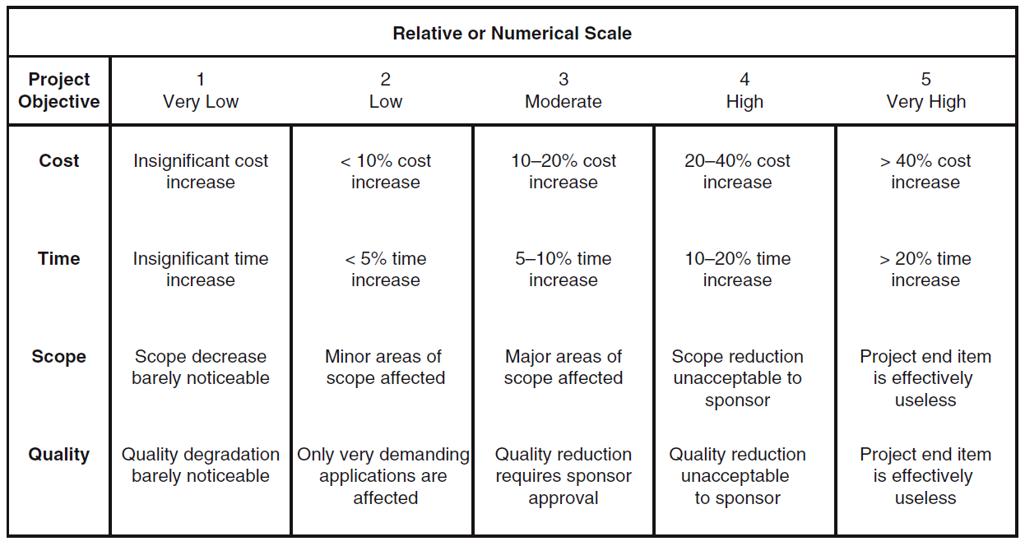
Defined Conditions for Impact Scales of a Risk on Major Project Objectives (examples for negative impacts only)
FIGURE 7.5

Slide 14
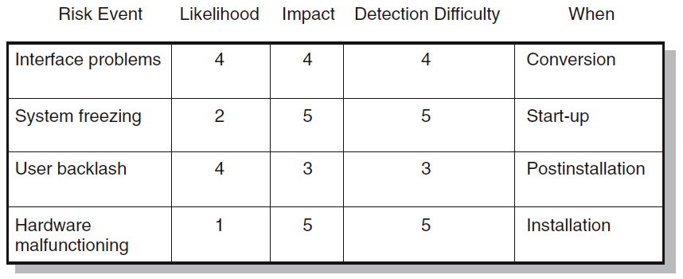
Risk Assessment Form
FIGURE 7.6

Slide 15
Risk Severity Matrix
Failure Mode and Effects Analysis (FMEA) Impact × Probability × Detection = Risk Value
 |  | User Backlash | Interface problems
 |  |  |  | System freezing
 |  |  |  | Hardware malfunc-tioning
5
4
Red zone (major risk)
Yellow zone (moderate risk)
Green zone (minor risk)
Likelihood
3
2
1
1
2
3
4
5
FIGURE 7.7

Slide 16
7.4 Step 3: Risk Response Development
Mitigating Risk
Reducing the likelihood that the event will occur
Reducing the impact that the adverse event would have on the project
Avoiding Risk
Changing the project plan to eliminate the risk or condition
Transferring Risk
Passing risk to another party
Examples: Fixed-price contracts, insurance, Build-Own-Operate-Transfer (BOOT) provisions
Escalating Risk
Notifying the appropriate people within the organization of the threat
Retaining Risk
Making a conscious decision to accept the risk of an event occurring

Slide 17
7.5 Contingency Planning
Contingency Plan Defined
Is an alternative plan that will be used if a possible foreseen risk event becomes a reality.
Is a plan of action that will reduce or mitigate the negative impact of the risk event.
Is not a part of the initial implementation plan and only goes into effect after the risk is recognized.
Risks of the absence of a contingency plan
Cause a manager to delay or postpone the decision to implement a remedy
Lead to panic and acceptance of the first remedy suggested
Make the decision making under pressure which can be dangerous and costly

Slide 18
Risk Response Matrix
FIGURE 7.8

Slide 19
Risk and Contingency Planning
Technical Risks
Backup strategies if chosen technology fails
Assess whether technical uncertainties can be resolved
Schedule Risks
Expedite or “crash” the project to get it back on track
Schedule activities in parallel or use start-to-start lag relationships
Use the best people for high-risk tasks
Cost Risks
Review price to avoid the trap of using one lump sum to cover price risks
Funding Risks
Evaluate the risk of reductions in funding—a cut in the project

Slide 20
7.6 Opportunity Management
An opportunity is an event that can have positive impact on project objectives.
Exploit
Seek to eliminate the uncertainty associated with an opportunity to ensure that it definitely happens
Share
Allocate some or all of the ownership of an opportunity to another party who is best able to capture the opportunity for the benefit of the project
Enhance
Take action to increase the probability and/or the positive impact of an opportunity
Escalate
Notify the appropriate people within the organization of the opportunity
Accept
Be willing to take advantage of the opportunity if it occurs, but not taking action to pursue it

Slide 21
7.7 Contingency Funding and Time Buffers
Contingency Funds
Are funds to cover project risks—identified and unknown
For control purposes, contingency funds are divided into
Contingency reserves—cover identified risks and allocated to specific segments or deliverables of the project
Management reserves—cover unidentified risks and are allocated to risks associated with the total project
Time Buffers
Are amounts of time used to cushion against potential delays in the project
Add to activities with severe risks
Add to merge activities that are prone to delays
Add to noncritical activities to reduce the likelihood that they will create another critical path
Add to activities that require scare resources

Slide 22
Budget Estimate
TABLE 7.1

Slide 23
7.4 Step 4: Risk Response Control
Risk Register
Details all identified risks, including descriptions, category, probability of occurring, impact, responses, contingency plans, owners, and current status
Risk Control involves
Executing the risk response strategy
Monitoring triggering events
Initiating contingency plans
Watching for new risks
Establishing a Change Management System
Monitoring, tracking, and reporting risk
Fostering an open organization environment
Repeating risk identification/assessment exercises
Assigning and documenting responsibility for managing risk

Slide 24
7.9 Change Control Management
Sources of Change
Project scope changes
Implementation of contingency plans
Improvement changes
Change Management Systems
Identify proposed changes
List expected effects of proposed change(s) on schedule and budget
Review, evaluate, and approve or disapprove of changes formally
Negotiate and resolve conflicts of change, condition, and cost
Communicate changes to parties affected
Assign responsibility for implementing change
Adjust master schedule and budget
Track all changes that are to be implemented

Slide 25
Change Control Process
FIGURE 7.9

Slide 26
Benefits of Change Control Systems
Inconsequential changes are discouraged by the formal process.
Costs of changes are maintained in a log.
Integrity of the WBS and performance measures is maintained.
Allocation and use of contingency and management reserves are tracked.
Responsibility for implementation is clarified.
Effect of changes is visible to all parties involved.
Implementation of change is monitored.
Scope changes will be quickly reflected in baseline and performance measures.

Slide 27
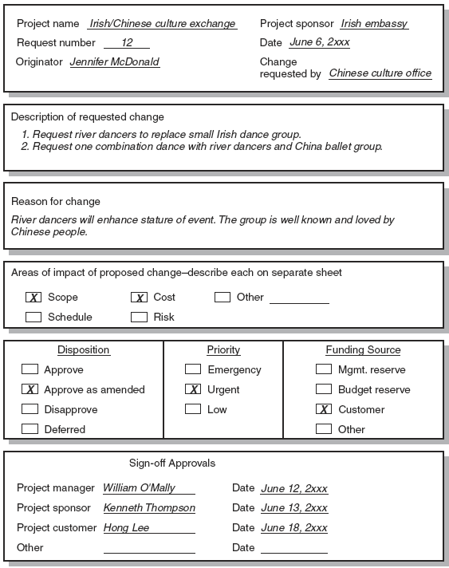
Sample Change Request
FIGURE 7.10

Slide 28
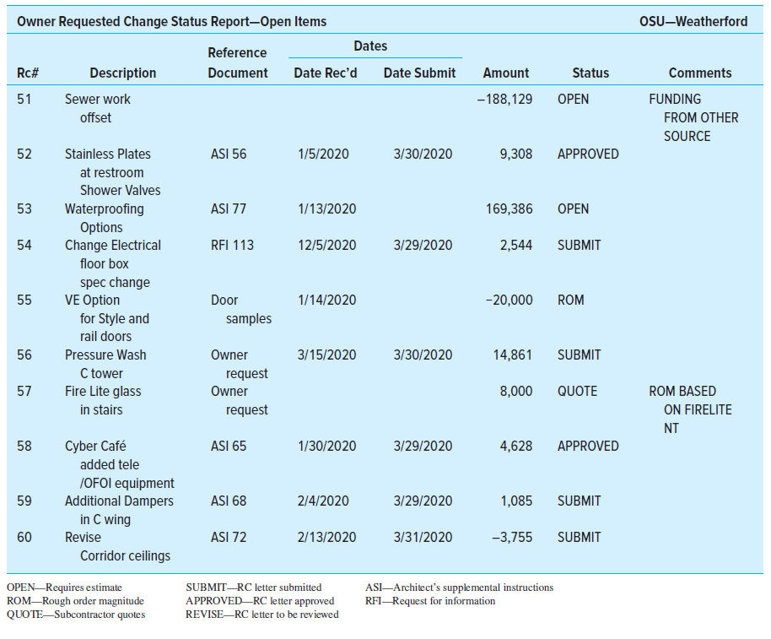
Change Request Log
FIGURE 7.11

Slide 29
Key Terms
Avoiding risk
Change management system
Contingency plan
Contingency reserves
Escalating risk
Management reserves
Mitigating risk
Opportunity
Retaining risk
Risk
Risk breakdown structure (RBS)
Risk profile
Risk register
Risk severity matrix
Scenario analysis
Time buffer
Transferring risk

Slide 30
PERT and PERT Simulation

Slide 31
PERT—Program Evaluation and Review Technique
Assumes each activity duration has a range that statistically follows a beta distribution
Uses three time estimates for each activity: optimistic, pessimistic, and a most likely time estimate to represent activity durations
From these three time estimates, a weighted average time estimate and a variance is calculated
Knowing the weighted average and variances for each activity allows the project planner to compute the probability of meeting different project durations
The longer the project duration is, the higher is the probability of meeting that duration

Slide 32
Activity and Project Frequency Distributions
FIGURE A7.1

Slide 33
Activity Time Calculations
The weighted average activity time is computed by the following formula:
$$t_{e}=\frac{a+4m+b}{6}$$
where t_{e} = weighted average activity time
a = optimistic activity time (1 chance in 100 of completing the
activity earlier under normal conditions)
b = pessimistic activity time (1 chance in 100 of completing the
activity later under normal conditions)
m = most likely activity time
(7.1)

Slide 34
Activity Time Calculations (Continued)
The variability in the activity time estimates is approximated by the following equations:
The standard deviation for the activity
$$σ_{t_{e}}=\left(\frac{b−a}{6}\right)$$
The standard deviation for the project
$$σ_{T_{E}}=\sqrt{\sum{σ_{t_{e}}^{2}}}$$
The above formula is just the square-root of the sum of the variances of all critical tasks
(7.2)
(7.3)

Slide 35
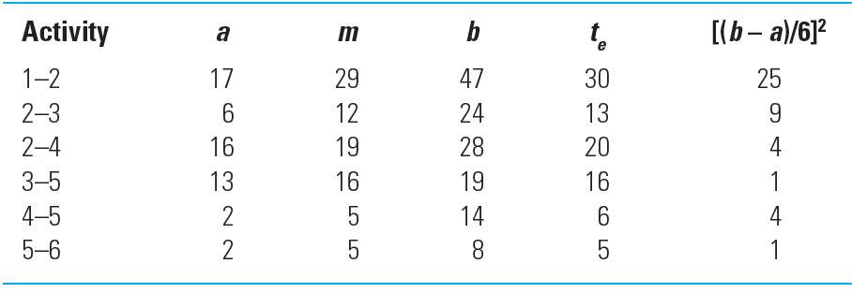
Activity Times and Variances
TABLE A7.1

Slide 36
Probability of Completing the Project
The equation below is used to compute the “Z” value found in statistical tables (Z = number of standard deviations from the mean), which, in turn, tells the probability of completing the project in the time specified.
$$Z=\frac{T_{s}−T_{E}}{\sqrt{\sum{σ_{t_{e}}^{2}}}}$$
where T_{E} = critical path duration
T_{S} = scheduled project duration
Z = probability (of meeting scheduled duration)
(see statistical Table A7.2)
(7.4)

Slide 37
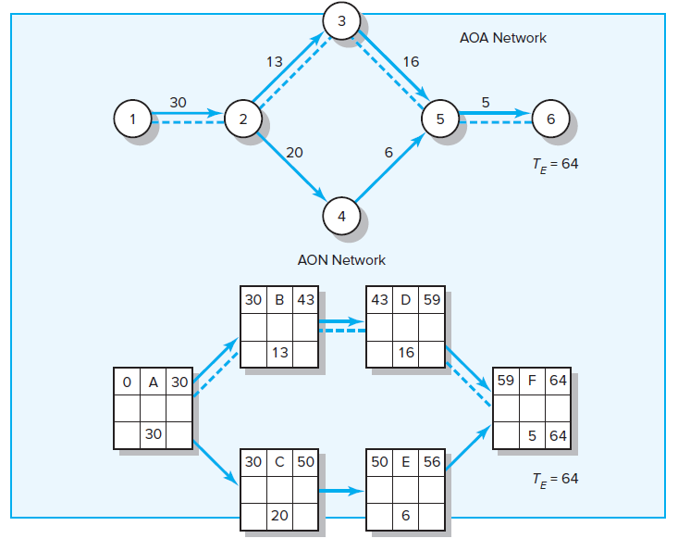
Hypothetical Network
FIGURE A7.2

Slide 38
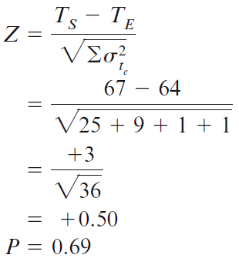
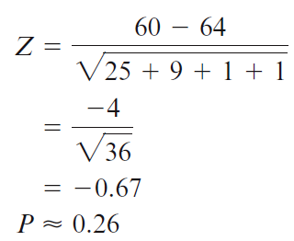
Possible Project Durations
Probability project is completed before scheduled time (T_{S}) of 67 units
Probability project is completed by the 60th unit time period (T_{S})
FIGURE A7.3

Slide 39
Z Values and Probabilities
TABLE A7.2

