Slide 1

Chapter Four
Defining the Project

Slide 2
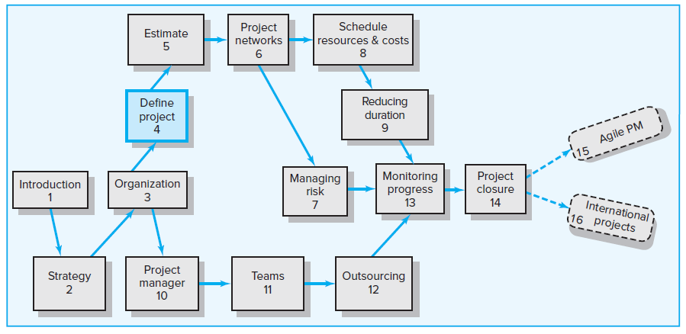
Where We Are Now

Slide 3
Learning Objectives
04-01 Identify key elements of a project scope statement and understand
why a complete scope statement is critical to project success.
04-02 Describe the causes of scope creep and ways to manage it.
04-03 Understand why it is important to establish project priorities in terms
of cost, time, and performance.
04-04 Demonstrate the importance of a work breakdown structure (WBS)
to the management of projects and how it serves as a database for
planning and control.
04-05 Demonstrate how the organization breakdown structure (OBS)
establishes accountability to organization units.
04-06 Describe a process breakdown structure (PBS) and when to use it.
04-07 Create responsibility matrices for small projects.
04-08 Create a communication plan for a project.

Slide 4
Chapter Outline
4.1 Step 1: Defining the Project Scope
4.2 Step 2: Establishing Project Priorities
4.3 Step 3: Creating the Work Breakdown Structure
4.4 Step 4: Integrating the WBS with the Organization
4.5 Step 5: Coding the WBS for the Information System
4.6 Process Breakdown Structure
4.7 Responsibility Matrices
4.8 Project Communication Plan

Slide 5
Five General Steps for Collecting Project Information
Step 1: Defining the Project Scope
Step 2: Establishing Project Priorities
Step 3: Creating the Work Breakdown Structure
Step 4: Integrating the WBS with the Organization
Step 5: Coding the WBS for the Information System

Slide 6
4.1 Step 1: Defining the Project Scope
Project Scope Defined
Is a definition of the end result or mission of your project—a product or service for your client/customer.
Defines the results to be achieved in specific, tangible, and measurable terms.
Purposes of the Project Scope Statement
To clearly define the deliverable(s) for the end user
To direct focus on the project purpose throughout the life of the project for the customer and project participants
To be published and used by the project owner and project participants for planning and measuring project success

Slide 7
Project Scope Checklist
Project objective
Product scope description
Justification
Deliverables
Milestones
Technical requirements
Limits and exclusions
Acceptance criteria

Slide 8
Project Scope: Terms and Definitions
Scope Statements
Is a short, one- to two-page summary of key elements of the scope, followed by extended documentation of each element.
Is also referred to as “statements of work (SOWs)”
Project Charter
Is a documentation that authorizes the project manager to initiate and lead the project.
Often includes a brief scope description as well as such items as risk limits, business case, spending limits, and even team composition.
Scope Creep
Is the tendency for the project scope to expand over time—usually by changing requirements, specifications, and priorities.

Slide 9
Five of the Most Common Causes of Scope Creep
Poor requirement analysis
Not involving users early enough
Underestimating project complexity
Lack of change control
Gold plating

Slide 10
4.2 Step 2: Establishing Project Priorities
Three major criteria (trade-offs) that a project manager has to manage are:
Cost (budget)
Time (schedule)
Performance (scope)
A project manager can manage the project trade-offs by completing a priority matrix for the project and identifying which criterion is:
Constrain—original parameter is fixed.
Enhance—a criterion should be optimized.
Accept—a criterion is tolerable not to meet the original parameter.

Slide 11
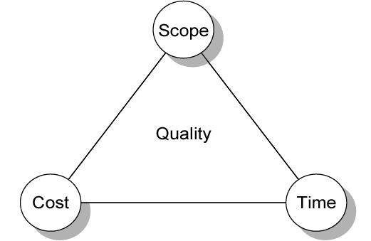
Project Management Trade-offs
FIGURE 4.1

Slide 12
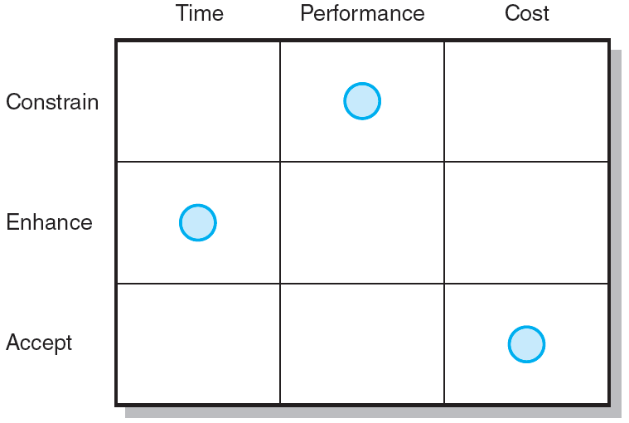
Project Priority Matrix for the Development of a New Wireless Router
FIGURE 4.2

Slide 13
4.3 Step 3: Creating the Work Breakdown Structure
Work Breakdown Structure (WBS)
Is a hierarchical outline of the project with different levels of detail.
Identifies the products and work elements involved in a project.
Defines the relationship of the final deliverable (the project) to its sub-deliverables, and, in turn, their relationships to work packages.
Serves as a framework for tracking cost and work performance.
Is best suited for design and build projects that have tangible outcomes rather than process-oriented projects.

Slide 14
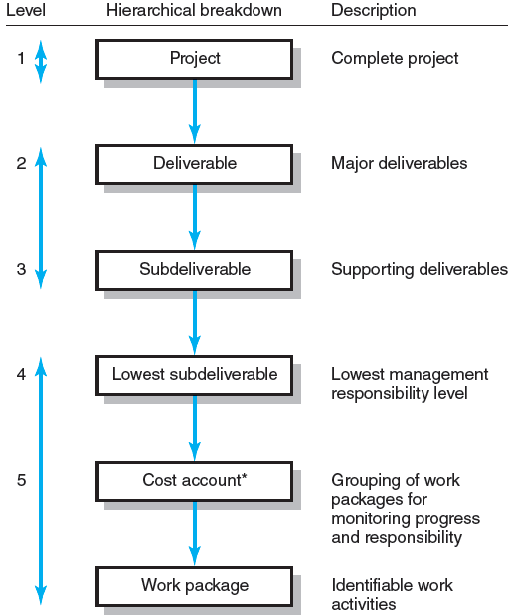
Hierarchical Breakdown of the WBS
* This breakdown groups work packages by type of work within a deliverable and allows assignment of responsibility to an organizational unit. This extra step facilitates a system for monitoring project progress (discussed in Chapter 13).
FIGURE 4.3

Slide 15
How WBS Helps the Project Manager
Assures project managers that all products and work elements are identified, to integrate the project with the current organization, and to establish a basis for control.
Facilitates the evaluation of cost, time, and technical performance at all levels in the organization over the life of the project.
Provides management with information appropriate to each organizational level.
Helps project managers to plan, schedule, and budget the project.
Helps in the development of the organization breakdown structure (OBS), which assigns project responsibilities to organization units and individuals.
Provides the opportunity to “roll up” (sum) the budget and actual costs of the smaller work packages into larger work elements.
Defines communication channels and assists in understanding and coordinating many parts of the project.

Slide 16
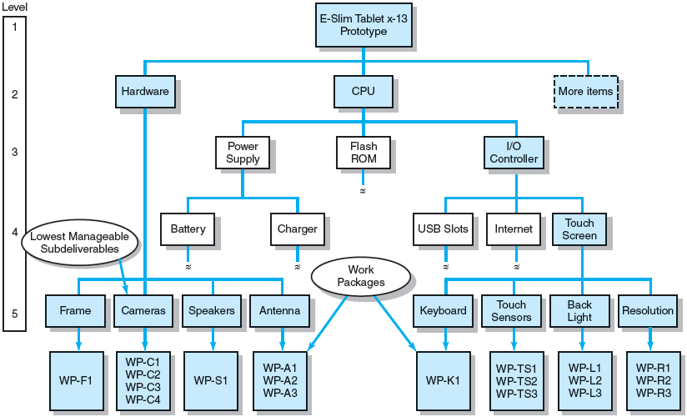
Work Breakdown Structure
FIGURE 4.4

Slide 17
A Work Package
Is the lowest level of the WBS.
Is a short-duration task that has a definite start and stop point, consumes resources, and represents cost.
Should not exceed 10 workdays or one reporting period.
Should be as independent of other work packages of the project as possible.
Is the basic unit used for planning, scheduling, and controlling the project.

Slide 18
Each Work Package in the WBS
Defines work (what).
Identifies time to complete a work package (how long).
Identifies a time-phased budget to complete a work package (cost).
Identifies resources needed to complete a work package (how much).
Identifies a single person responsible for units of work (who).
Identifies monitoring points for measuring progress (how well).

Slide 19
4.4 Step 4: Integrating the WBS with the Organization
Organization Breakdown Structure (OBS)
Depicts how the firm has organized to discharge work responsibility.
Provides a framework to summarize organization unit work performance.
Identifies the organization units responsible for work packages.
Ties the organizational unit to cost control accounts.
The intersection of work packages and the organization unit creates a project cost point or cost account that integrates work and responsibility.

Slide 20
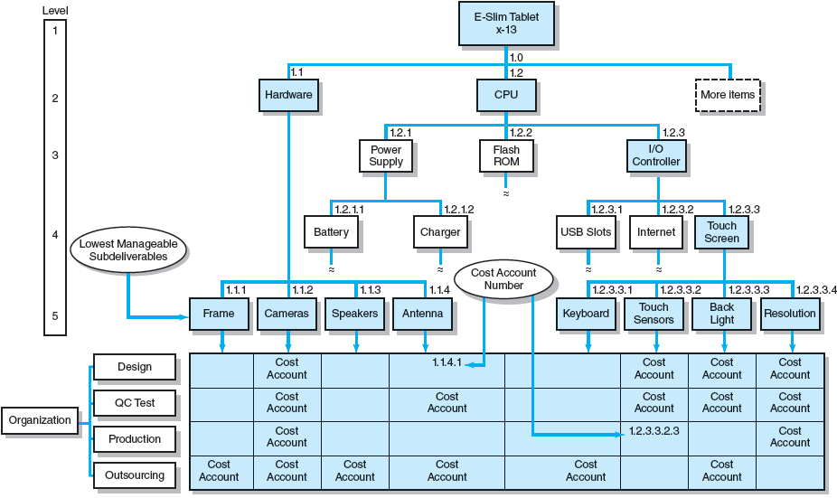
Integration of WBS and OBS
FIGURE 4.5

Slide 21
4.5 Step 5: Coding the WBS for the Information System
WBS Coding System
Defines
  Levels and elements in the WBS
  Organization elements
  Work packages
  Budget and cost information
Allows reports to be consolidated at any level in the structure.
WBS Dictionary
Provides detailed information about each element in the WBS.

Slide 22
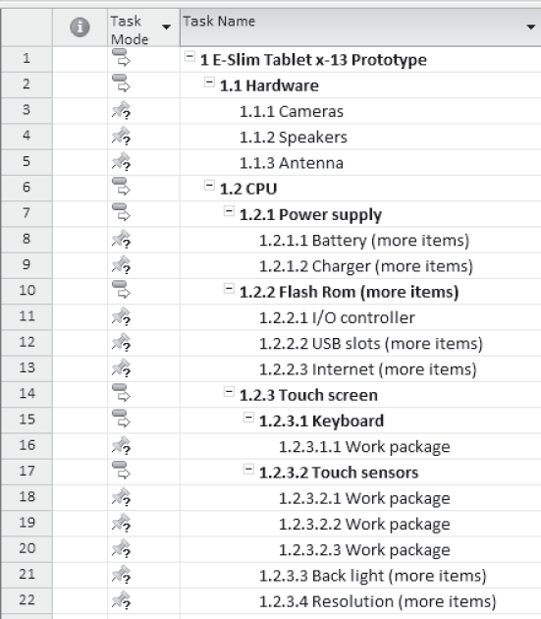
Coding the WBS
EXHIBIT 4.1

Slide 23
4.6 Process Breakdown Structure
Process Breakdown Structure (PBS)
Is used for process-oriented projects.
Is often referred to as the “waterfall method” in the software industry.
Process-oriented project
Is a project that the final outcome is a product of a series of steps and phases.
Is a project that evolves over time with each phase affecting the next phase.
Is a project that is driven by performance requirements, not by plans/blueprints.

Slide 24
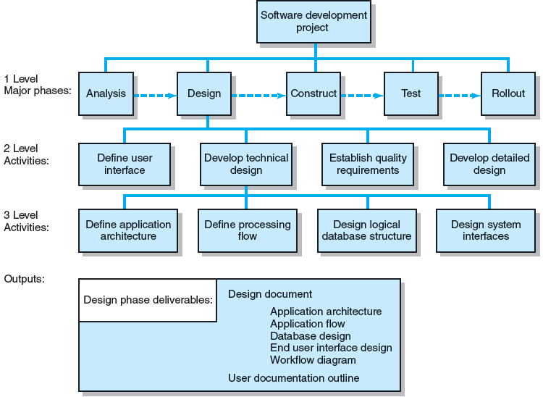
PBS for Software Development Project
FIGURE 4.6

Slide 25
4.7 Responsibility Matrices
Responsibility Matrix (RM)
Is also called a linear responsibility chart.
Summarizes the tasks to be accomplished and who is responsible for what on the project.
Lists all the project activities and the participants responsible for each activity.
Clarifies interfaces between units and individuals that require coordination.
Provides a mean for all participants in a project to view their responsibilities and agree on their assignments.
Clarifies the extent or type of authority exercised by each participant.

Slide 26
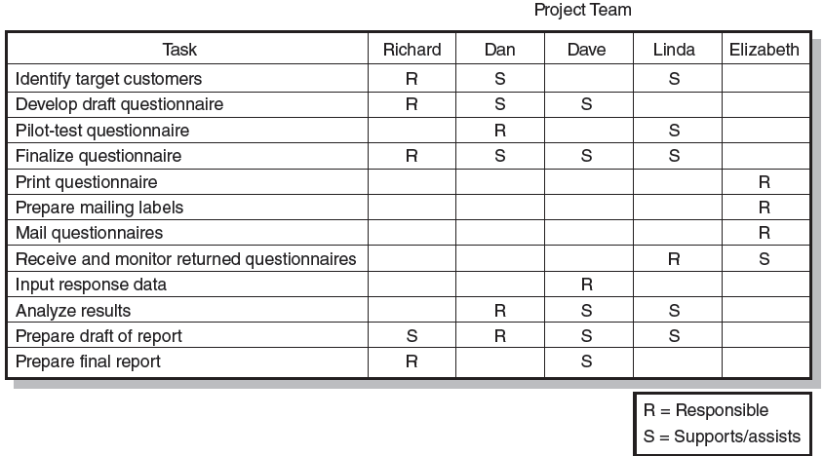
Responsibility Matrix for a Market Research Project
FIGURE 4.7

Slide 27
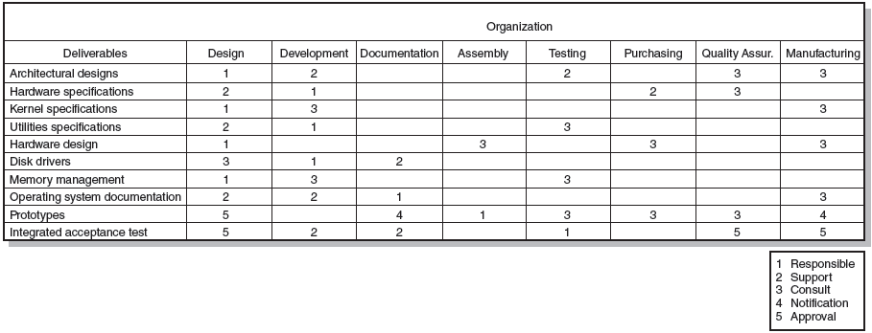
Responsibility Matrix for the Conveyor Belt Project
FIGURE 4.8

Slide 28
4.8 Project Communication Plan
Project communication plans address the following questions:
What information needs to be collected and when?
Who will receive the information?
What methods will be used to gather and store information?
What are the limits, if any, on who has access to certain kinds of information?
When will the information be communicated?
How will it be communicated?

Slide 29
Steps for Developing a Communication Plan
Stakeholder analysis—identify the target groups.
Information needs—project status reports, deliverable issues, changes in scope, team status meetings, gating decisions, accepted request changes, action items, milestone reports, etc.
Sources of information—where does the information reside?
Dissemination modes—hardcopy, e-mail, teleconferencing, SharePoint, and a variety of database sharing programs.
Responsibility and timing—determine who will send out the formation and when.

Slide 30
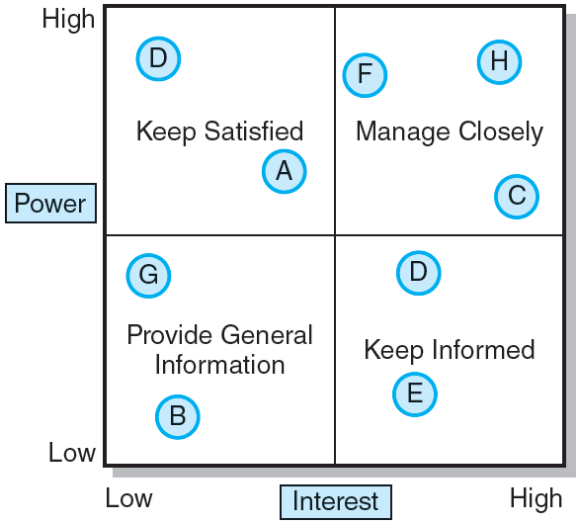
Stakeholder Communications
FIGURE 4.9

Slide 31
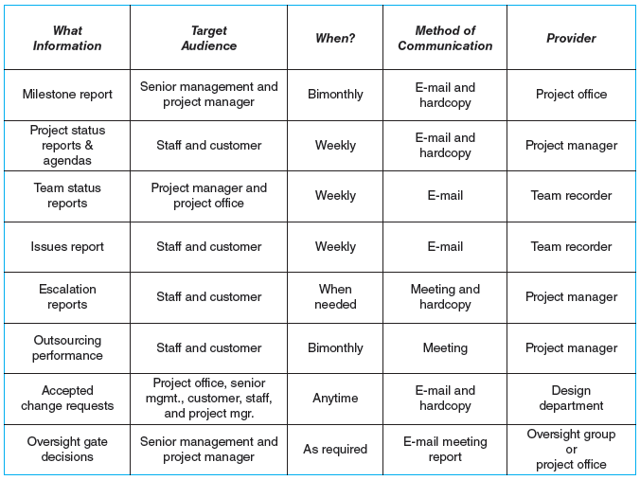
Shale Oil Research Project Communication Plan
FIGURE 4.10

Slide 32
Key Terms
Acceptance criteria
Cost account
Gold plating
Milestone
Organization breakdown structure (OBS)
Priority matrix
Process breakdown structure (PBS)
Product scope description
Project charter
Responsibility matrix
Scope creep
Scope statement
WBS dictionary
Work breakdown structure (WBS)
Work package

