Slide 1
Ch. 2 Buyer Behavior
MKT 442

Slide 2
Recent purchase…
Think of a recent purchase you have made – a significant one that took time to make your decision. Write down what that purchase was.
Now, think of the process you went through – from beginning to end –
How did you decide to start looking?
Where did you look?
What choices did you have, how did you compare?
What helped you decide?

Slide 4
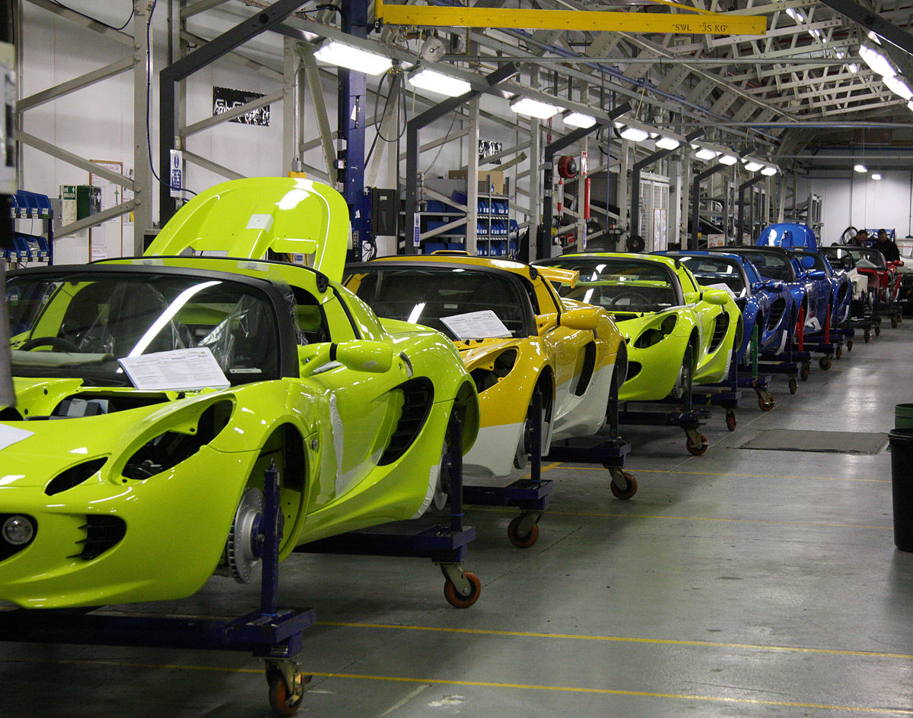
How does the purchase process work for different Business?
This Photo by Unknown Author is licensed under CC BY-NC-ND

Slide 5
Buyer Behavior
Buyer behavior is influenced by many factors – from cost, quality to perceived value, relationships, social or cultural needs.
2 types – Consumer and Business
Consumer Buyer Behavior – buying products or services by individuals or households for personal consumption
Business (organizational) Buyer Behavior – buying of goods or services from another business and used to manufacture or deliver other products.

Slide 6
Differences between Consumer and Organizational Buyers
Purchase decision made based on individual or household consumption
Purchase decision made by brand, reputation or recommendation
Decision based on personal emotions
Decisions can be fast
Purchase for individual use
Purchases made for meeting customer need or manufacturing of products
Decision made by several people
Decision made based on specialist knowledge and technical specifications
Decisions made rationally to meet criteria (not emotions)
Longer time for decision/more people involved
Products are complex and based on customer usage

Slide 7
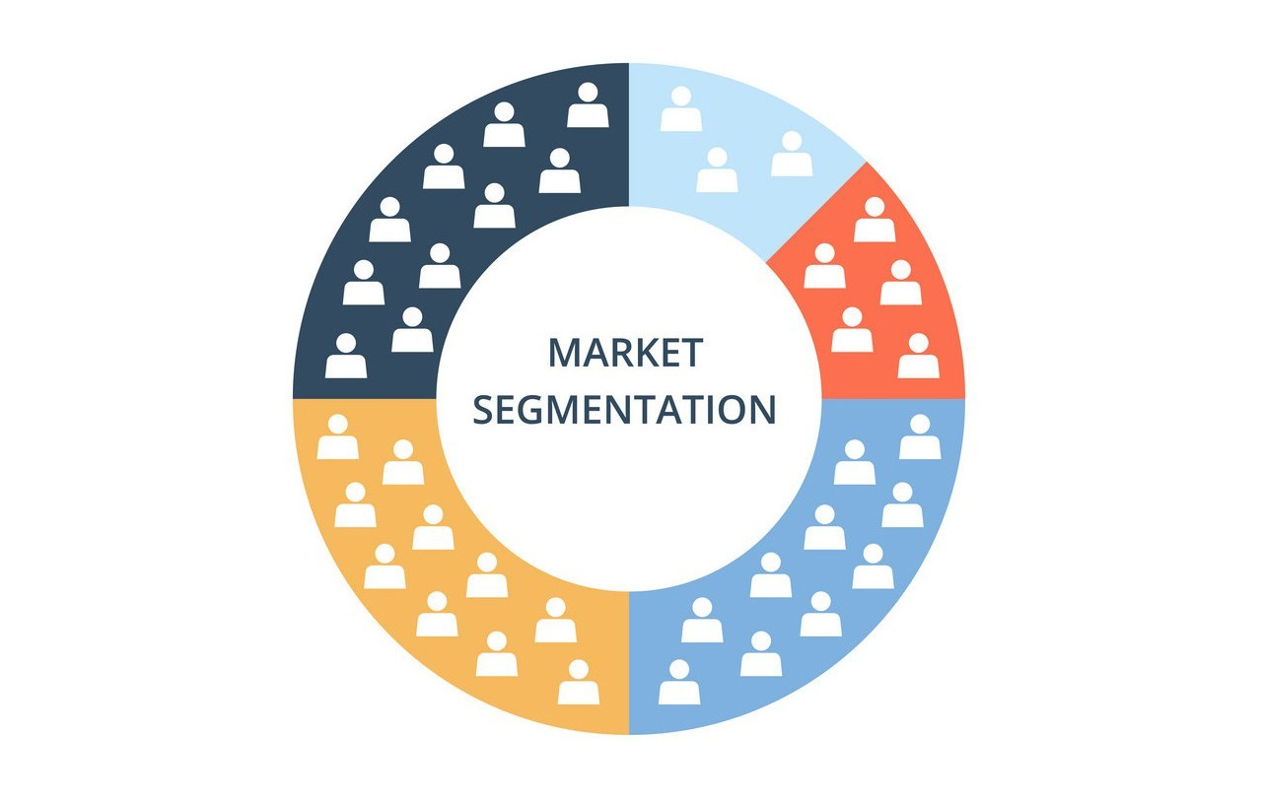
How to engage in business?

Slide 8
By Industry? By nature of business?
Look at the ‘technology’ associated with the business – “how does the customer[business] organize their activities in order to perform transformation processes that represent the essential components of their value-adding activities” (Woodward, 1965, as cited in Brennan, 2020)
Unit Production
Mass Production
Process Production

Slide 9
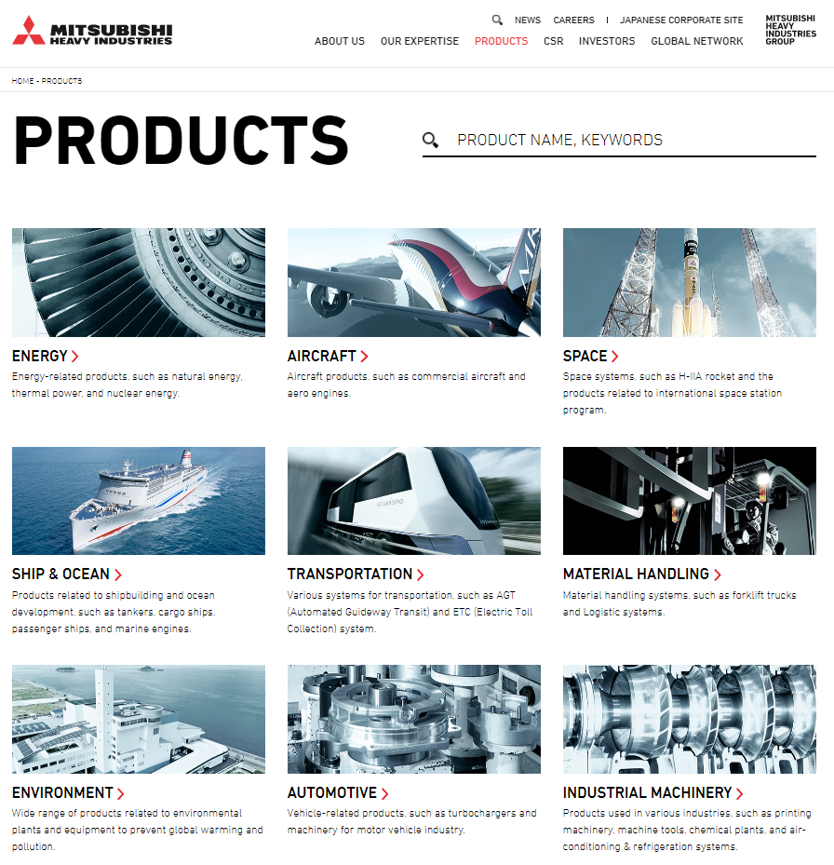
Unit Production
Involves the design and supply of products that are tailored to specific customer requirements.
Typically associated with major capital investment projects
Technological complexity and scale affect supply needs and purchasing behavior
Company also has to rely on design and production capabilities of suppliers that provide materials, components or equipment essential to finish project
Company typically requires involvement of suppliers in design and production/assembly phases and requires coordination to ensure completion and financing.
ex. Mitsubishi Heavy Industries Ltd. - Energy Division
competes for multi-million dollar projects - power generation installations and distribution systems
needs work with subcontractors to assemble finished systems

Slide 10
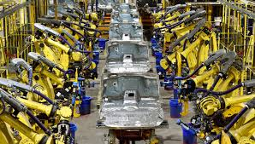
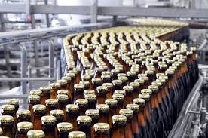
Mass Production
Involved in the design and supply of high-volume, standard products.
Operational efficiency and low cost base are central
Efficiency - determined by equipment used and integration of production sections
Cost base - determined by materials and components used to make finished product
Maximize efficient use of resources - production activities = high degree of inflexibility → requiring supply of materials to be precise, regular and consistent
Company expects suppliers to adjust logistical and admin procedures to fit
ex. adjust to match JIT delivery
Also involves regular introduction of new products into target market
Key suppliers would need to contribute to new product development activities
Supplier would have regular contact with company tech mgrs during development
ex. Nestle https://www.bloomberg.com/news/articles/2019-07-16/nestle-invents-new-way-to-make-chocolate-without-adding-sugar

Slide 11
Process Production
Also high-volume production like Mass Production
Firm does not assemble finished products
Processing of raw materials for use in other supply chains
Volume and uninterrupted supply are essential
Equipment is a big expenditure, but not frequent - ex. Steel manufacturers

Slide 12
Business Strategy
‘Go where your business goes’ - Identify your customer’s business strategy and align.
Product Leadership Strategy
Pursues Innovation in order to provide leading-edge products that consistently enhance value.
Requires companies with excellent technical and creative
Supplier involved in process is key
Operational Excellence
Provide reliable products with minimal inconvenience to customers at competitive prices
All about the $$$
Keep costs at a minimum
Rethink design and implementation to save $
Organized procurement to save $
Customer Intimacy
Develop adapted market offerings based on detailed understanding of customer requirements.
Have internal flexibility to respond quickly to shifts in demand
Suppliers provide equal response to changing customer needs

Slide 13
Activity

Slide 14
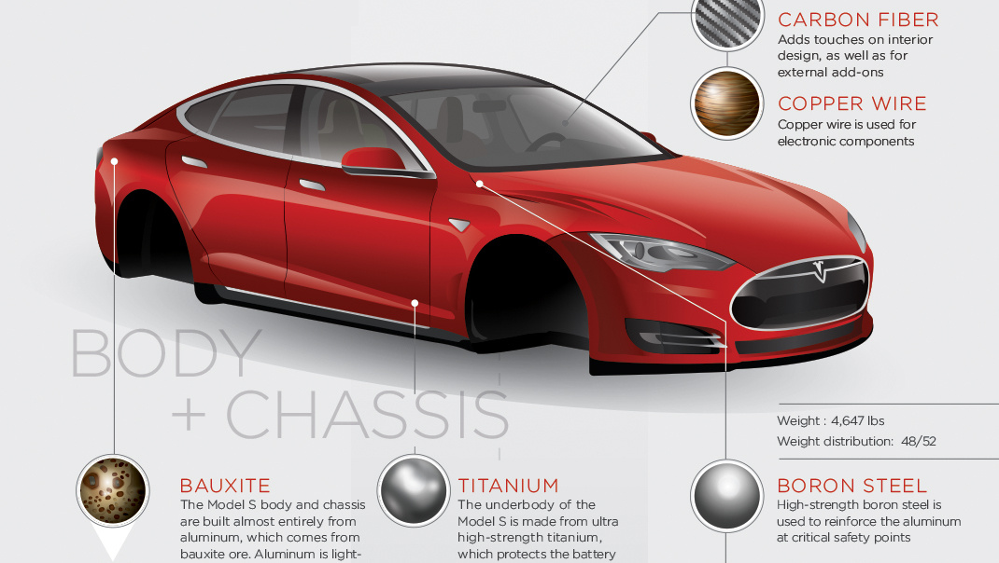
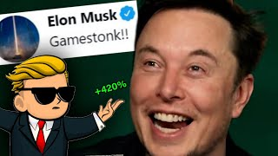

Slide 15
Purchasing Orientation
A company’s approach to acquiring resources and capabilities from external supply markets.
Differ between industries and even within an organization - a company may have several
Mainly - buying, procurement, supply management

Slide 16
Buying Orientation
Focus on achieving reductions in monetary value spent by company on goods and services.
Get the best deal or maximize power
Suppliers selected by ability to meet quality, availability AND lowest price
Company sets target price cap for suppliers
Negotiation power is key
tactics - centralize purchasing decision, consolidate company supply needs, leverage multiple sources of supply (competitor)
Short-term focus

Slide 17
Procurement Orientation
The “buy better” approach - rather than best deal, optimize purchase resource/increase productivity.
Often based on Total Cost of Ownership (TCO) - true cost of obtaining product including acquisition, possession, use, disposal.
Use over extended period - ex capital equipment, raw materials
Identify main cost drivers of different product categories is key
Set target cost (not target price) so suppliers can determine how to best fit
Requires willingness to share info to closely align
Longer-term perspective
ex. re-eval purchase and supply process, handling of goods, JIT delivery to reduce costs

Slide 18
Supply Management Orientation
Effort to maximize value in the supply chain.
Activities might involve:
Assessing core competencies and key capabilities to determine what can be done themselves
Outsourcing
Purchase ‘product systems’ central to buying org operations or finished product
Restructuring supply markets to rely on smaller number of suppliers

Slide 19
Segmenting Purchase Categories
Determine approach with supply markets - minimize supply risk and maximize buying power
Leverage
exploit buying power or
develop partnerships
Strategic
maximise, balance or diversify partnerships
Non-critical purchase efficiency
via
systems buying;
e-procurement
Bottleneck
supply security
via
long-term contracts; multiple suppliers/solutions;
broadening of specification
high
profit impact
low
low supply risk high
Notes:
Profit impact - the extent to which items add significant value to the organization’s output either because they account for a large proportion of that output or because they have a significant impact on quality.
Supply risk - the vulnerability of product availability, either because of scarcity of the item itself or supply chain instability, or because there are simply a limited number of suppliers.

Slide 20
The Purchase Process
Decision-Making
Need/Problem Recognition
2 Factors: need to solve supply problem, or ways org can improve operational performance or new market opportunities
Product Specification
based on need:
Functional
Tech/material
Process
Performance
Supplier and Product Search
2 issues: product fit and the right organization
Evaluation of Proposals and Selection of Suppliers
based on criteria / assessment
Selection of Order Routine
negotiation - process, delivery and payment
Performance Feedback and Evaluation

Slide 21
Purchase Process
New Task
Purchase decision is completely different than previous experiences. A “NEW” task that requires large amounts of information, consideration of alternative solutions and potential suppliers.
Judgmental Buying approach
highest uncertainty
possibly difficult to classify product, performance or specification
or solution is technically complex
typical evaluation tools cannot be used, so decision based on judgment of small group of managers
Strategic Buying approach
Decisions strategically important to business customer
Operational activities
significant financial outcome
need long-term perspective and corporate planning
requires invested effort in evaluating information, solutions, negotiation, etc.

Slide 22
Modified Re-buy
Repeat business but some customer change
Simple modified rebuy
product, process, suppliers already familiar
Complex modified rebuy
some uncertainty and large choice of suppliers
requires search for large amount of info

Slide 23
Straight Re-buy
Casual rebuy
low-value, low-importance items - purchase incidentally
little effort in decision
Routine, low-priority
products of some importance, more repetitive buying decision
perceive little distinction between competitor products
easy for e-procurement
Guidelines:
Ensure no switch
Regular contact
Look for ways to reduce effort/save

Slide 24
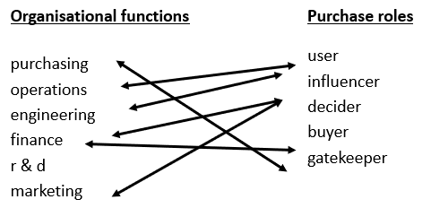
Buying Teams
Decision-making unit (DMU)
Initiators
Decision makers (deciders)
actual purchase decision, may not have formal authority - can be difficult to identify
Buyers (purchasing managers)
select suppliers and manage buying process - influence parameters of decision
Influencers
Users
Gatekeepers

