Slide 1

Chapter Sixteen
International Projects

Slide 2
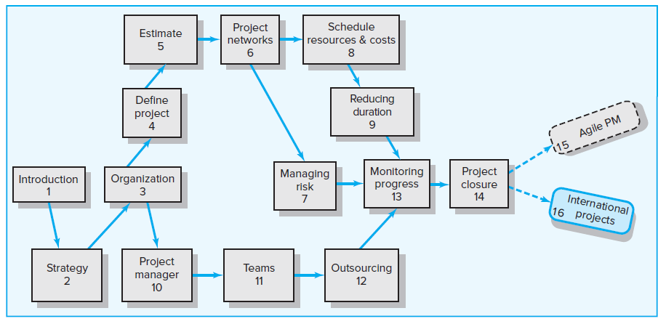
Where We Are Now

Slide 3
Learning Objectives
16-01 Describe environmental factors that affect project management in
different countries.
16-02 Identify factors that typically are considered in selecting a foreign
location for a project.
16-03 Understand cross-cultural issues that impact working on
international projects.
16-04 Describe culture shock and strategies for coping with it.
16-05 Understand how organizations select and prepare people to work
on international projects.

Slide 4
Chapter Outline
16.1 Environmental Factors
16.2 Project Site Selection
16.3 Cross-Cultural Considerations: A Closer Look
16.4 Selection and Training for International Projects

Slide 5
Four Major Issues of Managing International Projects
Major environmental factors impacting project selection and implementation
Global expansion considerations
Challenges of working in a strange and foreign culture
Selection and training professionals for international projects

Slide 6
Pros and Cons of International Assignments
Positives
Increased income
Increased responsibilities
Career opportunities
Foreign travel
New lifetime friends
Negatives
Absence from home, friends and family
Personal risks
Missed career opportunities
Difficulties with foreign language, culture, and laws
Adverse conditions

Slide 7
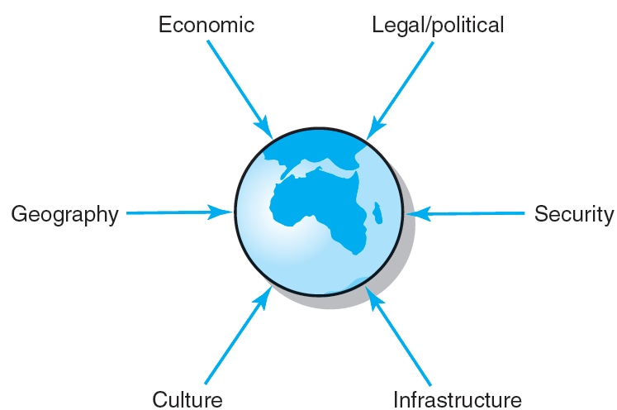
16.1 Environmental Factors
FIGURE 16.1

Slide 8
Environmental Factors (Continued)
Legal/Political
Political stability
Federal, state, and local bureaucracies
Government interference or support
National and local laws and regulations
Government corruption
Security
International terrorism
Local crime and kidnapping
National and local security
Risk management

Slide 9
Environmental Factors (Continued)
Geography
Climate and seasonal differences
Natural geographical obstacles
Economics
Gross domestic product (GDP)
Protectionist strategies and policies
Balance of payments
Local labor force: skills, educational levels and supply
Currency convertibility and exchange rates
Inflation rates

Slide 10
Environmental Factors (Continued)
Infrastructure
Telecommunication networks
Transportation systems
Power distribution grids
Local technologies
Educational systems
Culture
Customs
Values and philosophies
Social standards
Language
Religion
Multicultural environments

Slide 11
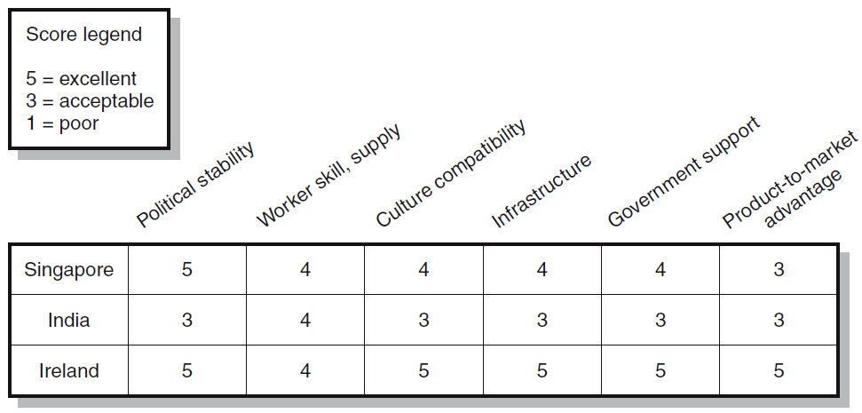
16.2 Project Site Selection
FIGURE 16.2

Slide 12
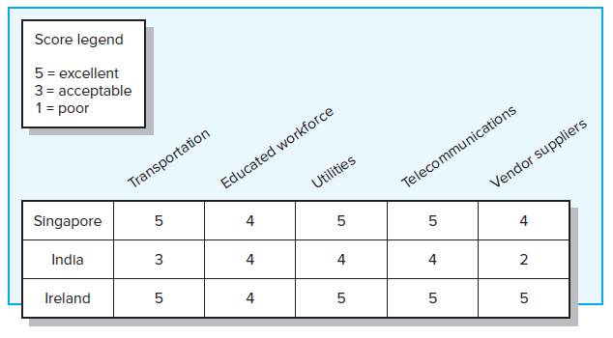
16.3 Evaluation Matrix Breakdown for Infrastructure
FIGURE 16.3

Slide 13
16.3 Cross-Cultural Considerations: A Closer Look
Culture
Is a concept created for descriptive purposes and depends on the group that is the focus of attention.
Is defined as a system of shared norms, beliefs, values and customs that bind people together, creating shared meaning and a unique identity.
Refers to certain regions, to specific nations, or to certain ethnic or religious groups.

Slide 14
Cross-Cultural Considerations (Continued)
Ethnocentric Perspective
Is a tendency to believe that one’s cultural values and ways of doing things are superior to all others.
  Wanting to conduct business only on your terms and stereotyping other countries as lazy, corrupt, or inefficient.
  Underestimating the importance that relationship building plays in conducting business in other countries.
Adjustments for Americans
Relativity of time and punctuality
Culture-related ethical dilemmas
Personal and professional relationships
Attitudes toward work and life

Slide 15
Cross-Cultural Orientations
Cultural Issues
Relation to nature. This issue reflects how people relate to the natural world around them and to the supernatural.
Time orientation. The culture focus on the past, present, or future.
Activity orientation. This issue refers to a desirable focus of behavior.
Basic nature of people. A culture views people as good, evil, or some mix of these two.
Relationships among people. This issue concerns the responsibility one has for others.

Slide 16
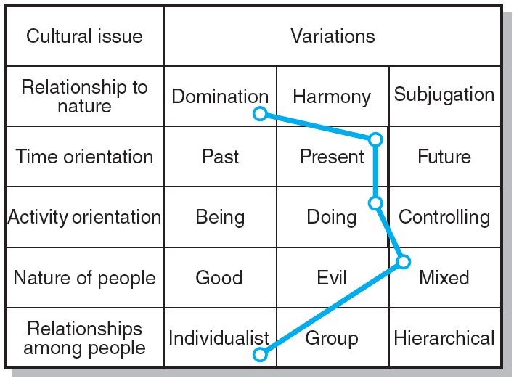
Kluckhohn-Strodtbeck’s Cross-Cultural Framework
Note: The line indicates where the United States tends to fall along these issues.
FIGURE 16.4

Slide 17
The Hofstede Framework
Different dimensions for examining cultures
Individualism versus collectivism—identifies whether a culture holds individuals or the group responsible for each member’s welfare.
Power distance—describes the degree to which a culture accepts status and power differences among its members.
Uncertainty avoidance—identifies a culture’s willingness to accept uncertainty and ambiguity about the future.
Masculinity-femininity—describes the degree to which the culture emphasizes competitive and achievement-oriented behavior or displays concerns for relationships.

Slide 18
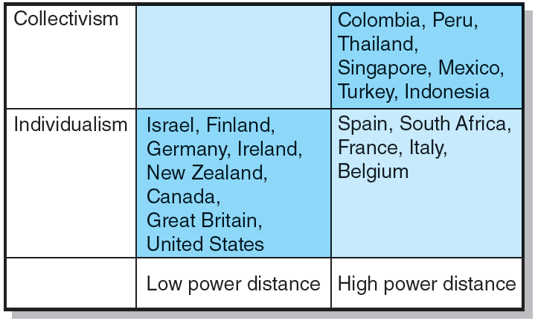
Sample Country Clusters on Hofstede’s Dimensions of Individualism-Collectivism and Power Distance
FIGURE 16.5

Slide 19
Working in Mexico
Personal relationships dominate all aspects of Mexican business.
Mexicans are obligated to give preference to relatives and friends when hiring, contracting, procuring, and sharing business opportunities.
Mexicans tend to perceive Americans as being “cold.” One thing Americans can do to prevent being seen as a typical Gringo is to take the time and effort in the beginning of a working relationship to really get to know Mexican counterparts.
Mexicans have a different concept of time than Americans do. Mexicans prefer open-ended schedules.
Mexicans do not share Americans’ confidence that they control their own destiny.

Slide 20
Working in Mexico (Continued)
Guidelines for working with Mexicans on projects
Mexicans can be very passionate and emotional when arguing.
Mexicans tend to see meetings as the place where persons with authority ratify what has been decided during informal private discussions.
While Mexicans can be emotional, they tend to shy away from any sort of direct confrontation or criticism.
Speech in Mexico is often indirect.
Titles are extremely important in Mexico and are always used when a person is introducing himself, or being introduced.

Slide 21
Working in France
In France, one’s social class is very important. Social interactions are constrained by class standing. A successful French person might, at least, climb one or two rungs up the social ladder.
The French tend to admire or be fascinated with people who disagree with them.
The French often determine a person’s trustworthiness based on their first-hand, personal evaluation of the individual’s character.
The French are often accused of lacking an intense work ethic.
The French enjoy a reputation for productive work, a result of the French tradition of craftsmanship.
Most French organizations tend to be highly centralized with rigid structures.
While the French admire American industriousness, they believe that quality of life is what really matters.

Slide 22
Working in France (Continued)
Cautions to remember with the French
The French value punctuality.
Great importance is placed on neatness and taste.
The French can be very difficult to negotiate with. Often, they ignore facts, no matter how convincing they may be.
French managers tend to see their work as an intellectual exercise.
The French generally consider managers to be experts.

Slide 23
Working in Saudi Arabia
In Saudi Arabia, a favorite expression is “Bukra insha Allah” which means “ Tomorrow if God wills,’ an expression that reflects the Saudis’ approach to time.
An associated cultural belief is that destiny depends more on the will of a supreme being than on the behavior of individuals.
Saudis often react on the basis of emotion, not logic.
Saudis use elaborate and ritualized forms of greeting and leave-taking.
Initial meetings are typically used to get to know the other party. Business-related discussions may not occur until the third or fourth meeting.
Saudis attach a great deal of importance to status and rank.

Slide 24
Working in Saudi Arabia (Continued)
Guidelines for working in an Arab culture
It is important never to display feelings of superiority because this makes the other party feel inferior.
A lot of what gets done is a result of going through administrative channels in the country.
Connections are extremely important in conducting business.
Patience is critical to the success of business negotiations.
Important decisions are usually made in person, not by correspondence or telephone.

Slide 25
Working in China
In China, face is more than simply reputation. Loss of face brings shame not only to individuals but also to family members.
In China, “whom you know is more important than what you know.” The term guanxi refers to personal connections with appropriate authorities or individuals. Many believe that the quickest way to build guanxi relationships is through tendering favors. Another common method for outsiders to acquire guanxi is by hiring local intermediaries, who use their connections to create contacts with Chinese officials and businesspeople.
Chinese are a collective society in which people pride themselves on being a member of a group.
Chinese people do not appreciate boisterous behavior, and when speaking to each other they maintain a greater physical distance than is typical in America.

Slide 26
Working in China (Continued)
Cautions with the Chinese
Once the Chinese decide who and what is best, they tend to stick to their decisions.
Reciprocity is important in negotiations.
The Chinese tend to be less animated than Americans.
The Chinese place less value on the significance of time and often get Americans to concede concessions by stalling.
In Confucian societies those in position of power and authority are obligated to assist the disadvantaged.

Slide 27
Working in the United States
Immigration has made the United States a melting pot of diverse culture.
Mainstream Americans are motivated by achievement and accomplishment.
Americans tend to idolize the self-made person who rises from poverty and adversity to become rich and successful.
Although Americans like to set precise objectives, they view planning as a means and not an end.
Americans fought a revolution and subsequent wars to preserve their concept of democracy, so they resent too much control or interferences, especially by governments.
“Getting things done,” is an American characteristic.
Americans in play or business generally are quite competitive, reflecting their desire to achieve and succeed.

Slide 28
Working in the United States (Continued)
Guidelines and cautions for working with Americans on projects
More than half of the U.S. women work outside the home; females have considerable opportunity for personal and professional growth, guaranteed by law.
In the United States, gifts are rarely brought by visitors in a business situation.
Americans tend to be quite friendly and open when first meeting someone.
Americans tend to be informal in greeting and dress.
American decision making is results oriented.

Slide 29
Summary Comments about Working in Different Cultures
Common practice to rely on local intermediaries to bridge the gap between cultures. These intermediaries
Act as translators.
Use their social connections to expedite transactions and protect the project against undue interference.
Serve as cultural guides, helping outsiders understand and interpret the foreign culture.
Culture shock
Is a natural psychological disorientation that most people suffer when they move into a culture different from their own.
Results from a breakdown in your selective perception and effective interpretation systems.

Slide 30
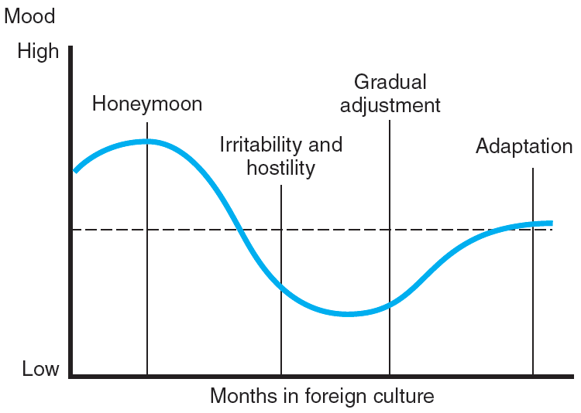
Culture Shock Cycle
FIGURE 16.6

Slide 31
Coping with Culture Shock
Engage in regular physical exercise programs
Practice meditation and relaxation exercises
Keep a journal
Create “stability zones”
Modify expectations and behavior
Redefine priorities and develop more realistic expectations
Focus on the most important tasks and relish small accomplishments
Use project work as a bridge until adjusted to the new environment
Help spouses and families manage the transition

Slide 32
16.4 Selection and Training for International Projects
Selection Factors
Work experience with cultures other than one’s own
Previous overseas travel
Good physical and emotional health
Knowledge of a host nation’s language
Recent immigration background or heritage
Ability to adapt and function in the new culture

Slide 33
Areas for Training
Religious
Dress codes
Education systems
Holidays—national and religious
Daily eating patterns
Family life
Business protocols
Social etiquette
Equal opportunity

Slide 34
Learning Approaches to Cultural Fluency
The “information-giving” approach—the learning of information or skills from a lecture-type orientation.
The “affective” approach—the learning of information/skills that raise the affective responses on the part of the trainee and result in cultural insights.
The “experiential” approach—a variant of the affective approach technique that provides the trainee with realistic simulations or scenarios.

Slide 35
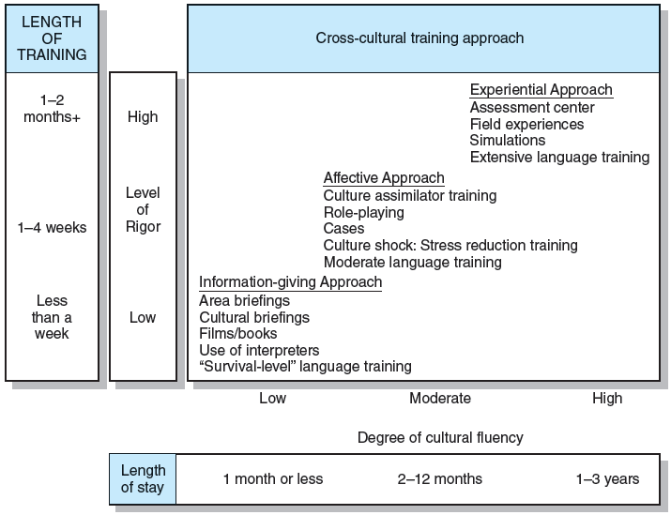
Relationship between Length and Rigor of Training and Cultural Fluency Required
FIGURE 16.7

Slide 36
Key Terms
Culture
Culture shock
Infrastructure

