Slide 1
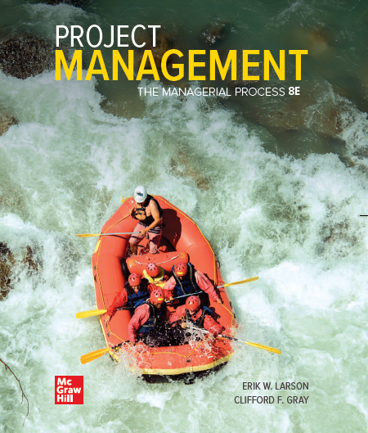
Chapter Fifteen
Agile Project Management

Slide 2
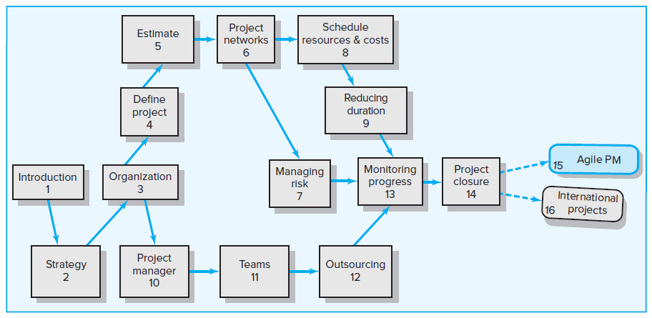
Where We Are Now

Slide 3
Learning Objectives
15-01 Recognize the conditions in which traditional project
management versus Agile Project Management should be used.
15-02 Understand the value of iterative, incremental development for
creating new products.
15-03 Identify core Agile principles.
15-04 Understand the basic methodology used in Scrum.
15-05 Understand the basic methodology used by Extreme
programming.
15-06 Know how to create and use a Kanban board.
15-07 Recognize the limitations of Agile Project Management.

Slide 4
Chapter Outline
15.1 Traditional versus Agile Methods
15.2 Agile PM
15.3 Agile PM in Action: Scrum
15.4 Extreme Programming and Kanban
15.5 Applying Agile PM to Large Projects
15.6 Limitations and Concerns
15.7 Hybrid Models

Slide 5
15.1 Traditional versus Agile Methods
Traditional Project Management Approach
Concentrates on thorough, up front planning of the entire project.
Requires a high degree of predictability to be effective.
Agile Project Management (Agile PM)
Relies on iterative, incremental development (IID).
Is ideal for exploratory projects in which requirements need to be discovered and new technology tested.
Focuses on active collaboration between the project team and customers representatives, breaking projects into small, functional pieces and adapting to changing requirements.

Slide 6
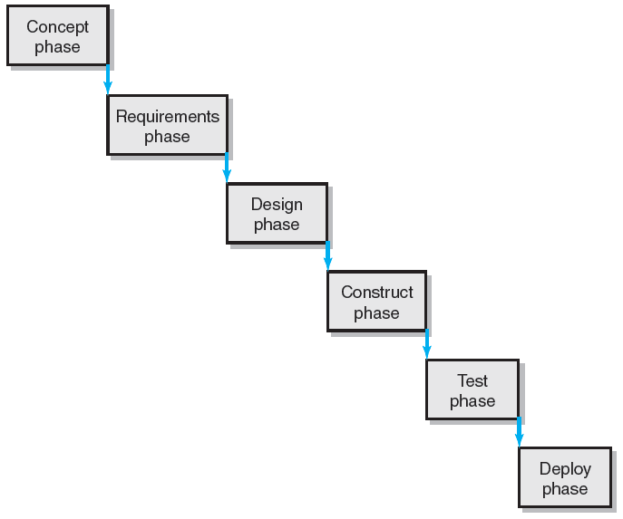
The Waterfall Approach to Software Development
FIGURE 15.1

Slide 7
A Set of 12 Guiding Principles for Agile PM
Our highest priority is to satisfy the customer through early and continuous delivery of valuable software.
Welcome changing requirements, even late in development.
Deliver working software frequently, from a couple of weeks to a couple of months, with a preference to the shorter timescale.
Businesspeople and developers must work together daily throughout the project.
Build projects around motivated individuals. Give them the environment and support they need and trust them to get the job done.
The most efficient and effective method of conveying information to and within a development team is face-to-face conversation.
Working software is the primary measure of progress.
Agile processes promote sustainable development.
Continuous attention to technical excellence and good design enhances agility.
Simplicity—the art of maximizing the amount of work not done—is essential.
The best architectures, requirements, and designs emerge from self-organizing teams.
At regular intervals, the team reflects on how to become more effective, then turns and adjusts its behavior accordingly.

Slide 8
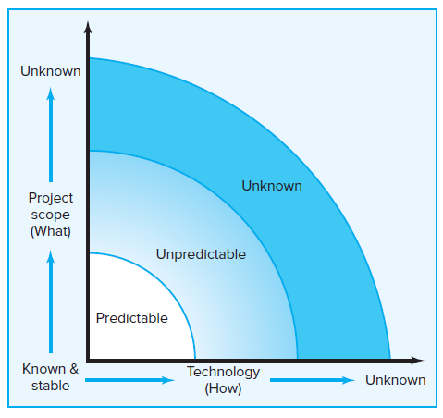
Project Uncertainty
FIGURE 15.2

Slide 9
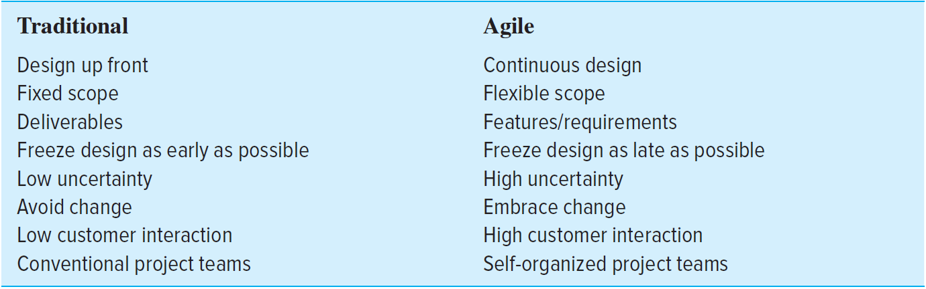
Traditional Project Management versus Agile Project Management
TABLE 15.1

Slide 10
15.2 Agile PM
Utilizes a rolling wave planning and scheduling project methodology.
Is continuously developed through a series of incremental iterations over time.
  Iterations are short time frames (“time boxes”).
  The goal of each iteration is to develop a workable product that satisfies one or more desired product features to demonstrate to the customer and other key stakeholders.
  At the end of each iteration, stakeholders and customers review progress and re-evaluate priorities to ensure alignment with customer needs and company goals.
  Each new iteration subsumes the work of the previous iterations and adds new capabilities to the evolving product.

Slide 11
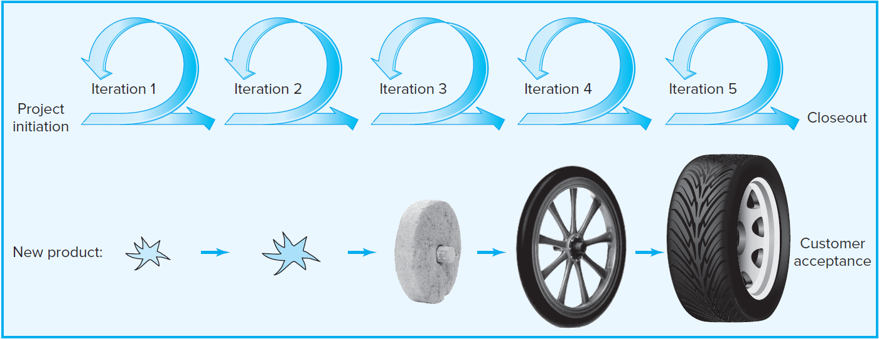
Iterative, Incremental Product Development
FIGURE 15.3

Slide 12
Advantages of Iterative Development Process
Continuous integration, verification, and validation of the evolving product.
Frequent demonstration of progress to increase the likelihood that the end product will satisfy customer needs.
Early detection of defects and problems.

Slide 13
Other Methodologies Responding to the Challenges of Unpredictable Projects
Scrum
Extreme Programming (XP)
Agile Modeling Lean Development
RUP (Rational Unified Process)
Crystal Clear
Dynamic Systems Development Method (DSDM)
Rapid Product Development (RPD)

Slide 14
Agile Principles
Focus on customer value
Iterative and incremental delivery
Experimentation and adaptation
Self-organization
Servant leadership
Continuous improvement

Slide 15
15.3 Agile PM in Action: Scrum
Scrum
Is a holistic approach to developing new products, where the whole team “tries to go the distance as a unit, passing the ball back and forth.”
Begins with a high-level scope definition and ballpark time and cost estimates for the project.
Use product features as deliverables.
  A feature is defined as a piece of a product that delivers some useful functionality to a customer.
  The project team tackles the highest-priority feasible feature first.
  Priorities are re-evaluated after each iteration.
    Iterations are called sprints and should last no longer than four weeks.
    The goal of each sprint is to produce fully functional features.
  Specific features are created according to four distinct phases: analysis, design, build, and test.

Slide 16
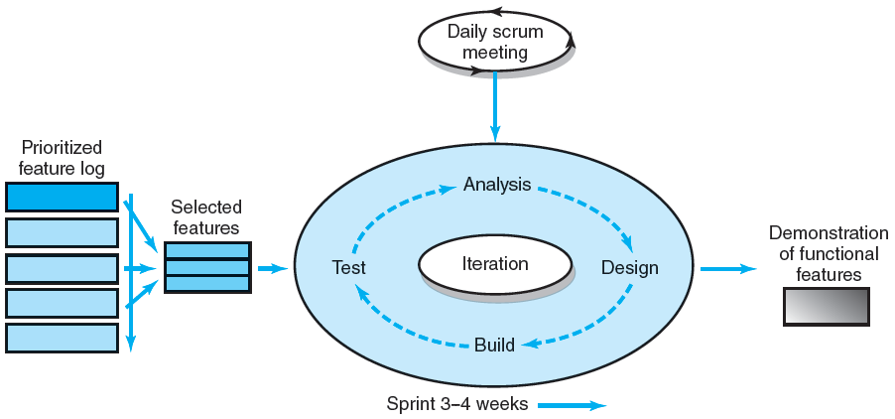
Scrum Development Process
FIGURE 15.4

Slide 17
Key Roles and Responsibilities in the Scrum Process
Product Owner
Acts on behalf of customers/end users to represent their interests.
Works with the development team to refine features through stories and end users cases.
Ensures that the development team focuses their efforts on developing a product that will fulfill the business objective of the project.
Development Team
Is responsible for delivering the product.
Is typically made up of five to nine people with cross-functional skill sets.
Scrum Master (Project Manager)
Facilitates the scrum process and resolves impediments at the team and organization levels.
Acts as buffer between the team and outside interference but not the leader of team (the team leads itself!)
Helps the product owner with planning and try to keep the team energized.

Slide 18
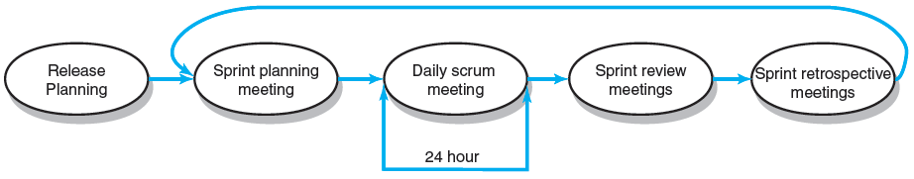
Scrum Meetings
FIGURE 15.5

Slide 19
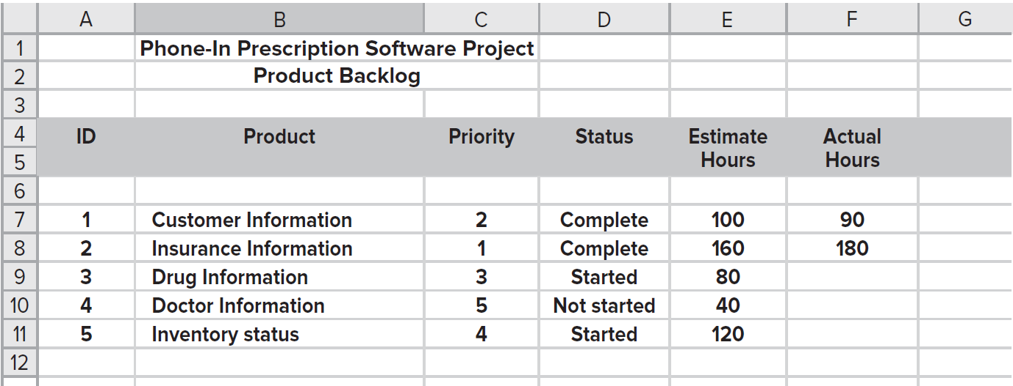
Partial Product Backlog
FIGURE 15.6

Slide 20
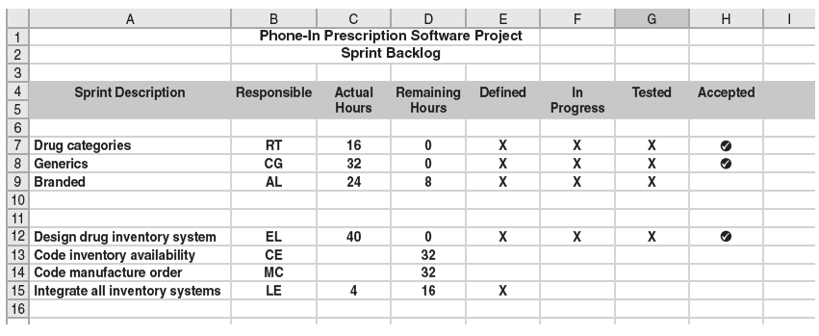
Partial Sprint Backlog
FIGURE 15.7

Slide 21
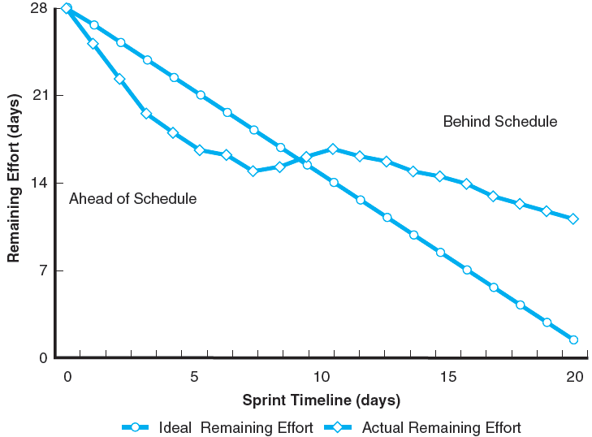
Sprint Burndown Chart
FIGURE 15.8

Slide 22
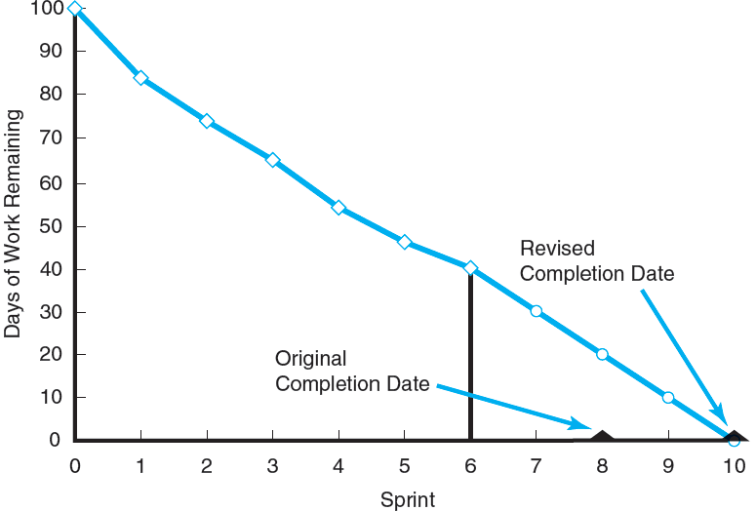
Release Burndown Chart after Six Sprints
FIGURE 15.9

Slide 23
15.4 Extreme Programming and Kanban
Extreme Programming (XP)
Is a more aggressive form of Scrum that organizes people to produce higher-quality software more efficiently.
Considers change a natural, even desirable aspect of software development projects and should be planned for, instead of eliminated.
Are test-driven development and paired programming.
Is founded on five values: communication, simplicity, feedback, courage and respect.
Kanban
Is a lean management methodology that has been adapted by Agile practitioners to help manage project work flow.
Consists of a whiteboard divided into three columns: Planned, Work in Progress, and Done.
Is based on the idea of a pull system—signaling when the team is ready for more work.
Helps the team visualize the work flow on the project and focus their attention on the most critical work.

Slide 24
15.5 Applying Agile PM to Large Projects
Scaling
Involves several teams working on different features at the same time.
Needs to make sure that the different features being created work in harmony with each other—integration.
Staging
Requires significant up-front planning to manage the interdependences of different features that will be developed.
Involves developing protocols and defining roles for coordinating efforts and assuring compatibility.

Slide 25
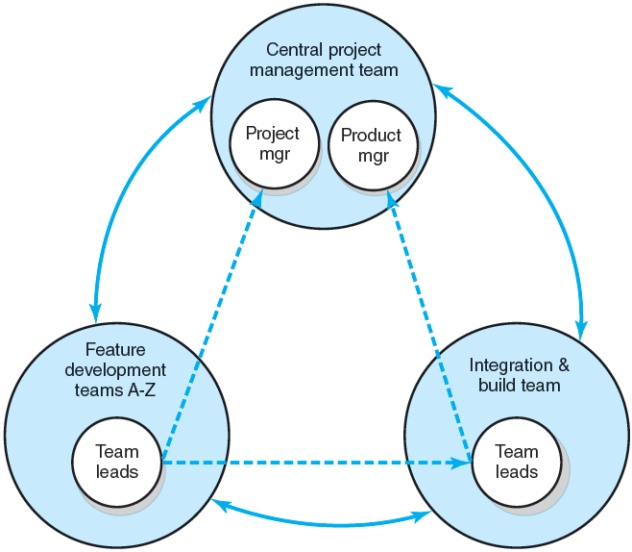
Hub Project Management Structure
FIGURE 15.10

Slide 26
15.6 Limitations and Concerns
Agile PM is not a simple methodology. Adoption tends to evolve over time.
Many of the Agile principles, including self-organizing teams and intense collaboration, are incompatible with corporate cultures.
Agile PM does not satisfy top management’s need for control.
Agile skeptics warn that evolving requirements contribute to scope creep.
Agile PM requires active customer involvement.

Slide 27
15.7 Hybrid Models
Agile PM is used up front to resolve key scope questions and define requirements. Then traditional PM is applied to complete the project.
Incremental, experimentation is used to resolve technical issues, allowing for a formal implementation plan.
Many companies use hybrid models on large projects that combine waterfall and Agile methods.
Teams use Agile techniques on plan-driven projects. Teams use shorter iterations and retrospectives to get critical customer feedback.
Kanban methods are used by traditional teams to visualize work and identify bottlenecks in the project schedule.

Slide 28
Key Terms
Agile Project Management
Extreme Programming
Feature
Hybrid model
Iterative, incremental development (IID)
Kanban
Product backlog
Product owner
Release burndown chart
Scaling
Scrum master
Self-organizing team
Sprint backlog
Sprint burndown chart
Waterfall method

