Slide 1

Chapter Three
Organization: Structure and Culture

Slide 2
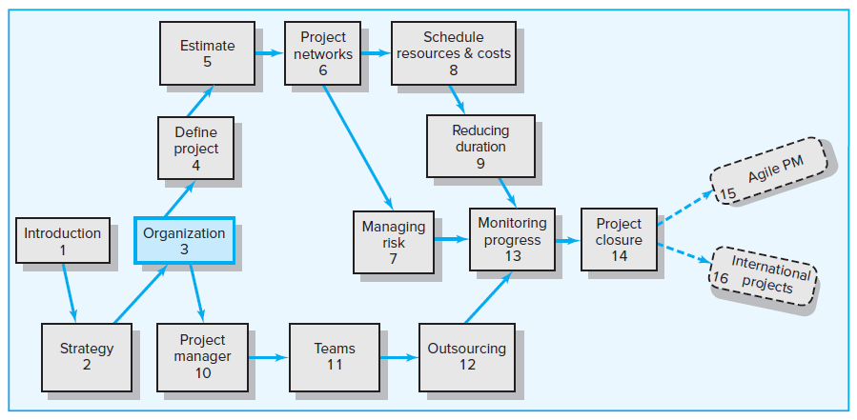
Where We Are Now

Slide 3
Learning Objectives
03-01 Identify different project management structures and understand
their strengths and weaknesses.
03-02 Distinguish three different types of matrix structures and
understand their strengths and weaknesses.
03-03 Describe how project management offices (PMOs) can support
and improve project execution.
03-04 Understand organizational and project considerations that should
be considered in choosing an appropriate project management
structure.
03-05 Appreciate the significant role that organizational culture plays in
managing projects.
03-06 Interpret the culture of an organization.
03-07 Understand the interaction between project management
structure and the culture of an organization.

Slide 4
Chapter Outline
3.1 Project Management Structures
3.2 Project Management Office (PMO)
3.3 What Is the Right Project Management Structure?
3.4 Organizational Culture
3.5 Implications of Organizational Culture for Organizing Projects

Slide 5
3.1 Project Management Structures
Three different project management structures are:
Functional organization
Dedicated project teams
Matrix structure
  Weak matrix
  Balanced matrix
  Strong matrix

Slide 6
Organizing Projects within the Functional Organization
Top management decides to implement the project, and different segments of the project are distributed to appropriate areas.
Coordination is maintained through normal management channels.
It is commonly used when one functional area plays a dominant role in completing the project or has a dominant interest in the success of the project.

Slide 7
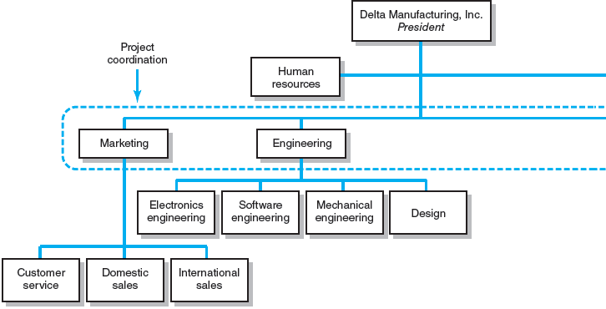
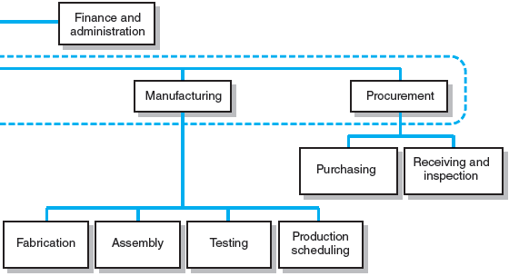
Functional Organizations
FIGURE 3.1

Slide 8
Advantages and Disadvantages of using Functional Organization to Administer and Complete projects
Advantages
No change
Flexibility
In-depth expertise
Easy post-project transition
Disadvantages
Lack of focus
Poor integration
Slow
Lack of ownership

Slide 9
Organizing Projects as Dedicated Teams
Dedicated project teams operate as units separate from the rest of the parent organization.
A full-time project manager is designated to pull together a core group of specialists who work full time on the project.
The project manager recruits necessary personnel from both within and outside the parent company.
In a projectized organization where projects are the dominant form of business, the entire organization is designed to support project teams.
“Projectitis” is referred to as a negative dimension to dedicated project teams. A we-they attitude can emerge between project team members and the rest of the organization.

Slide 10
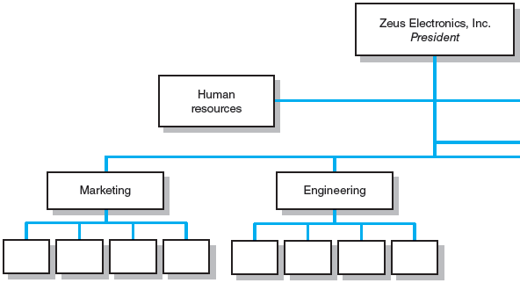
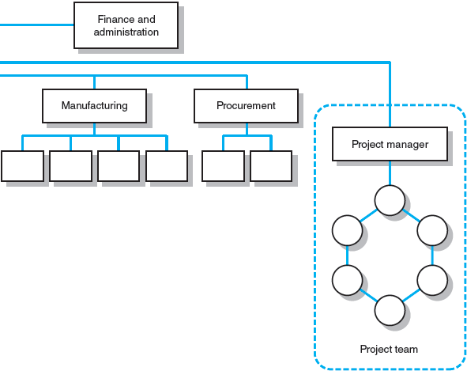
Dedicated Project Team
FIGURE 3.2

Slide 11
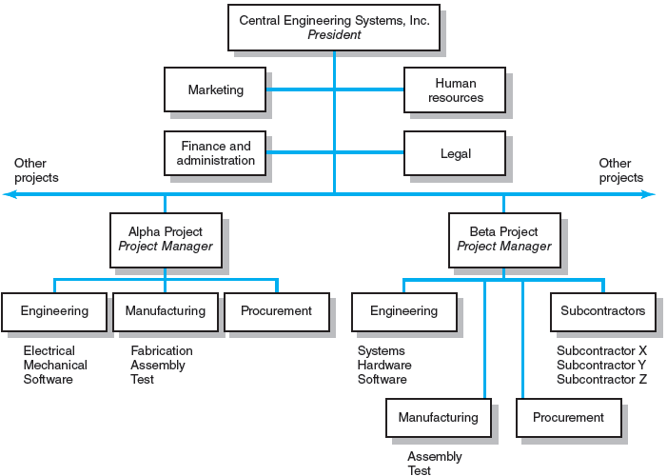
Projectized Organization Structure
FIGURE 3.3

Slide 12
Strengths and Weaknesses of the Dedicated Project Team Approach
Strengths
Simple
Fast
Cohesive
Cross-functional integration
Weaknesses
Expensive
Internal strife
Limited technological expertise
Difficult post-project transition

Slide 13
Organizing Projects within a Matrix Arrangement
Matrix management is a hybrid organizational form in which horizontal project management structure is overlaid on the normal functional hierarchy.
  There are usually two chains of command, one along functional lines and the other along project lines.
  Project participants report simultaneously to both functional and project managers.
The matrix structure is designed to utilize resources optimally.
  Individuals work on multiple projects as well as being capable of performing normal functional duties.
  It attempts to achieve greater integration by creating and legitimizing the authority of a project manager.
  It provides dual focus between functional/technical expertise and project requirements.

Slide 14
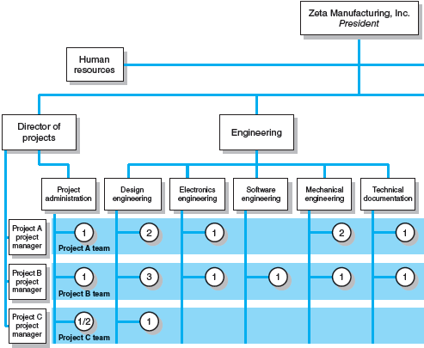
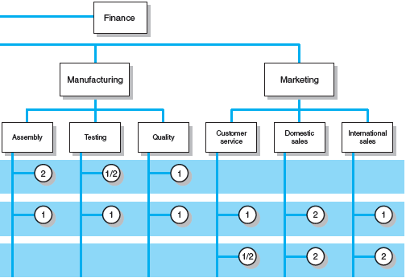
Matrix Organization Structure
FIGURE 3.4

Slide 15
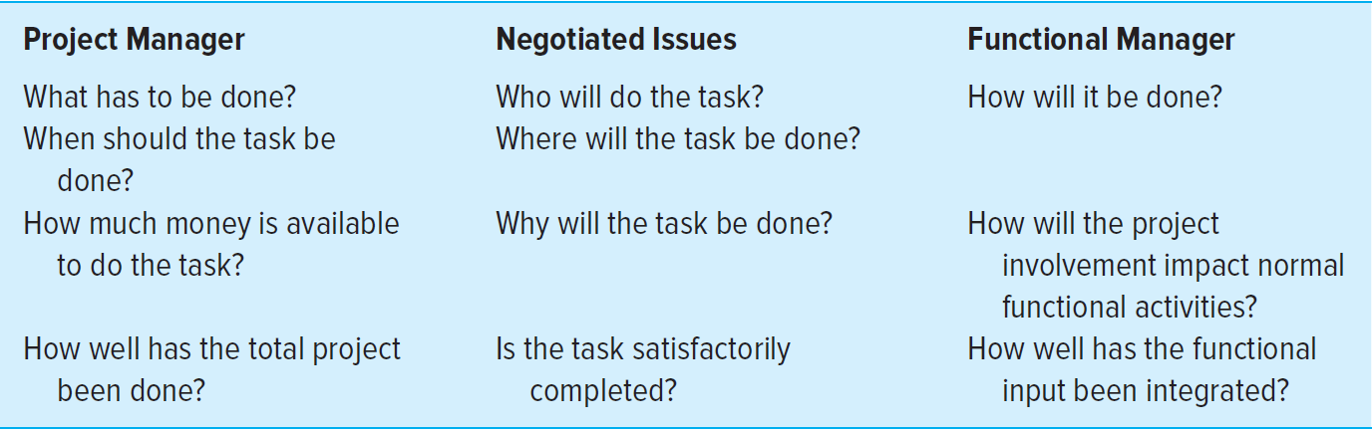
Division of Project Manager and Functional Manager Responsibilities in a Matrix Structure
TABLE 3.1

Slide 16
Different Matrix Forms
Weak matrix
This form is very similar to a functional approach with the exception that there is a formally designed project manager responsible for coordinating project activities.
Functional managers are responsible for managing their segment of the project.
The project manager acts as a staff assistant who draws the schedules and checklists, collects information on the status of the work, and facilitates project completion.

Slide 17
Different Matrix Forms (Continued)
Balanced matrix
The project manager is responsible for defining what needs to be accomplished. The project manager establishes the overall plan for completing the project, integrates the contribution of the different disciplines, set schedules, and monitors progress.
The functional managers are concerned with how it will be accomplished. The functional managers are responsible for assigning personnel and executing their segment of the project according to the standards and schedules set by the project manager.

Slide 18
Different Matrix Forms (Continued)
Strong matrix
The project manager controls most aspects of the project, including scope trade-offs and assignment of functional personnel. The project manager controls when and what specialists do and has final say on major project decisions.
The functional managers have title over their people and are consulted on a need basis. The functional managers serve as subcontractors for the project.

Slide 19
Advantages and Disadvantages of Matrix Management
Advantages
Efficient
Strong project focus
Easier post-project transition
Flexible
Disadvantages
Dysfunctional conflict
Infighting
Stressful
Slow

Slide 20
3.2 Project Management Office (PMO)
Is a centralized unit within an organization or a department that oversees and supports the execution of projects.
Plays a critical role in helping matrix systems mature into more effective project delivery platforms.
Can be characterized in different kinds:
  Weather station—tracks and monitors project performance.
  Control tower—improves project execution.
  Resource pool—provides the organization with a cadre of trained project managers and professionals.
  Command and control center—has direct authority over the project.

Slide 21
3.3 What Is the Right Project Management Structure?
Organization Considerations
How important is the project management to the success of the firm?
  What percentage of core work involves projects?
What level of resources are available?
Project Considerations
Size of project
Strategic importance
Novelty and need for innovation
Need for integration (number of departments involved)
Environmental complexity (number of external interfaces)
Budget and time constraints
Stability of resource requirements

Slide 22
3.4 Organizational Culture
Organizational Culture Defined
Is a system of shared norms, beliefs, values, and assumptions that blinds people together, thereby creating shared meanings.
Reflects the “personality” of the organization.
Performs several important functions in organizations.
  Provides a sense of identity for its members
  Helps legitimize the management system
  Clarifies and reinforces standards of behavior
  Helps create social order

Slide 23
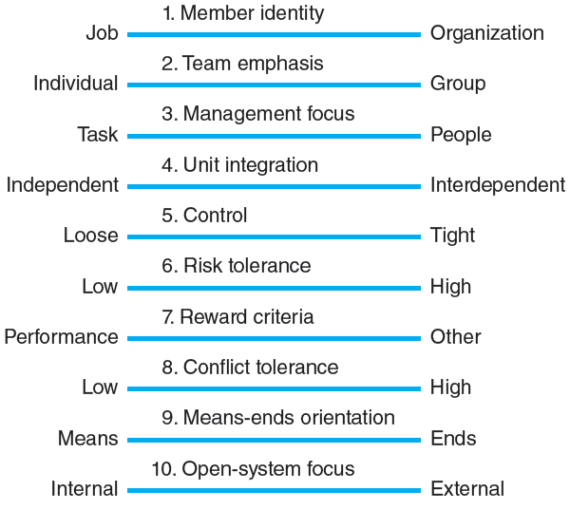
Key Dimensions Defining an Organization’s Culture
FIGURE 3.5

Slide 24
Identifying Cultural Characteristics
Study the physical characteristics of an organization.
Read about the organization.
Observe how people interact within the organization.
Interpret stories and folklore surrounding the organization.

Slide 25
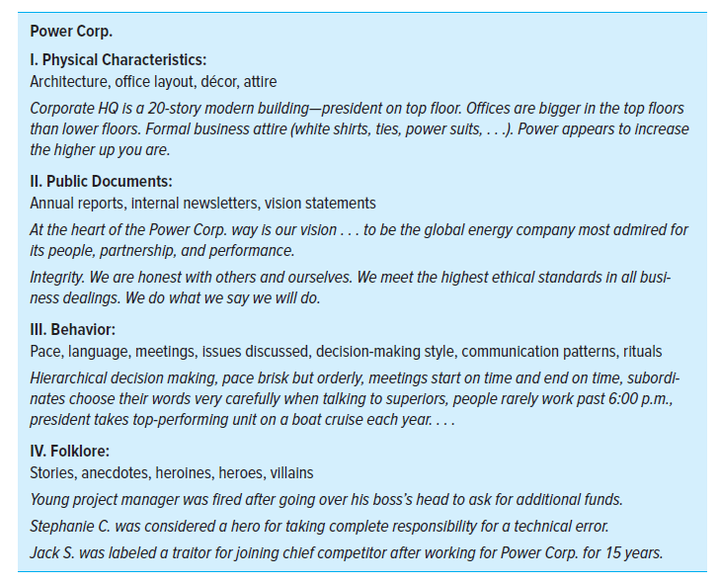
Organizational Culture Diagnosis Worksheet
FIGURE 3.6

Slide 26
3.5 Implications of Organizational Culture for Organizing Projects
Project managers interact with:
  The culture of their parent organizations as well as the subcultures of various departments.
  The project’s clients or customer organizations.
  Other organizations connected to the project such as suppliers and vendors, subcontractors, consulting firms, government and regulatory agencies, and community groups.
“A riverboat trip” is a metaphor describing the relationship between organizational culture and project management. Culture is the river and the project is the boat.

Slide 27
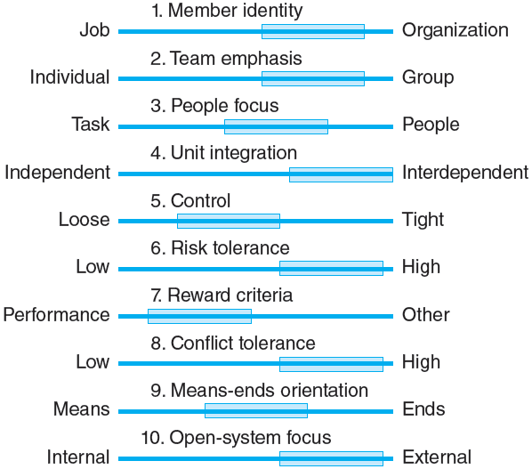
Cultural Dimensions of an Organization Supportive of Project Management
FIGURE 3.7

Slide 28
Key Terms
Balanced matrix
Dedicated project team
Matrix
Organizational culture
Projectitis
Projectized organization
Project management office (PMO)
Strong matrix
Weak matrix

