Slide 1
Chapter 8
Foreign Direct Investment
naqiewei/DigitalVision Vectors/Getty Images
© 2022 McGraw Hill. All rights reserved. Authorized only for instructor use in the classroom. No reproduction or further distribution permitted without the prior written consent of McGraw Hill.

Slide 2
Learning Objectives
8-1 Recognize current trends regarding foreign direct investment (F D I) in the world economy.
8-2 Explain the different theories of F D I.
8-3 Understand how political ideology shapes a government’s attitudes toward F D I.
8-4 Describe the benefits and costs of F D I to home and host countries.
8-5 Explain the range of policy instruments that governments use to influence F D I.
8-6 Identify the implications for managers of the theory and government policies associated with F D I.

Slide 3
Opening Case
J C B in India
British manufacturer J C B entered a joint venture with Indian engineering conglomerate Escorts in 19 79.
Government regulations and high tariffs spurred the action.
J C B looked to gain an advantage over global competitors.
In 19 99, J C B renegotiated terms with Escorts to take advantage of changes in government regulations.
Joint venture became a wholly owned subsidiary.
Soon expanded into the U.S., Brazil, and then China.
By 2008, J C B’s foreign investment was bearing fruit.
Notes:
By 2019 JCB was generating £4.1 billion in annual sales, almost half of which came from India. In addition to strong demand in India, JCB’s Indian factories were also now exporting to 93 other countries. India had become the jewel in the crown for JCB.
Sources: P. Marsh, “Partnerships Feel the Indian Heat,” Financial Times, June 22, 2006, p. 11; P. Marsh, “JCB Targets Asia to Spread Production,” Financial Times, March 16, 2005, p. 26; D. Jones, “Profits Jump at JCB,” Daily Post, June 20, 2006, p. 21; R. Bentley, “Still Optimistic about Asia,” Asian Business Review, October 1, 1999, p. 1; “JCB Launches India-Specific Heavy Duty Crane,” The Hindu, October 18, 2008; Michael Pooler, “JCB Piles Up Big Profits despite Dwindling Global Markets,” Financial Times, July 12, 2016; Malyaban Ghosh, “JCB India Revenues Rise,” Livemint.com, April 16, 2018; M. Pooler, “JCB Warns That India’s Banking Crisis Is Hurting Demand,” Financial Times, September 2, 2019.

Slide 4
Introduction
Foreign Direct Investment (F D I)
A firm invests directly in new facilities to produce or market in a foreign country.
According to U.S. Department of Commerce, F D I occurs when there is a 10 percent interest taken in a foreign business entity.
A firm engaged in F D I is a multinational enterprise.
Notes:
While much FDI takes the form of greenfield ventures—building up subsidiaries from scratch—acquisitions and joint ventures with well-established foreign entities are also important vehicles for foreign direct investment.

Slide 5
Foreign Direct Investment in the World Economy 1
Important Terms
Flow of F D I: amount of F D I undertaken over a given time period.
Stock of F D I: total accumulated value of foreign-owned assets at a given time.
Outflows of F D I: the flows of F D I out of a country.
Inflows of F D I: the flows of F D I into a country.
Notes:
LO 8-1 Recognize current trends regarding foreign direct investment (FDI) in the world economy.

Slide 6
Foreign Direct Investment in the World Economy 2
Trends in F D I
Both the flow and stock of F D I in the world economy have increased over the last 30 years.
F D I flow has grown more rapidly than world trade and world output.
Firms still fear protectionist policies.
The shift toward democratic political institutions and free market economies encourages F D I.
Globalization prompts firms to have a significant presence in many regions of the world.
Notes:
Despite the pullback since 2007, since 1990 the flow of FDI has accelerated faster than the growth in world trade and world output. For example, between 1990 and 2018, the total flow of FDI from all countries increased around sixfold, while world trade by value grew fourfold and world output by around 60 percent.

Slide 7
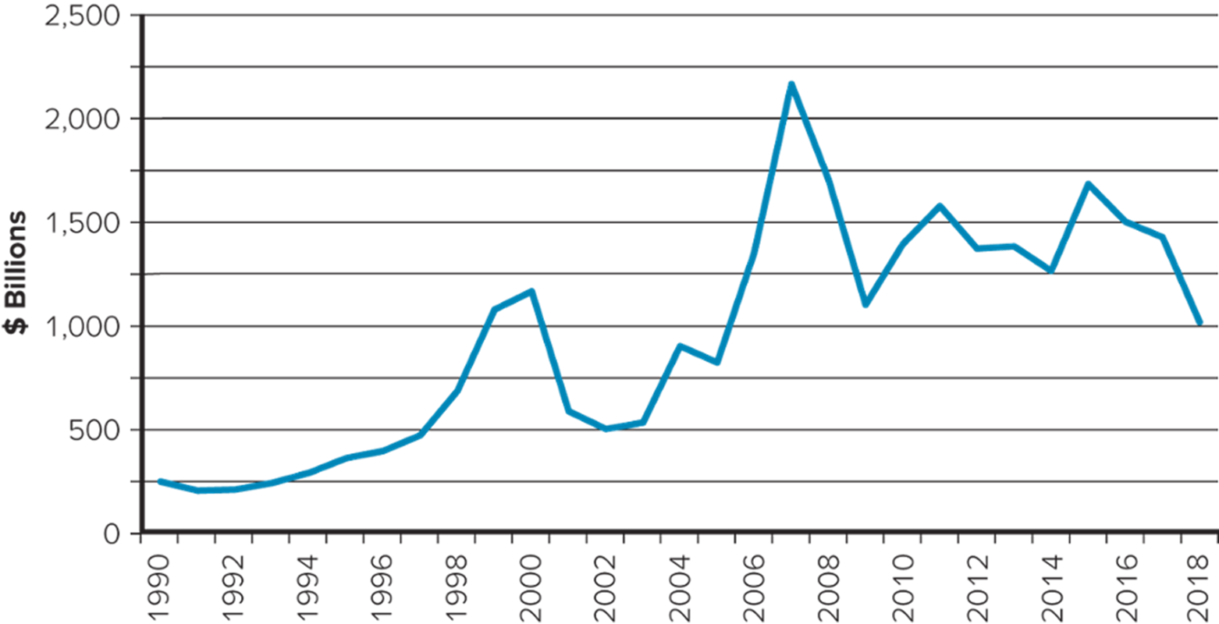
Figure 8.1 F D I Outflows, 1990 to 2019 ($ billions)
Access the text alternative for slide images.
Source: UNCTAD statistical data set, http://unctadstat.unctad.org
Notes:
The average yearly outflow of FDI increased from $250 billion in 1990 to a peak of $2.2 trillion in 2007, before slipping back to around $1.4 trillion by 2019.

Slide 8
Foreign Direct Investment in the World Economy 3
The Direction of F D I
Historically, most F D I has been directed at developed nations.
United States and European Union are favorite targets.
More recently, developing nations have been recipients of F D I.
Eastern Europe and Southeast Asia—particularly China—have received significant inflows.
Latin America is also emerging as an important region for F D I.
China is becoming a major investor in Africa, especially in the extraction industries.
Notes:
The United States has been an attractive target for FDI because of its large and wealthy domestic markets, its dynamic and stable economy, a favorable political environment, and the openness of the country to FDI. Investors include firms based in Great Britain, Japan, Germany, Holland, and France. Inward investment into the United States remained high during the 2000s and stood at $255 billion in 2019. The developed nations of Europe have also been recipients of significant FDI inflows, principally from the United States and other European nations. In 2019, inward investment into Europe was $274 billion. The United Kingdom and France have historically been the largest recipients of inward FDI.

Slide 9
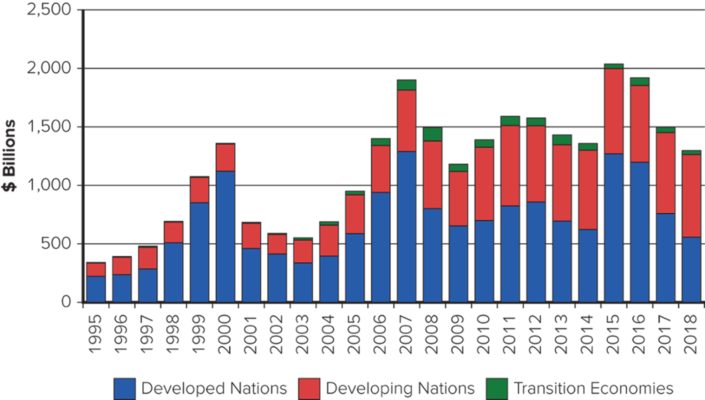
Figure 8.2 F D I Inflows by Region, 19 95 to 2019 ($ billions)
Access the text alternative for slide images.
Source: UNCTAD statistical data set, http://unctadstat.unctad.org
Notes:
Most recent inflows into developing nations have been targeted at the emerging economies of Southeast Asia.

Slide 10
Foreign Direct Investment in the World Economy 4
The Source of F D I
Since World War I I, the U.S. has been the largest source country for F D I.
Other important source countries: United Kingdom, Netherlands, France, Germany, and Japan.
Chinese firms recently emerging as major foreign investors.
Notes:
The largest source countries—the United States, United Kingdom, Japan, France, Germany, and the Netherlands—also predominate in rankings of the world’s largest multinationals.
Chinese firms invested around $46 billion in the United States in 2016, and another $30 billion in 2017, up very little prior to 2010. In 2018 and 2019, however, Chinese investment in the U.S. slumped to around $5 billion as the ongoing trade conflict between the two nations soured relations.

Slide 11
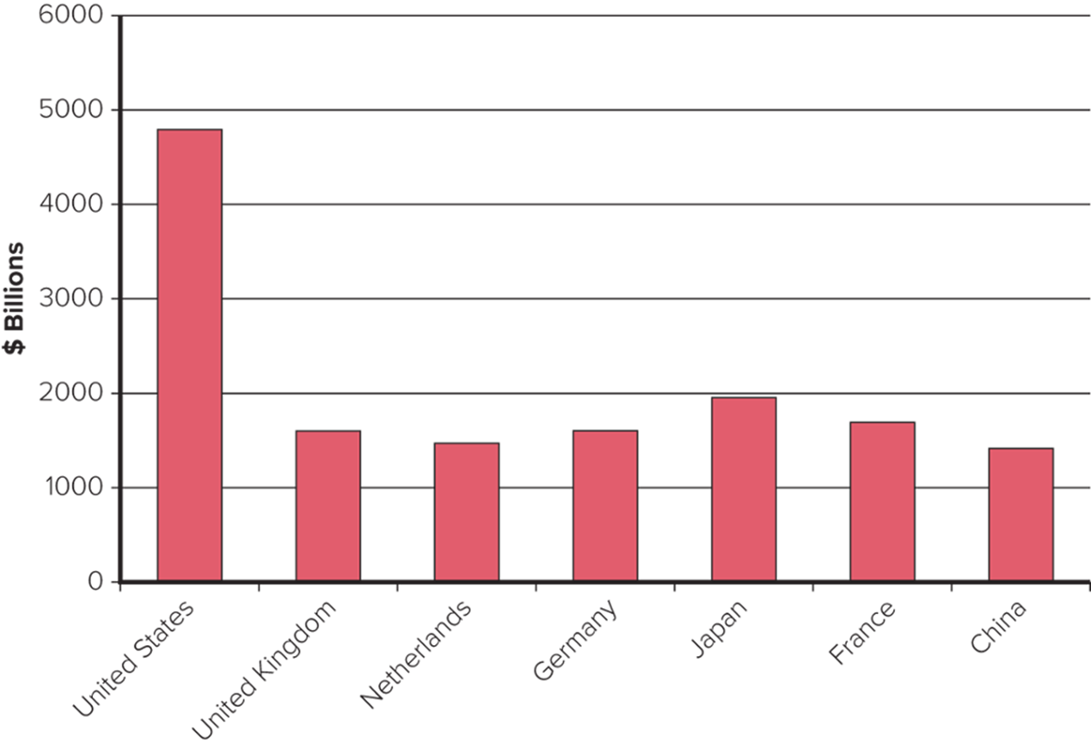
Figure 8.3 Cumulative F D I Outflows, 19 99 to 2019 ($ billions)
Access the text alternative for slide images.
Source: UNCTAD statistical data set, http://unctadstat.unctad.org

Slide 12
Foreign Direct Investment in the World Economy 5
The Form of F D I: Acquisitions versus Greenfield Investments
Greenfield investments: establishing new operations in a foreign country.
Acquisitions are attractive because:
They are quicker to execute than greenfield investments.
Easier and less risky for a firm to acquire desired assets than build them from the ground up.
Firms believe they can increase the efficiency of an acquired unit by transferring capital, technology, or management skills.
Notes:
In the case of developing nations, only about one-third or less of FDI is in the form of cross-border mergers and acquisitions. The lower percentage of mergers and acquisitions may simply reflect the fact that there are fewer target firms to acquire in developing nations.

Slide 13
Theories of Foreign Direct Investment 1
Three Complementary Perspectives
Why does a firm favor direct investment over exporting and licensing?
Why do firms in the same industry undertake foreign direct investment at the same time and favor certain locations as targets for F D I?
Eclectic paradigm combines these two perspectives.
Notes:
LO 8-2 Explain the different theories of FDI.
Eclectic paradigm is the argument that combining location-specific assets or resource endowments and the firm’s own unique assets often requires FDI; it requires the firm to establish production facilities where those foreign assets or resource endowments are located.

Slide 14
Theories of Foreign Direct Investment 2
Why Foreign Direct Investment?
Exporting: producing goods at home and then shipping them to the receiving country for sale.
Licensing: granting a foreign entity the right to produce and sell the firm’s product in return for a royalty fee on every unit the foreign entity sells.
Foreign direct investment may be both expensive and risky compared with exporting and licensing.
Notes:
FDI is expensive because a firm must bear the costs of establishing production facilities in a foreign country or of acquiring a foreign enterprise. FDI is risky because of the problems associated with doing business in a different culture where the rules of the game may be very different. Relative to indigenous firms, there is a greater probability that a foreign firm undertaking FDI in a country for the first time will make costly mistakes due to its ignorance.

Slide 15
Theories of Foreign Direct Investment 3
Why Foreign Direct Investment? continued
Limitations of Exporting.
Exporting strategy can be limited by transportation costs and trade barriers.
When transportation costs are high, exporting can be unprofitable.
Low value-to-weight ratio.
Foreign direct investment may be a response to actual or threatened trade barriers such as import tariffs or quotas.
Notes:
Often, the desire to reduce the threat that trade barriers might be imposed is enough to justify foreign direct investment as an alternative to exporting.

Slide 16
Theories of Foreign Direct Investment 4
Why Foreign Direct Investment? continued
Limitations of Licensing.
Internalization theory (or market imperfections approach):
Licensing could result in a firm’s giving away valuable technological know-how to a potential foreign competitor.
Licensing does not give a firm the tight control over manufacturing, marketing, and strategy in a foreign country that may be required to maximize its profitability.
Licensing may be difficult if the firm’s competitive advantage is not amenable to it.
Notes:
All of this suggests that when one or more of the following conditions holds, markets fail as a mechanism for selling know-how and FDI is more profitable than licensing: (1) when the firm has valuable know-how that cannot be adequately protected by a licensing contract, (2) when the firm needs tight control over a foreign entity to maximize its market share and earnings in that country, and (3) when a firm’s skills and know-how are not amenable to licensing.

Slide 17
Theories of Foreign Direct Investment 5
Why Foreign Direct Investment? continued
Advantages of Foreign Direct Investment.
F D I will be favored over exporting when:
Transportation costs are high.
Trade barriers are high.
F D I will be favored over licensing when:
The firm wants control over its technological know-how.
The firm wants control over its operations and business strategy.
The firm’s capabilities are not amenable to licensing.
Notes:
Gaining technology, productive assets, market share, brand equity, distribution systems, and the like through FDI by purchasing the assets of an established company can all speed up market entry, improve production in the firm’s home base, and facilitate the transfer of technology from the acquired company to the acquiring company.

Slide 18
Theories of Foreign Direct Investment 6
The Pattern of Foreign Direct Investment
Strategic Behavior.
Knickerbocker explored the relationship between F D I and rivalry in oligopolistic industries: industries composed of a limited number of large firms.
F D I flows reflect strategic rivalry between firms.
This theory can be extended to multipoint competition: when two or more enterprises encounter each other in different regional markets, national markets, or industries.
Firms will try to match other’s moves in different markets to try to hold each other in check.
Notes:
Although Knickerbocker’s theory and its extensions can help explain imitative FDI behavior by firms in oligopolistic industries, it does not explain why the first firm in an oligopoly decides to undertake FDI rather than to export or license. Internalization theory addresses this phenomenon.

Slide 19
Theories of Foreign Direct Investment 7
The Eclectic Paradigm
Dunning’s eclectic paradigm: in addition to the previous factors, two additional factors must be considered when explaining both the rationale for and the direction of foreign direct investment.
Location-specific advantages: arise from using resource endowments or assets that are tied to a particular location and that a firm finds valuable to combine with its own unique assets.
Externalities: knowledge spillovers that occur when companies in the same industry locate in the same area.
Notes:
Dunning’s theory, therefore, seems to be a useful addition to those outlined previously because it helps explain how location factors affect the direction of FDI.

Slide 20
Location Factors and F D I
Google Headquarters in Mountain View, California, U S A.
Notes:
Dunning’s theory has implications that go beyond basic resources such as minerals and labor. Consider Silicon Valley, which is the world center for the computer and semiconductor industry. Many of the world’s major computer and semiconductor companies—such as Apple Computer, Hewlett-Packard, Oracle, Google, and Intel—are located close to each other in the Silicon Valley region of California. As a result, much of the cutting-edge research and product development in computers and semiconductors occurs there. According to Dunning’s arguments, knowledge being generated in Silicon Valley with regard to the design and manufacture of computers and semiconductors is available nowhere else in the world.

Slide 21
Political Ideology and Foreign Direct Investment 1
Political Ideology
Ideology toward F D I has ranged from a radical stance that is hostile to all F D I to the noninterventionist principle of free market economies.
Between these two extremes is an approach called pragmatic nationalism.
Notes:
LO 8-3 Understand how political ideology shapes a government's attitudes toward FDI.

Slide 22
Political Ideology and Foreign Direct Investment 2
The Radical View
M N E is an instrument of imperialist domination and a tool for exploiting host countries to the exclusive benefit of their capitalist-imperialist home countries.
Has been in retreat since the 19 90s due to:
Collapse of communism in Eastern Europe.
Poor economic performance of countries that embraced the policy.
Strong economic performance of developing countries that embraced capitalism.
Still lingers in some countries, such as Venezuela.
Notes:
The radical view traces its roots to Marxist political and economic theory. Radical writers argue that the multinational enterprise (MNE) is an instrument of imperialist domination. They see the MNE as a tool for exploiting host countries to the exclusive benefit of their capitalist–imperialist home countries. They argue that MNEs extract profits from the host country and take them to their home country, giving nothing of value to the host country in exchange.

Slide 23
Political Ideology and Foreign Direct Investment 3
The Free Market View
International production should be distributed among countries according to the theory of comparative advantage.
Countries should specialize in the production of goods and services they can produce most efficiently.
F D I by the M N E increases the overall efficiency of the world economy.
Notes:
The free market view traces its roots to classical economics and the trade theories of Adam Smith and David Ricardo.

Slide 24
Political Ideology and Foreign Direct Investment 4
Pragmatic Nationalism
F D I has benefits and costs.
Benefits: inflows of capital, technology, skills, and jobs.
Costs: repatriation of profits to the home country, a negative balance of payments effect.
F D I should be allowed only if benefits outweigh the costs.
Tendency to aggressively court F D I believed to be in the national interest by offering subsidies.
Also seen in competition between individual states in the U.S.
Notes:
Countries adopting a pragmatic stance pursue policies designed to maximize the national benefits and minimize the national costs. According to this view, FDI should be allowed so long as the benefits outweigh the costs. Japan offers an example of pragmatic nationalism.

Slide 25
Political Ideology and Foreign Direct Investment 5
Shifting Ideology
In recent years, there has been a strong shift toward the free market stance.
A surge in the volume of F D I worldwide.
An increase in the volume of F D I directed at countries that have recently liberalized their regimes—China, India, Vietnam.
However, some countries are becoming more hostile to F D I.
Venezuela, Bolivia.
Notes:
In some developed nations, there is increasing evidence of hostile reactions to inward FDI as well. In Europe in 2006, there was a hostile political reaction to the attempted takeover of Europe’s largest steel company, Arcelor, by Mittal Steel, a global company controlled by the Indian entrepreneur Lakshmi Mittal. In mid-2005, China National Offshore Oil Company withdrew a takeover bid for Unocal of the United States after highly negative reaction in Congress about the proposed takeover of a “strategic asset” by a Chinese company.

Slide 26
Benefits and Costs of F D I 1
Host-Country Benefits
Resource-Transfer Effects.
F D I can bring capital, technology, and management resources that would otherwise not be available.
Employment Effects.
F D I can bring jobs that would otherwise not be created there.
Opponents say not all “new jobs” represent net additions in employment.
An employee uses a robotic arm to fit a wheel onto a Volkswagen A G Vento automobile on the production line at the Volkswagen India Pvt. plant in Chakan, Maharashtra, India.
Notes:
LO 8-4 Describe the benefits and costs of FDI to home and host countries.
Foreign management skills acquired through FDI may also produce important benefits for the host country. Foreign managers trained in the latest management techniques can often help improve the efficiency of operations in the host country, whether those operations are acquired or greenfield developments.

Slide 27
Benefits and Costs of F D I 2
Host-Country Benefits continued
Balance-of-Payments Effects.
The balance-of-payments account records a country’s payments to and receipts from other countries.
The current account records a country’s export and import of goods and services.
A surplus is usually favored over a deficit.
F D I can help achieve a current account surplus if:
It is a substitute for imports of goods and services.
The M N E uses a foreign subsidiary to export goods and services to other countries.
Notes:
A current account deficit, or trade deficit as it is often called, arises when a country is importing more goods and services than it is exporting. Governments typically prefer to see a current account surplus rather than a deficit.

Slide 28
Benefits and Costs of F D I 3
Host-Country Benefits continued
Effect on Competition and Economic Growth.
F D I in the form of greenfield investment:
Increases the level of competition in a market.
Drives down prices.
Improves the welfare of consumers.
Increased competition leads to:
Increased productivity growth.
Product and process innovation.
Greater economic growth.
Notes:
FDI’s impact on competition in domestic markets may be particularly important in the case of services, such as telecommunications, retailing, and many financial services, where exporting is often not an option because the service has to be produced where it is delivered.

Slide 29
Benefits and Costs of F D I 4
Host-Country Costs
Adverse Effects on Competition.
Subsidiaries of foreign M N Es may have greater economic power than indigenous competitors because they may be part of a larger international organization.
M N E could draw on funds generated elsewhere to subsidize costs in the local market.
Could allow the M N E to drive indigenous competitors out of the market and create a monopoly position.
Notes:
In general, while FDI in the form of greenfield investments should increase competition, it is less clear that this is the case when the FDI takes the form of acquisition of an established enterprise in the host nation.

Slide 30
Benefits and Costs of F D I 5
Host-Country Costs continued
Adverse Effects on the Balance of Payments.
Two possible adverse effects of F D I on a host country’s balance-of-payments:
The capital outflows as foreign subsidiaries repatriate earnings to the parent country.
There is a debit on the current account of the host country’s balance of payments associated with imports of input products by the foreign subsidiary.
Notes:
One criticism leveled against Japanese-owned auto assembly operations in the United States, for example, is that they tend to import many component parts from Japan. Because of this, the favorable impact of this FDI on the current account of the U.S. balance-of-payments position may not be as great as initially supposed. The Japanese auto companies responded to these criticisms by pledging to purchase 75 percent of their component parts from U.S.-based manufacturers (but not necessarily U.S.-owned manufacturers).

Slide 31
Benefits and Costs of F D I 6
Host-Country Costs continued
Possible Effects on National Sovereignty and Autonomy.
F D I can mean some loss of economic independence.
Key decisions that can affect the host country’s economy will be made by a foreign parent that has no real commitment to the host country, and over which the host country’s government has no real control.
Notes:
Political scientist Robert Reich has noted that such concerns are the product of outmoded thinking because they fail to account for the growing interdependence of the world economy. In a world in which firms from all advanced nations are increasingly investing in each other’s markets, it is not possible for one country to hold another to “economic ransom” without hurting itself.

Slide 32
Benefits and Costs of F D I 7
Home-Country Benefits
The effect on the home country’s balance of payments from the inward flow of foreign earnings.
Positive employment effects that arise from outward F D I.
Gains from learning valuable skills from foreign markets that can subsequently be transferred back to the home country.
Notes:
Through its exposure to a foreign market, an MNE can learn about superior management techniques and superior product and process technologies. These resources can then be transferred back to the home country, contributing to the home country’s economic growth rate.

Slide 33
Benefits and Costs of F D I 8
Home-Country Costs
Balance-of-payments effects.
Suffers from the initial capital outflow required to finance the F D I.
Current account is negatively affected if the F D I is to serve the home market from a low-cost production location.
Current account suffers if the F D I is a substitute for direct exports.
Employment effects.
If the home country is suffering from unemployment, there may be concern about the export of jobs.
Notes:
One objection frequently raised by U.S. labor leaders to the free trade pact among the United States, Mexico, and Canada (see Chapter 9) is that the United States would lose hundreds of thousands of jobs as U.S. firms invest in Mexico to take advantage of cheaper labor and then export back to the United States.

Slide 34
Benefits and Costs of F D I 9
International Trade Theory and F D I
Home country concerns about the negative economic effects of offshore production—F D I undertaken to serve the home market—may not be valid.
F D I may actually stimulate economic growth by freeing home country resources to concentrate on activities where the home country has a comparative advantage.
Consumers may also benefit in the form of lower prices.
Notes:
When assessing the costs and benefits of FDI to the home country, keep in mind the lessons of international trade theory. International trade theory tells us that home-country concerns about the negative economic effects of offshore production may be misplaced.

Slide 35
Government Policy Instruments and F D I 1
Home-Country Policies
Encouraging Outward F D I.
Have government-backed insurance programs to cover major types of foreign investment risk.
Have special funds or banks that make governmental loans to firms investing in developing countries.
Eliminate double taxation of foreign income.
Many host nations have relaxed restrictions on inbound F D I.
Notes:
LO 8-5 Explain the range of policy instruments that governments use to influence FDI.
In response to direct U.S. pressure, Japan relaxed many of its formal restrictions on inward FDI. In response to further U.S. pressure, Japan relaxed its informal barriers to inward FDI. One beneficiary of this trend was Toys “R” Us, which, after five years of intensive lobbying by company and U.S. government officials, opened its first retail stores in Japan in December 1991. By 2012, Toys “R” Us had more than 170 stores in Japan, and its Japanese operation, in which Toys “R” Us retained a controlling stake, had a listing on the Japanese stock market. Interestingly, although Toys “R” Us ceased operations in the United States in 2017 due to bankruptcy, it continues to operate in Japan and as of 2019 has around 130 stores there.

Slide 36
Government Policy Instruments and F D I 2
Home-Country Policies continued
Restricting Outward F D I.
Virtually all investor countries, including the U.S., have exercised some control over outward F D I periodically.
Countries manipulate tax rules to make it more favorable for firms to invest at home.
Countries may restrict firms from investing in certain nations for political reasons.
Restrictions may be formal or informal.
Cuba and Iran, South Africa.
Notes:
Countries sometimes prohibit national firms from investing in certain countries for political reasons. Such restrictions can be formal or informal. For example, formal U.S. rules prohibited U.S. firms from investing in countries such as Cuba and Iran, whose political ideology and actions are judged to be contrary to U.S. interests. Similarly, during the 1980s, informal pressure was applied to dissuade U.S. firms from investing in South Africa. In this case, the objective was to pressure South Africa to change its apartheid laws, which happened during the early 1990s.

Slide 37
Government Policy Instruments and F D I 3
Host-Country Policies
Encouraging Inward F D I.
Governments offer incentives to foreign firms to invest in their countries.
Gain from the resource-transfer and employment effects of F D I.
Capture F D I away from other potential host countries.
In the United States, state governments often compete to attract F D I.
Notes:
Host countries adopt policies designed both to restrict and to encourage inward FDI. As noted earlier in this chapter, political ideology has determined the type and scope of these policies in the past.

Slide 38
Government Policy Instruments and F D I 4
Host-Country Policies continued
Restricting Inward F D I.
Ownership restraints:
Exclude foreign firms from certain sectors on the grounds of national security or competition.
Local owners can help maximize the resource-transfer and employment benefits of F D I.
Performance requirements:
Used to maximize the benefits and minimize the costs of F D I for the host country.
Tend to be more common in less developed countries than in advanced industrialized nations.
Notes:
Host governments use a wide range of controls to restrict FDI in one way or another. The two most common are ownership restraints and performance requirements.

Slide 39
Government Policy Instruments and F D I 5
International Institutions and the Liberalization of F D I
Until recently, there has been no consistent involvement by multinational institutions in the governing of F D I.
The formation of the World Trade Organization in 19 95 changed this.
The W T O has had some success in establishing a universal set of rules to promote the liberalization of F D I.
Agreements reached in 19 97 for liberalization of trade in telecommunications and financial services.
Notes:
The WTO has had less success trying to initiate talks aimed at establishing a universal set of rules designed to promote the liberalization of FDI. Led by Malaysia and India, developing nations have so far rejected efforts by the WTO to start such discussions.

Slide 40
360° View: Managerial Implications 1
F D I and Government Policy
The Theory of F D I:
The location-specific advantages argument associated with Dunning help explain the direction of F D I.
However, internalization theory is needed to explain why firms prefer F D I to licensing or exporting.
Notes:
LO 8-6 Identify the implications for managers of the theory and government policies associated with FDI.

Slide 41
360° View: Managerial Implications 2
The Theory of F D I continued
Exporting is preferable to licensing and F D I if transportation costs and trade barriers are low.
Licensing is unattractive when:
The firm’s proprietary property cannot be properly protected by a licensing agreement.
The firm needs tight control over a foreign entity in order to maximize its market share and earnings in that country.
The firm’s skills and capabilities are not amenable to licensing.
Notes:
Finally, it should be noted that the product life-cycle theory and Knickerbocker’s theory of FDI tend to be less useful from a business perspective. The problem with these two theories is that they are descriptive rather than analytical. They do a good job of describing the historical evolution of FDI, but they do a relatively poor job of identifying the factors that influence the relative profitability of FDI, licensing, and exporting. Indeed, the issue of licensing as an alternative to FDI is ignored by both these theories.

Slide 42
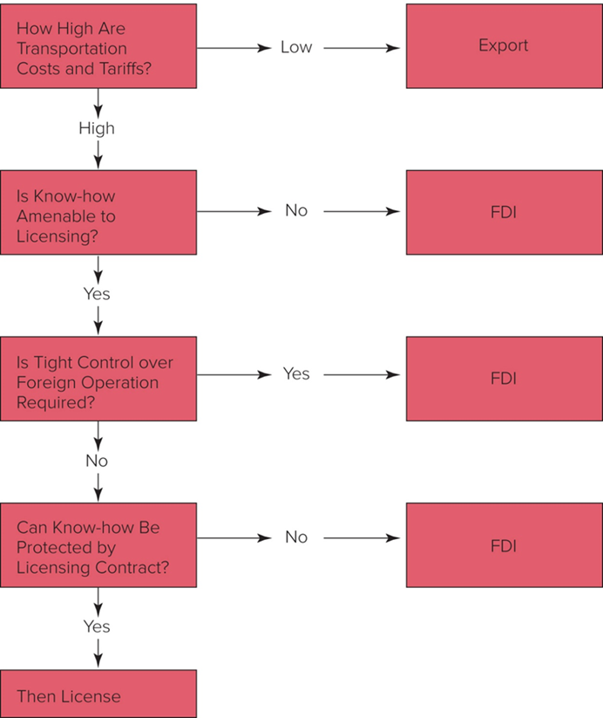
Figure 8.4 A Decision Framework
Access the text alternative for slide images.
Notes:
Although licensing may work, it is not an attractive option when one or more of the following conditions exist:
(1) the firm has valuable know-how that cannot be adequately protected by a licensing contract,
(2) the firm needs tight control over a foreign entity to maximize its market share and earnings in that country, and
(3) a firm’s skills and capabilities are not amenable to licensing.
Figure 8.4 presents these considerations as a decision tree.

Slide 43
360° View: Managerial Implications 3
F D I and Government Policy continued
Government Policy.
A firm’s bargaining power with the host government is highest when:
The host government places a high value on what the firm has to offer.
There are few comparable alternatives available.
The firm has a long time to negotiate.
Notes:
A host government’s attitude toward FDI is important in decisions about where to locate foreign production facilities and where to make a foreign direct investment.

Slide 44
Summary
In this chapter, we have
Recognized current trends regarding foreign direct investment (F D I) in the world economy.
Explained the different theories of F D I.
Understood how political ideology shapes a government’s attitudes toward F D I.
Described the benefits and costs of F D I to home and host countries.
Explained the range of policy instruments that governments use to influence F D I.
Identified the implications for managers of the theory and government policies associated with F D I.

Slide 45
End of Main Content
© 2022 McGraw Hill. All rights reserved. Authorized only for instructor use in the classroom. No reproduction or further distribution permitted without the prior written consent of McGraw Hill.

Slide 46
Accessibility Content: Text Alternatives for Images

Slide 47
Figure 8.1 F D I Outflows, 19 90 to 2019 ($ billions) – Text Alternative
Return to parent-slide containing images.
The vertical axis has billions of dollars ranging from 0 to 2,500 in increments of 500. The horizontal axis has years. A line representing F D I outflows is given as follows: 19 90, 250. 19 98, 750. 2002, 500. 2007, 2,200. 2009, 1,100. 2014, 1,250. 2016, 1,500. 2018, 1,000. All values are estimated.
Return to parent-slide containing images.

Slide 48
Figure 8.2 F D I Inflows by Region, 19 95 to 2019 ($ billions) – Text Alternative
Return to parent-slide containing images.
The vertical axis has billions of dollars ranging from 0 to 2,500 in increments of 500. The horizontal axis has years. The entries are as follows. 19 95: Developed Nations, 250. Developing Nations, 125. 19 98: Developed Nations, 500. Developing Nations, 200. Transition Economies, 10. 2001: Developed Nations, 490. Developing Nations, 200. Transition Economies, 10. 2005: Developed Nations, 600. Developing Nations, 300. Transition Economies, 20. 2008: Developed Nations, 800. Developing Nations, 600. Transition Economies, 160. 2010: Developed Nations, 700. Developing Nations, 600. Transition Economies, 70. 2015: Developed Nations, 1,250. Developing Nations, 750. Transition Economies, 50. 2018: Developed Nations, 550. Developing Nations, 800. Transition Economies, 30. All values are estimated.
Return to parent-slide containing images.

Slide 49
Figure 8.3 Cumulative F D I Outflows, 19 99 to 2019 ($ billions) – Text Alternative
Return to parent-slide containing images.
The vertical axis has billions of dollars ranging from 0 to 6000 in increments of 1000. The horizontal axis has countries. The entries are as follows. United States, 4850. United Kingdom, 1700. Netherlands, 1500. Germany, 1700. Japan, 1950. France, 1800. China, 1400. All values are estimated.
Return to parent-slide containing images.

Slide 50
Figure 8.4 A Decision Framework – Text Alternative
Return to parent-slide containing images.
How High Are Transportation Costs and Tariffs? If Low: Export. If high: Is Know-how Amenable to Licensing? If No: F D I. If yes: Is Tight Control over Foreign Operation Required? If Yes: F D I. If No: Can Know-how Be Protected by Licensing Contract? If No: F D I. If yes: Then license.
Return to parent-slide containing images.

