Slide 1
Chapter 5
Ethics, Corporate Social Responsibility, and Sustainability
naqiewei/DigitalVision Vectors/Getty Images
© 2022 McGraw Hill. All rights reserved. Authorized only for instructor use in the classroom. No reproduction or further distribution permitted without the prior written consent of McGraw Hill.

Slide 2
Learning Objectives
5-1 Understand the ethical, corporate social responsibility, and sustainability issues faced by international businesses.
5-2 Recognize an ethical, corporate social responsibility, and/or sustainability dilemma.
5-3 Identify the causes of unethical behavior by managers as they relate to business, corporate social responsibility, or sustainability.
5-4 Describe the different philosophical approaches to business ethics that apply globally.
5-5 Explain how global managers can incorporate ethical considerations into their decision making in general, as well as corporate social responsibility and sustainability initiatives.

Slide 3
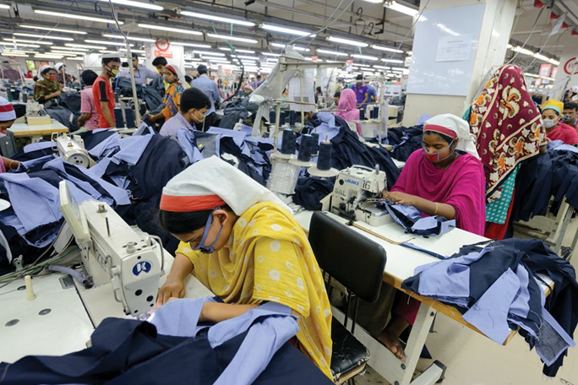
Opening Case
Who Stitched Your Designer Jeans?
Densely populated Bangladesh is now world’s second largest exporter of readymade garments.
Accounts for 20 percent of its G D P and 80 percent of its exports.
Lifted country out of the ranks of poorest nations in the world.
Success rests on low labor costs and lax regulations.
Questionable practices regarding child labor and safe working environments.
Soltan Frédéric/Getty Images
Notes:
The success of its textile industry has helped Bangladesh achieve very high levels of economic growth, which are lifting the country out of the ranks of the world’s poorest nations. Over the past decade, Bangladesh’s economy has grown almost 200 percent, one of the best performances in the world.
Research suggests that child labor in Bangladesh is still widespread, with as many as 4 million children under 14 working. In theory, regulations in Bangladesh outlaw the employment of child labor in garment factories, but as studies have found, labor laws are widely ignored.
Sources: Hannah Abdulla, “Bangladesh RMG Exports Slip in Q1,” Just-Style, November 12, 2019; Jason Beaubien, “Child Laborers in Bangldesh Are Working 64 Hours a Week,” National Public Radio, December 7, 2016; S. Butler, “Why Are Wages So Low for Garment Workers in Bangladesh?” The Guardian, January 21, 2019; H. A. Hye, “Sustaining Bangladesh’s Economic Miracle,” Financial Express, February 17, 2020; M. Nonkes, “A Look at Child Labor inside a Garment Factory in Bangladesh,” World Vision, June 10, 2015.

Slide 4
Introduction
Ethics
Accepted principles of right or wrong that govern conduct of a person, members of a profession, or actions of an organization.
Business ethics: accepted principles of right or wrong governing conduct of business people.
Ethical strategy: strategy, or course of action, that does not violate these accepted principles.
Notes:
Ethics, corporate social responsibility, and sustainability are intertwined issues facing countries, companies, and societies. These "social" issues arise frequently in international business, often because business practices and regulations differ from nation to nation.

Slide 5
Ethics and International Business 1
Common Ethical Issues in Business
Employment practices.
Human rights.
Environmental regulations.
Moral obligations.
Notes:
LO 5-1 Understand the ethical, corporate social responsibility, and sustainability issues faced by international businesses.

Slide 6
Ethics and International Business 2
Employment Practices
What practices should be used when work conditions are inferior in host nation?
Human Rights
What is the responsibility of a foreign multinational when operating in a country where basic human rights are not respected?
South Africa and apartheid.
Sullivan principles adopted by G M.
Many oppressive regimes still exist around the world.
Notes:
Sullivan argued that it was ethically justified for GM to operate in South Africa so long as two conditions were fulfilled. First, the company should not obey the apartheid laws in its own South African operations (a form of passive resistance). Second, the company should do everything within its power to promote the abolition of apartheid laws.
Although change has come in South Africa, many repressive regimes still exist in the world. In fact, according to the Freedom House, only about 45 percent of the world’s population of 7.6 billion people are living in free democratic countries (30 percent are partly free and 25 percent are not free). People in countries that are not considered free by the Freedom House typically face severe consequences if they try to exercise their most basic rights, such as expressing their views, assembling peacefully, and organizing independently of the countries in which they live.

Slide 7
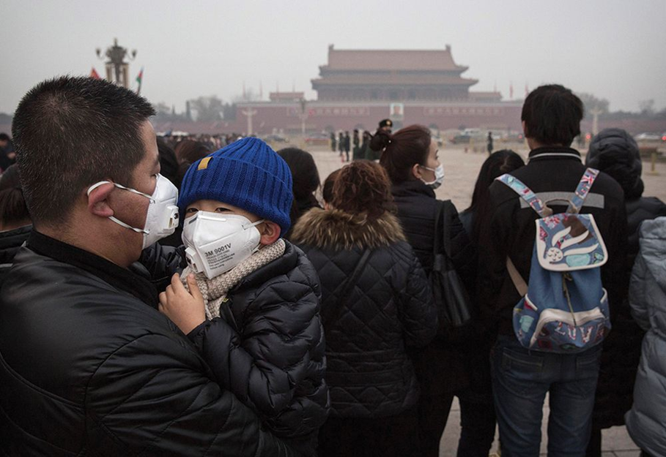
Ethics and International Business 3
Environmental Pollution
Should a multinational feel free to pollute in a developing nation if doing so does not violate laws?
Tragedy of the commons.
May be legal, but is it ethical?
People wearing breathing masks at Tian’anmen Square in China’s capital city, Beijing.
Kevin Frayer/Getty Images
Notes:
The atmosphere and oceans can be viewed as a global commons from which everyone benefits but for which no one is specifically responsible. In such cases, a phenomenon known as the tragedy of the commons becomes applicable. The tragedy of the commons occurs when a resource held in common by all but owned by no one is overused by individuals, resulting in its degradation.
Corporations can contribute to the global tragedy of the commons by moving production to locations where they are free to pump pollutants into the atmosphere or dump them in oceans or rivers, thereby harming these valuable global commons.

Slide 8
Ethics and International Business 4
Corruption
Is it ethical to make payments to government officials to secure business?
Foreign Corrupt Practices Act (F C P A).
Convention on Combating Bribery of Foreign Public Officials in International Business Transactions.
Facilitating payments, or speed money, excluded.
Some argue paying bribes might be price of doing greater good.
Others argue that corruption reduces returns on business investment and leads to low economic growth.
Many multinationals have adopted a zero-tolerance policy.
Notes:
The Lockheed case was the impetus for the 1977 passage of the Foreign Corrupt Practices Act (FCPA) in the United States, discussed in Chapter 2. The act outlawed the paying of bribes to foreign government officials to gain business.
In 1997, the trade and finance ministers from the member states of the Organization for Economic Cooperation and Development (OECD) followed the U.S. lead and adopted the Convention on Combating Bribery of Foreign Public Officials in International Business Transactions. The convention, which went into force in 1999, obliges member states and other signatories to make the bribery of foreign public officials a criminal offense. The convention excludes facilitating payments made to expedite routine government action from the convention.

Slide 9
Ethical Dilemmas
Situations in which no available alternative seems ethically acceptable.
Exist because real-world decisions are complex, difficult to frame, and involve various consequences that are difficult to quantify.
No universal worldwide agreement about what constitutes accepted ethical principles.
Cultural perspectives vary considerably.
International managers often face situations where appropriate course of action is not clear.
Notes:
LO 5-2 Recognize an ethical, corporate social responsibility, and/or sustainability dilemma.
The ethical obligations of a multinational corporation toward employment conditions, human rights, corruption, and environmental pollution are not always clear-cut. However, what is becoming clear-cut is that managers and their companies are feeling more of the marketplace pressures from customers and other stakeholders to be transparent in their ethical decision making.

Slide 10
Child Labor
A young girl making cigarettes in Bagan, Myanmar.
Angela N Perryman/Shutterstock

Slide 11
Roots of Unethical Behavior 1
Managerial Behavior Influences
Personal ethics.
Decision-making processes.
Organizational culture.
Unrealistic performance goals.
Leadership.
Societal culture.
Notes:
LO 5-3 Identify the causes of unethical behavior by managers as they relate to business, corporate social responsibility, or sustainability.

Slide 12
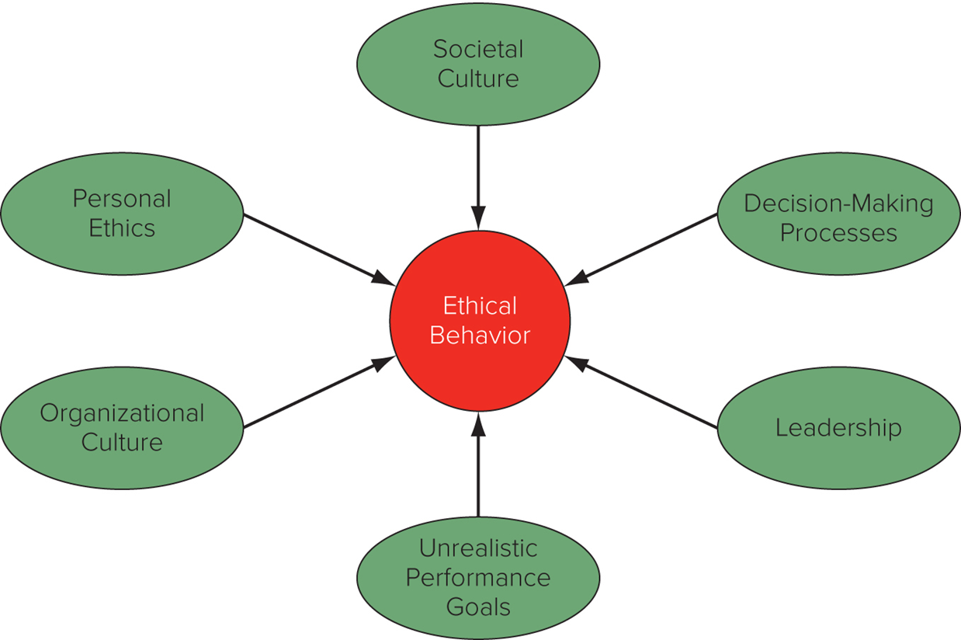
Figure 5.1 Determinants of Ethical Behavior
Access the text alternative for slide images.

Slide 13
Roots of Unethical Behavior 2
Personal Ethics
Business ethics reflect personal ethics.
Expatriates may face pressure to violate personal ethics.
Away from ordinary social context and supporting culture.
Psychologically and geographically distant from parent company.
Decision-Making Processes
Businesspeople may behave unethically because they fail to ask relevant questions.
Decisions made based on economic logic.
Notes:
Personal ethics refer to the generally accepted principles of right and wrong governing the conduct of individuals.
To improve ethical decision making in a multinational firm, the best starting point is to better understand how individuals make decisions that can be considered ethical or unethical in an organizational environment. Two assumptions must be taken into account. First, too often it is assumed that individuals in the workplace make ethical decisions in the same way as they would if they were home. Second, too often it is assumed that people from different cultures make ethical decisions following a similar process. Both of these assumptions are problematic. First, within an organization, there are very few individuals who have the freedom (for example, power) to decide ethical issues independent of pressures that may exist in an organizational setting (for example, should we make a facilitating payment or resort to bribery?). Second, while the process for making an ethical decision may largely be the same in many countries, the relative emphasis on certain issues is unlikely to be the same.

Slide 14
Roots of Unethical Behavior 3
Organizational Culture
Unethical behavior may exist in firms with an organizational culture that does not emphasize business ethics.
Values and norms shape the culture of a firm, and that culture influences decision making.
Unrealistic Performance Goals
Pressure from parent company to meet goals that are unrealistic and can only be attained by acting in an unethical manner.
Notes:
The term organizational culture refers to the values and norms that are shared among employees of an organization.
The combination of an organizational culture that legitimizes unethical behavior, or at least turns a blind eye to such behavior, and unrealistic performance goals may be particularly toxic.

Slide 15
Roots of Unethical Behavior 4
Leadership
Leaders establish the culture of the organization and set the example.
Actions speak louder than words.
Societal Culture
Ethical policies differ by country.
M N Es located in countries with strong individualism and uncertainty avoidance are more likely to emphasize ethical behavior.
M N Es located in countries with high masculinity and high power distance are less likely to promote ethical behavior.
Notes:
Employees often operate and work within a defined structure with a mindset very much similar to the overall culture of the organization that employs them.

Slide 16
Philosophical Approaches to Ethics 1
Straw Men
The Friedman doctrine states that the social responsibility of business is to increase profits, so long as company stays within rules of law.
Companies should do only what is mandated by law and what is required to run a business efficiently.
Cultural relativism: ethics are culturally determined, and firms should adopt ethics of the cultures in which they operate.
“When in Rome, do as the Romans do.”
Some universal ideas of morality are found across cultures.
Notes:
LO 5-4 Describe the different philosophical approaches to business ethics that apply globally.
Straw men approaches are raised by business ethics scholars primarily for the purpose of demonstrating that they offer inappropriate guidelines for ethical decision making in a multinational enterprise.
Critics charge that Friedman’s arguments break down under examination. This is particularly true in international business, where the “rules of the game” are not well established and differ from country to country. As with Friedman’s approach, cultural relativism does not stand up to a closer look. At its extreme, cultural relativism suggests that if a culture supports slavery, it is okay to use slave labor in a country.

Slide 17
Philosophical Approaches to Ethics 2
Righteous moralist: M N E’s home country standards of ethics are appropriate for companies to follow in foreign countries.
Common among managers from developed countries.
Critics say it is not always appropriate to adopt home-country standards.
Naive immoralist: if a manager of M N E sees firms from other nations not following ethical norms in host nation, that manager should not either.
Actions are ethically justified if everyone else is doing the same thing.
Notes:
The main criticism of the righteous moralist approach is that its proponents go too far. While there are some universal moral principles that should not be violated, it does not always follow that the appropriate thing to do is adopt home-country standards.
The objection to the naive immoralist approach is twofold. First, to say that an action is ethically justified if everyone is doing it is not sufficient. Second, the multinational must recognize that it does have the ability to change the prevailing practice in a country.

Slide 18
Philosophical Approaches to Ethics 3
Utilitarian and Kantian Ethics
Utilitarian approach to ethics: moral worth of actions or practices is determined by their consequences.
Actions have multiple consequences, some good, some not.
Actions are desirable that produce greatest good for greatest number of people.
Kantian ethics: Immanuel Kant argued that people should be treated as ends and never purely as means to the end of others.
People have dignity and need to be respected; they are not machines.
Notes:
The utilitarian philosophy does have some serious drawbacks as an approach to business ethics. One problem is measuring the benefits, costs, and risks of a course of action. The second problem with utilitarianism is that the philosophy omits the consideration of justice.
Although contemporary moral philosophers tend to view Kant’s ethical philosophy as incomplete—for example, his system has no place for moral emotions or sentiments such as sympathy or caring—the notion that people should be respected and treated with dignity resonates in the modern world.

Slide 19
Philosophical Approaches to Ethics 4
Rights Theories
Human beings have fundamental rights and privileges that transcend national boundaries and culture.
Human rights form basis of moral compass that managers should navigate by when making decisions that have an ethical component.
Idea that some fundamental rights transcend national borders and cultures was underlying motivation for U N’s Universal Declaration of Human Rights.
Certain people or institutions are obligated to provide benefits or services that secure rights of others.
Notes:
The UN’s Universal Declaration of Human Rights specifies the basic principles that should always be adhered to irrespective of the culture in which one is doing business.
It is important to note that along with rights come obligations. Because we have the right to free speech, we are also obligated to make sure that we respect the free speech of others.

Slide 20
Philosophical Approaches to Ethics 5
Universal Declaration of Human Rights
Everyone has the right to work, to free choice of employment, to just and favorable conditions of work, and to protection against unemployment.
Everyone, without any discrimination, has the right to equal pay for equal work.
Everyone who works has the right to just and favorable remuneration ensuring for himself and his family an existence worthy of human dignity, and supplemented, if necessary, by other means of social protection.
Everyone has the right to form and to join trade unions for the protection of his interests.
Notes:
This excerpt is from Article 23, which relates directly to employment.

Slide 21
Philosophical Approaches to Ethics 6
Justice Theories
Focus on attainment of just distribution—one that is considered fair and equitable—of economic goods and services.
John Rawls: all economic goods and services should be distributed equally except when unequal distribution would work to everyone’s advantage.
Impartiality is guaranteed by veil of ignorance—everyone is imagined to be ignorant of all their particular characteristics.
Race, sex, intelligence, etc.
Notes:
Rawls’ veil of ignorance is a conceptual tool that contributes to the moral compass that managers can use to help them navigate through difficult ethical dilemmas.

Slide 22
Philosophical Approaches to Ethics 7
Under Rawls’ veil of ignorance, each person is permitted the maximum amount of basic liberty compatible with a similar liberty for others.
Once equal liberty is assured, inequality in basic social goods are allowed only if they benefit everyone.
The difference principle suggests that inequalities are justified if they benefit the position of the least-advantaged person.
Notes:
The first principle is that each person be permitted the maximum amount of basic liberty compatible with a similar liberty for others. Rawls takes these to be political liberty (for example, the right to vote), freedom of speech and assembly, liberty of conscience and freedom of thought, the freedom and right to hold personal property, and freedom from arbitrary arrest and seizure.
The second principle is that once equal basic liberty is ensured, inequality in basic social goods—such as income and wealth distribution, and opportunities—is to be allowed only if such inequalities benefit everyone. Rawls accepts that inequalities can be just if the system that produces inequalities is to the advantage of everyone.

Slide 23
360° View: Managerial Implications 1
Making Ethical Decisions Internationally
Favor hiring and promoting people with well-grounded sense of personal ethics.
Build organizational culture that places high value on ethical behavior.
Put decision making processes in place that require people to consider ethical dimensions of business decisions.
Institute ethical officers in organization.
Develop moral courage.
Make corporate social responsibility cornerstone of enterprise policy.
Pursue sustainable strategies.
Notes:
LO 5-5 Explain how global managers can incorporate ethical considerations into their decision making in general, as well as corporate social responsibility and sustainability initiatives.

Slide 24
360° View: Managerial Implications 2
Hiring and Promotion.
Businesses should strive to identify and hire people with a strong sense of personal ethics.
Prospective employees should research organization’s ethical climate.
Organizational Culture and Leadership.
Articulate values that emphasize ethical behavior, repeatedly emphasize their importance, and then act on them.
Code of ethics: a business’s formal statement of ethical priorities.
Provide incentives and rewards to those who engage in ethical behavior.
Notes:
For example, the Academy of International Business (the top professional organization in international business) has a Code of Ethics for its leadership (as well as a COE for its members).
AIB’s Motivation for the Code of Ethics of the Leadership: The leadership of an organization is ultimately responsible for the creation of the values, norms and practices that permeate the organization and its membership. A strong ethically grounded organization is only possible when it is governed by a strong ethical committee. The term “committee” is used for succinctness; it includes all organizational structures that have managerial, custodial, decision-making or financial authority within an organization.

Slide 25
360° View: Managerial Implications 3
Decision-Making Processes.
If manager answers “yes” to following questions, the decision is ethically acceptable:
Does my decision fall within the accepted values or standards that typically apply in the organizational environment (as articulated in a code of ethics or some other corporate statement)?
Am I willing to see the decision communicated to all stakeholders affected by it—for example, by having it reported in newspapers, on television, or via social media?
Would the people with whom I have a significant personal relationship, such as family members, friends, or even managers in other businesses, approve of the decision?
Notes:
A moral compass can help determine whether a decision is ethical.

Slide 26
360° View: Managerial Implications 4
Five-step process helps managers think through ethical issues:
How would a decision affect stakeholders?
Internal stakeholders.
External stakeholders.
Judge ethics of proposed strategic decision.
Establish moral intent.
Engage in ethical behavior.
Audit decisions.
Notes:
A moral compass can help determine whether a decision is ethical.
Stakeholder analysis involves a certain amount of what has been called moral imagination. This means standing in the shoes of a stakeholder and asking how a proposed decision might impact that stakeholder. For example, when considering outsourcing to subcontractors, managers might need to ask themselves how it might feel to be working under substandard health conditions for long hours.
Internal stakeholders: People who work for or own the business such as employees, directors, and stockholders.
External stakeholders: Individuals or groups that have some claim on a firm such as customers, suppliers, and unions.

Slide 27
360° View: Managerial Implications 5
Ethics Officers
Encourage ethical behavior in a business.
Act as an internal ombudsperson.
Moral Courage
Managers must walk away from decisions that are profitable but unethical.
Requires moral courage.
Companies must commit to not retaliating against those exercising moral courage.
Notes:
It is the job of the ethics officer to:
Assess needs and risks that ethics program must address.
Develop and distribute code of ethics.
Conduct training programs.
Establish confidential service to address employee questions.
Make sure company in compliance with laws.
Monitor and audit ethical conduct.
Take action on possible violations.
Review and update code of ethics periodically.

Slide 28
360° View: Managerial Implications 6
Corporate Social Responsibility (C S R)
Multinationals need to give something back to the societies that enable them to prosper and grow.
Businesses should consider social consequences of economic actions.
There should be a presumption in favor of decisions that have both good economic and good social consequences.
Noblesse oblige.
Notes:
Advocates of this approach argue that businesses, particularly large successful businesses, need to recognize their noblesse oblige and give something back to the societies that have made their success possible. Noblesse oblige is a French term that refers to honorable and benevolent behavior considered the responsibility of people of high (noble) birth. In a business setting, it is taken to mean benevolent behavior that is the responsibility of successful enterprises.

Slide 29
360° View: Managerial Implications 7
Sustainability
Sustainable strategies: strategies that help M N Es make profits without harming the environment, while ensuring company operates in a socially responsible manner with regard to its stakeholders.
Good for shareholders, environment, local communities, employees, and customers.
Notes:
A company pursuing a sustainable strategy would not adopt business practices that degrade the environment for short-term economic gain because doing so would impose a cost on future generations. In other words, international businesses that pursue sustainable strategies try to ensure that they do not precipitate or participate in a situation that results in a tragedy of the commons.

Slide 30
Summary
In this chapter, we have
Explored ethical, corporate social responsibility, and sustainability issues faced by international businesses.
Recognized ethical, corporate social responsibility, and/or sustainability dilemma.
Identified causes of unethical behavior by managers as they relate to business, corporate social responsibility, or sustainability.
Described different philosophical approaches to business ethics that apply globally.
Explained how managers can incorporate ethical considerations into their decision making.

Slide 31
End of Main Content
© 2022 McGraw Hill. All rights reserved. Authorized only for instructor use in the classroom. No reproduction or further distribution permitted without the prior written consent of McGraw Hill.

Slide 32
Accessibility Content: Text Alternatives for Images

Slide 33
Figure 2.1 Rankings of Corruption by Country, 2019 – Text Alternative
Return to parent-slide containing images.
Ethical behaviour comprises Unrealistic Performance Goals, Leadership, Decision-Making Processes, Societal Culture, Personal Ethics, and Organizational Culture.
Return to parent-slide containing images.

