Slide 1
EMPLOYEES PERFORMANCE ANALYSIS
Author(s)
Affiliation
Institution
Instructor
Date

Slide 2
Planning
Base on the data collected by my colleague concerning the number of sick days by every employee as compared to their respective performance rating, null hypothesis indicates that there is no correlation between an employee's performance rating and the number of sick days taken by every employee.
The alternative hypothesis in this case is that there is correlation between employees rate of performance as compared to the sick days taken in the organization.
This data collection was basically taken within the organization that I work in (Amazon Organization) and collection of the data was specifically done by one of my colleague (Diana Dantron).
Notes:
The p-value, which assesses the results' statistical significance, serves as the foundation for both the null hypothesis and the alternative hypothesis. The employee who is an associate in my company acquired the data.

Slide 3
Analysis
Descriptive Statistics | Employees Performance Rating | Number of Sick Days
Mean | 56.00 | 8.90
Median | 65.00 | 8.50
Mode | 67.00 | 10.00
Standard Deviation | 28.65 | 5.88
Range | 95 | 20
Confidence Level (95%) | 8.14 | 1.67
Count | 50 | 50
Notes:
This analysis data is retrieved from the analysis conducted in the excel spread sheet. It shows different mean, median, mode and standard deviation of every employee concerning their respective performance rating and sick days taken (Dyrbye et al. 2019).

Slide 4
Continue,,,,,
The data comprises of 50 observations in total count.
The mean number of sick days taken by employees performance rating is 56 while that of sick days taken is 8.90.
The median number of sick days taken by employees is 8.50 which has given rise to 65 on their performance rating.
The mode of the number of sick days taken by employees is 10 while that of performance rating has resulted to 67.
The standard deviation of the number of sick days taken by employees is 5.88 which has given performance rating of 28.65.
Notes:
In this descriptive statistical analysis shows that sick days taken by each and every employee in this case will always give an impact in every employee performance rating and what he or she can achieve in every month of service delivery to the organization (Brown, 2020).

Slide 5
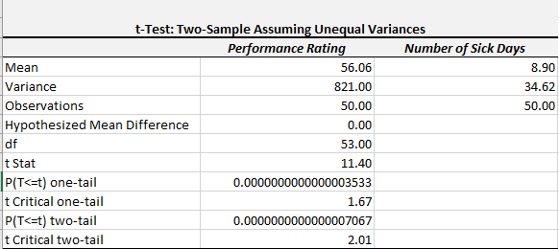
Results & Discussion
Notes:
This analysis was done using excel spreadsheet which is equally attached in this presentation. This is a t-Test for two sample assuming there is a difference in variances for instance the variance of employees performance rating is 821 which is unequal to that of sick days taken (34.62) (Dyrbye et al. 2019).

Slide 6
Continue…..
The result for this analysis is based on a two tailed test in which there is a general difference between the two sets which is evaluated and the result is obtained as below.
At df = 53, and t = 2.01, two tailed p value = 0.00007067.
Since p value of 0.00007067 is less than 0.05 which is the alpha level, it is advisable to reject the null hypothesis and conclude that there is a correlation between employees performance rating and employees number of sick days taken out of their respective jobs in the organization (Brown, 2020).
This means we cannot entirely generalize the level of employees performance ratings within the organization in comparison with their sick days taken while not working for the organization.
Notes:
Since p value of 0.00007067 is less than 0.05 which is the alpha level, it is advisable to reject the null hypothesis and conclude that there is a correlation between employees performance rating and employees number of sick days taken out of their respective jobs in the organization.
This means we cannot entirely generalize the level of employees performance ratings within the organization in comparison with their sick days taken while not working for the organization.

Slide 7
Organization Recommendation
Base on this analysis, I will recommend that the organization need to look into specific factors that can greatly impact the employees performance rating apart from sick days taken by the employees.
This will enable the employees to understand their roles and perform effectively in their respective roles leading to high ratings (Dyrbye et al. 2019).
This includes exploring on different factors that may be unique but still very influential in the employees level of performance rating within the organization.

Slide 8
References
Brown, M. G. (2020). Keeping score: using the right metrics to drive world class performance. Productivity Press.
Dyrbye, L. N., Shanafelt, T. D., Johnson, P. O., Johnson, L. A., Satele, D., & West, C. P. (2019). A cross-sectional study exploring the relationship between burnout, absenteeism, and job performance among American nurses. BMC nursing, 18(1), 1-8.

