Slide 1
Hypothesis testing
Name
Institution
Course
Instructor
Date

Slide 2
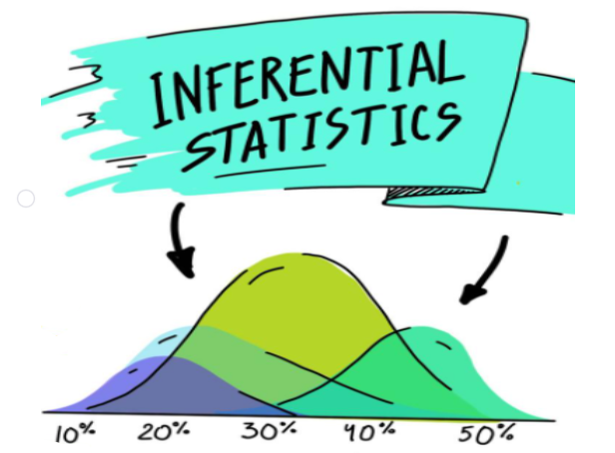
Inferential statistics
It is a branch of statistics utilizing different analytical tools to conclude a particular data set.
The main aim of inferential statistics is to make generalizations about a population (Hillier, 2023).
A good example would be a teacher who wants to know how many students understood a course effectively.
Inferential statistics will use this data to determine how many learners are competent in the course.
Notes:
It is a branch of statistics utilizing different analytical tools to conclude a particular data set. Moreover, inferential statistics assist in understanding a population by using its samples. The main aim of inferential statistics is to make generalizations about a population (Hillier, 2023). A good example would be a teacher who wants to know how many students understood a course effectively. The teacher would take a class sample, question them on the course, and perform an average. Inferential statistics will use this data to determine how many learners are competent in the course.

Slide 3
Hypothesis testing
Hypothesis testing is a category of statistics that helps analysts test assumptions about a population.
A hypothesis is mostly tested by evaluating and measuring a random sample of the population under study.
The main aim is usually to test the null and alternative hypotheses.
The null hypothesis states no relationship exists between the two factors under study.
The alternative hypothesis shows a statistical relation between the two variables under study.
Majorly, the null hypothesis is what the researcher aims to disapprove of, while an alternative is what the study aims to prove.
Notes:
Hypothesis testing is a category of statistics that helps analysts test assumptions about a population. A hypothesis is mostly tested by evaluating and measuring a random sample of the population under study. The main aim is usually to test the null and alternative hypotheses. The two types of hypotheses have major differences and their role in statistics. The null hypothesis states no relationship exists between the two factors under study. The alternative hypothesis shows a statistical relation between the two variables under study. Majorly, the null hypothesis is what the researcher aims to disapprove of, while an alternative is what the study aims to prove.

Slide 4

The alpha and the p-value
Alpha, sometimes called the level of significance, indicates the chances of getting your outcomes because of chance (Abdelgawad & Tenny, 2022).
A p-value is a number, usually in statistics, that explains how the researcher is likely to have discovered certain observations if the null hypothesis is correct.
A researcher makes statistical significance that data outcomes are not explained by chance only.
Notes:
Alpha, sometimes called the level of significance, indicates the chances of getting your outcomes because of chance (Abdelgawad & Tenny, 2022). The smaller the alpha value, the more unique the outcomes. Alpha mostly indicates the probability of making a type 1 error. In other words, it is the ability to deny the null hypothesis when you should not. In simpler terms, the sample data shows that there is a difference, while in real, it is not there. A p-value is a number, usually in statistics, that explains how the researcher is likely to have discovered certain observations if the null hypothesis is correct. The lower the value, the higher chances of denying the hypothesis. A researcher makes statistical significance that data outcomes are not explained by chance only. That means that the statistical significance of two factors is caused by something, not chance.

Slide 5
Inferred results and limitations of hypothesis testing
When an outcome is inferred to a population, the inferences acquired from a sample can work on the bigger population from which the sample was acquired.
In other words, the results of a sample test can apply to the major population from which the researcher got the sample.
The limitations of hypothesis testing include:
The sample was chosen randomly.
There are chances of errors (biswal, 2023).
There is the possibility of making type i error. That
Test results are sample-specific.
Notes:
When an outcome is inferred to a population, the inferences acquired from a sample can work on the bigger population from which the sample was acquired. In other words, the results of a sample test can apply to the major population from which the researcher got the sample. The limitations of hypothesis testing suggest that the sample was chosen randomly. The other limitation is that there are chances of errors (Biswal, 2023). When doing tests, there is the possibility of making type I error. The last limitation is that test results are sample-specific. After analyzing a sample, the outcomes of a hypothesis test are directly related to the sample.

Slide 6

Questions answered by hypothesis test
Mostly, when doing hypothesis testing, one starts with ideas of a population and then starts testing to see if a sample supports the insight.
Mostly, hypothesis testing tries to answer questions like Does the population look like or not?
The other question that hypothesis testing answers is the possibility of something happening.
Majorly, hypothesis testing cannot answer assumptions where there is no data to prove.
Notes:
Mostly, when doing hypothesis testing, one starts with ideas of a population and then starts testing to see if a sample supports the insight. Mostly, hypothesis testing tries to answer questions like Does the population look like or not? That helps make informed decisions about ideas since the test helps make conclusions. The other question that hypothesis testing answers is the possibility of something happening. A researcher might have an idea about the occurrence of something, but through sample testing, they can make conclusions. Majorly, hypothesis testing cannot answer assumptions where there is no data to prove.

Slide 7
References
Abdelgawad, I., & Tenny, S. (2022). Statistical Significance. National Library of Medicine. https://www.ncbi.nlm.nih.gov/books/NBK459346/#:~:text=The%20alpha%20is%20the%20decimal,the%20outcome%20of%20the%20study.
Biswal, A. (2023). What is Hypothesis Testing in Statistics? Types and Examples. simplilearn.com. https://www.simplilearn.com/tutorials/statistics-tutorial/hypothesis-testing-in-statistics#:~:text=Limitations%20of%20Hypothesis%20Testing&text=Possible%20errors%3A%20During%20hypothesis%20testing,reject%20a%20false%20null%20hypothesis).
Hillier, W. (2023). What’s the Difference Between Descriptive and Inferential Statistics? careerfoundry.com. https://careerfoundry.com/en/blog/data-analytics/inferential-vs-descriptive-statistics/

