Slide 1
Diabetes Management
Name
Institution
Course
Instructor
Date

Slide 2
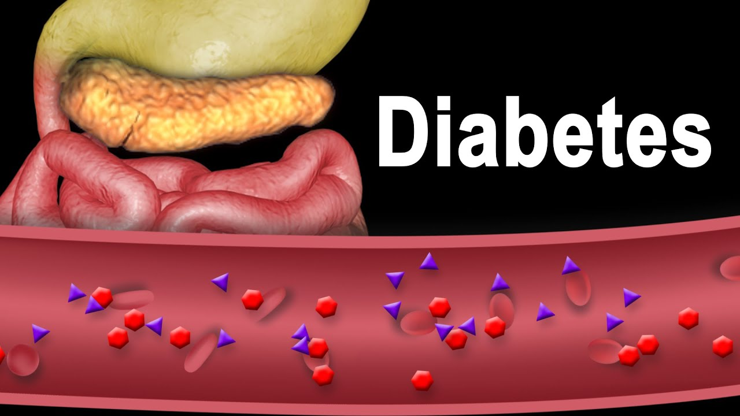
Diabetes Management
Diabetes happens when the blood glucose is beyond the normal level.
Many interventions and tools are available today to help people with diabetes live a normal life.
This presentation discusses one of the latest interventions
Notes:
Diabetes is a condition that happens when the blood glucose is beyond the normal level (Sapra & Bhandari, 2019). Glucose usually helps gain energy, but it must be broken down by insulin. However, with diabetes, the body produces little or no insulin, making the glucose remain in the blood. However, many researches and studies have been done to help people with this disease. Many interventions and tools are available today to help people with diabetes live a normal life. Therefore, this presentation discusses one of the latest interventions merged to help manage diabetes in adults. The presentation also discusses the necessary support for people living with diabetes.

Slide 3
Stem cell Technology
Bagley (2022) explains that stem cell technology is emerging for treating diabetes.
According to the article, stem cell has been greatly studied recently and has had promising results, especially for people with type 1 diabetes.
Stem cell technology, particularly pec-direct, according to Bagley (2022), has shown that it can help generate insulin.
The PEC-Direct, once implanted in the type 1 diabetic's body, can differentiate and become insulin-creating cells with the capacity to control glucose in the body.
Notes:
Stem cell Technology
Bagley (2022) explains that stem cell technology is emerging for treating diabetes. According to the article, stem cell has been greatly studied recently and has had promising results, especially for people with type 1 diabetes. As we all know, type I diabetes usually affects the insulin-producing cells in the pancreas, the main hormone that controls and helps break down glucose. However, stem cell technology, particularly PEC-Direct, according to Bagley (2022), has shown that it can help generate insulin. The PEC-Direct, once implanted in the type 1 diabetic's body, can differentiate and become insulin-creating cells with the capacity to control glucose in the body.

Slide 4
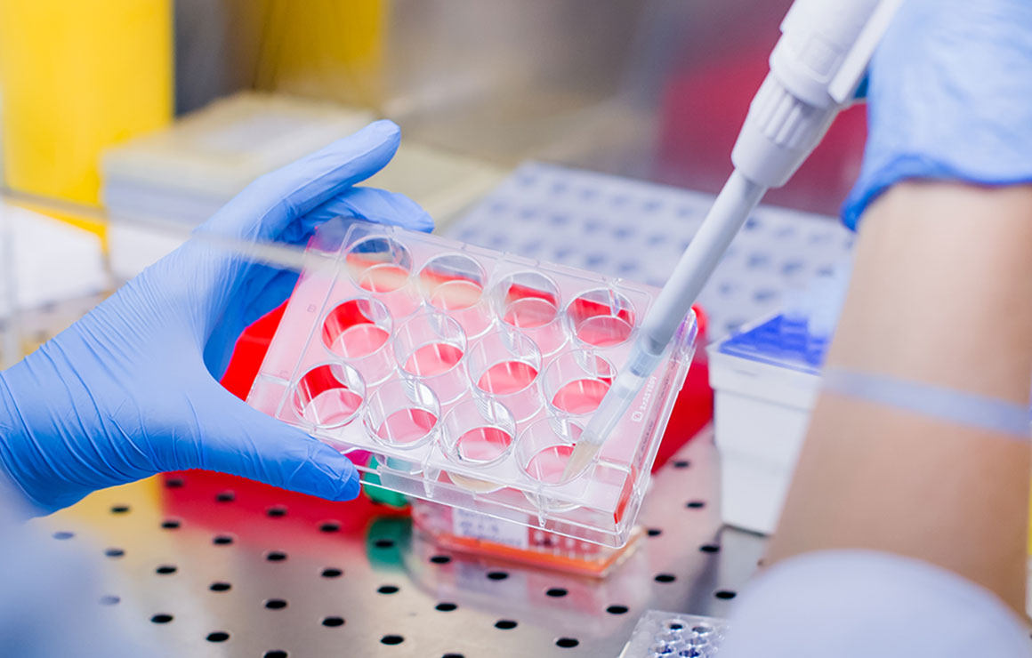
Research findings
Bagley (2022), stem cell technology has proved effective for type I diabetes.
PEC-Direct leads to a positive c-peptide after some months.
That shows there is a possibility to differentiate endoderm cells and make renewable insulin-generating islet cells.
Through the intervention, patients can maintain a c-peptide enough to have the necessary glycemic impact.
Notes:
Research findings
Based on the study by Bagley (2022), stem cell technology has proved effective for type I diabetes. The main idea of the research is to create stem cells that will help in the generation of insulin in type 1 diabetics. According to various trial studies done by the researchers, the implanted PEC-Direct led to a positive C-peptide after some months. That showed that there is a possibility to differentiate endoderm cells and make renewable insulin-generating islet cells. Also, from various trials, the researchers realized that patients could maintain a C-peptide enough to have the necessary glycemic impact.

Slide 5
Research findings
Research is still underway to ensure it produces the best treatment for type 1 diabetes.
Researchers have partnered with CRISPR to integrate more technology
The intervention relates to diabetes since the researchers are working hard to make an intervention that will help create insulin for type 1 diabetics.
Notes:
According to Bagley (2022), research is still underway to ensure it produces the best treatment for type 1 diabetes. For instance, the original researchers have partnered with CRISPR to integrate more technology to ensure they come up with the best solution. That has led to better stem cells that promise to drop unnecessary practices like immunosuppression. The practice is relevant to nursing practice given that the practice should be client focused and provide the best care that does not affect the patient. Moreover, the intervention relates to diabetes since the researchers are working hard to make an intervention that will help create insulin for type 1 diabetics.

Slide 6

Integrating stem cell technology in nursing practice and its effects
Integrating the intervention into nursing practice requires several considerations.
One of the considerations is the knowledge gap.
Other considerations include:
Increasing awareness of regenerative science and continuous education to nurses on new technologies
Providing the necessary resources to become conversant with the interventions.
Notes:
Stem cell technology, especially PEC-Direct, is a regenerative technology that has emerged to help manage diseases like type 1 diabetes. Therefore, integrating the intervention into nursing practice requires several considerations. One of the considerations is the knowledge gap about regenerative technologies in nurses. Since this practice is new to nurses, integrating the intervention into their practice requires education and forming a competent profession. As Chlan et al. (2019) explain, other considerations include increasing awareness of regenerative science, continuous education to nurses on new technologies, and providing the necessary resources to become conversant with the interventions.

Slide 7
Integrating stem cell technology in nursing practice and its effects
Integrating the intervention into nursing practice requires caregivers to be conversant with the effects
Patients implanted with pec-direct need constant monitoring to track glucose levels
Nurse practice has to change from inpatient to community-based, continuously monitoring patients
The intervention will change the disease process since the body will have renewable cells
Notes:
It is important to educate nurses on PEC-Direct to ensure that they become conversant with the intervention for them to be able to provide the right care. Integrating the intervention into nursing practice requires caregivers to be conversant with the effects to ensure they change their care practices. For example, patients implanted with PEC-Direct need constant monitoring to track glucose levels and other side effects. That will mean that nurse practice has to change from inpatient to community-based, continuously monitoring patients at their homes. Lastly, the intervention will change the disease process since the body will have renewable cells that will help generate insulin. Natural beta cells will not affect disease recovery since PEC-Direct will replace them.

Slide 8
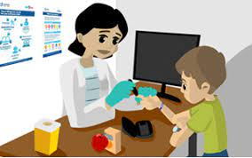
Aspects to consider in diabetes patients
Diabetes is a long-term condition that affects a patient throughout their lifetime.
It is essential to consider psychological aspects because diabetes affects a person's mental well-being
Patient education can enlighten patients on ways to cope with the condition
Notes:
It is important to consider psychological, cultural, and spiritual elements when caring for patients with diabetes. That is because diabetes is a long-term condition that affects a patient throughout their lifetime. It is essential to consider psychological aspects because diabetes affects a person's mental well-being due to sudden life changes (Van Duinkerken et al., 2020). Thus, providing the necessary support to these patients is essential for a nurse. For instance, nurses can enlighten patients on ways to cope with the condition and live normal lifestyles through patient education. That can help lessen the tension and help patients cope easily.

Slide 9
Aspects to consider in diabetes patients
Culture usually entails certain practices and food choices.
It is important to consider culture since diabetes requires changing diet and lifestyle behaviors.
It is necessary to be resourceful and enlighten the patient on how their choices affect their conditions.
It is important to consider spiritual aspects since spirituality can affect coping with diabetes.
It would be appropriate to explain the necessity of any interventions against their religious beliefs.
That would help ensure patients receive all interventions necessary for managing diabetes.
Notes:
Culture usually entails certain practices and food choices. Thus, it is important to consider culture since diabetes requires changing diet and lifestyle behaviors. As a caregiver, it is necessary to be resourceful and enlighten the patient on how their choices affect their conditions. For example, giving the patient a list of the foods that fall in their culture but are appropriate to their help would help improve clinical outcomes. Lastly, it is important to consider spiritual aspects since spirituality can affect coping with diabetes. As a nurse, it is important to understand a patient's beliefs and provide education while still considering their faith. For example, it would be appropriate to explain the necessity of any interventions against their religious beliefs. That would help ensure patients receive all interventions necessary for managing diabetes.

Slide 10
References
Bagley, D. (2022). Islets in the Stream: Could Stem Cell Technology Be an Eventual Cure for Type 1 Diabetes? endocrinenews.endocrine.org. https://endocrinenews.endocrine.org/islets-in-the-stream/
Chlan, L. L., Tofthagen, C., & Terzic, A. (2019). The regenerative horizon: opportunities for nursing research and practice. Journal of Nursing Scholarship, 51(6), 651-660. https://sigmapubs.onlinelibrary.wiley.com/doi/full/10.1111/jnu.12520
Sapra, A., & Bhandari, P. (2019). Diabetes Mellitus. StatPearls. https://www.ncbi.nlm.nih.gov/books/NBK551501/
Van Duinkerken, E., Snoek, F. J., & De Wit, M. (2020). The cognitive and psychological effects of living with type 1 diabetes: a narrative review. Diabetic Medicine, 37(4), 555-563. https://onlinelibrary.wiley.com/doi/full/10.1111/dme.14216

