Slide 1
Industry External Analysis
Name
Institution
Course
Instructor
Date

Slide 2
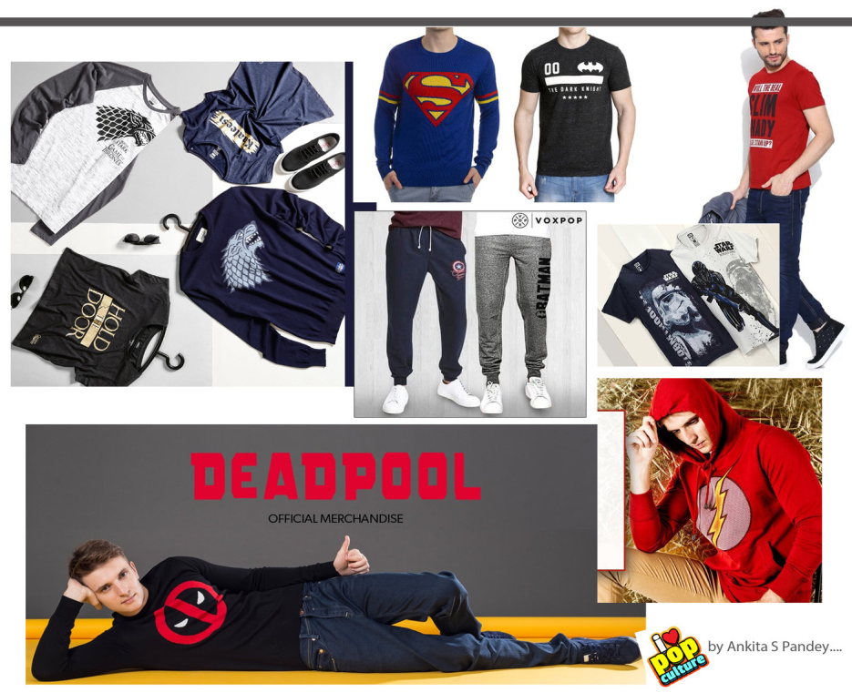
Industry External Analysis
Pop culture merchandise is a multi-billion-dollar industry.
It deals with products such as action figures, t-shirts, and posters based on popular characters from movies or TV shows.
The sector has really grown due to wide acceptance of pop culture.
Hot Topic one of the major players in the pop culture merchandise industry.
Notes:
Introduction
Pop culture merchandise is a multi-billion-dollar industry comprising a wide range of products like action figures, t-shirts, posters, and other collectibles based on popular characters from video games, comics, television shows, and movies. The sector has witnessed a noteworthy increase in the past few years because of the popularity of comic book conventions, streaming services, and the general acceptance of pop culture. Hot Topic is among the major players in the pop culture merchandise industry. The firm was established in 1988 and became a popular destination for alternative fashion and pop culture fans. The organization began as a small store selling clothing and accessories inspired by music. It has expanded to include numerous product offerings based on franchises such as Star Wars, Harry Potter, and Marvel. This paper focuses on evaluating the external environment of Hot Topic.

Slide 3
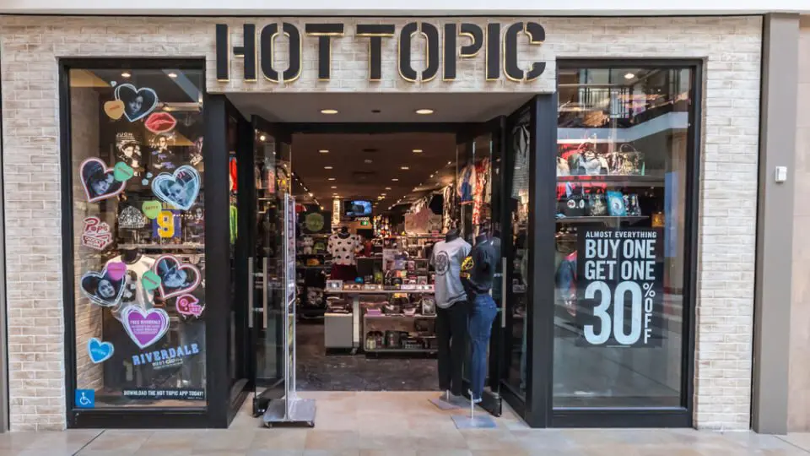
Company Description
Brief history of the company
Hot Topic is a retail chain organization that sells pop culture-themed clothes and accessories.
It was established in 1988 and has over 600 stores across US and worldwide.
It is one of the largest retailers in the industry.
The company has flourished over the years because it stays ahead of the trends.
It has also faced several criticisms.
Notes:
Company Description
Brief History of the Company
Hot Topic is a retail chain organization focusing on selling pop culture-themed clothing and accessories. The organization was established in 1988 by Orv Madden and launched its first store in Montclair, California. Today, the organization owns more than 600 stores across the United States and worldwide. Therefore, the firm is among the largest retailers in the industry. During Hot Topic's initial years of operation, it focused on selling music-related merchandise, catering to rock, metal, and punk fans. The stores stocked CDs, band shirts, and other merchandise, and it became a popular destination for music fans. The firm's expansion necessitated an increase in its product offering, comprising many different types of pop culture-themed merchandise like apparel and accessories inspired by TV shows, movies, and video games. One of the major drivers of the firm's success is its ability to maximize the advantages of the cultural zeitgeist and stay ahead of trends. For instance, in the late 1990s and early 2000s, the firm capitalized on emo and pop-punk music's popularity by selling band t-shirts and products for bands such as Fall Out Boy, My Chemical Romance, and Panic! at the Disco.
Recently, the firm has focused on selling merchandise inspired by popular movies and TV shows such as Harry Potter, Game of Thrones, and Stranger Things. Additionally, the organization's willingness to implement new technology and social media has promoted the firm's success. Hot Topic was among the first retailers to sell its products through various online platforms, and it has continued to innovate in the e-commerce space. Furthermore, the organization actively engages with its customers on social media platforms like Twitter, Facebook, and Instagram. By capitalizing on social media platforms, the organization has innovatively connected with numerous customers worldwide, establishing a loyal customer base and increasing sales. Despite the firm's success, Hot Topic has experienced criticism over the years. Some critics have accused Hot Topic of co-opting underground subcultures and selling them to the mainstream. In contrast, others have criticized the organization for its business practices, such as paying its worker's low wages and lack of diversity in the firm's recruitment processes. However, the organization remains a go-to store for pop culture fans, and it has continued to open more stores in new locations and increase its product offerings.

Slide 4
  Description of Organizational Operating Units
  The organization’s key operating units are;
    The product development unit
    The merchandising unit
    The marketing and advertising unit
  Other units include the supply chain, logistics, finance, and accounting.
  The firm operates in various markets such as the US, Europe, and Canada.
Notes:
Description of Organizational Operating Units
The organization has numerous operating units that work together to support the firm's business operations and promote growth. The product development unit is among the firm's functional units. The product development unit focuses on identifying current trends in the pop culture landscape and designing new products that will attract the target customers' attention. The product development unit collaborates with the Merchandising unit to guarantee that newly developed products align with the firm's brand identity and meet the customer’s needs (Sugihartati, 2020). The merchandising unit is also a key operating unit within the firm. The merchandising team is responsible for sourcing and buying products for the firm's stores and e-commerce sites. The firm has an active marketing and advertising unit. The marketing and advertising unit is responsible for formulating and launching campaigns that create awareness and increase sales of the firm's products. Besides the firm's key operating divisions, Hot Topic has numerous units that play a crucial role in the firm's overall success. Some teams include the supply chain, logistics, finance, and accounting. The organization operates in many different markets around the world. Key markets include the United States, Europe, and Canada.

Slide 5
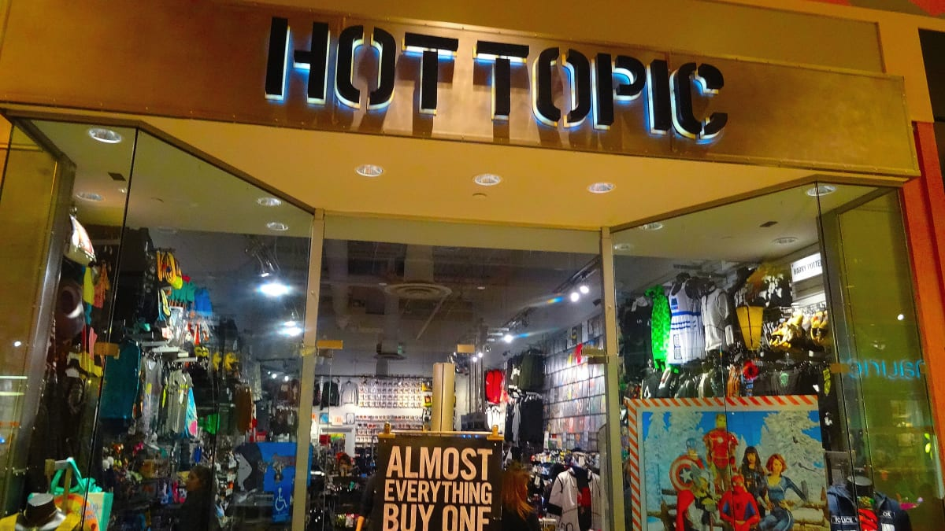
External Analyses
Industry analysis and description
Hot Topic operates in the pop culture merchandise industry.
This industry serves consumers who love popular entertainment franchises like TV Shows.
Some of the pop culture products are clothes, accessories, and entertainment franchises.
The industry also produces products that serve underrepresented communities, like LGBTQ groups.
Notes:
External Analyses
Industry Analysis
Industry Description
Hot Topic operates in the pop culture merchandise industry. The pop culture merchandise industry is a multi-billion dollar market that focuses on serving consumers who love popular entertainment franchises like TV Shows, Movies, music, and Video games, among others. The sector has recorded continuous growth in the past few years due to the increase in social media and online shopping, which enables consumers to find and buy unique and exclusive products easily. Pop culture products comprise numerous products like accessories, clothing, and home décor. Logos, popular entertainment franchises, characters, and collectibles. These products enable fans to express their love for their favorite franchises and connect with other like-minded consumers. The close connection between consumer identity and pop culture drives the pop culture merchandise sector. Pop culture franchise fans believe they are part of a bigger community and utilize products to express their connection and tie to the community. The diversity and inclusiveness of the industry have increased in recent years, with numerous firms launching product lines that serve underrepresented communities, such as body positivity and LGBTQ groups. Furthermore, countless firms have been growing their product offering to include products inspired by social justice movements like Black Lives Matter.

Slide 6
  External analyses
  Industry operations
  The pop culture merchandise industry is a broad-scope market.
  The production of pop culture products involves multiple supply industries like;
    Printing firms
    Textile manufacturers.
  Main consumers are the adolescents and adults from diverse cultures.
  Industry Life Cycle and Growth Rate
  The pop culture merchandise industry is currently in the growth phase.
  The industry has grown due to its close connection with consumer identity.
  The popularity and relevance of pop culture influence the demand for its products.
  Competition may, however, slow its growth.
  The industry has to adapt to the changing needs of customers.
Notes:
Industry Operations
The pop culture merchandise industry is a broad-scope market comprising numerous products such as collectibles, home décor, and clothing. The production of these products involves multiple supplier industries. Textile manufacturers provide fabrics and materials for clothing and accessories (Jones, 2022). Metal and plastic manufacturers provide materials needed to produce collectibles and other appropriate products. Printing firms also play a crucial role in the industry as they provide images and designs for products. The manufacturing process involves the production of pop culture merchandise based on the product and supplier industry. Collectibles can be produced using 3D printing technology, while clothing and accessories may be made using industrial sewing machines. The demand industry comprises consumers passionate about well-known entertainment franchises like TV Shows, Video games, movies, and music. The consumers are adolescents and adults from diverse cultures and backgrounds. A strong connection between consumer identity and pop culture promotes pop culture merchandise's popularity.
Industry Life Cycle and Growth Rate
The pop culture merchandise industry is currently in the growth phase of its life cycle. The close connection between consumer identity and pop culture drives the high growth rate experienced within the sector. The popularity and relevance of pop culture influence the demand for pop culture products. Nevertheless, the saturation of the market and increase in competition may slow down the industry's growth rate. Firms operating in the pop culture merchandise industry must adapt to changing consumer needs and preferences and improve their innovation strategies to maintain their market position and growth.

Slide 7
  External analyses
  Dominant Economic Features of Industry’s
  The industry is characterized by various factors like;
    competition among firms
    diverse consumer groups
    rapid technological advancements
  The industry's market size is billions of dollars globally.
  Profit margins broadly vary based on the product and producer.
  Industry Trends
  The key trend in the industry is ethical production and sustainability.
  The other trend is production of unique and personalized options to consumers.
Notes:
Dominant Economic Features of Industry’s
The pop culture merchandise industry is characterized by various factors, such as competition among firms, diverse consumer groups, and rapid technological advancements. The industry's market size is billions of dollars globally, with millions of products sold yearly (Jones, 2022). Nevertheless, profit margins broadly vary based on the product and producer. Due to high competition, organizations focusing on the sales of clothing and accessories may record low profits. In contrast, firms selling collectibles and limited edition products may record higher earnings because of scarcity and exclusivity.
Industry Trends
Emphasis on ethical production and sustainability is among the key trends in the pop culture merchandise industry. Consumers are increasingly focusing on minimizing their impact on the environment and society. Therefore, producers respond to these changes by implementing sustainable and ethical practices in their production processes. Additionally, many firms adopted virtual try-on and augmented reality technology to improve the consumer experience. Lastly, the industry has increased demand for personalization and customization, with firms providing more unique and personalized options to consumers.

Slide 8

Contextual Industry Environmental Analysis
Political/Legal Factors
Political and legal factors are crucial in regulating the pop culture merchandise industry.
They include;
  property rights
  intellectual property rights,
  product safety regulations
  tariffs, trade agreements, and taxation.
Economic Factors
The pop culture merchandise industry is impacted by numerous economic factors like;
  inflation rates
  spending patterns
  currency exchange rates
Notes:
Contextual Industry Environmental Analysis
Political/Legal Factors
Political and legal factors are crucial in regulating the pop culture merchandise industry. Areas such as property rights, intellectual property rights, and product safety regulations help in the regulation of various activities in the industry. Producers must guarantee that their products do not violate any intellectual property rights of other producers and that they attain the safety standards outlined by regulatory authorities (Smith et al., 2022). Furthermore, firms must adhere to international trade laws and regulations when investing in new markets. Political factors such as tariffs, trade agreements, and taxation can also affect the industry's growth potential and profitability.
Economic Factors
The pop culture merchandise industry is impacted by numerous economic factors such as inflation rates, spending patterns, currency exchange rates, and spending habits. The sector's growth and profitability are closely related to the general state of the nation's economy, with customers' spending power increasing during economic expansion. Furthermore, fluctuations in exchange rates can affect the cost of importing goods and the cost of production, while inflation can increase the cost of raw materials. Firms operating in the industry must understand the various economic conditions and adjust their approaches appropriately.

Slide 9
  Contextual Industry Environmental Analysis
  Sociocultural factors
  Some of the sociocultural factors affecting the industry include;
    emergence of social media
    current cultural trends
    issues like inclusion, diversity, and representation in its products.
  Demographic factors
  Demographic factors are key in influencing a firm's success in the industry.
  They include;
    Ethnicity
    Gender
    Income level
    Age
Notes:
Sociocultural Factors
Sociocultural factors also play a key role in the industry because it influences consumers' preferences and tastes. For instance, pop culture franchises and trends are often shaped by wide cultural events and movements like the emergence of social media or the popularity of specific TV shows or movies. Furthermore, the sector must address various issues such as inclusion, diversity, and representation in its products because these are increasingly important customer values. Organizations operating within the industry must be updated on current trends and adjust their products and messaging to remain relevant and attract customers.
Demographic Factors
Demographic factors are key in influencing a firm's success in the industry, as various consumer groups have different preferences and purchasing habits. For instance, younger customers may prefer purchasing products associated with popular video games or anime franchises, while older customers may prefer buying products related to classical music. Furthermore, ethnicity, gender, and income level influence consumer preferences and the most popular products.

Slide 10
  Contextual Industry Environmental Analysis
  Technological factors
  Technological advancements influence the production and consumption of products in the industry.
  Firms should;
    Advance in 3D printing
    Adopt digital technology like interactive websites
    upgrade to the latest technologies,
    implement new technologies.
  Global factors
  Global factors also influence the industry because it serves consumers worldwide.
  They include;
    Global trade regulations
    currency exchange rates
    geopolitical risks.
Notes:
Technological Factors
Technological factors also play a crucial role in influencing the success of an organization in the industry because technological advancements influence the production and consumption of products. For instance, advances in 3D printing can enable organizations to easily produce products at an affordable price (Crothers, 2021). Furthermore, the sector is increasingly adopting digital technology to improve consumer experiences like interactive websites and try-on technology. Organizations must be updated on the latest technological advancements and implement new technologies to maintain competitiveness.
Global Factors
Global factors also influence the industry because it serves consumers worldwide. Globalization has enabled firms to operate in other parts of the world and collaborate with local businesses to create different types of products. Therefore, firms must adhere to global trade regulations, currency exchange rates, and geopolitical risks that can impact the industry's growth and profitability.

Slide 11
  Summary of Contextual Environmental
  Pop culture merchandise industry is affected by numerous factors.
  Businesses operating in the sector must understand and find proper ways to address them.
  Firms in the industry that must be aware of these factors to remain competitive.
Notes:
Summary of Contextual Environmental
Overall, the pop culture merchandise industry is affected by numerous factors that businesses operating in the sector must understand and find proper ways to address. For instance, multiple technological factors influence the growth and profitability of companies within the industry. Therefore, these firms must adopt the latest technology within their business or production processes. Numerous factors impact firms in the industry that must be aware of to remain competitive.

Slide 12
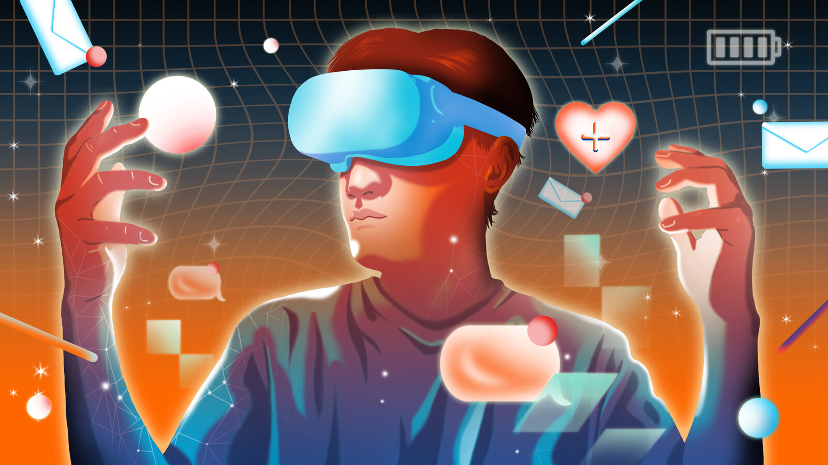
Driving Contextual Forces for the Future
The industry faces numerous contextual forces for the future.
Such as;
  technological advancements
  the increasing significance of ethical production processes and sustainability
  changing customer preferences.
Notes:
Driving Contextual Forces for the Future
The industry faces numerous contextual forces for the future, such as technological advancements, the increasing significance of ethical production processes and sustainability, and changing customer preferences. The emergence of new technical solutions requires firms to adapt the technological solution to stay competitive. Additionally, consumers are increasingly seeking and purchasing more products that align with their values, like products manufactured using sustainable products. Hence, organizations operating in the industry must focus on addressing these driving forces to remain competitive.

Slide 13

Five Forces Analysis
The threat of New Entry
The threat of new entry is low in the pop culture merchandise industry.
That is because it is dominated by few key players.
The cost of entry is also high.
Power of suppliers
Suppliers in the pop culture merchandise industry have a relatively high power because;
They sell products based on well-known intellectual properties.
They use stringent policies in licensing agreements.
Notes:
Five Forces Analysis
The threat of New Entry
The threat of new entry is low in the pop culture merchandise industry. The threat of new entry is not common in the industry because it is dominated and saturated by a few key players. Firms such as Warner Bros, Funko, and Disney have large market shares. Furthermore, the industry entry cost is high because firms must invest in production and distribution capabilities and formulate marketing strategies to attract customers. Nevertheless, a new player can gain a market share by focusing on a specific subculture and developing products designed to appeal to the identified subculture.
Power of Suppliers
Suppliers in the pop culture merchandise industry have a relatively high power because organizations depend on licensing agreements with content creators to manufacture and sell products based on well-known intellectual properties. Content owners like Warner Bros and Disney have higher power. At the same time, bargaining licensing terms and firms must meet specific standards for product quality and designs to preserve their licensing agreements. Furthermore, the sector depends on an international network of suppliers for materials and production capabilities. Therefore, any change in supply and demand can impact the sector's profitability. Organizations must establish close links with suppliers to guarantee a dependable, cost-effective supply chain.

Slide 14
  Five Forces Analysis
  Power of Buyers
  Buyers in this industry have high power.
  The sector is highly influenced by changing consumer tastes and preferences.
  Organizations must cultivate a strong brand and engage their fans to increase their power.
  Threat of substitutes
  The pop culture merchandise industry experiences a moderate threat of substitutes.
  Even though some popular franchises like Marvel are dominant, consumers prefer buying generic products.
  Strong brand loyalty and fandoms can address this challenge.
  Competitive Rivalry
  There is high competition in the pop culture merchandise industry.
  The main competitors are Hasbro, Funko, and Disney.
  The rivalry is caused by aspects like;
    brand recognition
    licensing contracts with well-known franchises
    pricing strategy
    uniqueness of products
Notes:
Power of Buyers
The power of buyers in the industry is relatively high because consumers have a wide variety of options and can easily compare products and prices online. Therefore, many business experience challenges in differentiating themselves and commanding higher prices. Furthermore, the sector is highly influenced by changing consumer tastes and preferences, and organizations must stay updated on these changes and adjust appropriately. Nevertheless, many firms in the industry benefit from brand loyalty among specific consumers, especially consumers passionate about particular franchises. Organizations must cultivate a strong brand and engage their fans to increase their power.
Threat of Substitutes
The pop culture merchandise industry experiences a moderate threat of substitutes. Even though there are no exact alternatives to popular franchises such as Marvel or Star Wars, consumers have many other options in the form of video games, books, or streamings services. Additionally, some consumers may prefer purchasing non-branded products like generic clothing or toys. Nevertheless, strong brand loyalty and fandoms can address this challenge because consumers may like purchasing officially licensed products for their collectivity and originality. Overall, the threat of substitute products in the pop culture merchandise industry is moderate.
Competitive Rivalry
There is high competition in the pop culture merchandise industry because numerous firms compete for market share. Key players in the sector include Hasbro, Funko, and Disney. The rivalry in the industry is caused by various factors such as brand recognition, licensing contracts with well-known franchises, pricing strategy, and uniqueness of products. Organizations also compete through other factors such as technologies, new product lines, and the quality of products. Furthermore, the sector is significantly influenced by consumer tastes and preferences, which change rapidly and affect the success of an organization. Generally, there is high competition in the pop culture merchandise industry, with firms focusing on gaining an edge over their competitors.

Slide 15
  Summary Assessment of the Five Forces
  The competition is high in pop culture industry.
  Suppliers have low power due to easy availability of distributors.
  The threat of substitutes is low because pop culture products are highly differentiated.
  The threat of new entrants is moderate because established players have strong brand recognition.
  Buyers have a higher bargaining power because they may have options and can quickly switch brands.
Notes:
Summary Assessment of the Five Forces
There is high competition in the pop culture industry, with key players focusing on gaining an edge over their competitors. Suppliers have a relatively low purchasing power because of the easy availability of distributors. Nevertheless, buyers have a higher bargaining power because they may have options and can quickly switch brands. The threat of new entrants is moderate because established players have strong brand recognition and economies of scale. The threat of substitutes is low because pop culture products are highly differentiated.

Slide 16
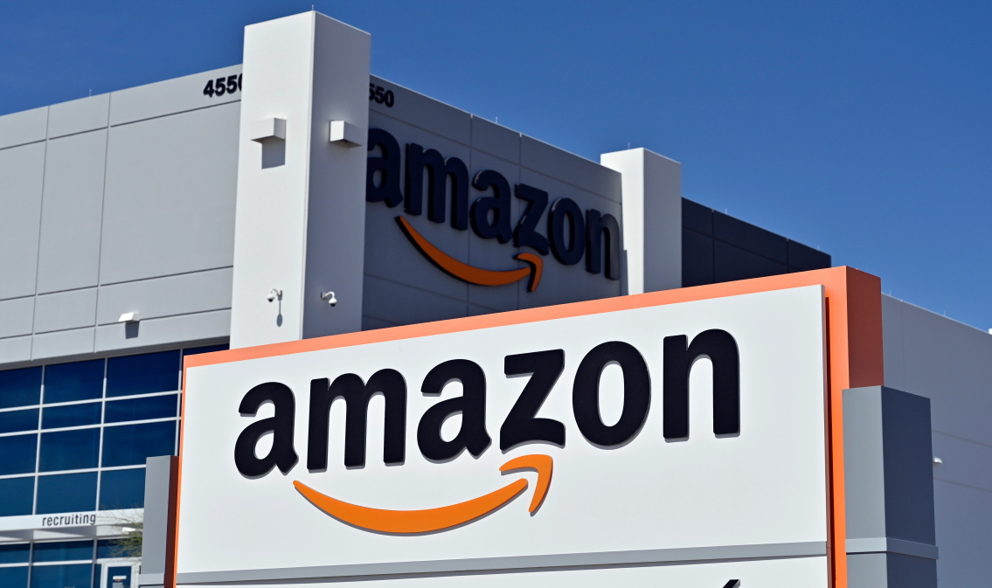
Industry Competitive Analysis
Industry competitors
The key competitors in the pop culture merchandise industry are;
  Amazon
  Funko
  Hot Topic
  GameStop.
A strategic group map can determine the industry's key players and their position in the market.
Notes:
Industry Competitive Analysis
Industry Competitors
The key competitors in the pop culture merchandise industry comprise organizations like Amazon, Funko, Ho Topic, and GameStop. The market leader in the industry is Funko, with the major market share in the pop culture collectibles division. Hot Topic is among the key players in pop culture merchandise, specializing in clothing and accessories. GameStop is a major video games retailer and related product, while Amazon is a key player in the e-commerce platform that sells numerous pop culture merchandise (Shim et al., 2020). There are also countless minor players in the industry, such as online marketplaces, boutique stores, and independent retailers. These little retailers often focus on niche products or serve specific market divisions. A strategic group map can be utilized to determine the industry's key players and their positioning in the market. The map can include various elements like market share, pricing, distribution channels, and product range. The key players in the pop culture merchandise industry would be positioned in the upper right quadrant of the map, with minor players placed in other areas.

Slide 17
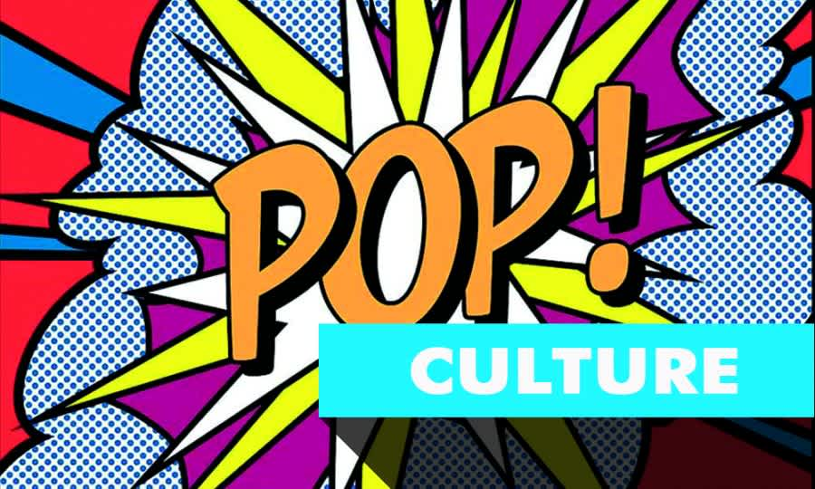
Anticipated Strategic Moves
The pop culture industry is expected to expand in the coming years.
Release of new movies, TV shows, will inspire the growth.
Alternatives to the products, such as gaming may become more competitive in the future.
Notes:
Anticipated Strategic Moves
The pop culture industry is expected to expand in the coming years, and the release of new movies, TV shows, and other forms of entertainment will inspire the growth. New entrants can enter the market and focus on the e-commerce sector. Alternatives to the products, such as gaming and comic book products, may become more competitive in the coming years.

Slide 18

Key Success Factors
The primary success factors are;
  developing a strong brand image
  extensive product offerings
  effective marketing
  excellent customer service
  capitalizing on social media
  providing unique and innovative products.
Notes:
Key Success Factors
The primary success factors are developing a strong brand image, extensive product offerings, and effective marketing. Organizations that can provide unique and innovative products and excellent customer service will likely prosper in the industry. Furthermore, firms that capitalize on social media and other digital platforms to engage with customers and promote their products will probably have an advantage over their rivals.

Slide 19
  Summary of External Analysis
  External analysis plays a crucial role in evaluating the external environment of an organization.
  The external analysis enables an organization to identify opportunities and threats within the industry.
  Hot Topic is affected by various external factors.
  Such as;
    demographic factors
    sociocultural factors
    political, global and technological factors.
Notes:
Summary of External Analysis
External analysis plays a crucial role in evaluating the external environment in which an organization operates. The external analysis enables an organization to identify opportunities and threats within the industry. In the case of Hot Topic, numerous external factors influence the firm's operations. For instance, technological factors such as the emergence of social media platforms and e-commerce platforms play a crucial role in the success of firms operating in the industry. Demographic characteristics are key in influencing a firm's success in the industry, as various consumer groups have different preferences and purchasing habits. For instance, younger customers may prefer purchasing products associated with popular video games or anime franchises, while older customers may prefer buying products related to classical music. Sociocultural factors also impact organizations in the industry because cultural events often influence demand for pop culture merchandise. Overall, the pop culture merchandise industry is affected by numerous issues, and organizations operating in the industry must focus on guaranteeing that they adopt the changes to ensure their survival.

Slide 20
  References
  Crothers, L. (2021). Globalization and American popular culture. Rowman & Littlefield Publishers.
  Jones, S. (2022). 14 Mass Communication, Intellectual Property Rights, International Trade, and the Popular Music Industry. In Mass media and free trade (pp. 331-350). University of Texas Press.
  Shim, A., Yecies, B., Ren, X., & Wang, D. (2020). Cultural intermediation and the basis of trust among webtoon and webnovel communities. Information, Communication & Society, 23(6), 833-848.
  Smith, A. C., Skinner, J., & Read, D. (2022). Popular culture, sport, and management. In A research agenda for sport Management (pp. 39-56). Edward Elgar Publishing.
  Sugihartati, R. (2020). Youth fans of global popular culture: Between prosumer and free digital labourer. Journal of Consumer Culture, 20(3), 305-323.

