Slide 1
The Impact of Unconscious Bias
Presented by:
Soliel Omega; Josephine Santos; Allyl Soriano; Manuela Shayne Castro; Rosselle Marigomen; Jerviz Angbengco; Nikki Ton; Jasmine Luu
American University of Health Sciences
GN506 Global Health, Culture and Health Policy for the Advanced Practice Nurse
Dr. Jennifer Obsania
February 4, 2023

Slide 2
Unconscious Bias
Also known as implicit bias
Prejudice or unsupported judgments in favor of or against one thing, person, or group as compared to another.
Occurs automatically as the brain makes quick judgments based on past experiences and background.
Exhibited toward minority groups based on factors such as class, gender, sexual orientation, race, ethnicity, nationality, religious beliefs, age, disability and more.

Slide 3
Unconscious Bias (cont.)
Attitudes and behaviors of health care providers have been identified as one of many factors that contribute to health disparities.
Thoughts and feelings that often exist outside of conscious awareness.
Difficult to consciously acknowledge and control.
Often automatically activated and can influence human behavior without conscious volition.

Slide 4
Unconscious Bias (cont.)
Healthcare professionals exhibit the same levels of implicit bias as the wider population.
Likely to influence diagnosis and treatment decisions and levels of care in some circumstances and need to be further investigated.
Implicit associations (unconscious, uncontrollable, or arational processes) may influence our judgements resulting in bias.
Manifest in our non-verbal behavior towards others, such as frequency of eye contact and physical proximity.
Explain a potential dissociation between what a person explicitly believes and wants to do and the hidden influence of negative implicit associations on her thoughts and action.

Slide 5
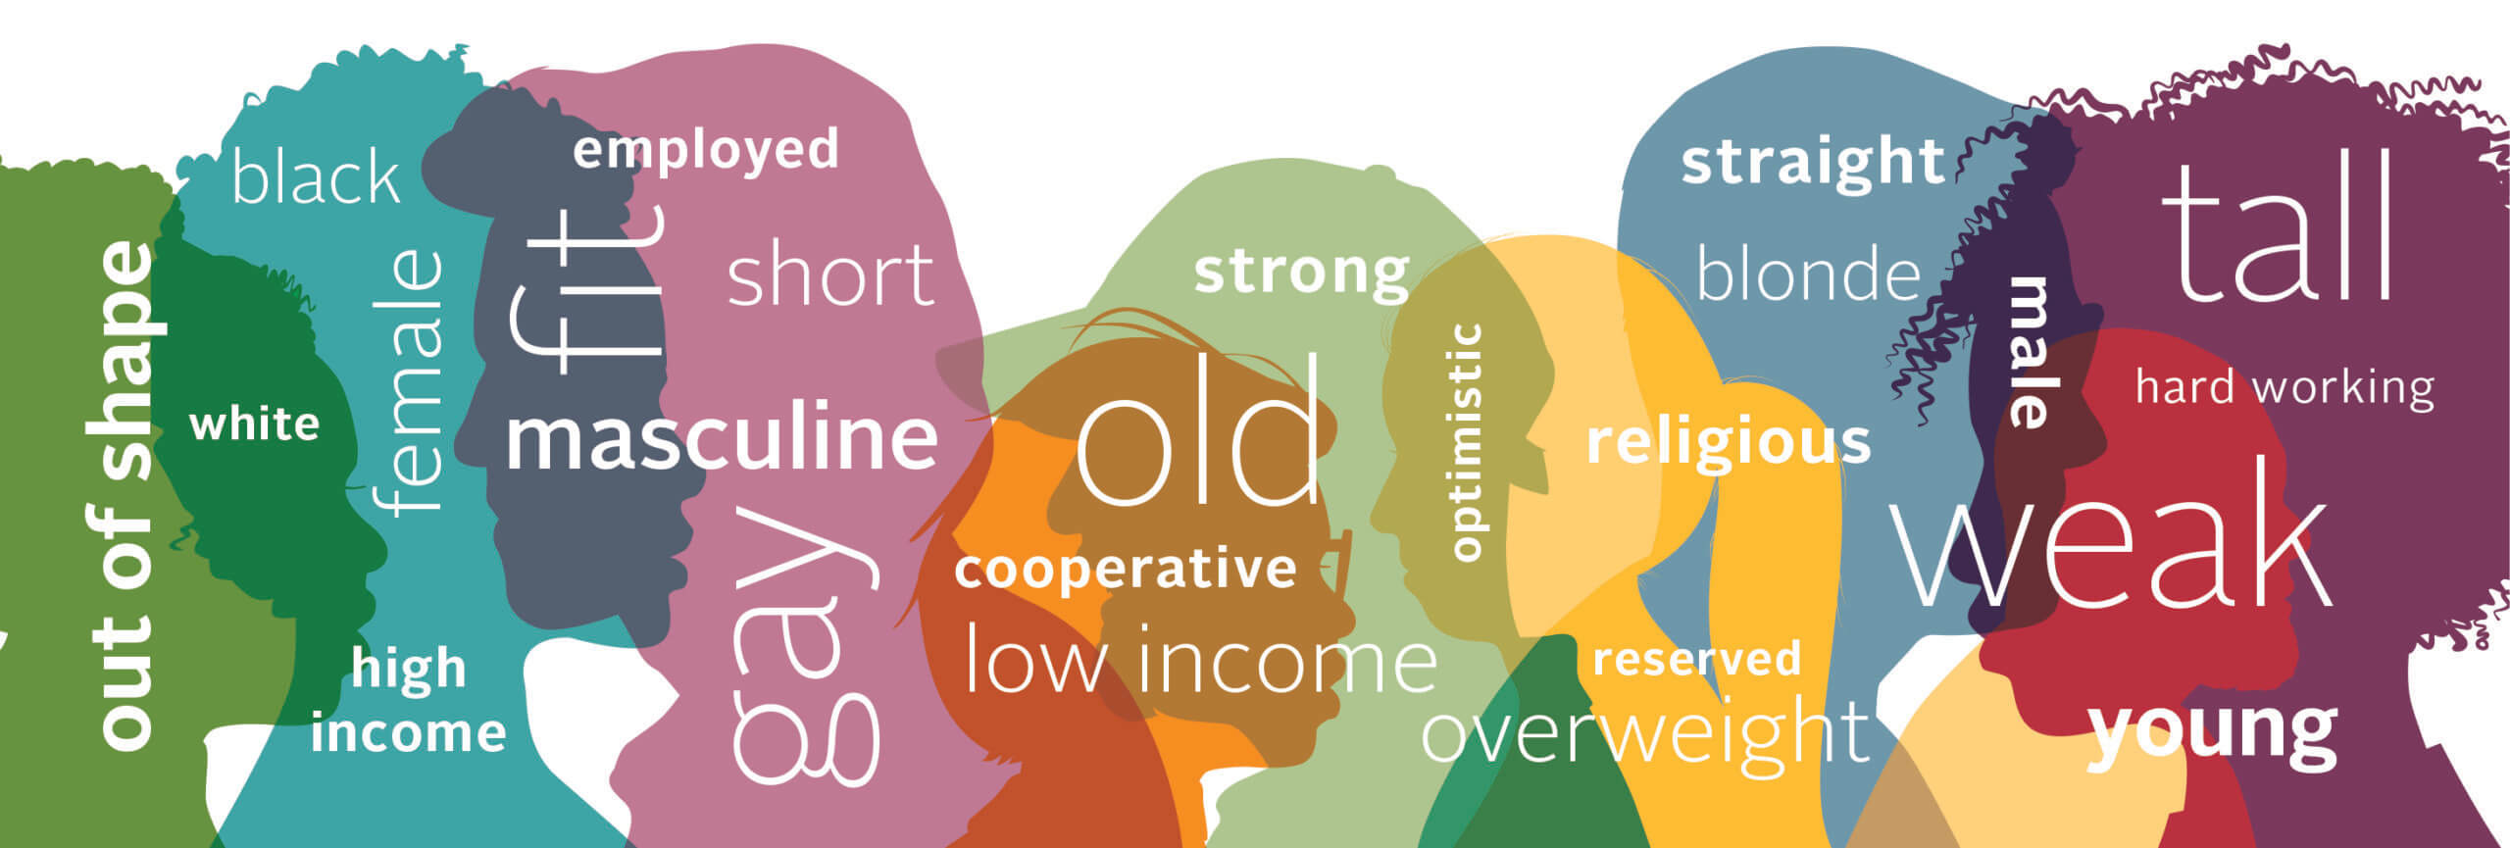
Four Biases in Healthcare
Racial bias
Gender bias
Sexual and Gender Minority bias
Disability bias

Slide 6
Racial Bias
Disparities between racial and ethnic minorities in healthcare as compared to the general population.
People of color face disparities in access to health care, the quality of care received, and health outcomes.
Negative implicit attitudes about people of color may contribute to racial/ethnic disparities in health and health care.

Slide 7
Racial Bias (cont.)
People of color also face disparities in terms of morbidity, mortality, and health status.
Most health care providers appear to have implicit bias in terms of positive attitudes toward Whites and negative attitudes toward people of color.
People of color are also generally less satisfied with their interactions with health care providers.

Slide 8
How to Mitigate Racial Bias
Identify and understand your own implicit biases. Be proactive in identifying the negative stereotypes you have about others.
Don't stereotype your patients; individuate them.
Recognize situations that magnify stereotyping and bias.
Be aware and pro active in being more inclusive.
Have a basic understanding of the cultures your patients come from.
Understand and respect the tremendous power of unconscious bias.
Increasing your contact with different groups can help undermine your subconscious stereotypes.

Slide 9
Gender Bias
Is the act of favoring men and women or vice versa.
Gender discrimination described the situation in which people are treated differently simply because they are male or female, rather than on the basis of their individual skills or capabilities.

Slide 10
Gender Bias Examples
Unequal pay or Gender pay gaps
In 2015, the American Association of University Women (AAUM) determined that women working full- time in the United States (across all professions) were paid 80% of what men were paid– a 20% wage gap.
In 2016, White House launched the Equal Pay Pledge, which encourages business to take action to advance equal pay.
Diminished responsibilities by gender
Women are given less responsibilities at times as gender-biased leader stereotypes as weaker or less performance. Gender discrimination related to women's struggles to gain access to career ladders and equal compensation within a male-dominated society has been documented.
Gender Biased interview questions
Questions like “Are you planning to have kids, or how many children do you plan to have” are seldom asked to a man.

Slide 11
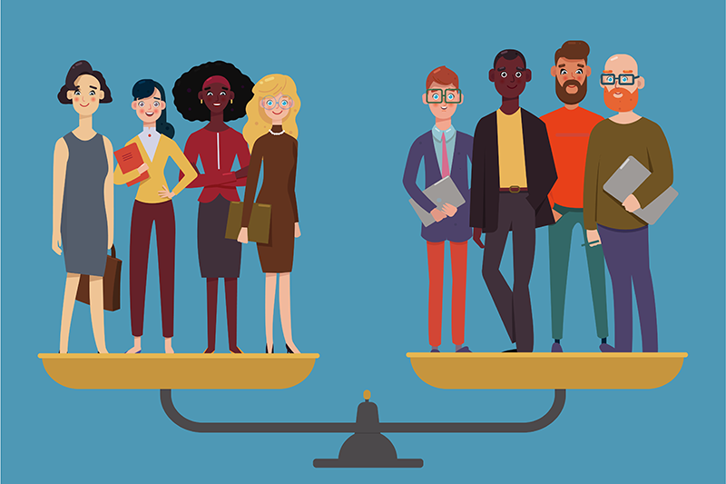
Causes of Gender Bias
Misinterpretation is one of the cause due to many industries simply don’t have equal gender representation.
Objectification, women are seen less as competent peers and more as pretty window dressing to be admired and sometimes even harassed.

Slide 12
How to Mitigate Gender Bias
Considering diversity as a performance metric for organizations
Further documentation of implicit associations and other potential psychological obstacles to women’s success will be important for determining the most effective interventions to reduce gender inequality.
Self-awareness by teaching your team how to recognize the bias by making the unconscious bias conscious.
Increasing transparency of hiring and promotion policies.
Support Ally (supporting equal rights for everyone – regardless of race, sexual orientation, gender or religion.

Slide 13
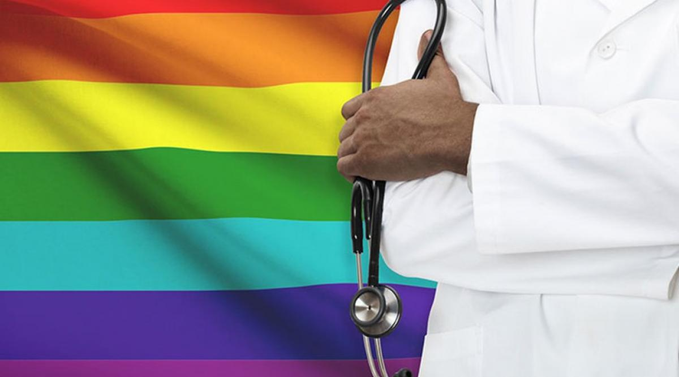
Sexual & Gender Minority Bias
Individuals who identify as a gender or sexual minority experience significant differences in their physical and mental health, as well as risk factors for disease and care obstacles.
Lesbian, gay, bisexual, transgender, queer, and other (LGBTQ+) people are more likely to experience adverse social determinants of health as a result of institutional and interpersonal prejudice, discrimination, and violence against them and their communities.
Awareness on the LGBTQ+ community and gender minority has increased for the most part as these individuals were learned to have unique health care needs.

Slide 14
Sexual & Gender Minority Bias (cont.)
Individual healthcare professionals and clinics have an ethical obligation to provide an atmosphere that is openly affirming and culturally competent.
Emergence of the epidemic AIDS had extensively heightened which demonstrates that sexual behavior could have a large impact and consequence to public health.
The American Psychiatric Association argued whether homosexual behavior was pathological and recommended that these individuals have special needs that is best dealt with a knowledgeable practitioner.
APA has concluded that homosexuality was never a mental illness but social norms and can absolutely affect access for appropriate care, which as a result, could compromise mental health (Kenneth H. Mayer, 2008).

Slide 15
How to Mitigate Sexual & Gender Minority Bias
Building Awareness
Noticing times when an assumption or prejudicial belief arises and asking colleagues to point out any observed errors.
Engaging in Practice Exercises and Mindfulness
Awareness paired with training in culturally affirming care and practicing communication strategies may be effective.
Addressing Structural Bias
Replacing negative stereotypes with positive attributes
Focusing on a person's individual characteristics rather than their group membership.
The goal is to help people recognize that they may be unconsciously making decisions based on stereotyped beliefs.
Acknowledge that healthcare inequities must also be addressed at neighborhood, institutional, and policy levels.

Slide 16
How to Mitigate Sexual & Gender Minority Bias (cont.)
Continuing Education and Research
Increasing Research on Implicit Bias
Participate in conferences, meetings, and online continuing medical education programs, such as those offered by the National LGBT Health Education Center (lgbthealtheducation.org), the World Professional Association for Transgender Health (wpath.org), and the Center of Excellence for Transgender Health (transhealth.ucsf.edu).
Conduct more research on the influence of clinician implicit bias on SGM health.
Training clinicians on SGM implicit bias through case scenarios and other curricular methods to improve clinical communication skills and the health outcomes.

Slide 17
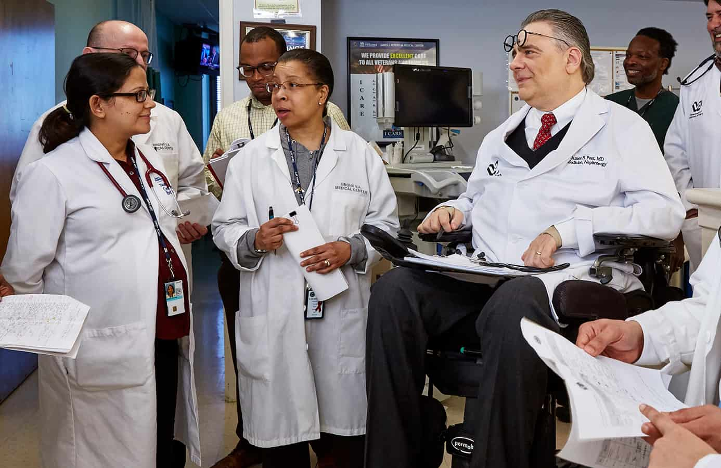
Disability Bias
Physicians with disabilities-constitute another minority group.
Degree of bias may vary depending on whether disability visible, invisible, racial and ethnic minorities.

Slide 18
Disability Bias (cont.)
Medical Schools must comply with the Americans With Disabilities Act.
Only a small group of school support the spectrum of accommodation for the disabled student.
Physicians with disabilities tend to work twice as hard as normal Physicians in order to gain acceptance.

Slide 19
How to Mitigate Disability Bias
Strategy to counter unconscious bias of disability include an intentional multidimensional approach, diversity, inclusion, and equity.
Accreditation council for graduate medical education (ACGME) requirement for fellowship programs such as make an effort to recruit and retain diversity in the workforce.
Make conscious awareness when encounter someone different from yourself.

Slide 20
Conclusion
Healthcare professionals have an obligation to provide culturally competent care to patients.
Organizations must identify deficiencies in competency through cultural assessments and provide steps to change the culture.
Providing healthcare professionals with tools and education relating to cultural competency.

Slide 21
Conclusion
Through understanding cultural competence, the healthcare professional will be able to truly demonstrate respect for patient regardless of race, gender identity, sexual orientation, and disability.
Be able to integrate the patient’s values, beliefs, and conditions into healthcare, and in turn, be able to appropriately assess and treat a patient’s unique needs.
Better prepared and better capable of caring for diverse population of patients.
Improved patient outcomes and patient satisfaction with care received.

Slide 22
References
https://en.m.wikipedia.org/wiki/Racial_bias_in_criminal_news_in_the_United_States
https://www.ncbi.nlm.nih.gov/pmc/articles/PMC4638275/
https://www.vanderbilt.edu/diversity/unconscious-bias/
Hall, W. J., Chapman, M. V., Lee, K. M., Merino, Y. M., Thomas, T. W., Payne, B. K., ... & Coyne-Beasley, T. (2015). Implicit racial/ethnic bias among health care professionals and its influence on health care outcomes: a systematic review. American journal of public health, 105(12), e60-e76.
FitzGerald, C., & Hurst, S. (2017). Implicit bias in healthcare professionals: a systematic review. BMC medical ethics, 18(1), 1-18.
Marcelin, J. R., Siraj, D. S., Victor, R., Kotadia, S., & Maldonado, Y. A. (2019). The impact of unconscious bias in healthcare: how to recognize and mitigate it. The Journal of infectious diseases, 220(Supplement_2), S62-S73.
Salles, A. MD, PhD; Awad, M. MD, PhD; Goldin, L. MA; et al. (July 2019). Estimating Implicit and Explicit Gender Bias Among Health Care Professionals and Surgeons. https://jamanetwork.com/journals/jamanetworkopen/fullarticle/2737309

Slide 23
References
Decapua, M. DNP
https://www.melissadecapua.com/even-nurse-practitioners-face-a-gender-pay-gap/
https://athenacommons.muw.edu/msn-projects/136/
https://diversity.social/gender-bias
EM, Burgess CM. Sexual and Gender Minority Health Care Disparities: Barriers to Care and Strategies to Bridge the Gap. Prim Care. 2021 Jun;48(2):179-189.doi:10.1016/j.pop.2021.02.007.Epub 2021 Apr 22. PMID: 33985698.https://pubmed.ncbi.nlm.nih.gov/33985698/
M. Gelman, A. Van Wagenen, J. Potter Principles for taking an LGBTQ-inclusive health history and conducting a culturally competent physical exam
H. Makadon, K. Mayer, J. Potter, H. Goldhammer (Eds.), The Fenway guide to lesbian, gay, bisexual, and transgender health (2nd ed), American College of Physicians, Philadelphia, PA (2015), pp. 159- 192https://www.sciencedirect.com/science/article/pii/S0033318220301523#bib39
Kenneth H. Mayer, M. J. (2008, June). Nationakl Library of Medicine. Retrieved from Sexual and Gender Minority Health: What We Know and What Needs to Be Done: https://www.ncbi.nlm.nih.gov/pmc/articles/PMC2377288/
Cultural Competency for the Healthcare Professional. www.fastceforless.com

