Slide 1
STARBUCKS CORPORATION ANALYSIS
Author(s)
Affiliation
Institution
Instructor

Slide 2
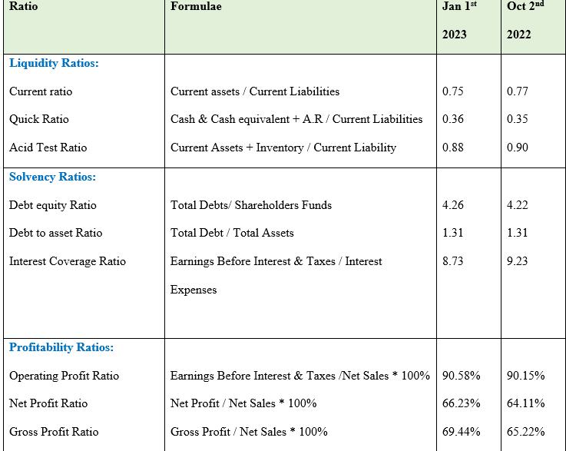
Starbucks Corporation Financial Health
The financial health of Starbucks can be evaluated using liquidity ratios and profitability ratios.
The current ratio of 0.75 suggests that the company has sufficient liquidity to meet its short-term obligations.
The quick ratio of 0.36 indicates that the company is not able to pay off its current liabilities using its most liquid assets.
The operating profit ratio of 90.58% indicates that the company is generating a high return on its sales, which is a sign of good operational efficiency.
The net profit ratio of 66.23% indicates that the company is able to generate profits even after accounting for all expenses.
Starbuck Ratio Analysis
Notes:
The liquidity ratios of Starbucks indicate a relatively weak financial health. The current ratio of 0.75 suggests that the company has more current liabilities than assets, and the quick ratio of 0.36 indicates that the company has very few assets to cover its current liabilities. This suggests that the company may be struggling to manage its short-term debt.
However, the profitability ratios of Starbucks suggest that it is doing well financially. The operating profit ratio of 90.58% and the net profit ratio of 66.23% show that the company is generating good returns on its operations and profits. This indicates that the company is making smart decisions and is able to generate strong returns on its investments.
Overall, Starbucks' financial health appears to be mixed. While its liquidity ratios are weak, its profitability ratios are strong. It is possible that the company is making up for its weak liquidity ratios with strong returns on its investments.

Slide 3
Performance Strengths and Weaknesses
Starbucks Strengths
Starbucks has a high operating profit ratio of 90.58% and a net profit ratio of 66.23%, indicating that the company is able to generate strong returns on its investments.
Starbucks is constantly innovating and introducing new products, such as their recent launch of the Starbucks Reserve brand. This has allowed the company to stay ahead of its competitors and keep customers interested in their products.
Weaknesses:
Starbucks has a weak liquidity ratio of 0.75, which suggests that the company has more current liabilities than assets. This could make it difficult for the company to manage its short-term debt.
Starbucks has been criticized for its high prices, which can make it difficult for the company to attract budget-conscious customers.
Notes:
Starbucks has a high operating profit ratio of 90.58% and a net profit ratio of 66.23%, indicating that the company is able to generate strong returns on its investments. Starbucks is constantly innovating and introducing new products, such as their recent launch of the Starbucks Reserve brand. This has allowed the company to stay ahead of its competitors and keep customers interested in their products. Starbucks has a weak liquidity ratio of 0.75, which suggests that the company has more current liabilities than assets. This could make it difficult for the company to manage its short-term debt. Starbucks has been criticized for its high prices, which can make it difficult for the company to attract budget-conscious customers.

Slide 4
Starbucks Profit Trend Analysis
Notes:
Based on the above sales, profit and expenses trend of Starbucks company, it is notable that the company is selling its products at a constant trend (100%). This may be due to good pricing of the goods. The expenses are decreasing spontaneously which means the company is cutting off some of its expenses that does not bring a positive impact on the profit. The profit is perfectly increasing over the years.

