Slide 1
Principles of Psychopharmacology
Name
Institution
Course
Instructor
Date

Slide 2

Drug addiction
Drug use substantially affects nearly all human body parts (McLellan, 2017).
The effects of various substances on the nervous system differ from one person to another.
Some effects occur on the initial day of usage
Notes:
Drug use substantially affects nearly all human body parts (McLellan, 2017). The effects of various substances on the nervous system differ from one person to another. The variations depend on body weight, medication dosage and potency, overall health, and the presence of other chemicals in the system. Many individuals begin taking drugs with the idea that they would not impact the body, yet drugs have long-lasting consequences on the tissues. Some effects occur on the initial day of usage, such as headaches and dizziness, which an individual may attribute to the fact that they are using the drug for the first time but which subsequently have a substantial influence on the body's organs.

Slide 3
Drug addiction and the central nervous system
The mind, vertebral column, and neurons make up the central nervous system.
The system transports messages from the brain to various organs and regulates all bodily functions.
Therefore, drug addiction affects the mind's chemical transmitters, such as dopamine, serotonin, norepinephrine, and Gamma-aminobutyric acid.
Therefore, an influence in any of these transmitters leads to abnormal body functioning.
Notes:
The mind, vertebral column, and neurons make up the central nervous system. The system transports messages from the brain to various organs and regulates all bodily functions. That makes the mind the body's command center. Thus, the brain is impacted by all substances, regardless of drug kind, dosage, or route of administration. The mind's chemical transmitters, such as dopamine, serotonin, norepinephrine, and Gamma-aminobutyric acid, are modified by drug addiction. Dopamine is a chemical transmitter that controls moods, emotions, and energy (Ranjbar-Slamloo & Fazlali, 2020). Large doses of dopamine impair a person's decision-making abilities and cause obsessive behavior. Therefore, an influence in any of these transmitters leads to abnormal body functioning.

Slide 4

Drug addiction and the central nervous system
Opiates, heroin, narcotics, and marijuana affect the brain's dopamine concentration.
Opioids impede the creation of norepinephrine.
Also, opioids activate some sections of the neurological system, resulting in nausea, drowsiness, or disorientation.
Cocaine affects dopamine lecells, resulting in memory damage and emotional issues, and increases the likelihood of developing a nerve disorder.
Notes:
Opiates, heroin, narcotics, and marijuana affect the brain's dopamine concentration. Opioids impede the creation of norepinephrine, which results in drowsiness, slows the heartbeat, blocks pain sensations, and lowers body temperature, among other effects. The mind may ultimately cease functioning if the substance is withdrawn. Also, opioids activate some sections of the neurological system, resulting in nausea, drowsiness, or disorientation. They also slow a person's breathing rates, which can result in coma or death. Lastly, opiates lower the state of consciousness and impair cognitive functioning. Heroin dependency also affects the brain, which aﬀects a person's response to anxiety, decision-making capacity, and emotional regulation. Cocaine affects dopamine lecells, resulting in memory damage and emotional issues, and increases the likelihood of developing a nerve disorder.

Slide 5
Drug addiction and the central nervous system
As the brain is the core of all bodily functions, the effects of dependency on the brain extend to the rest of the body.
Cocaine dependency raises blood pressure and pulse rate and alters the heart's electrical impulses, increasing the likelihood of a person having a heart attack (Greenwald et al., 2021).
Hallucinogens impact serotonin and the brain's frontal lobe, resulting in severe effects.
Notes:
As the brain is the core of all bodily functions, the effects of dependency on the brain extend to the rest of the body. Substance abuse substantially affects the heart since it often results in cardiac arrest. Cocaine dependency raises blood pressure and pulse rate and alters the heart's electrical impulses, increasing the likelihood of a person having a heart attack (Greenwald et al., 2021). The glutamate chemical is responsible for thinking, emotions, memory, and sensory abilities. Like other psychoactive substances, hallucinogens impact serotonin and the brain's frontal lobe, resulting in severe effects. That leads to the inability to move, unconsciousness, bodily spasms, memory problems, and anxiety. It can also affect moods and other physical systems, such as breathing.

Slide 6
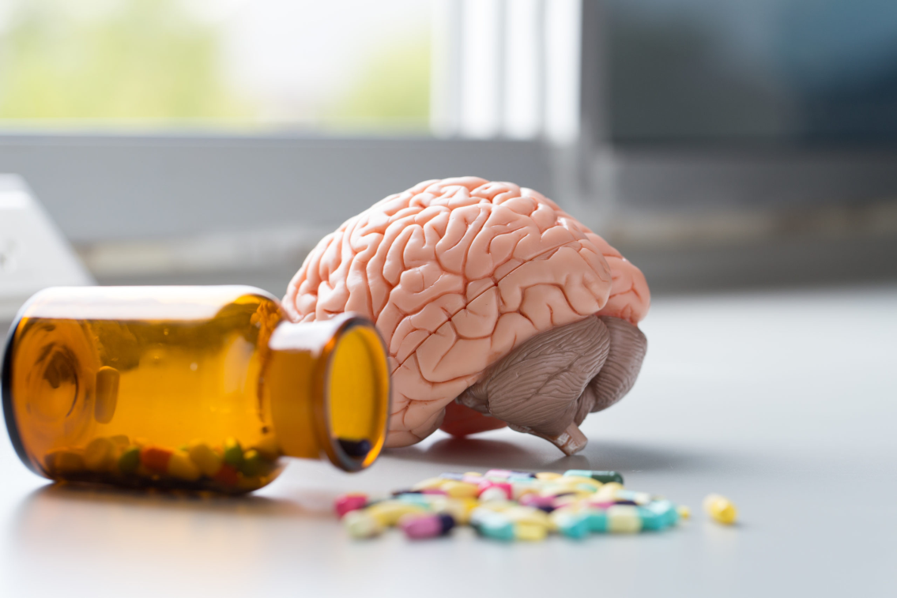
Drug addiction and the central nervous system
Drugs interfere with the transfer, reception, and translation of neuronal signals through neurotransmitters.
Amphetamine and cocaine, may cause nerves to emit unusually high levels of endogenous neurotransmitters
They may also hinder the regular regeneration of these neurochemicals by messing with receptors.
That also enhances or disturbs standard neuronal transmission.
Notes:
Essentially, drugs interfere with the transfer, reception, and translation of neuronal signals through neurotransmitters. Since their chemical elements look like typical neurotransmitters, some substances, such as cannabis and heroin, can influence neurons. That allows the drugs to enter the synapses and stimulate them. These substances elements look like the brain's biological chemicals, but they cannot influence neurons like a typical neurotransmitter, causing the system to relay aberrant information. Other substances, such as amphetamine and cocaine, may cause nerves to emit unusually high levels of endogenous neurotransmitters or hinder the regular regeneration of these neurochemicals by messing with receptors. That also enhances or disturbs standard neuronal transmission.

Slide 7
The process of Neurotransmission
is the act of signal transmission within the body (Sheffler et al., 2022).
For neurons to transmit signals, they must be able to interact with one another despite being ordinarily unconnected.
Synapse is a little point at the tip of every neuron, and in order to communicate with the subsequent cell, the signal must be able to traverse this short area.
That happens via the neurotransmission process.
Notes:
Neurotransmission is the act of signal transmission within the body (Sheffler et al., 2022). For neurons to transmit signals, they must be able to interact with one another despite being ordinarily unconnected. The transmitter response might be either stimulating or inhibiting. Excitation is the rise in the level of stimuli, while inhibition is its reduction. The impact is dependent on the type of synaptic receptors. Synapse is a little point at the tip of every neuron, and in order to communicate with the subsequent cell, the signal must be able to traverse this short area. That happens via the neurotransmission process. The axon terminal releases a chemical transmitter at a position where the neurons may connect.

Slide 8
The process of Neurotransmission
The process has a step that includes:
Step 1. The neuron produces the neurotransmitter, which is then contained in capsules at the axon tip.
Step 2. The neurotransmitter chemicals are released from the capsules into the synaptic cleft when the action pulse hits the axon end.
Step 3. The neurotransmitter propagates through the aperture and attaches to post-synaptic cell modules.
Step 4. The stimulated receptors make changes in the reaction of the post-synaptic neuron.
Step 5. The neurotransmitter chemicals flow back into the neural cleft after being freed from the receptors.
Step 6. The post-synaptic synapse reabsorbs the neurotransmitter. The procedure is referred to as Reuptake.
Notes:
The process has a step that includes:
Step 1. The neuron produces the neurotransmitter, which is then contained in capsules at the axon tip.
Step 2. The neurotransmitter chemicals are released from the capsules into the synaptic cleft when the action pulse hits the axon end.
Step 3. The neurotransmitter propagates through the aperture and attaches to post-synaptic cell modules.
Step 4. The stimulated receptors make changes in the reaction of the post-synaptic neuron.
Step 5. The neurotransmitter chemicals flow back into the neural cleft after being freed from the receptors.
Step 6. The post-synaptic synapse reabsorbs the neurotransmitter. The procedure is referred to as Reuptake.

Slide 9
References
Greenwald, M. K., Lundahl, L. H., Shkokani, L. A., Syed, S., Roxas, R. S., & Levy, P. D. (2021). Effects of cocaine and/or heroin use on resting cardiovascular function. International Journal of Cardiology Cardiovascular Risk and Prevention, 11, 200123. https://www.sciencedirect.com/science/article/pii/S2772487521000258
McLellan, A. T. (2017). Substance misuse and substance use disorders: why do they matter in healthcare?. Transactions of the American Clinical and Climatological Association, 128, 112. https://www.ncbi.nlm.nih.gov/pmc/articles/PMC5525418/
Ranjbar-Slamloo, Y., & Fazlali, Z. (2020). Dopamine and noradrenaline in the brain; overlapping or dissociate functions?. Frontiers in molecular neuroscience, 12, 334. https://www.frontiersin.org/articles/10.3389/fnmol.2019.00334/full
Sheffler, Z. M., Reddy, V., & Pillarisetty, L. S. (2022). Physiology, neurotransmitters. In StatPearls [Internet]. StatPearls Publishing. https://www.ncbi.nlm.nih.gov/books/NBK539894/

