Slide 1
MARRIOTT HOTEL: A NEED FOR INDUSTRY CHANGE DESCRIPTION
MARRIOTT HOTEL
Author(s)
Affiliation
Institution
Instructor
Date

Slide 2
Outline For the Hotel Employees In Service Program
Employers In Service Program Outline: A Need For Industry Change
Audience: All the Hotel Employees Being Groomed For Future Sustainability of the Hotel Lodging Industry Purpose of the Program: The Future of Sustainability in the Lodging Industry
Objective | Key Topics | Techniques | Timing | Description and Outcome
Needs for Industry Change | Issues Associated with Global Warming | Discussion and use of Power Point Slide | 25 Minutes | Rising global temperatures are causing a number of problems for the hotel industry, including increased energy costs, increased water consumption and increased air pollution.
Future Sustainability of Hotel Lodging Industry | Rising of Sea Levels | Discussion and Oral Presentation | 35 Minutes | As sea levels rise, coastal areas and beaches become increasingly susceptible to flooding and storm surge, making the industry less desirable locations for tourist destinations.
Total | 2 Major Topics Discussed | 3 Techniques Used | 60 Minutes Spent | Both global warming and rising in sea level should be controlled for industry sustainability
Notes:
Rising sea levels can have a significant negative impact on the lodging industry. As sea levels rise, coastal areas and beaches become increasingly susceptible to flooding and storm surge, making them less desirable locations for tourist destinations. This can result in decreased demand for lodging in coastal areas, leading to decreased revenue for the lodging industry.

Slide 3
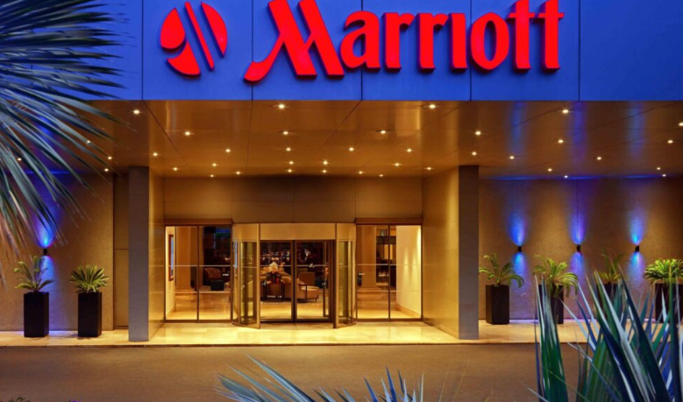
Marriott Hotel
Description of Marriott Hotel and What It Does
Temperature checks: Marriott Hotel is requiring temperature checks for all guests upon arrival.
Increased cleaning protocols: Marriott Hotel is increasing the frequency and intensity of their cleaning protocols throughout the hotel, including all high-touch surfaces.
Social distancing measures: Marriott Hotel is enforcing social distancing protocols in all areas of the hotel, including common areas and individual guest rooms.
Mask requirements: Marriott Hotel is requiring all staff and guests to wear masks in all public areas.
Contactless check-in: Marriott Hotel is offering contactless check-in options for guests.
Contactless payment: Marriott Hotel is offering contactless payment options to reduce physical contact.
Mobile app: Marriott Hotel is offering a mobile app to enable guests to access hotel services without needing to physically interact with staff (Lai & Wong, 2020).
Notes:
Marriott Hotels has implemented several measures to mitigate the risks of COVID-19, including:
Enhanced Cleaning and Sanitization: Marriott has implemented a program called “Commitment to Clean,” which features a deep clean and sanitization of all hotel surfaces and guest rooms using hospital-grade disinfectants.
Contactless Check-In and Mobile Key: Marriott has implemented a contactless check-in experience that allows guests to use their own mobile device to open their hotel room doors.
Social Distancing: Marriott has implemented social distancing measures in all public areas to ensure there is enough space between guests. Additionally, they have limited the number of guests in the restaurant and lobby to ensure social distancing.
Face Masks: Marriott has implemented a policy requiring the use of face masks throughout the hotel, including the lobby, restaurants, and public spaces.
Contactless Dining: Marriott has implemented contactless dining options to limit contact between staff and guests. They have also implemented contactless menus, including QR codes that allow guests to view digital menus on their own device.

Slide 4
Impacts of Laws/Bills on the Short-term Future of the Hotel Industry
The Families First Coronavirus Response Act: This bill was passed in March 2020 in response to the COVID-19 pandemic. It provides free coronavirus testing and expands paid leave, unemployment benefits, and food assistance for those impacted by the crisis. The bill also includes provisions for small businesses, such as tax credits for providing paid leave and incentives for maintaining healthcare coverage (Lai & Wong, 2020). For Marriott Hotels and the entire hotel industry, this bill will help them to remain operational during the pandemic and provide them with additional financial relief.
The American Rescue Plan Act: This bill was signed into law in March 2021 and provides financial relief to businesses, households, and states in response to the economic fallout of the COVID-19 pandemic (Lai & Wong, 2020). The act includes a $28.6 billion relief fund specifically for the hotel industry, which will provide Marriott Hotels with much needed financial support to help them stay afloat during this difficult time. This bill also expands unemployment benefits and provides additional funding for small businesses, which will help Marriott Hotels to keep their employees employed.
Notes:
Both Families First Coronavirus Response Act and The American Rescue Plan Act relief bills will have a significant impact on the short-term future of the hotel industry, particularly Marriott Hotels (Lai & Wong, 2020). The direct payments and unemployment benefits provided by the Families First Coronavirus Response Act and the American Rescue Plan Act will help boost consumer spending, which will likely lead to an increase in leisure and business travel. Additionally, the additional funding for small businesses and rent and mortgage relief will help Marriott Hotels stay afloat and continue to provide jobs to their employees.

Slide 5
Impact of Technology In Hospitality Industry
I believe artificial intelligence (AI) will have the most impact on the hospitality industry over the next 5 years.
AI has the potential to revolutionize the hospitality industry by automating mundane tasks, improving customer service, and personalizing experiences for guests.
AI can be used to automate mundane tasks such as managing reservations, check-ins, and checkout processes. It can also analyze customer data to provide personalized experiences for guests (Kaushal & Srivastava, 2021).
AI can be used to create smarter chat-bots that can provide personalized customer service and answer customer inquiries. AI can also be used to generate insights from customer data to help hotels better understand their guests and optimize operations.
AI will also help hotels better predict customer demand and optimize pricing accordingly. AI can also be used to automate marketing campaigns and provide guests with more personalized offers. All of these features will help hotels better serve their guests and improve their overall experience for the next 5 years.
Notes:
AI is projected to have an enormous impact on the hospitality industry in the next 5 years. AI can be used to automate mundane tasks, improve customer service, and provide valuable insights into customer behavior. AI can also be used to improve operational efficiency, optimize staff allocation, and improve the overall customer experience. AI-powered virtual assistants can help customers book rooms, answer queries, and provide personalized recommendations. Chatbots can provide immediate customer service, and AI-driven analytics can identify customer trends and preferences. AI can also be used to optimize marketing campaigns and improve customer engagement. Finally, AI can be used to automate tasks in the back office, such as accounts receivable and accounts payable, eliminating manual processes and increasing efficiency (Kaushal & Srivastava, 2021).

Slide 6
Terrorist Attack Imminent (US Hospitality Industry)
No, I do not believe that a major terrorist attack is imminent in the US hospitality industry within the next 5 years.
The US government has taken numerous measures in recent years to strengthen security in the hospitality industry, such as increased security screenings at airports and hotels, upgraded surveillance technologies, and improved risk management protocols (Kaushal & Srivastava, 2021).
Additionally, the hospitality industry has implemented its own measures to help protect its guests, including enhanced screening of employees, increased security training for staff, and the use of biometric technology.
These measures have significantly reduced the likelihood of a major terrorist attack occurring in the US hospitality industry within the next 5 years.
Notes:
There is no evidence to suggest that a major terrorist attack is imminent in the US hospitality industry within the next five years. The US Department of Homeland Security and other federal law enforcement agencies work diligently to protect the US from potential terrorist threats. Additionally, there has been a decrease in the number of terrorist attacks globally since 2015, suggesting that the threat of terrorism has decreased (Kaushal & Srivastava, 2021). Finally, the US hospitality industry has implemented security measures, such as increased surveillance, employee training, and improved communication between agencies, to help prevent potential attacks. All of these factors suggest that a major terrorist attack is unlikely in the US hospitality industry within the next five years.

Slide 7
Causes of Environmentalism on Lessoned
Lack of Media Attention: Environmental issues have been pushed out of the news cycle by a variety of other issues, including politics and other global issues (Davahli et al., 2020). As a result, there is less public awareness and understanding of the environmental crisis.
Lack of Government Support: Many governments around the world have been slow to address environmental issues, either out of fear of economic repercussions or simply a lack of political will. Without the support of governments, it is difficult for the environmental movement to gain momentum.

Slide 8
Factors Leading to Hospitality Industry Recovery from COVID 19 Ratios
My opinion is that the hospitality industry will have a full recovery within the next three years.
Two specific factors that will contribute to this recovery are increased consumer confidence and increased government support (Davahli et al., 2020).
Increased consumer confidence can be achieved through effective communication regarding safety protocols and hygiene standards to reassure customers that it is safe to return to hotels and restaurants.
Meanwhile, increased government support, such as financial aid, can help hospitality businesses stay afloat during the recovery process.
Notes:
Increased consumer confidence and increased government support will be essential for the hospitality industry to recover from the pre-COVID-19 ratios. Increased consumer confidence will result in more customers returning to the hospitality industry, which will lead to more revenue. Increased government support will help the hospitality industry to cover expenses, such as employee wages, rent, and utilities, while they wait for customer demand to return. Furthermore, the government can provide incentives to encourage people to return to the hospitality industry, such as by allowing for tax credits for those who dine out or providing subsidies for businesses to keep their doors open (Davahli et al., 2020). Finally, the government can also provide additional funding for marketing and advertising campaigns to promote the hospitality industry, which will make customers aware of the industry and help to build confidence in its services. All of these measures will help the hospitality industry to return to pre-COVID-19 ratios.

Slide 9
Reference Lists
Davahli, M. R., Karwowski, W., Sonmez, S., & Apostolopoulos, Y. (2020). The hospitality industry in the face of the COVID-19 pandemic: Current topics and research methods. International Journal of Environmental Research and Public Health, 17(20), 7366.
Kaushal, V., & Srivastava, S. (2021). Hospitality and tourism industry amid COVID-19 pandemic: Perspectives on challenges and learnings from India. International journal of hospitality management, 92, 102707.
Lai, I. K. W., & Wong, J. W. C. (2020). Comparing crisis management practices in the hotel industry between initial and pandemic stages of COVID-19. International Journal of Contemporary Hospitality Management.

