Slide 1
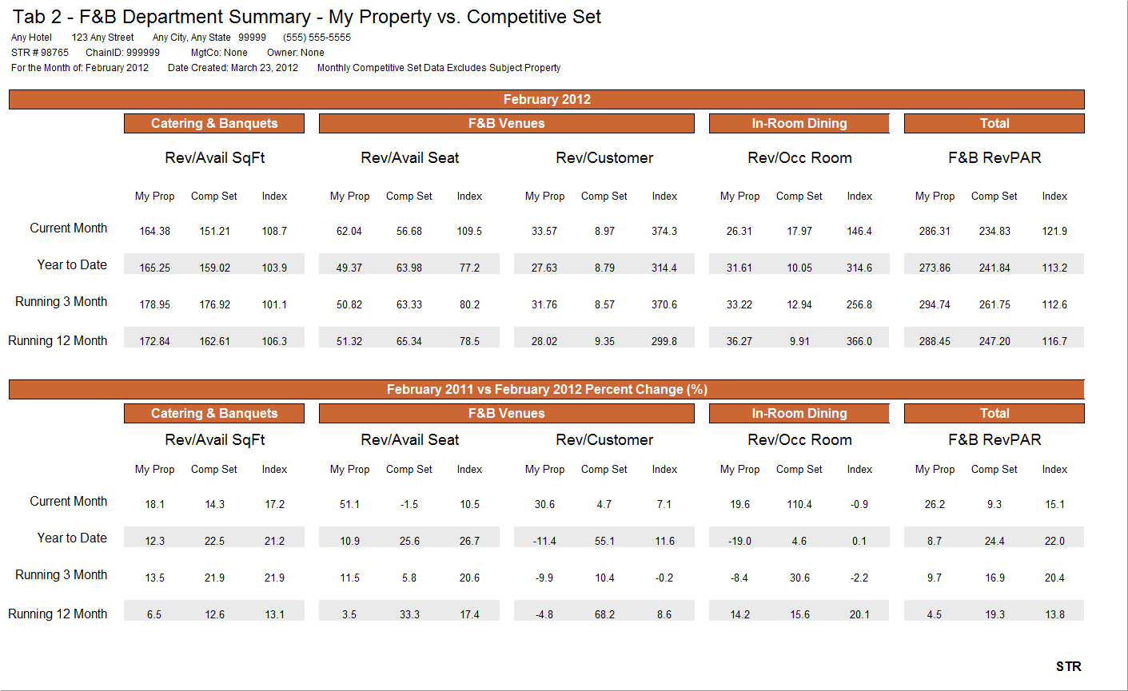
F&B STAR Report - Department Summary

Slide 2
Application Activity Module 7
Study slide 1 in the power point from Mod 7.
Write a Food & Beverage (F&B) analysis based on the data. This report should cover all components of the various divisions of F & B.
Minimum word count is 650 words.

