Slide 1
Name
Institution
Course
Instructor
Date

Slide 2
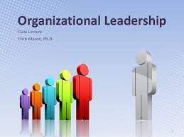
Organizational leadership
For companies to function effectively, they need competent leadership.
As we all know, leadership is a characteristic that is both innate and can be developed.
Organizational leadership requires an understanding of both human dynamics and expert methods.
Thus, organizational leadership entails a larger range of responsibilities than conventional management (Moe, 2021).
Notes:
For companies to function effectively, they need competent leadership. As we all know, leadership is a characteristic that is both innate and can be developed. Organizational leadership requires an understanding of both human dynamics and expert methods. Organizational leadership focuses on developing transferable leadership skills and competencies across companies. It refers to an individual's capacity to overcome adversity in the business and continue to thrive. Thus, organizational leadership entails a larger range of responsibilities than conventional management (Moe, 2021). Organizational leadership conveys the purpose and ambition of the firm, sets the comprehensive plan, and motivates employees to contribute their abilities to achieve the comprehensive plan's and, eventually, the leader's vision-aligned objectives.

Slide 3
Continuation…..
Organizational leadership demands qualified and focused executives who can move the organization forward.
In general, a good institutional leader has various desirable characteristics and exhibits a high level of business acumen.
Numerous natural leaders are likely to retain these qualities and attributes with little effort.
Notes:
Organizational leadership demands qualified and focused executives who can move the organization forward. In general, a good institutional leader has various desirable characteristics and exhibits a high level of business acumen. Numerous natural leaders are likely to retain these qualities and attributes with little effort. Among these characteristics is goal orientation. A great leader should be ready to quantify and assess what victory implies for the company at all stages, which implies that success must be measurable against specific objectives. Another trait is persuasive communication (Global, 2020). Finally, corporate leaders must possess sufficient relational skills. A large part of a professional's task in a leadership post is developing and maintaining strong working connections, motivating staff, and participating in outside and internal disputes.

Slide 4
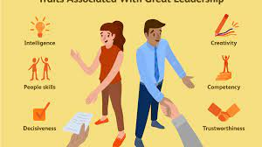
organization leadership characteristics and traits
Similarly, these organizational leaders exhibit empathy for employees, a commitment to good ethics, and an ability to recognize greatness.
Any attitude conducive to leadership involves empathy.
That implies that you gain a grasp of your worldview and the worldviews of others.
Notes:
Similarly, these organizational leaders exhibit empathy for employees, a commitment to good ethics, and an ability to recognize greatness. Any attitude conducive to leadership involves empathy. That implies that you gain a grasp of your worldview and the worldviews of others. You examine others' circumstances through the prism of their circumstances to determine their capabilities and comprehend their viewpoint. Moreover, organizational leaders capitalize on the assets of their subordinates. Strength is derived through aptitude, knowledge, and abilities. Strengthening a particular area requires an innate interest in that field and the capacity to practice or study consistently. Finally, ethics is perhaps one of the most critical characteristics of a leadership attitude. A leader of an organization must constantly strike a balance between success and result and honesty and loyalty.

Slide 5
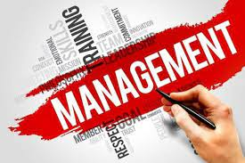
management
Management is the process of coordinating and administering tasks to accomplish a goal.
These administrative responsibilities include formulating the institution's strategy and organizing staff operations to achieve these goals via the effective use of existing resources.
Notes:
Management is the process of coordinating and administering tasks to accomplish a goal. These administrative responsibilities include formulating the institution's strategy and organizing staff operations to achieve these goals via the effective use of existing resources. Management may also apply to the organizational hierarchy of staff personnel.

Slide 6
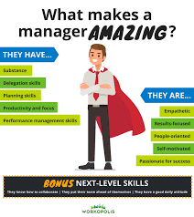
Management characteristics and traits
Managers who run businesses and organizations often exhibit various features and attributes.
Management is characterized by several traits, one of which is goal-oriented. Management's primary mission is to accomplish corporate and social goals (Venkatesh, 2015).
In general, possessing positive characteristics results in inefficient management and increases worker trust and competency.
Notes:
Managers who run businesses and organizations often exhibit various features and attributes. Management is characterized by several traits, one of which is goal-oriented. Management's primary mission is to accomplish corporate and social goals (Venkatesh, 2015). It exists to accomplish certain aims or purposes. In management, group activities are always aimed at achieving some predefined objective. The second distinguishing feature is that administration is general. Management is a skill that any organization can use. Whenever human activities occur, management occurs. The fundamental management concepts are universally applicable and may be used in any commercial, social, or spiritual enterprise.
On the other side, other ideas provide varying and often contradictory explanations. From administration approaches to personality characteristics, there are and usually will be a variety of methods to characterize what it means to be a successful manager. Effective managers demonstrate various characteristics, including problem-solving and rational reasoning, project administration and assignment, and resolving conflict. In general, possessing positive characteristics results in inefficient management and increases worker trust and competency.

Slide 7
Summary of differences
Among the primary distinctions is that organizational leadership focuses on developing leadership qualities and capabilities applicable across businesses.
At the same time, management is concerned with coordinating and executing activities necessary to accomplish a goal.
The other distinction is that management entails the capacity to direct a group or a collection of units toward a common objective.
At the same time, leadership relates to a person's capacity to persuade, encourage, and empower others to engage in corporate achievement.
Notes:
Leadership and administration perform distinct but necessary responsibilities within an institution since management cannot exist without leadership. Indeed, a professional and successful manager must exhibit leadership abilities to manage and motivate subordinates effectively. Among the primary distinctions is that organizational leadership focuses on developing leadership qualities and capabilities applicable across businesses. At the same time, management is concerned with coordinating and executing activities necessary to accomplish a goal. The other distinction is that management entails the capacity to direct a group or a collection of units toward a common objective. At the same time, leadership relates to a person's capacity to persuade, encourage, and empower others to engage in corporate achievement.

Slide 8
Global, C. (2020). Three traits of an effective organizational leader. The Official Blog of CSU Global. https://csuglobal.edu/blog/three-traits-of-an-effective-organizational-leader
Moe, K. (2021). What Is organizational leadership and why is it important? Betterup. https://www.betterup.com/blog/what-is-organizational-leadership-and-why-is-it-important
Venkatesh, V. (2015). Top 10 characteristics of management. Your Article Library. https://www.yourarticlelibrary.com/management/top-10-characteristics-of-management/53124

