Slide 1
Walmart Inc. Financial Information & Key Performance Indicators
Joseph Ruiz
University of Phoenix
FIN/571: Corporate Finance
Kent Moser
1/10/2022

Slide 2
Company Background
Selected Fortune 500 company Walmart Inc.
Walmart is World’s largest retailer
Headquartered in Bentonville, Arkansas
Walmart operates over 11,7000 stores and ecommerce sites in almost 28 countries
Serves 270 million customers in over 11,7000
Notes:
To complete this project, I selected Walmart Inc., a Fortune 500 company dealing with a wide range of retail consumer products and has an extensive inventory portfolio.
Walmart Inc. is an American company with multinational operations, with a main office based in Bentonville, Arkansas.
Walmart is at the forefront of helping its customers worldwide to save money through its network of discount department stores, hypermarkets, and grocery stores, while living better life anywhere and at any time through its retail and e-commerce stores.
Through its Omni-channel, Walmart offers shoppers the opportunity to save enormous time acquiring desired retail items throughout its 11,7000 stores and eCommerce sites in almost 28 countries, serving 270 million customers.

Slide 3
Background Information Cont’…nd
Walmart Inc.
Combines differentiation and Cost-leadership strategies
Segments: Walmart U.S, Sam’s Club, and Walmart international
Combines best price/value
Offer broad product line at low cost
Offer a wide selection of products at low prices
Notes:
Walmart Inc is engaged in wholesale, retail, other unit operations, and online eCommerce, combining differentiation and cost-leadership strategies in its operations in the U.S, Argentina, Africa, Brazil, China, Chile, Japan, India, UK, Central America, and Mexico.
Walmart Inc has three main segments, Walmart U.S, Sam’s Club, and Walmart international, selling similar products and services in all its segments.
Walmart combines the best price/value in all its segments offering a wide selection of low-priced products.

Slide 4
Background Information Cont’…nd
The largest Segment is Walmart U.S which
Generate 64% net sales annually
Leads in overall revenue
Tops fortune 500 charts
Notes:
The company’s largest segment is the Walmart U.S., which operates in all American states, Puerto Rico and Washington D.C. The Walmart U.S. segments generate over 64% net sales annually, contributing the highest net sales and operating income.
Walmart U.S. Segments puts the company at the top of the Fortune 500 charts leading to its direct and main competitors: Amazon, Home Depot, Costco, The Kroger Company, and Lowe’s.

Slide 5
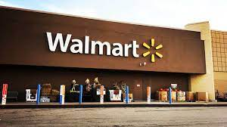
Company Name & Ticker symbol
Walmart Inc
WMT in NYSE.
Notes:
The company name is Walmart Inc., and its ticker symbol on the NYSE stock exchange is WMT.

Slide 6
Walmart Inc. Cash flow
Uncertain management for the past five years
Variable product demands experiences
Declining cash flow due to massive competition and sales slowdown
Cash flow grew in the last two years after the Covid-19 pandemic
Walmart’s U.S. sales increased due to the Covid-19 pandemic-driven consumer stockpiling and online shopping
Notes:
Walmart management has been uncertain management for the past five years due to unstable product demand, particularly variable product demands experiences.
There was declining cash flow due to massive competition and sales slowdown before the Covid-19 pandemic, but the cash flow grew in the last two years after the Covid-19 pandemic.
Walmart’s U.S. sales in 2020 increased due to the pandemic-driven consumer stockpiling and online shopping, particularly during a widespread lockdown.

Slide 7
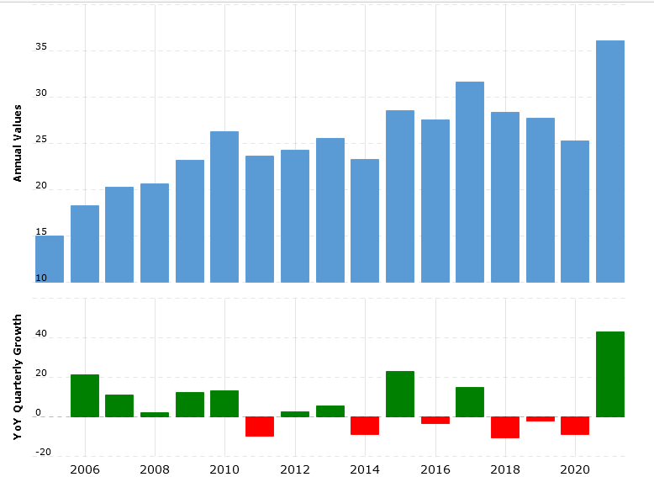

Slide 8
Price-to-earnings ratio
Notes:
Walmart’s latest performance of price earning ratio between 2017 – 2021 is averaged at 27.7x. However, in 2020 it is was 39.7x due to a jump in the Covid-19 pandemic online shopping and stockpiling.
In the fiscal years between 2017 – 2021, the median price-to-earnings ratio can be averaged at 22.5x, with a peak of 54.0x in the past five years on Jan 2019 (FinBox, 2021).

Slide 9
Walmart Stock dividends and the yield
Notes:
Looking at Walmart’s dividends and yield, the payout ratio is 76.92%, and the yield is low at 1.52%. Its annual dividend stands at $2.2, and the yield is 1.62% on Jan 2021 (YCharts, 2021).
Walmart’s stock price is currently $144.89 per share; thus, the shareholder earning per share is approximately $3.5.

Slide 10
Walmart Inc. Revenue Estimates
Next 12 Months
Constant and with gradual increase
More sales in post pandemic
Notes:
For the next 12 months, the revenue estimates for Walmart are expected to slightly slowdown due to reduced momentum on online shopping post pandemic.
The economic conditions are improving as the pandemic fades away, with things returning to new normal. Therefore, with the Covid-19 policies normalizing, things might slow down in online shopping momentum for the next 12 months, Walmart will see reduced sales on wholesale and retail outlets projected to be $419,883(m) in 2022.

Slide 11
Walmart Inc. Revenue Estimates
Past 3 years
A steady increase as projected
Spike in current year revenue caused by excessive sales of the necessary goods
Notes:
In the past three years, revenue has been increasing tremendously, with a steady increase as per the projections, with annual revenue rising from $485 M in 2017 to $ 514 in 2019 (Nasdaq, 2021). The rise has been linked to a rush sale during the Covid-19 pandemic-driven stock-piling and online shopping.

Slide 12
Statement of Cash Flows
Notes:
Walmart’s cash flow net income-expenditure shows steady growth from 6.16 billion in 2019 to 13.71 billion last year, with a peak growth of 146.73% in 2020 (Market Watch, 2021). The peak growth in 2020 is linked to the increased online shopping and stockpiling witnessed during the Covid-19 pandemic.

Slide 13
Average trade volume
Current Stock Price
Walmart Trade Volume is hourly 248.68K
Stock Price Forecast
Median target 170.00,
High estimate of 196.00
Notes:
Currently, Walmart stock is trading at $143.96 with hourly trading volume of 248.68K and a change of -2.54% (Market Watch, 2021).
For the 12-month price, stock Price Forecast shows that Walmart has a median 170.00, with 196.00 as the high estimate.

Slide 14
Analysts’ recommendations
The company has a mammoth revenue and post the Covid-19 pandemic life is normalizing.
I recommend a hold on bullish; due to adaption of eCommerce. We will see a spike in sales on online shopping in the future.
After major holidays Christmas, and New Year Walmart will register significant growth in 2022 fiscal year.
The company is expected to see a growth of 9.5% to $6 a share
Notes:
Walmart has mammoth revenue and as people get back to new normal after Covid-19 pandemic. I recommend Buy; due to back-to-school season and child credit.
We will see a spike in sales. Likewise, we are approaching major holidays Christmas, and New Year; the company will register significant growth in this fiscal year. In 2022, analysts expect to see Walmart grow 9.5% to $6 a share (Larkin, 2021).

Slide 15
Market capitalization
Market capitalization of Walmart Company market cap of $409.65 Billion, which is among the top twenty companies with the largest market cap in the world.
Notes:
Walmart’s market capitalization is approximately $409.65 Billion, making it among the top twenty entities with the largest market cap in the worldwide.

Slide 16
Market capitalization Cont’..nd
To investors market capitalization or Market cap is the total value call shares of stock held by shareholders or in the company
Market cap
= price of a stock x outstanding shares
Market cap help investors understand the company’s value
Notes:
The market cap or market capital is the total value of shares helped by all shareholders in the company. It is calculated by multiplying all outstanding shares and the stock price.
Therefore, the market cap helps investors understand the value of their company over its competitors and project their overall standings in the industry.

Slide 17
References
FinBox (2021). P/E Ratio for Walmart Inc.. From https://finbox.com/NYSE:WMT/explorer/pe_ltm
Larkin, M. (2021). Is Walmart Stock A Buy Right Now? Here's What Charts, Analysis Show. From https://www.investors.com/research/walmart-stock-good-buy/
Macro Trends (2021). Walmart Cash Flow from Operating Activities 2006-2021 WMT. From https://www.macrotrends.net/stocks/charts/WMT/walmart/cash-flow-from-operating-activities

Slide 18
References Cont’..nd
Market Watch (2021). Walmart Inc. From https://www.marketwatch.com/investing/stock/wmt/financials/cash-flow
Market Watch (2021). Walmart Inc. From https://www.marketwatch.com/investing/stock/wmt/financials/cash-flow
Nasdaq (2021). Walmart Inc. Common Stock (WMT). From https://www.nasdaq.com/market-activity/stocks/wmt/dividend-history
YCharts (2021). Walmart Inc (WMT). From https://ycharts.com/companies/WMT/dividend_yield

