Slide 1
Chapter 18
A Dual Threat: Drug-Related Crime,
and Organized Crime

Slide 2
Introduction
Drug gangs have turned many communities into virtual war zones
Organized crime is heavily involved in the drug trade
Be aware of the response and involvement of different jurisdictional levels
In most cases, local law enforcement detects these problems and opens the cases

Slide 3
The Threat of Drugs
HISTORY
  Cocaine use was common by the 1880s
  Harrison Narcotics Act (1914)
  1970s marijuana usage
  1980s “Just say no to drugs”
Notes:
Learning Objective:
Name the act that made it illegal to sell or use certain narcotics and dangerous drugs and the year it was passed.
In 1914, the federal government passed the Harrison Narcotics Act, which made the sale or use of certain drugs illegal.

Slide 4
Seriousness and Extent of the Drug Problem
DRUG TRAFFICKING ORGANIZATIONS (DTOs)
  Complex entities
  Highly defined command-and-control structures
  Produce, transport, and distribute
  Monitoring the Future (MTF)

Slide 5
Legal Definitions
TERMS AND LEGALITIES
  Narcotics
  Controlled substances
  Five schedules of controlled substances
  Illegal to sell or distribute without a license
  Illegal to possess or use without a prescription
Notes:
Learning Objective:
Explain when it is illegal to use or sell narcotics or dangerous drugs.
It is illegal to possess or use narcotics or dangerous drugs without a prescription and to sell or distribute them without a license.

Slide 6
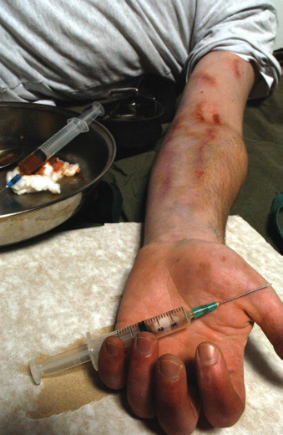
Classification of Controlled Drugs
CLASSES
  Depressants
  Stimulants
  Narcotics
  Hallucinogens
  Inhalants
Notes:
Learning Objective:
List the classes of drugs that are regulated by the CSA and provide at least two examples of each group.
The main drug classes regulated by the CSA are depressants, stimulants, narcotics, hallucinogens, and anabolic steroids.
Learning Objective:
Understand what drugs are most commonly observed on the street, in the possession of users, and seized in drug raids, and what the most frequent drug arrest is.
The most commonly observed drugs on the street, in possession of users and seized in drug raids are cocaine, codeine, crack, heroin, marijuana, morphine and opium. Arrest for possession or use of marijuana is the most frequent drug arrest.
---
Once a person is addicted, it can be extremely difficult for him or her to quit using drugs without special intervention and treatment. Here, a heroin addict suffers an overdose after getting his fix through a
hypodermic needle.
© Turner, A./Alamy

Slide 7
Identification of Controlled Substances
OVERVIEW
  Sale of prescription drugs
  Physicians’ Desk Reference (PDR)
  Narcotic field-test kit
  Field testing cannot be used to establish probable cause, only confirm it

Slide 8

Investigating Illegal Possession
or Use of Controlled Substances
MAJOR LEGAL EVIDENCE
  Physical evidence of possession or use of controlled substances includes:
    The actual drugs
    Apparatus associated with their use
    Suspect’s appearance and behavior
    Urine and blood tests
Notes:
Learning Objective:
Summarize the major legal evidence to seek in prosecuting drug use and possession.
Physical evidence of possession or use of controlled substances includes the actual drugs, apparatus associated with their use, the suspect’s appearance and behavior and urine and blood tests.
---
A collection of drug paraphernalia.
© Treacy, P./Alamy

Slide 9
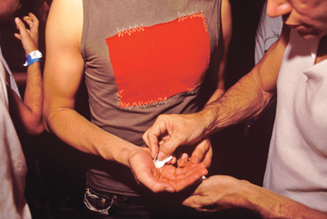
Investigating Illegal Sale and
Distribution of Controlled Substances
INVESTIGATIVE ACTIONS
  Actual transfer of drugs is major legal evidence
  Warrantless arrest
    Observing what appears to be a drug buy
  Undercover drug buys
    Make two or more buys
    Avoid entrapment
Notes:
Learning Objective:
Identify the major legal evidence in prosecuting drug sale and distribution.
The actual transfer of drugs from the seller to the buyer is the major legal evidence in prosecuting drug-sale cases.
Learning Objective:
Discuss the circumstances under which an on-sight arrest can be made for a drug buy.
If you observe what appears to be a drug buy, you can make a warrantless arrest if you have probable cause. Often, however, it is better to simply observe and gather information.
Learning Objective:
Describe the precautions to take in undercover drug buys, including how to avoid a charge of entrapment.
Undercover drug buys are carefully planned, witnessed and conducted so that no charge of entrapment can be made.
Make two or more buys to avoid the charge of entrapment.
---
Drugs are commonly bought and sold at raves and other events where young people congregate.
© Bragg, D./Everynight Images/Alamy

Slide 10
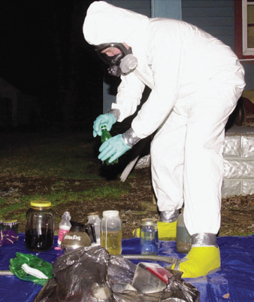
Clandestine Drug Laboratories
CHALLENGES
  Identifying
  Entering
  Processing
  Cleanup of labs
  Physical, chemical
  and toxic hazards
Notes:
Assessment team members investigating clandestine drug laboratories wear fire- and chemical-resistant suits, gloves, and boots and use self-contained breathing devices for protection. The team determines what safety equipment and clothing the processing team (who will identify and collect evidence) will need. Here, a member of the Southwest Virginia Clandestine Lab Team piles up methamphetamine-making ingredients and cooking devices on the lawn of a Damascus, Virginia, home.
© AP Images/Smith, R.

Slide 11
Indoor Marijuana Growing Operations
OVERVIEW
  Sinsemilla
  Excessive use of electricity
  Type and amount of traffic
  Inherent dangers with high energy needs
  High-humidity environment

Slide 12
Investigative Aids
TOOLS
  DEA’s National Drug Pointer Index (NDPIX)
  K-9s and handlers
  High-accuracy laser rangefinder
  Flying drones

Slide 13
Agency Cooperation
PRIMARY EMPHASIS
  Requires cooperation at all levels
  Federal Drug Enforcement Administration (FDEA)
    Unified leadership
    Narcotics trafficking and drug abuse
    Emphasis on source and distribution
Notes:
Learning Objective:
Identify the agency responsible for providing unified leadership in combating illegal drug activities and what its primary emphasis is.
The federal DEA provides unified leadership in attacking narcotics trafficking and drug abuse. The DEA’s emphasis is on the source and distribution of illicit drugs rather than on arresting abusers.

Slide 14
Drug Asset Forfeitures
BENEFITS
  Seize items used in that crime
  Provides assets needed
    Cash and property
  Precise recording necessary
  Forfeiture program

Slide 15
Preventing Problems with Illegal Drugs: Community Partnerships
GROUPS AND AGENCIES
  Federal funding
  Businesses
  Schools
  Public health departments
  Individual citizens
  Operation Weed and Seed
  OTC drugs

Slide 16
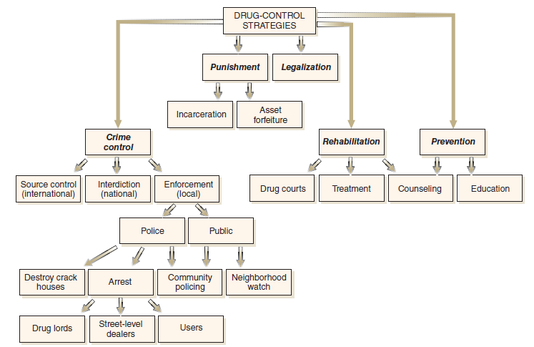
National Drug Control Strategy
APPROACH
  Addressing our nation’s drug problem
  Three-pronged approach
    Prevention
    Treatment
    Law enforcement
Notes:
Figure 18.2 Overview of drug-control strategies.
Source: From Hess, K. M. (2009). Introduction to law enforcement and criminal justice, 9th ed. © 2009 Wadsworth, a part of Cengage Learning, Inc.

Slide 17
Organized Crime: An Overview
CHARACTERISTICS
  Definite organization and control
  High-profit and continued-profit crimes
  Singular control through force and threats
  Protection through corruption
Notes:
Learning Objective:
Recognize the distinctive characteristics of organized crime.
The characteristics of organized crime are:
Definite organization and control.
High-profit and continued-profit crimes.
Singular control through force and threats.
Protection through corruption.

Slide 18
Applicable Laws against Organized Crime
AREAS OF PROSECUTION
  It is a prosecutable conspiracy to:
    Acquire any enterprise with money obtained from illegal activity
    Acquire, maintain, or control any enterprise by illegal means
    Use any enterprise to conduct illegal activity
Notes:
Learning Objective:
List the three activities that can be prosecuted under Title 18 of the U.S. Code, Section 1962, as they relate to organized crime.
It is a prosecutable conspiracy to
Acquire any enterprise with money obtained from
illegal activity.
Acquire, maintain or control any enterprise by
illegal means.
Use any enterprise to conduct illegal activity.

Slide 19
Major Activities of Organized Crime
CRIMINAL ACTIVITIES
  Gambling and drugs
  Pornography and prostitution
  Fraud
  Loan-sharking
  Money laundering
  Human trafficking
  Infiltration of legitimate businesses
Notes:
Learning Objective:
Understand the crimes organized crime is typically involved in.
Organized crime is heavily involved in the so-called victimless crimes of gambling, drugs, pornography, and prostitution, as well as fraud, loan-sharking, money laundering, human trafficking, and infiltration of legitimate businesses.

Slide 20

Threat of Specific Organized Crime Groups
INTERNATIONAL CRIME GROUPS
  Italian
  Asian
  Latino
  African
  Russian
Notes:
Gang member Pedro Espinoza sits in a courtroom on November 2, 2012, as he is sentenced to death for the 2008 murder of Jamiel Shaw II. Prosecutors argued that Shaw, a star Los Angeles High School athlete, was targeted because he was carrying a red Spiderman backpack, a color Espinoza thought linked Shaw to a rival gang.
© AP Images/Ut, N.

Slide 21
Organized Crime and Corruption
A GREAT THREAT
  Entire legal system
  Public officials
  Police officers
  Report bribes immediately
  Attempt to make arrest

Slide 22
The Police Response
EYES AND EARS
  Daily observations
  Report all suspicious activities
  Be the first line of defense in controlling all crime
    Law enforcement officers seldom break into these hierarchies
  Check out new businesses in the area
Notes:
Learning Objective:
Explain what the investigator’s primary role is in dealing with the organized crime problem.
The daily observations of local law enforcement officers provide vital information for investigating organized crime. Report all suspicious activities and persons possibly associated with organized crime to the appropriate person or agency.

Slide 23
Agencies Cooperating in
Investigating Organized Crime
MAJOR ORGANIZATIONS
  FBI
  Postal Inspection Service
  U.S. Secret Service
  Department of Labor
  Securities and Exchange Commission
  Internal Revenue Service

Slide 24
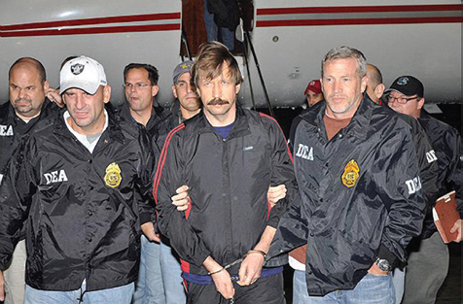
Methods to Combat Organized Crime
INVESTIGATIVE AIDS
  Electronic surveillance
  Pen registers
  Regional Information Sharing
  System (RISS)
  ASSET FORFEITURE
  Seize funds and property
Notes:
International arms dealer Viktor Bout arrives in New York, flanked by DEA agents, to stand trial on terrorism charges. Arrested in Bangkok in 2008 during a foreign sting operation, it took more than two years of legal proceedings to get Bout extradited to the United States. In November 2011 he was convicted of conspiring to kill American citizens, officers, and employees by agreeing to sell weapons to drug enforcement informants whom he believed to be members of the Revolutionary Armed Forces of Colombia, a terrorist organization known as FARC. Bout was also found guilty of conspiring to acquire and export surface-to-air antiaircraft missiles and of conspiring to provide material support or resources in the form of weapons to a foreign terrorist organization.
Source: DEA Photo

Slide 25
The Decline of Organized Crime?
TRUE DECLINE OR NOT
  Tougher legislation
  Improved investigative techniques
  Increased use of tools
  Decline of traditional organized crime
  New criminal enterprises emerging

Slide 26
Summary
Harrison Narcotics Act (1914) made the sale or use of certain drugs illegal
The Drug Enforcement Administration (DEA) provides unified leadership in attacking narcotics trafficking and drug abuse
Distinctive characteristics of organized crime include definite organization and control
Daily observations of local law enforcement officers provide vital information

